Slide 1
PMPD
Construction site protection and restoration standards
June 20, 2019
David Cutter – Campus Landscape Architect
Dan Schied – Grounds Director

Slide 2
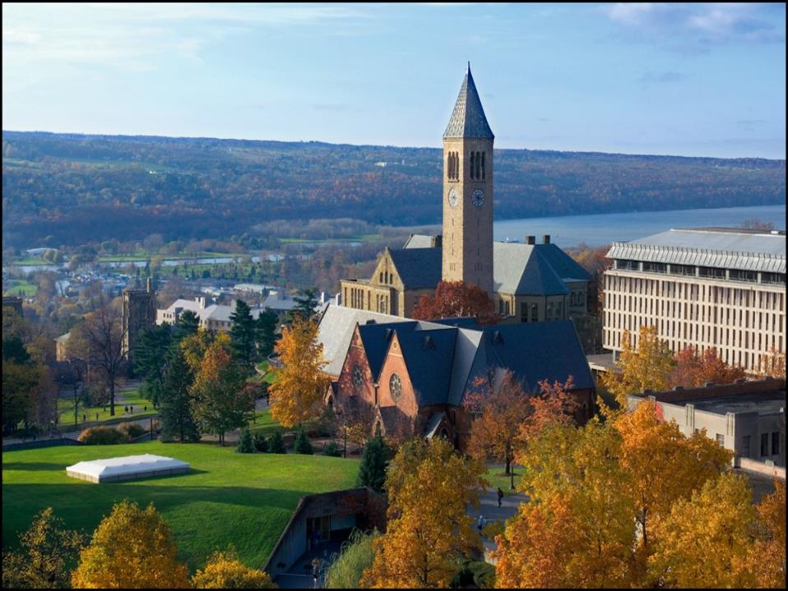
Why is landscape protection important?
“Cornell’s landscapes are its most distinguishing physical feature.
They are essential not only to the image of the Ithaca campus, but also to the university’s academic mission and quality of life.”
2008 Cornell Master Plan
Notes:
Arguably, our campus trees are the most significant and visible component in our campus landscape.

Slide 3
10-Year Tree Campus USA data
Notes:
David – For the last 10 years we have been following national standards and best practices of urban forestry established by the National Arbor Day Foundation to manage the trees on campus as a system. This includes inventory, planting, management, education and outreach.

Slide 4
Recent Tree Campus USA data
2018: 175 trees planted vs. 325 removed
2017: 460 trees planted vs. 440 removed
2016: 195 trees planted vs. 340 removed
What’s happening?
Notes:
David – In reviewing recent data, we were disappointed to see that 2 out of the last 3 years we have had a net loss of trees on campus.
Emerald Ash Borer and climate change. As campus continues to densify, the landscape is the cheapest and easiest place to develop.
While our pace of new construction has slowed recently, addressing our deferred maintenance and renovation needs also can have a significant impact on our landscape. So Dan and I have pulled together some key points to consider when managing any project, and to remind you that we are available as a resource at any point in your project, but preferably sooner than later.

Slide 5
Three easy ways to kill a tree in five years or less:
Soil Compaction in the Critical Root Zone
Cutting the Roots
Backfilling over the Roots
Notes:
David – I share this slide not because I think you need coaching in how to kill a tree, but as a reminder that many impacts of construction don’t show up until several years after construction. So a tree that may look OK at project closeout, could end up as a maintenance expense for Grounds after the contractor has received final payment and the contingency is gone.

Slide 6
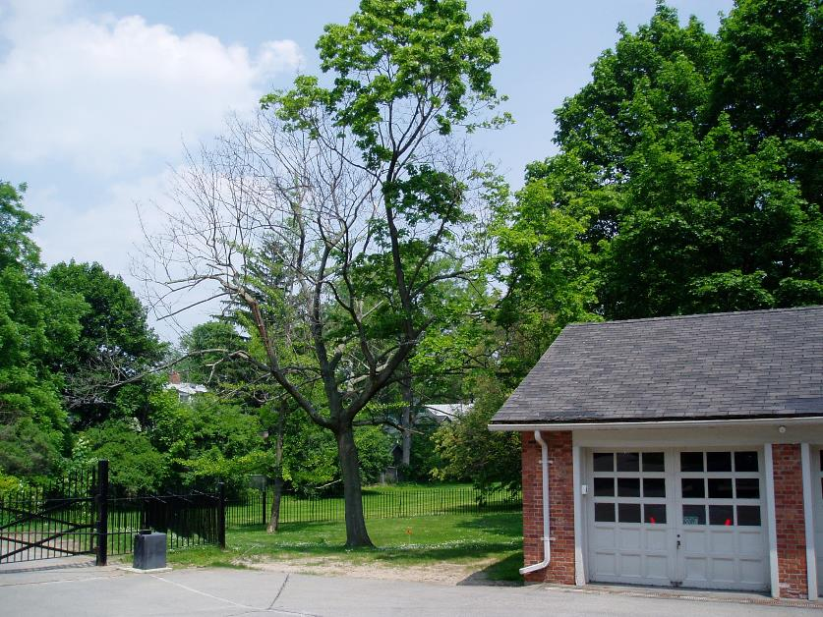
Results of poor protection
Notes:
Dan

Slide 7
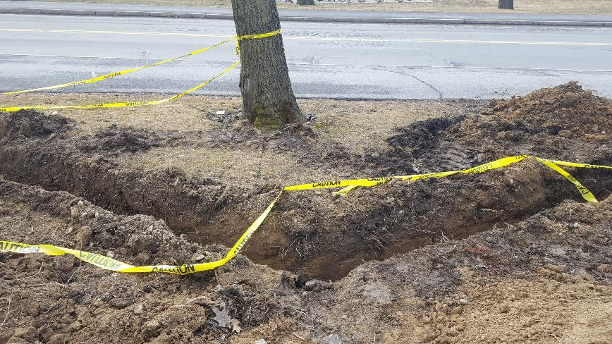
Tree/Landscape Preservation Concepts
Requires planning for all construction components & phases.
Tree protection is soil and root protection.
Properly identify tree protection zone and maintain tree protection fencing.
Respect the critical root zone and no cut zone.
Plan for site restoration, including soil.
Notes:
David

Slide 8
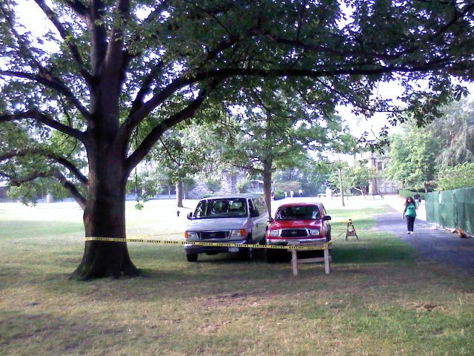
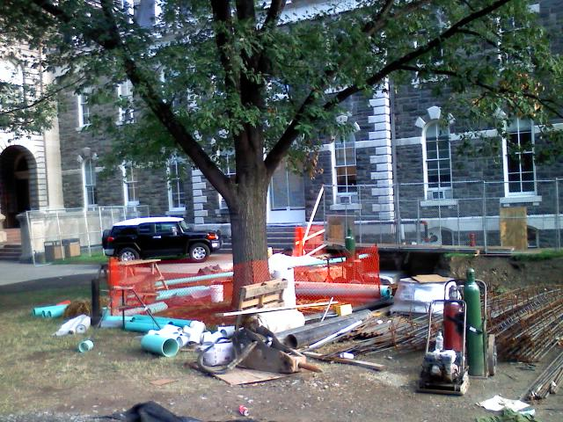
Tree Protection Zone
Notes:
David – Perhaps there is some confusion on the part of some contractors over the purpose of a tree protection zone. It’s not about the tree providing protection of the contractors vehicles from the hot sun. Or acting as an unpaid security guard for construction materials and equipment.

Slide 9
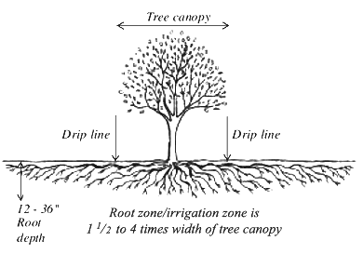
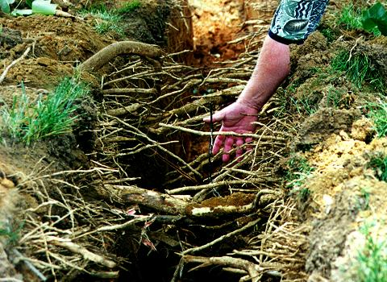
What should we be protecting?
Notes:
Dan

Slide 10
Where are the majority of the roots?
Notes:
Dan

Slide 11
No Cut Zone
Critical Root Zone
Typically within 6’ – 10’ of a mature (24” dbh) tree
Cutting within this radius can destabilize the tree
Radius = 1.5’ x DBH of tree or 5’ beyond the dripline
No vehicles, equipment, stockpiling or grading
No Cut Zone—6-10’
Tree Dripline
Tree Protection Fence
36’ R
Critical Root Zone (24” DBH x 1.5) = 36’ radius
Notes:
Dan

Slide 12
Critical Root Zone (CRZ)
50% of the root system is in the top one foot of soil and over 90% is in the top three feet.
Construction equipment with large tires or tracks tends to go deep within the soil, 12-20 inches, whereas compaction associated with pedestrian traffic is often restricted to the surface 3 to 6 inches. Both types of compaction are harmful to tree roots.
A single pass by a cement or dump truck can sever or crush roots.
Wet soils will compact to a greater degree than dry soils.
Smothered roots have their oxygen supply cut off. The most common method of smothering roots is changing the grade. This also cuts off water supply too. For some tree species, like red oak, only a few inches of fill is enough to do serious damage. Roots can be smothered by ‘temporary’ piles of soil placed inside the tree’s dripline or by pools of water impounded by construction activities.
Soil compaction should be considered permanent. Recovery for significant compaction is at least two human generations. Soils do not ‘come back’ from compaction.
From: Construction damage causes and remedies – Minnesota Dept. of Natural Resources.
Soil Compaction Impacts on Tree Roots – Dr. Kim Coder, University of Georgia
Notes:
Dan

Slide 13
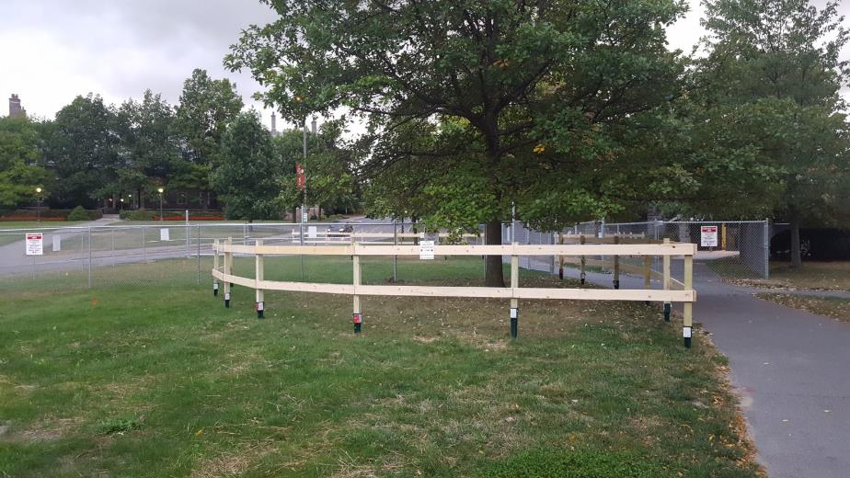
Protection detail
Notes:
Dan

Slide 14
What Goes on a Tree Preservation Plan
Trees labeled and CRZs noted
Trees to be removed labeled
Tree protection fence
Access routes
Mulched areas for access inside the CRZs of trees
Areas for boring or air spading within CRZs
Storage areas, parking areas
Tree protection notes
Details
Notes:
David

Slide 15
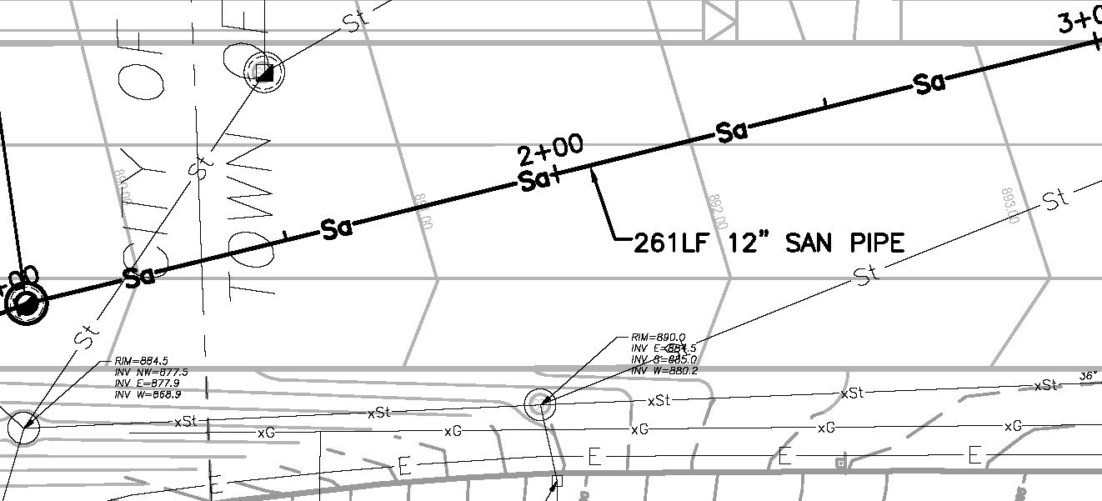
Anticipate construction methods
Notes:
David

Slide 16
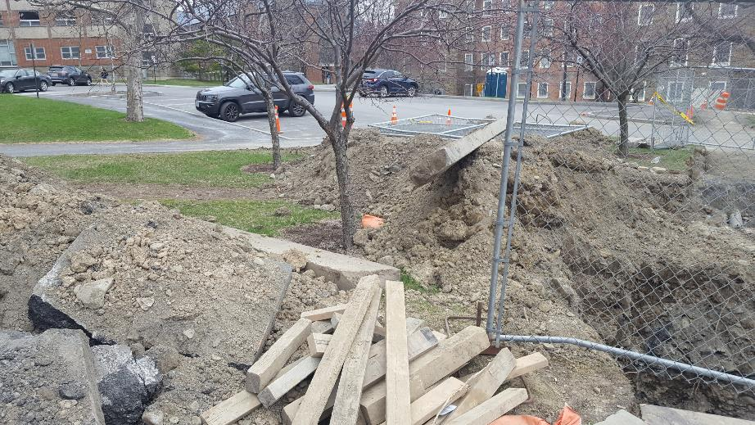
Protecting Tree Roots From Construction Damage
Poor or no root protection
Good root protection
Notes:
Dan

Slide 17
Mitigating Work Inside a CRZ
Work has to be done inside at least some of the trees’ CRZs
Notes:
Dan

Slide 18
Boring
(HDD Horizontal Directional Drilling)
Notes:
David – when utilities have to go through the critical root zone in plan view, one good option is to use directional drilling to take advantage of tree biology (90% roots in the upper 3 feet). Instead of trenching and cutting critical roots, go under them.

Slide 19
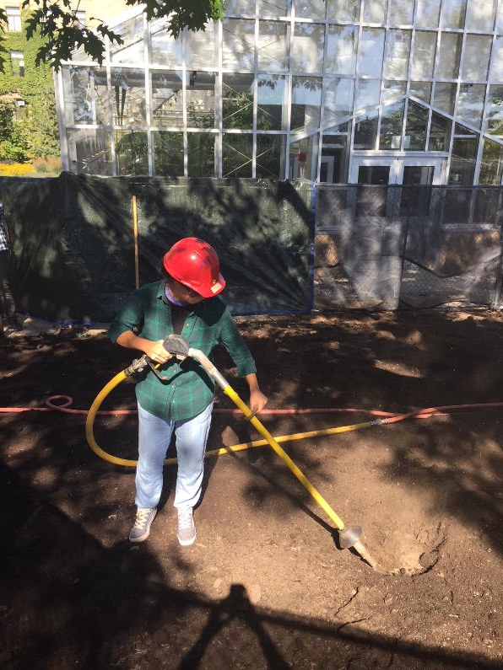
Use of Air Spade
Notes:
David – Air spading is a method of excavation that removes the soil but leaves the roots in place so smaller utility lines can be threaded below or between major roots. At the risk of stating the obvious, if you were to cut all the roots exposed by the air spade to install your utility line, you might as well have just dug a traditional trench. Another situation where air spade excavation would be beneficial is if you are installing new pavement e.g. a sidewalk within the CRZ. By backfilling the excavation with CU Structural Soil you will maintain access to uncompacted soil within and beyond the CRZ.

Slide 20
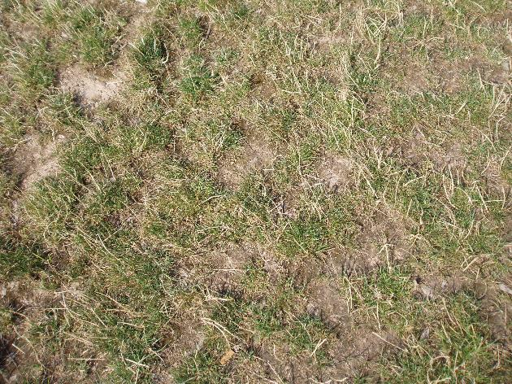
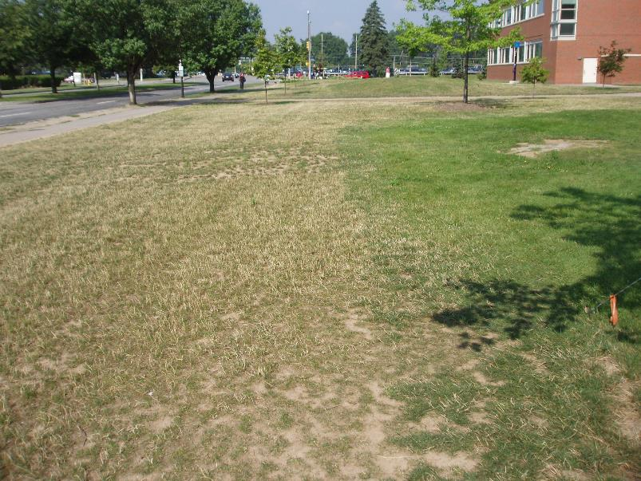
Soils, importance of getting them right!
Notes:
Dan

Slide 21
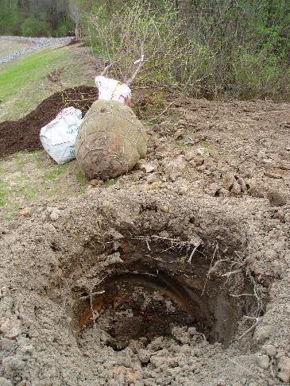
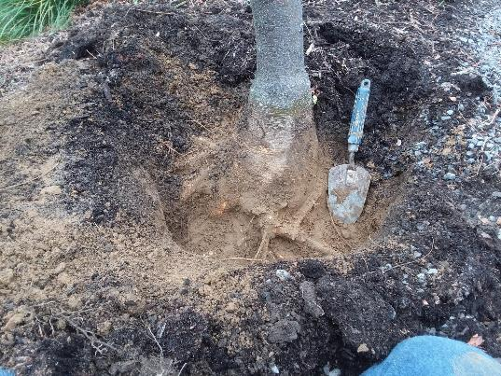
Proper planting
Notes:
Dan

Slide 22
Take aways
Restoration plan in place prior to project start, staging areas identified
Site protection in place prior to mobilization and maintained throughout project – protect critical root zone from compaction
Methods for construction within critical root zone identified
Soils specified located, tested, approved, secured and procured
Proper planting techniques followed – landscape contractors with proper experience
Notes:
Dan

