Slide 1
Facilities Engineering Minute
Facilities Engineering
Ithaca, NY
272133
Notes:
Introduction

Slide 2
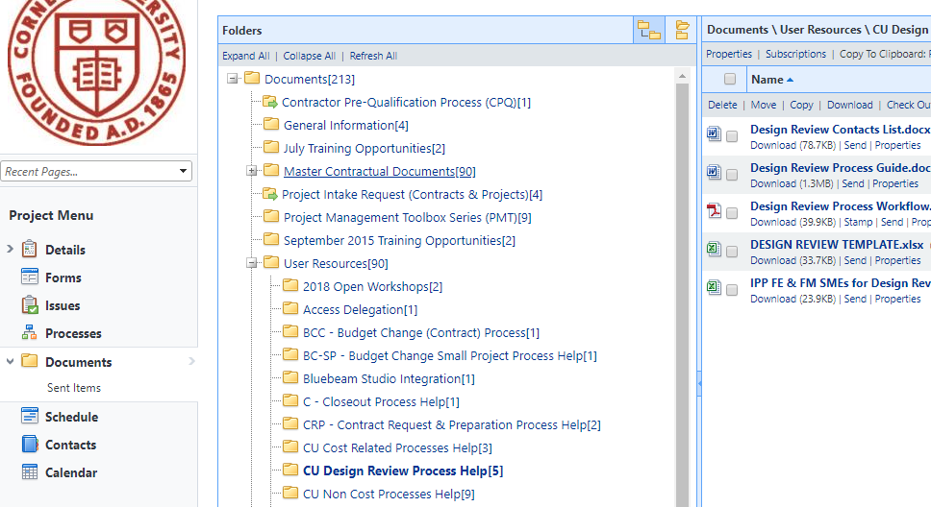
Design Reviews - Reminder
Notes:
Design Review Process (FM Global, Ebuilder list, email CIT, Bluebeam, DR lookahead) Updated 9/21/18

Slide 3
Drawing Review Contacts List
Consistently updated
Various Stakeholders Identified
Facilities Engineering: FEdesignreview@cornell.edu
EH&S: ehsdesignreview@cornell.edu
Energy/Sustainability: Cole Tucker/Frank Perry
CIT: Jeff Simmons/Tom Theimer
UA/CUPD/Transportation/FM/FM Global/AHJ
Notes:
Last updated 9/2018

Slide 4
Design Reviews – Best Practice
Include consultant responses with next phase submission
Engage with follow-up discussion or clarification as needed
Notes:
Schedule so important – other stakeholders EH&S, CIT on this distribution. N Campus DR – Mircrosoft Porject
Two week turnaround
Reviews are typically multi-discipline in nature.
Time involved varies by the size of the project.
Small project: < 200 page Project Manual and 10 drawings
Large project: > 4000 page Project Manual and 600 drawings

Slide 5
Priority - Design Standard Updates Fall 2018
013010 Accessibility for People with Disabilities
071000 Subgrade Waterproofing
221100 Backflow Prevention
222500 Plumbing (Potable) Water Treatment
262413 Service and Main Secondary Distribution
272133 Data Communication Wireless Access Pts
Notes:
Issues with water treatment across campus
Separate from HVAC Water Treatment 232500
Backflow Prevent: Three water purveyor's on campus (Bolton _ Town, CU, and City) following last PMT, updated to expand on early coordination requirement

Slide 6
Best Practice: Existing Buildings & Sprinklers
Consider extending sprinklers to renovated areas if existing building is:
Partially sprinklered
Not sprinklered
Required by
FM Global
CU Fire Protection Standard
FE, EH&S can help with preliminary evaluations
Notes:
May not be a code requirement, but PM’s need to consider.
Baker – backbone installed required by city to extend into renovated city. ST Olin, set a precedent on one floor, renovation extends. Phillips agreement with a city. Backbone capacity is there, as renovate wings, extend sprinklers.

Slide 7
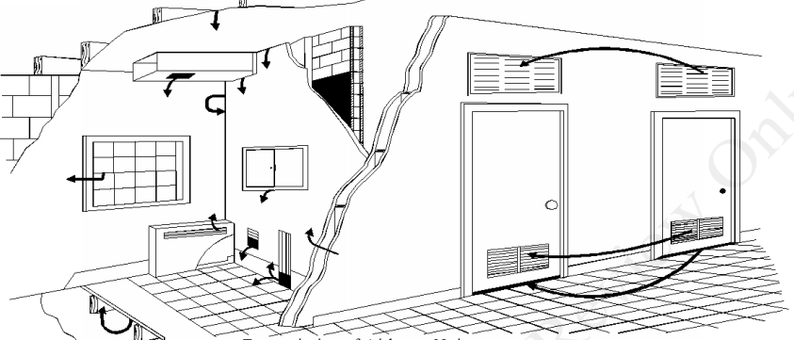
Acoustics Update
Working Group Established
Standard in Development
Scope
Timeline
Notes:
Codes weigh in on sound transmission for occupancy/classification,
local ordinances or zoning may limit nuisance noise from specific sites/operations
Owners and Designers may target quitter building for occupant

Slide 8
PM Feedback & Dialogue

