Slide 1
Project Management – Professional Development Series
Facilities and Campus Services
Engineering and Project Management
October, 25 2018

Slide 2
Project Management Professional Development
Mission:
Provide informative and engaging content to assist our Project Managers to deliver high quality and consistent service to our campus partners.
Vision:
Partner with the campus community to share best practices within the Project Management Profession

Slide 3
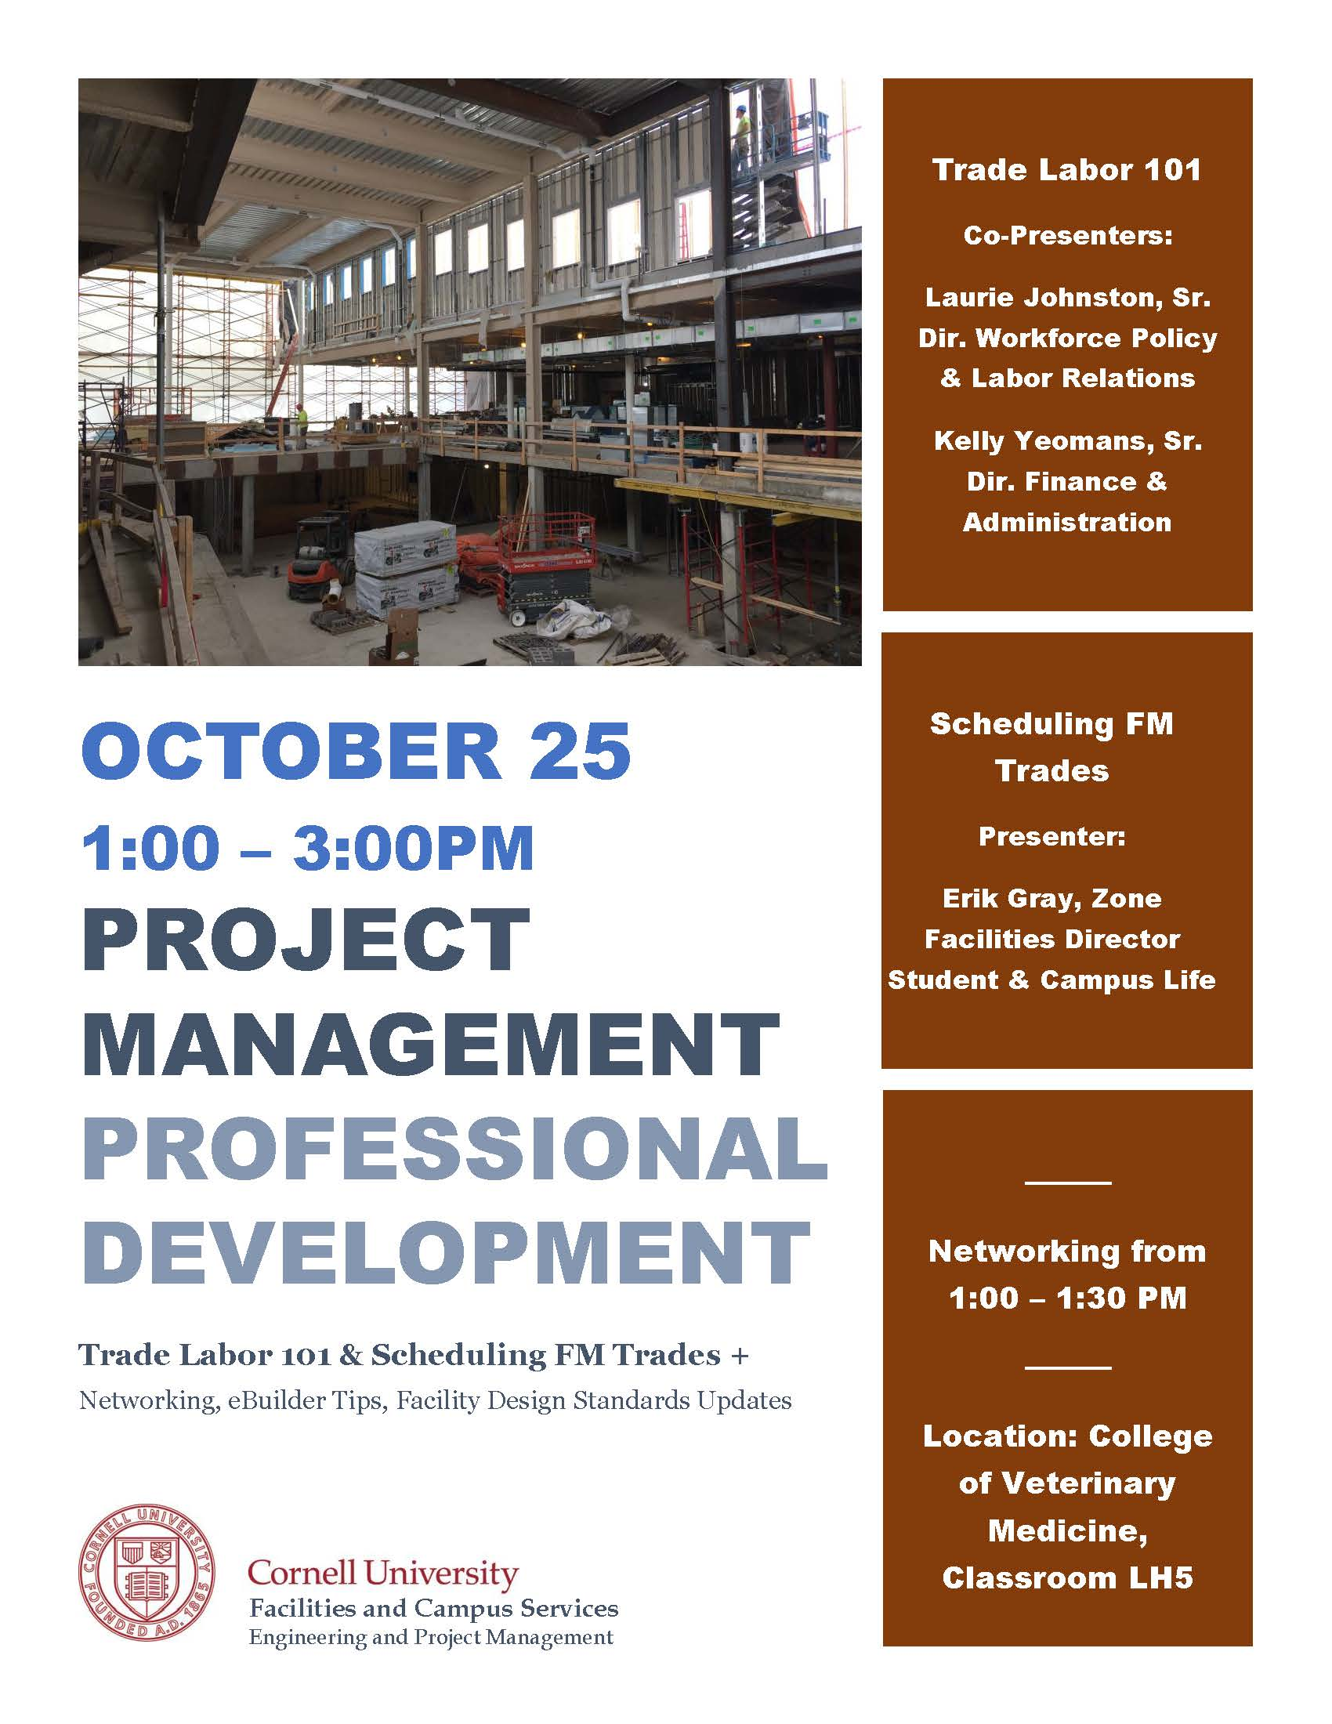
Series Format
Networking –
“Toolbox” References–
Process and Procedures
Professional Development –
Project Team Management &
Leadership
Project Administration &
Development
Procurement &
Contract Management
Design Phase Management
Construction Management
Process & Approval Management
Sharing of Content: (Cornell Net ID Required)
https://fcs.cornell.edu/content/project-management-professional-development-series
Notes:
Content will Concentrate on and around the Essential Functions and key Responsibilities of a Project Manager
Management Tools & Skills
Technical Knowledge
Process Guidance
Institutional Knowledge
Lesson Learned
Best Practices
The intent is to hold these sessions monthly and the content will be vetted by a committee.
I volunteered to take on the role of the Professional Development Chair for our department the discipline of Project Management within Cornell to collaborate with in FCS was well as within the campus community
Since that time, I have had several people express interest in topics to discuss.
To keep the sessions interesting I hope to partner with the campus community and local PMI chapter for relative and pertinent information.
Provide panel discussions, and possibly have accredited presentations toward professional Licensures and Certifications.
Topics of interest that have been brought to my attention.
Tool Kits –
Construction Trailer Hookups
Site Plan Approval Process
RFP Process
PAR Sections
- EUI
Panel Discussions
Design Reviews
Project Estimating
Permitting
Professional Development
Lab design
LAB + Consortium
Climate Literacy
Project Procurement Methodology - defining the different contract types.
Integrated Project Delivery

Slide 4
Today’s Agenda
Introduction
“Toolbox” References
Facilities Engineering Minute
eBuilder Quick Tips
Professional Development –
Trade Labor 101
Scheduling FM Trades
Sharing of Content: (Cornell Net ID Required)
https://fcs.cornell.edu/content/project-management-professional-development-series

