Slide 1
NYS Energy Code Update
9/30/2026
Jaimee Wilson, PhD, PE, BEAP, BEMP
Co-Author: Brendan Hall, PE (from an ASHRAE presentation)
Cornell Facilities Engineering

Slide 2
Outline
What is the NYS Energy Code?
  Compliance Pathways: IECC vs ASHRAE
  NYS ASHRAE 90.1-2025 vs ASHRAE 90.1-2025
  Prescriptive vs Performance
  Energy Savings Target
What you need to know when scoping a project
  Substantial Alterations
  Energy Monitoring
  On-site and Off-site renewable energy requirements
  Energy Efficiency requirements
  All-electric act is PENDING
  What does it mean to be “Electrification Ready”

Slide 3
What is the 2025 NYS Energy Code?
NYS ASHRAE 90.1-2025
  A mix of ASHRAE 90.1-2019 and ASHRAE 90.1-2022 and NYS specific edits
2025 NYS Energy Conservation Construction Code
  A mix of IECC 2021 and IECC 2024 and NYS specific edits
Compliance Paths* include:
  NYS ASHRAE 90.1-2025
    Prescriptive
    Energy Cost Budget (ECB)
    Performance Rating Method (Appendix G)
  2025 NYS ECCC
    Prescriptive
    Simulated Building Performance (C407/R405)
Notes:
Brendan – Coordinate with the Architect – can’t pick and choose. Check with the AHJ

Slide 4
Energy Code Jump
2018 IECC
2020 NYS Energy Conservation Code
ASHRAE 90.1-2016
ASHRAE 90.1-2019
2021 IECC
2025 NYS Energy Conservation Code
ASHRAE 90.1-2022
2024 IECC
NYS ASHRAE 90.1-2025
Notes:
Brendan

Slide 5
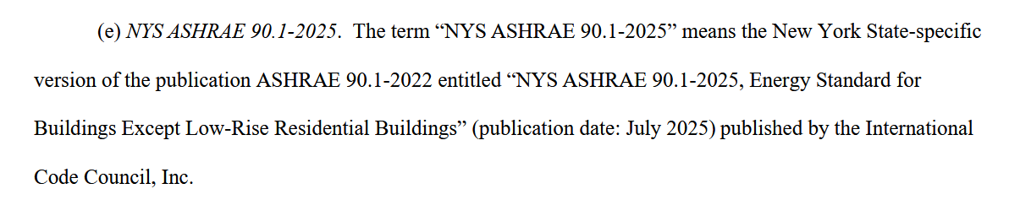
NYS ASHRAE 90.1-2025 is different from ASHRAE 90.1-2025
https://dos.ny.gov/system/files/documents/2025/07/2025-7-17-rule-text-energy-code.pdf
Notes:
Brendan

Slide 6
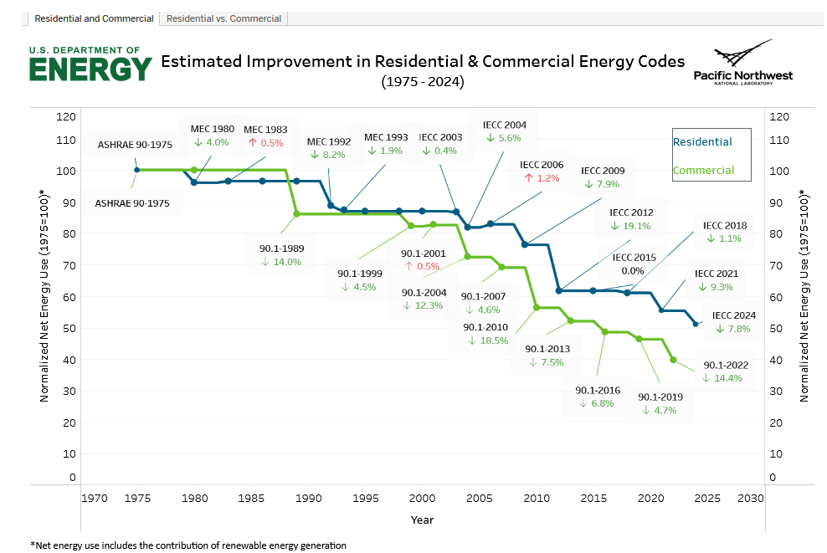
Estimated Model Energy Code Improvement
https://www.energycodes.gov/infographics
Notes:
Brendan

Slide 7
Disclaimer
This is an introduction to major changes and references for 2025 NYS Enery Code. This is not intended as an all-inclusive session on how to comply with 2025 NYS Energy Code*.
  *Definitions and requirements differ for 2025 NYS ECCC vs NYS ASHRAE 90.1-2025
Notes:
Brendan

Slide 8
What do you need to know to scope a project?

Slide 9
Information for identifying energy code scope
What | Why
Who is the Authority Having Jurisdiction (AHJ)? | Identifies applicable energy code paths including supplemental codes and optional appendices*
% Scope of HVAC, Envelope, and Lighting and/or estimated project cost | Is this a substantial alteration (90.1) or substantial improvement (IECC)?
Square footage (new construction, addition and existing building) | Identifies triggers for additional efficiency requirements, on-site renewable requirements and substantial alterations
Climate Zone | Building Envelope, Mechanical, and Additional Efficiency requirements
Building/Occupancy Type and Schedule | Additional efficiency and on-site renewable energy requirements
Basis of Design HVAC system | Eligibility for additional efficiency requirements
New Cooling Load | Identifies triggers for mechanical system and ventilation requirements
  * Both Town of Ithaca (effective as of Dec 31, 2025) and City of Ithaca (anticipated October 2026) to adopt Appendices RC/CC: Zero Energy Building Provisions
Notes:
Jaimee

Slide 10
When is a project a substantial alteration?
NYS ASHRAE 90.1 Substantial Alteration,
NYS ECCC Substantial Improvement,
IECS Phase II Renovation
NYS ASHRAE
90.1-2025
Alterations >5,000 SF AND at least 2 of:
>50% HVAC,
>50% Lighting,
>25% Envelope
2025 NYS Energy Conservation Construction Code (NYS ECCC)
Project costs are greater than 50% market assessed value
City of Ithaca
(IECS Phase II)
Work area exceeds 75% AND at least 2 of
>50% HVAC,
>50% Envelope,
>50% lighting
Antcipated to transition to ASHRAE/NYS ECCC definitions in October

Slide 11
Energy Monitoring: Section 8.4 and 10.4
Section 8.4 Electrical Energy Monitoring
(>10% of total electric load)
Total electric energy
HVAC systems
Interior Lighting
Exterior Lighting
Receptacle Circuits
Refrigeration Systems
Section 10.4 Whole Building Energy Monitoring
Natural Gas
Fuel Oil
Propane
Steam
Chilled Water
Hot Water
Exceptions:
Buildings and Additions < 25,000 SF
Individual Tenants < 10,000 SF
Dwelling Units
Residential buildings < 10,000 SF common area
Notes:
Jaimee

Slide 12
Section 10.5: On-site Renewable Energy
1. >0.75 W/sf of gross conditioned floor up to largest three floors –Requirements based on square footage
  > 5,000 SF New Construction
  > 5,000 SF Additions
  Substantial alterations are exempt
2. Town of Ithaca and City of Ithaca have adopted optional appendices RC/CC: Zero Energy Building Provisions.
Applicable to new construction (not renovations or additions)
3. If project is eligible for on-site renewable energy exceptions, the project is still required to meet renewable energy requirements through off-site procurement strategies
  *Some differences in definitions and requirements for 2025 NYS ECCC vs NYS ASHRAE 90.1-2025
Notes:
Jaimee

Slide 13
Section 11 Additional Efficiency Requirements
New prescriptive compliance path: projects must earn a minimum credit score selected from a menu of 35 efficiency measures; required minimum varies by building type, size, and occupancy [ECCCNYS App. CF]
  Applies to buildings greater than 2,000 sf. Greater than 5,000, shall also follow Renewable and Load Management Credits
Mechanical credit options include: high-efficiency HVAC systems, heat pump water heating, ground-source heat pumps, DOAS with heat recovery, demand-controlled ventilation [ECCCNYS App. CF §CF103]
Additional mechanical credits available for on-site renewable energy, thermal energy storage, and demand response-capable HVAC and DHW systems [ECCCNYS App. CF / §406]
Credits should be selected early in schematic design, late-stage credit substitutions risk compliance gaps and permit delays [ECCCNYS App. CF §CF101]
Existing buildings undergoing alterations on the prescriptive path are also subject to minimum credit requirements, designers should confirm applicability at project outset [ECCCNYS App. CF §CF102]
Notes:
Jaimee

Slide 14
Section 11: Additional Energy Efficiency
(if project is not compliant with NYS ASHRAE 90.1-2025 Appendix G, Performance Rating method)
1. Identify Occupancy type to determine Energy Efficiency Credits
  >1,000 SF Initial Build-Out Construction: % Energy Credits varies by scope
  > 2,000 SF New Construction: 100% Energy Efficiency Credits
  >2,000 SF Additions: 100% Energy Efficiency Credits
  > 5,000 SF Substantial Alterations: 50% Energy Efficiency Credits
2. Not all credits are available for all occupancy types or HVAC system types
3. Many credits are partial based on a calculated analysis
4. Some credits may not be available if they are required by the base prescriptive code
  *Major differences in requirements for 2025 NYS ECCC vs NYS ASHRAE 90.1-2025.
Notes:
Jaimee

Slide 15
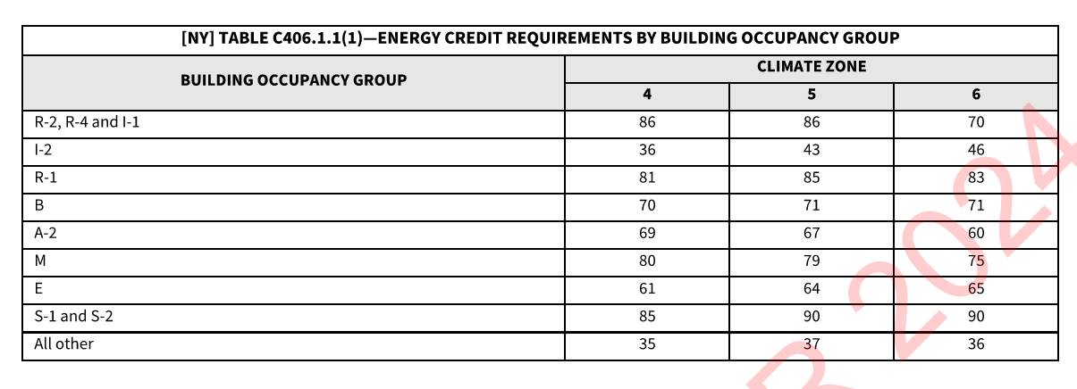
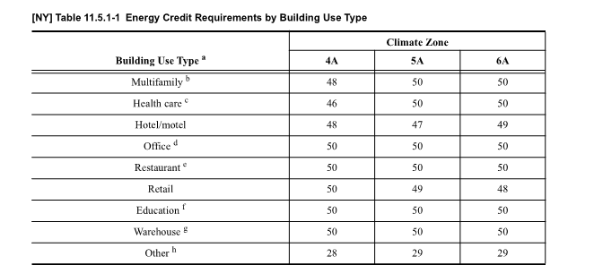
1. Scope and Occupancy Type dictate required energy efficiency requirements
2. % Point requirements differ for new construction, additions and substantial alterations/improvements
3. Major differences for IECC Path vs 90.1 Path
IECC Path
Section 11/C406
NY-Specific notation
90.1 Path
NY-Specific notation
  *Definitions and requirements differ for 2025 NYS ECCC vs NYS ASHRAE 90.1-2025
Notes:
Jaimee – Verbal – Major Differences between ASHRAE 90.1/IECC – Add Detail/images

Slide 16
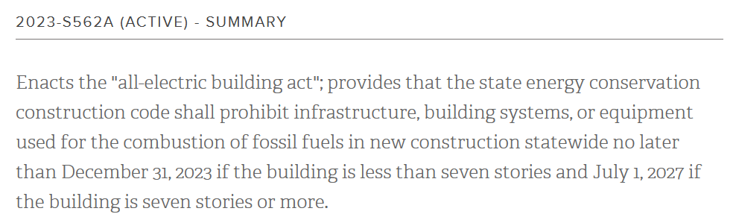
NY All-Electric Building Act Status ?? SUSPENDED
What does this mean for New Construction?
What does it mean for a design to be electrification ready?
In November 2025, the state agreed to suspend the relevant regulations until 120 days after the Second Circuit rules or, if one of the parties ask the Supreme Court to take the case, 120 days after the Supreme Court either rejects the request or issues its own ruling.
Second circuit oral argument on the case was held on January 30, 2026. The Second Circuit panel issued their ruling on June 30, 2026 and AFFIRMED the judgements of the district courts. The plaintiff has a 90-day window (October 2026) to file a petition to the US Supreme Court.
https://www.nysenate.gov/legislation/bills/2023/S562/amendment/A
Notes:
Brendan

Slide 17
NY Energy Code Interpretations/Variances for Town of Ithaca
Any variances from the core Energy Code (without the optional appendices) will go to NYS Deparment of State.
Any variance requests from the residential or commercial net-zero appendices (RC/CC) will go through the City of Ithaca/Town of Ithaca Board of Zoning Appeals (BZA).

Slide 18
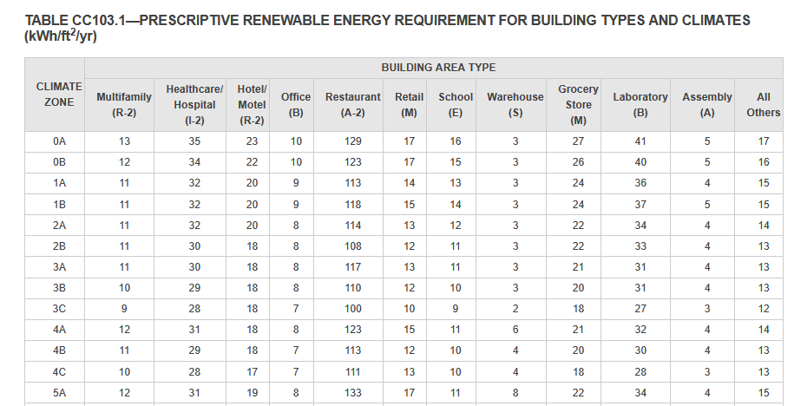
Appendix RC/CC applies for new construction projects located in the City of Ithaca/Town of Ithaca
*
*Alternative: Calculation of on-site renewable energy requirement with proposed model annual energy production

Slide 19
What about smaller projects? It depends…
When repairing: the intent is to maintain or reduce energy usage of the building system (ie Don’t make it worse)
When altering: the intent is to conform to the provisions of the code related to the new building system without requiring unaltered portions to comply with the energy code.
However, other project requirements, standards or codes may trigger an energy code update.
Examples: A change-of-occupancy increases energy use intensity rank OR Project scope may trigger energy code improvements in order to meet mechanical code requirements.

Slide 20
Retrofit Projects – Adding Cooling
New cooling systems installed to serve previously uncooled spaces shall comply with this section as described in Section 6.2.
  Section 6.2 is the full compliance path for new HVAC systems.
Adding cooling forces compliance with current ventilation rates
  The new HVAC system must be designed to deliver MCNYS Chapter 4 outdoor air quantities regardless of what the existing system provides. Buildings ventilated under older codes, designed without mechanical ventilation, or with non-functioning OA systems must remediate through the new system. This is the provision that brings outdoor air into the system for the first time, triggering the economizer, DCV, and ERV requirements that follow.
Notes:
Brendan

Slide 21
Questions?

Slide 22
Reference Tools
Links to find code documents
Overview
Architecture Tools
Mech – TSPR tools

Slide 23
Energy Scope | Notes | New Construction | Addition | Major Renovation | Partial Renovation | Repair
All-Electric Building Act | [Status: ON HOLD, update anticipated October 28, 2026] | Variance OR interpretation may be required for connection to district energy. | N/A | N/A | N/A | N/A
NY Energy Code – On-site Renewables Section 10/C405 | See Appendix RC/CC for City and Town of Ithaca. Variance required for >5-year off-site asset | YES. SF trigger. Varies based on AHJ. Net-Zero for Town & City of Ithaca | YES. SF trigger. Limited to addition. | N/A | N/A | N/A
NY Energy Code –Energy Efficiency Section 11/C406 | Prioritize controls, thermal demand reduction strategies, heat recovery | YES. SF trigger | YES. SF trigger | YES. SF trigger | N/A | N/A
Energy Model requirement - Cornell Standard 018110 | Energy model for heating, cooling, electric load requirements for district energy and annual operating budget. | YES. | YES. | YES. | Maybe. Project Scope/Cost trigger. | N/A

Slide 24
Links for energy code documents
Read-only version of the 2025 NYS 90.1: https://codes.iccsafe.org/content/NYSASHRAE9012025P1
ASHRAE 90.1-2022 Changes: https://www.ashrae.org/technical-resources/bookstore/ansi-ashrae-ies-standard-90-1-2022-changes
Read-only version of the 2025 ECCCNYS: https://codes.iccsafe.org/content/NYSECC2025P1
Read-only version of the 2024 IECC: https://codes.iccsafe.org/content/IECC2024P1
Notes:
Jaimee

Slide 25
Overview of Energy Code Documents
DOE/PNNL’s Building Energy Codes Program: https://www.energycodes.gov/
  Determinations (changes in efficiency): https://www.energycodes.gov/determinations
  Infographics: https://www.energycodes.gov/infographics
  Tableau: https://public.tableau.com/app/profile/doebecp/vizzes
Residential Energy Consumption Survey: Residential Energy Consumption Survey
City Energy Burdens: https://www.aceee.org/policy-brief/2024/09/data-update-city-energy-burdens
How energy codes affect you: https://imt.org/resources/how-energy-codes-affect-you/
Notes:
Jaimee

Slide 26
Tools for Better Understanding Significant Changes - Envelope
Thermal Bridging video: https://www.youtube.com/watch?v=IM_dphE-WDY
BC Hydro, Thermal Bridging Guide: https://www.bchydro.com/content/dam/BCHydro/customer-portal/documents/power-smart/builders-developers/building-envelope-thermal-bridging-guide-v1-6.pdf
Blower door, small home: https://building-performance.org/bpa-journal/blower-door-testing-a-small-home/
Notes:
Jaimee with Matthew Hudson (SWA) Review

Slide 27
Total System Performance Ratio References
TSPR Tool: https://energycode.pnl.gov/HVACSystemPerformance/
TSPR Documents: https://energycode.pnl.gov/HVACSystemPerformance/resources
*Limited application
Notes:
Jaimee

Slide 28
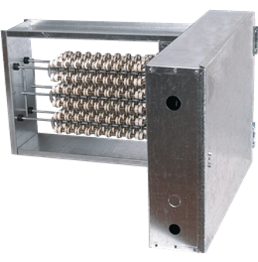
Electric Resistance Heating
C403.1.3 - Electric resistance space heating limited to 2 kW per unit in new multifamily, commercial buildings are limited to 2.5 W/sf (8.5 BTU/sf).
  5 percent of the total building HVAC system heating capacity or serve less than 5 percent of the conditioned floor area, whichever is less.
  Exceptions for health care, research and process related loads
C403.4.1.1 - Electric heat is meant for backup and supplemental during defrost but with controls to prevent simultaneous usage with the compressor.
C403.4.6 - Demand Responsive Controls : Electric heating and cooling systems shall be provided with demand responsive controls capable of executing the following actions in response to a demand response signal
Notes:
Brendan

Slide 29
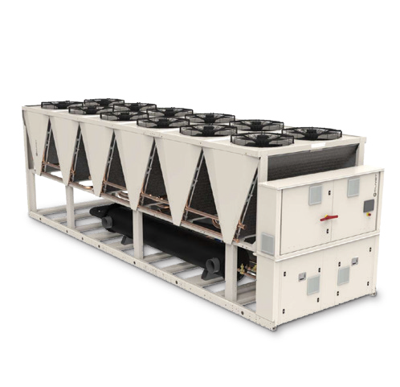
Increased equipment efficiency and metrics.
Legally binding provisions found in Title 10 CFR Part 431
Chiller efficiency tables updated — IPLV (Integrated Part Load Value) is required in addition to full-load COP/EER [ASHRAE 90.1-2025 §6.8 Tables 6.8.1-3]
  Adjustment calculation for nonstandard conditions
Detailed tables for heat pump and heat recovery water chilling packages at a range of source and hot water temperatures [ASHRAE 90.1-2025 §6.8 / Table 6.8.1-4] There are 17 footnotes so review carefully.
  C403.3.1 A single piece of equipment providing both heating and cooling shall satisfy this provision for one function with the capacity for the other function as small as possible, within available equipment options.
CFEI (Ceiling Fan Energy Index) introduced for large-diameter low-speed fans, verify compliance for warehouse, industrial, and atrium applications [ASHRAE 90.1-2025 §6.8.1 Table 6.8.1-14]
Table 6.8.1-13 and 14 Minimum efficiency for DX-DOAS Units,
Increased minimum efficiency for AC, refrigeration, and water heating equipment per updated federal appliance standards (DOE) [ECCCNYS C403 / ASHRAE 90.1-2025 §6.8]
Notes:
Brendan

Slide 30
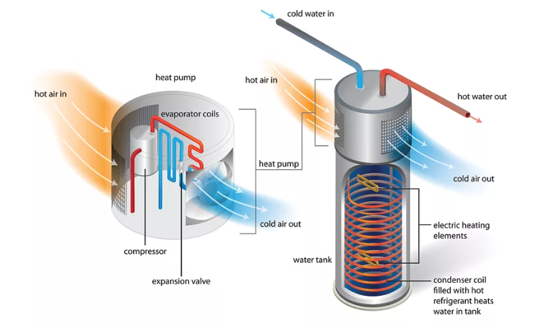
Domestic Hot Water
Gas water heaters remain permissible while All Electric Buildings is pending, but still must meet updated minimum efficiency standards in ECCCNYS or ASHRAE 90.1-2025 §7 tables [ASHRAE 90.1-2025 §7.4 / ECCCNYS C404]
C404.2 - UEF requirements are set in a way that makes electric resistance domestic hot water heaters allowed in only narrow range as primary source in commercial buildings and multifamily common-area systems, , generally with small tank sizes typical of multifamily/dwelling units
Heat pump water heaters are the preferred compliance strategy for multifamily central DHW and earn credits under Appendix CF , mechanical room space and ventilation must be coordinated [ECCCNYS App. CF / ASHRAE 90.1-2025 §7]
C404.8 - Electric storage water heaters with a rated water storage volume of 40 to 120 gallons and a nameplate input rating equal to or less than 12kW shall be provided with demand responsive controls
When All Electric Building stay lifts: gas water heaters prohibited first in low-rise buildings [§1240.6 ECCCNYS / 19 NYCRR §1240.6(d)]
Notes:
Brendan

Slide 31
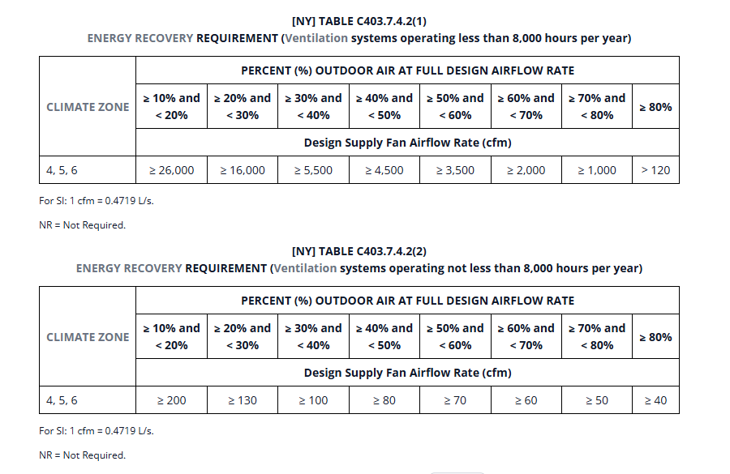
Air Energy Recovery
C403.7.4.1- ERV or HRV now mandatory for dwelling units in commercial buildings, and in zone 6 for residential
C403.7.9 Dwelling Unit Ventilation System
  A fan that is the air mover for a heating or cooling system that serves an individual dwelling unit shall not be used to provide outdoor air.
Expanded commercial ERV requirements for systems with high ventilation rates or 100% OA — minimum sensible/enthalpy recovery ratio must be met per climate zone [ASHRAE 90.1-2025 §6.5.6]
Notes:
Brendan

Slide 32
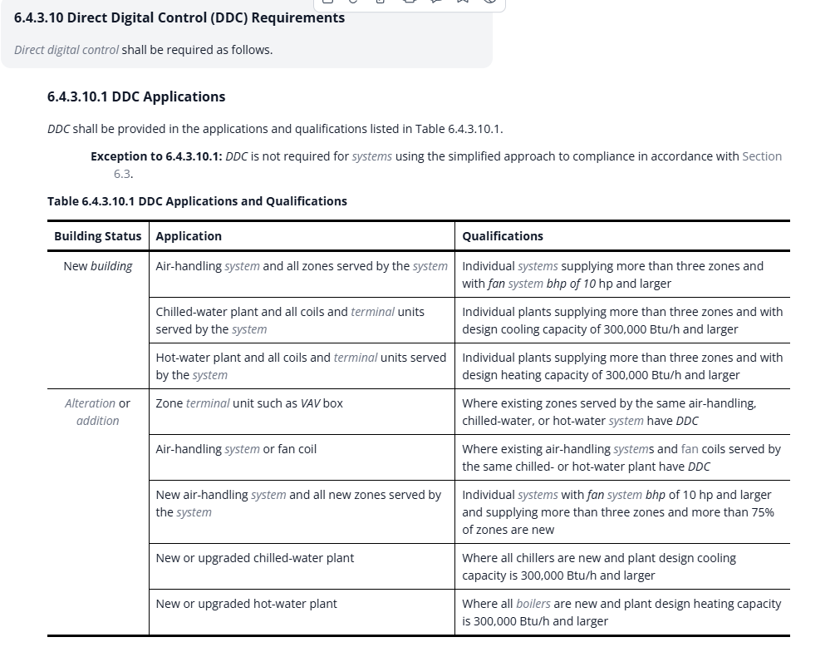
Only in 90.1
DDC Controls

Slide 33
Other code items that had assumed AEBA
[NY] Section 2704 Electrification Ready
[NY] 2704.1 General : Where required, buildings that include fossil fuel equipment and building systems shall comply with this section.
[NY] 2704.2 Electrical Capacity : The minimum service load for the building shall be calculated for the future installation of electric equipment and appliances in accordance with NFPA 70.
ASHRAE 90.1 Normative Appendix G (Performance Path Baseline) — Appendix G baseline building was written assuming an all-electric proposed design.
Appendix CF Energy Credits — Credit values and minimum required scores were calibrated assuming heat pumps as the starting point, not a credit-worthy upgrade over gas.
Demand Response for Water Heating (§406) — Demand response requirements for DHW were written for electric systems (heat pump water heaters) that can shed electrical load on command.
Envelope Standards Calibrated for Heat Pump Loads — Enhanced R-values, thermal bridge mitigation, and air leakage thresholds were sized for heat-pump-dependent buildings, which are more sensitive to envelope quality.
Notes:
On-Site Renewable Energy Requirement — In a gas-heated building, PV offsets only lighting and plug loads while the dominant heating energy source is untouched.

