Slide 1
Summer Construction Update
May 28, 2026

Slide 2
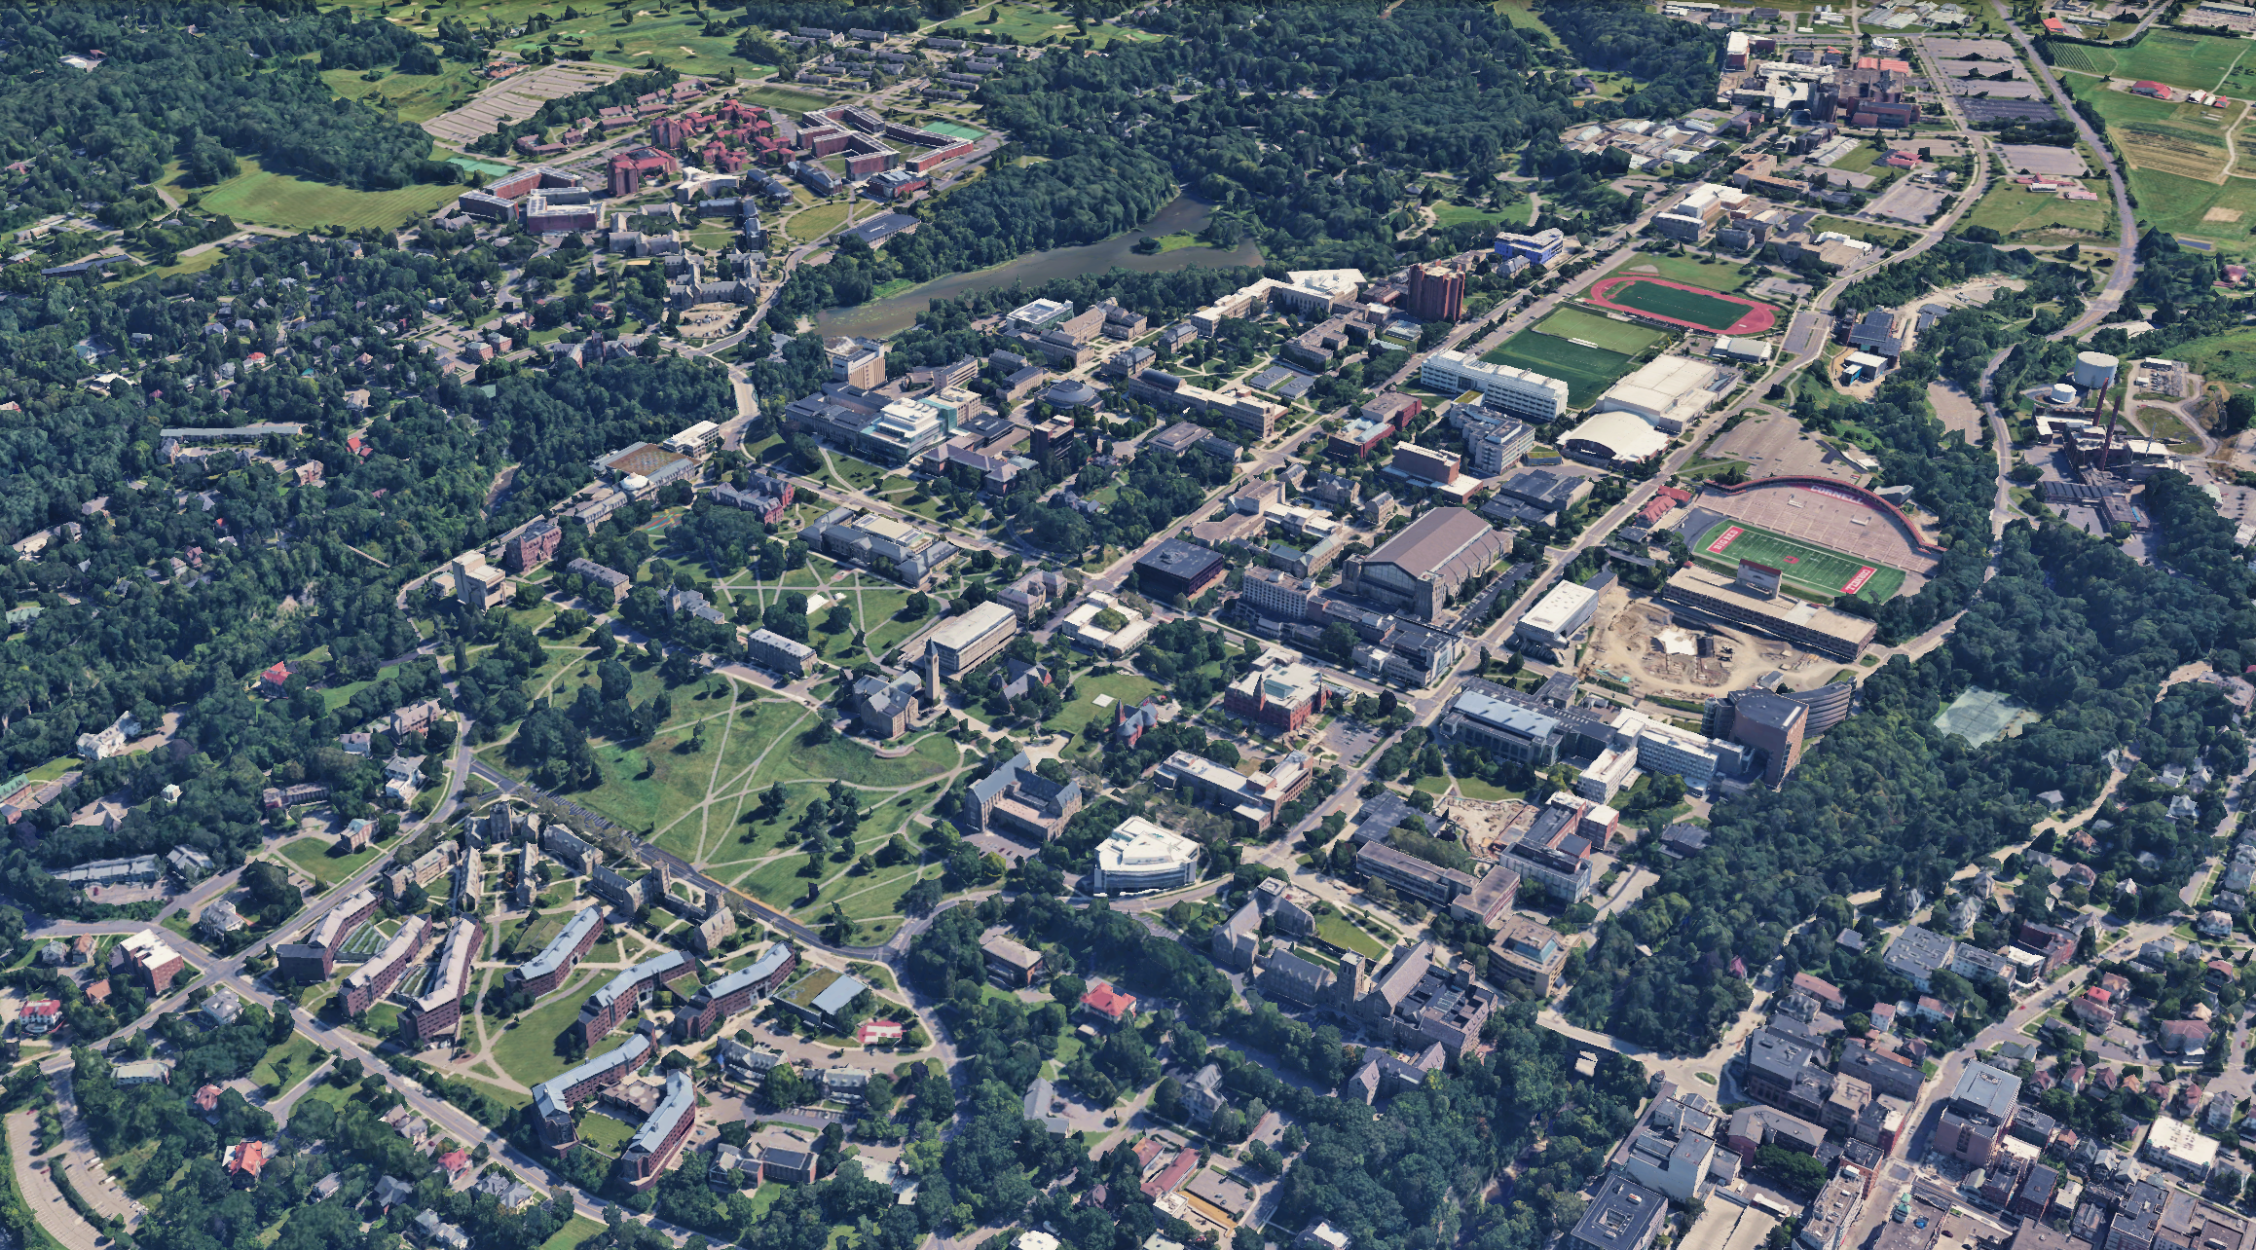
Scale of Summer Work
~ 125 Projects @ $574M Project Cost
58 projects: < $500K
32 projects: $500K - $2M
20 projects: $2M - $5M
15 projects: > $5M
~ peak $20M per month in construction billings

Slide 3
Capital Program - Projects > $10M (CCF Projects in Green)
2022
2023
2024
2025
2026
2027
2028
2029
2030
NEW EXP. HALL FOR CHESS ($28M)
Mar ‘22 - Dec ‘23
Jan ‘24 - Jan ‘25
OLIN LIBRARY RENO - McGraw ($22.1M)
Jan ‘23 – Sep ‘23
Dec ’23 - Mar ‘25
ATKINSON HALL ($87.9M)
Apr ‘22 - Apr ‘25
CIS BUILDING ($113M)
Nov ‘22
Feb ‘23 – May ‘25
.
BALCH HALL RENOVATION ($89M)
Mar ‘22 - Jul ‘24
Aug ‘25
HUGHES HALL ENV REPLACE ($15M)
Jan ‘23
May ‘23 - Apr ‘26
PLANT SCIENCE PHASE I ($69M)
Dec ‘22
Mar ‘22 - May ‘26
SIBLEY DOME RENOVATION ($17.6M)
Aug ‘23 - Nov ‘23
Mar ‘24 - Jun ‘26
MEINIG FIELDHOUSE ($53.7M)
Aug ‘23 - July ‘24
Nov ‘24 - Aug ‘26
KING-SHAW RENOVATION ($11M)
Feb ‘24 - Feb ‘25
May ‘25 - Jan ‘27
RICE HALL RENOVATION ($26M)
May ‘25 - Mar‘ 27
LIFE SCIENCES PAVILION ($22M)
Feb ‘24 - Feb ‘25
Feb ‘24 - Apr ‘27
Feb ‘24 - Feb ‘25
FIELD HOCKEY CLUBHOUSE ($11.3M)
Aug ‘23 - Dec ‘25
Mar - Jul ‘27
McGRAW HALL RENOVATION ($108.5M)
Jan ‘23 - Aug ‘24
Jan ‘25 - Jan ‘28
DUFFIELD HALL EXPANSION ($88.3M)
Sep ‘23 - Feb ‘25
Jan ‘25 - Apr ‘28
TMCF RENOVATION ($10M)
BB HALL MAKER SPACE ($11M)
GENEVA FOOD RESEARCH LAB RENO ($30M)
PLANT SCIENCE PHASE II ($74)
AHDC EXPANSION ($30M)
CARPENTER ADDITON ($35M)

Slide 4
Capital Program - Projects > $10M (CCF Projects in Green)
2022
2023
2024
2025
2026
2027
2028
2029
2030
NEW EXP. HALL FOR CHESS ($28M)
Mar ‘22 - Dec ‘23
Jan ‘24 - Jan ‘25
OLIN LIBRARY RENO - McGraw ($22.1M)
Jan ‘23 – Sep ‘23
Dec ’23 - Mar ‘25
5 projects @ $340M Warranty & Closeout
ATKINSON HALL ($87.9M)
Apr ‘22 - Apr ‘25
CIS BUILDING ($113M)
Nov ‘22
Feb ‘23 – May ‘25
.
BALCH HALL RENOVATION ($89M)
Mar ‘22 - Jul ‘24
Aug ‘25
HUGHES HALL ENV REPLACE ($15M)
Jan ‘23
May ‘23 - Apr ‘26
SIBLEY DOME RENOVATION ($17.6M)
Aug ‘23 - Nov ‘23
Mar ‘24 - Jun ‘26
PLANT SCIENCE PHASE I ($69M)
Dec ‘22
Mar ‘22 - May ‘26
MEINIG FIELDHOUSE ($53.7M)
Aug ‘23 - July ‘24
Nov ‘24 - June ‘26
KING-SHAW RENOVATION ($11M)
Feb ‘24 - Feb ‘25
May ‘25 - Jan ‘27
RICE HALL RENOVATION ($26M)
May ‘25 - Mar‘ 27
LIFE SCIENCES PAVILION ($22M)
Feb ‘24 - Feb ‘25
Feb ‘24 - Apr ‘27
Feb ‘24 - Feb ‘25
FIELD HOCKEY CLUBHOUSE ($11.3M)
Aug ‘23 - Dec ‘25
Mar - Jul ‘27
McGRAW HALL RENOVATION ($108.5M)
Jan ‘23 - Aug ‘24
Jan ‘25 - Jan ‘28
DUFFIELD HALL EXPANSION ($88.3M)
Sep ‘23 - Feb ‘25
Jan ‘25 - Apr ‘28
TMCF RENOVATION ($10M)
BB HALL MAKER SPACE ($11M)
GENEVA FOOD RESEARCH LAB RENO ($30M)
PLANT SCIENCE PHASE II ($74)
AHDC EXPANSION ($30M)
CARPENTER ADDITON ($35M)

Slide 5
Capital Program - Projects > $10M (CCF Projects in Green)
2022
2023
2024
2025
2026
2027
2028
2029
2030
NEW EXP. HALL FOR CHESS ($28M)
Mar ‘22 - Dec ‘23
Jan ‘24 - Jan ‘25
OLIN LIBRARY RENO - McGraw ($22.1M)
Jan ‘23 – Sep ‘23
Dec ’23 - Mar ‘25
ATKINSON HALL ($87.9M)
Apr ‘22 - Apr ‘25
CIS BUILDING ($113M)
Nov ‘22
Feb ‘23 – May ‘25
.
BALCH HALL RENOVATION ($89M)
Mar ‘22 - Jul ‘24
Aug ‘25
HUGHES HALL ENV REPLACE ($15M)
Jan ‘23
May ‘23 - Apr ‘26
4 projects @ $152M
Recently Completed
SIBLEY DOME RENOVATION ($17.6M)
Aug ‘23 - Nov ‘23
Mar ‘24 - Jun ‘26
PLANT SCIENCE PHASE I ($69M)
Dec ‘22
Mar ‘22 - May ‘26
MEINIG FIELDHOUSE ($53.7M)
Aug ‘23 - July ‘24
Nov ‘24 - June ‘26
KING-SHAW RENOVATION ($11M)
Feb ‘24 - Feb ‘25
May ‘25 - Jan ‘27
RICE HALL RENOVATION ($26M)
May ‘25 - Mar‘ 27
LIFE SCIENCES PAVILION ($22M)
Feb ‘24 - Feb ‘25
Feb ‘24 - Apr ‘27
Feb ‘24 - Feb ‘25
FIELD HOCKEY CLUBHOUSE ($11.3M)
Aug ‘23 - Dec ‘25
Mar - Jul ‘27
McGRAW HALL RENOVATION ($108.5M)
Jan ‘23 - Aug ‘24
Jan ‘25 - Jan ‘28
DUFFIELD HALL EXPANSION ($88.3M)
Sep ‘23 - Feb ‘25
Jan ‘25 - Apr ‘28
TMCF RENOVATION ($10M)
BB HALL MAKER SPACE ($11M)
GENEVA FOOD RESEARCH LAB RENO ($30M)
PLANT SCIENCE PHASE II ($74)
AHDC EXPANSION ($30M)
CARPENTER ADDITON ($35M)

Slide 6
Capital Program - Projects > $10M (CCF Projects in Green)
2022
2023
2024
2025
2026
2027
2028
2029
2030
NEW EXP. HALL FOR CHESS ($28M)
Mar ‘22 - Dec ‘23
Jan ‘24 - Jan ‘25
OLIN LIBRARY RENO - McGraw ($22.1M)
Jan ‘23 – Sep ‘23
Dec ’23 - Mar ‘25
ATKINSON HALL ($87.9M)
Apr ‘22 - Apr ‘25
CIS BUILDING ($113M)
Nov ‘22
Feb ‘23 – May ‘25
.
BALCH HALL RENOVATION ($89M)
Mar ‘22 - Jul ‘24
Aug ‘25
HUGHES HALL ENV REPLACE ($15M)
Jan ‘23
May ‘23 - Apr ‘26
SIBLEY DOME RENOVATION ($17.6M)
Aug ‘23 - Nov ‘23
Mar ‘24 - Jun ‘26
PLANT SCIENCE PHASE I ($69M)
Dec ‘22
Mar ‘22 - May ‘26
MEINIG FIELDHOUSE ($53.7M)
Aug ‘23 - July ‘24
Nov ‘24 - June ‘26
KING-SHAW RENOVATION ($11M)
Feb ‘24 - Feb ‘25
May ‘25 - Jan ‘27
6 projects @ $356M
In Construction
RICE HALL RENOVATION ($26M)
May ‘25 - Mar‘ 27
LIFE SCIENCES PAVILION ($22M)
Feb ‘24 - Feb ‘25
Feb ‘24 - Apr ‘27
Feb ‘24 - Feb ‘25
FIELD HOCKEY CLUBHOUSE ($11.3M)
Aug ‘23 - Dec ‘25
Mar - Jul ‘27
McGRAW HALL RENOVATION ($108.5M)
Jan ‘23 - Aug ‘24
Jan ‘25 - Jan ‘28
DUFFIELD HALL EXPANSION ($88.3M)
Sep ‘23 - Feb ‘25
Jan ‘25 - Apr ‘28
TMCF RENOVATION ($10M)
BB HALL MAKER SPACE ($11M)
GENEVA FOOD RESEARCH LAB RENO ($30M)
PLANT SCIENCE PHASE II ($74)
AHDC EXPANSION ($30M)
CARPENTER ADDITON ($35M)

Slide 7
Capital Program - Projects > $10M (CCF Projects in Green)
2022
2023
2024
2025
2026
2027
2028
2029
2030
NEW EXP. HALL FOR CHESS ($28M)
Mar ‘22 - Dec ‘23
Jan ‘24 - Jan ‘25
OLIN LIBRARY RENO - McGraw ($22.1M)
Jan ‘23 – Sep ‘23
Dec ’23 - Mar ‘25
ATKINSON HALL ($87.9M)
Apr ‘22 - Apr ‘25
CIS BUILDING ($113M)
Nov ‘22
Feb ‘23 – May ‘25
.
BALCH HALL RENOVATION ($89M)
Mar ‘22 - Jul ‘24
Aug ‘25
HUGHES HALL ENV REPLACE ($15M)
Jan ‘23
May ‘23 - Apr ‘26
SIBLEY DOME RENOVATION ($17.6M)
Aug ‘23 - Nov ‘23
Mar ‘24 - Jun ‘26
PLANT SCIENCE PHASE I ($69M)
Dec ‘22
Mar ‘22 - May ‘26
MEINIG FIELDHOUSE ($53.7M)
Aug ‘23 - July ‘24
Nov ‘24 - June ‘26
KING-SHAW RENOVATION ($11M)
Feb ‘24 - Feb ‘25
May ‘25 - Jan ‘27
RICE HALL RENOVATION ($26M)
May ‘25 - Mar‘ 27
LIFE SCIENCES PAVILION ($22M)
Feb ‘24 - Feb ‘25
Feb ‘24 - Apr ‘27
Feb ‘24 - Feb ‘25
FIELD HOCKEY CLUBHOUSE ($11.3M)
Aug ‘23 - Dec ‘25
Mar - Jul ‘27
McGRAW HALL RENOVATION ($108.5M)
Jan ‘23 - Aug ‘24
Jan ‘25 - Jan ‘28
DUFFIELD HALL EXPANSION ($88.3M)
Sep ‘23 - Feb ‘25
Jan ‘25 - Apr ‘28
TMCF RENOVATION ($10M)
6 Projects
in Design
BB HALL MAKER SPACE ($11M)
GENEVA FOOD RESEARCH LAB RENO ($30M)
PLANT SCIENCE PHASE II ($74)
AHDC EXPANSION ($30M)
CARPENTER ADDITON ($35M)

Slide 8
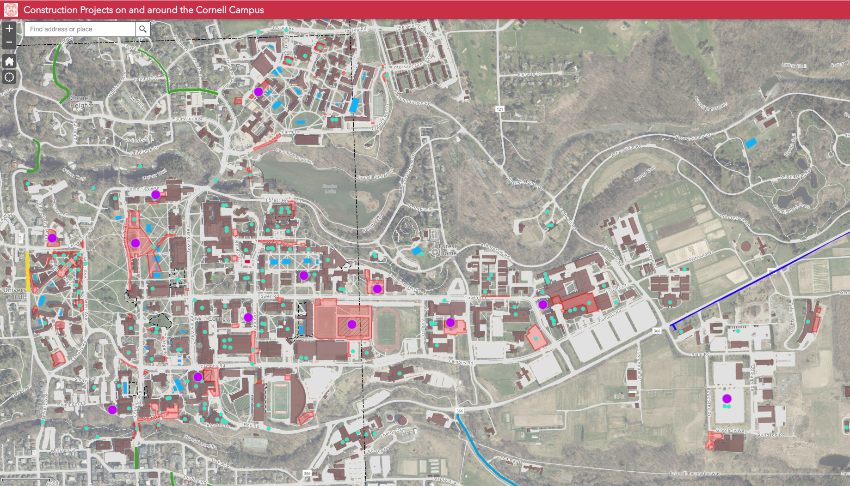
Summer Operations GIS Map
https://cornell.maps.arcgis.com/apps/webappviewer/index.html?id=e7eb8bb4a2b0459c8208f3d44612c6fe
Notes:
114 projects in construction
$838 M in total project cost

Slide 9
Major Roadwork & Paving
Large Animal Research Lot Paving
Cradit Farm Drive Paving & Sidewalks
Campus/Garden Water Service
Olin Hall Accessibility
Hollister Drive and Lot Paving & Sidewalks

Slide 10
Building Envelope & Roofing
VMC Roof
George Jameson and HR5 Storefronts
Clara Dickson
Roof
Corson/Mudd
Roof

Slide 11
Arts Quad and West Campus Area
Arts Quad
Site Lighting
Sibley Stairs
Arts Quad
Duct Bank
West Campus Generator Expansion
Gothic Chimney Repairs
WSH Generator
McGraw Hall
Baker Tunnel HW

Slide 12
Large Capital Projects
Life Sciences Pavilion
GFR FH Clubhouse
Rice Hall
Meinig Field House
King Shaw
McGraw Hall
Duffield Hall
Expansion

Slide 13
Construction Phase - Communication
“The single biggest problem in communication is the illusion that it has taken place.” - George Bernard Shaw
  Please Err on the side of over communicating but…be clear and concise
  Think early and often about the local and campus wide impact of your project (update Trimble project construction impacts statement)
  Use a layered approach targeted for each type of audience
    “Success with Constant Contact bi-weekly project updates for impactful projects”
  Don’t forget your third-party consultants (FM Global, Commissioning Agents, Testing agents etc…)
  Every project should have a project communication plan/strategy in place…that has been shared and vetted with partners and stakeholders

Slide 14
Questions?

