Slide 1
Effects of Changes to Snow Loads in 2025 Codes
Quinn Olsen-Bieber, P.E.
Structural Engineer, Facilities Engineering
April 29, 2026 PMPD

Slide 2
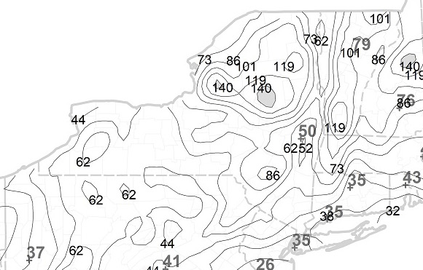
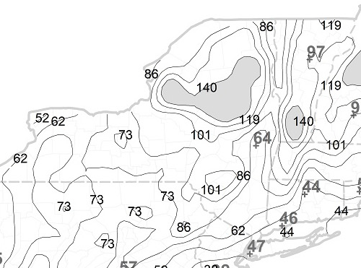
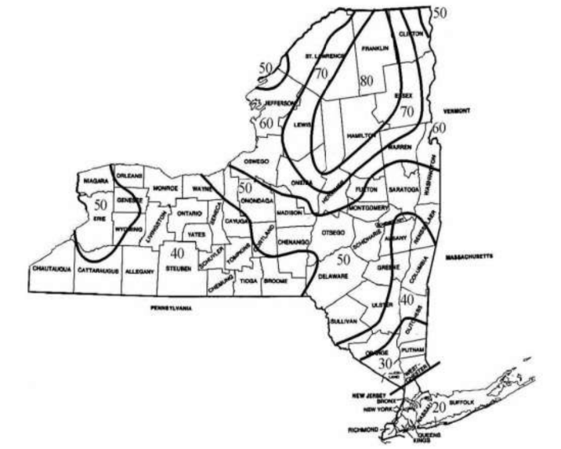
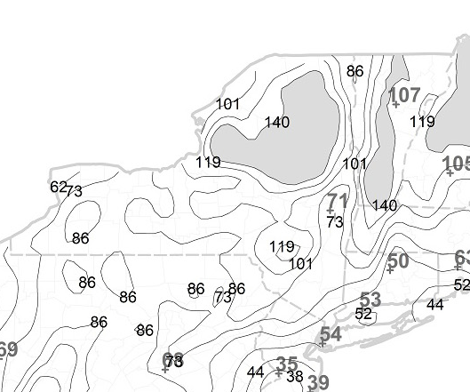
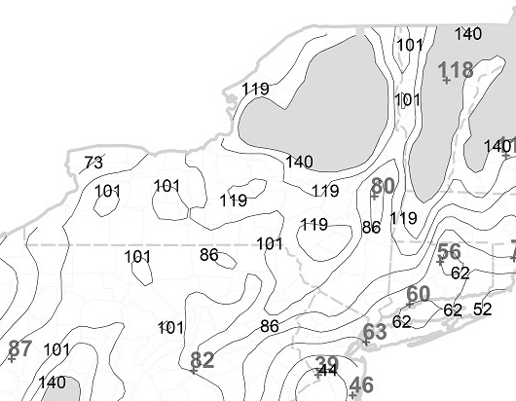














Building Code of New York State 2025 Section 1608: What’s new?
Risk Cat. I
Risk Cat. II
Risk Cat. III
Risk Cat. IV
Old Ground Snow Map
Determined by NYS
New Ground Snow Maps Based on Risk Category
Determined by ASCE 7-22
Figures 1608.2(1) – 1608.2(4)
Notes:
What’s new? The ground snow has changed as have some of the procedures for calculating snow loads. On the left we have the old snow map that has been in the NYS codes for over twenty years. On the right are the NYS portion of the new snow maps which were taken directly from ASCE 7-22. ASCE 7 is a publication by the American Society of Civil Engineers titled “Minimum Design Loads and Associated Criteria for Buildings and Other Structures.” This is NOT a code document in and of itself. It is an industry standard referenced by the code. The current code says to calculate the snow loads from ASCE 7 Chapter 7. The old map is Figure 1608.2(5) in the current code because the state does not want buildings designed for anything lower than the old snow loads.

Slide 3
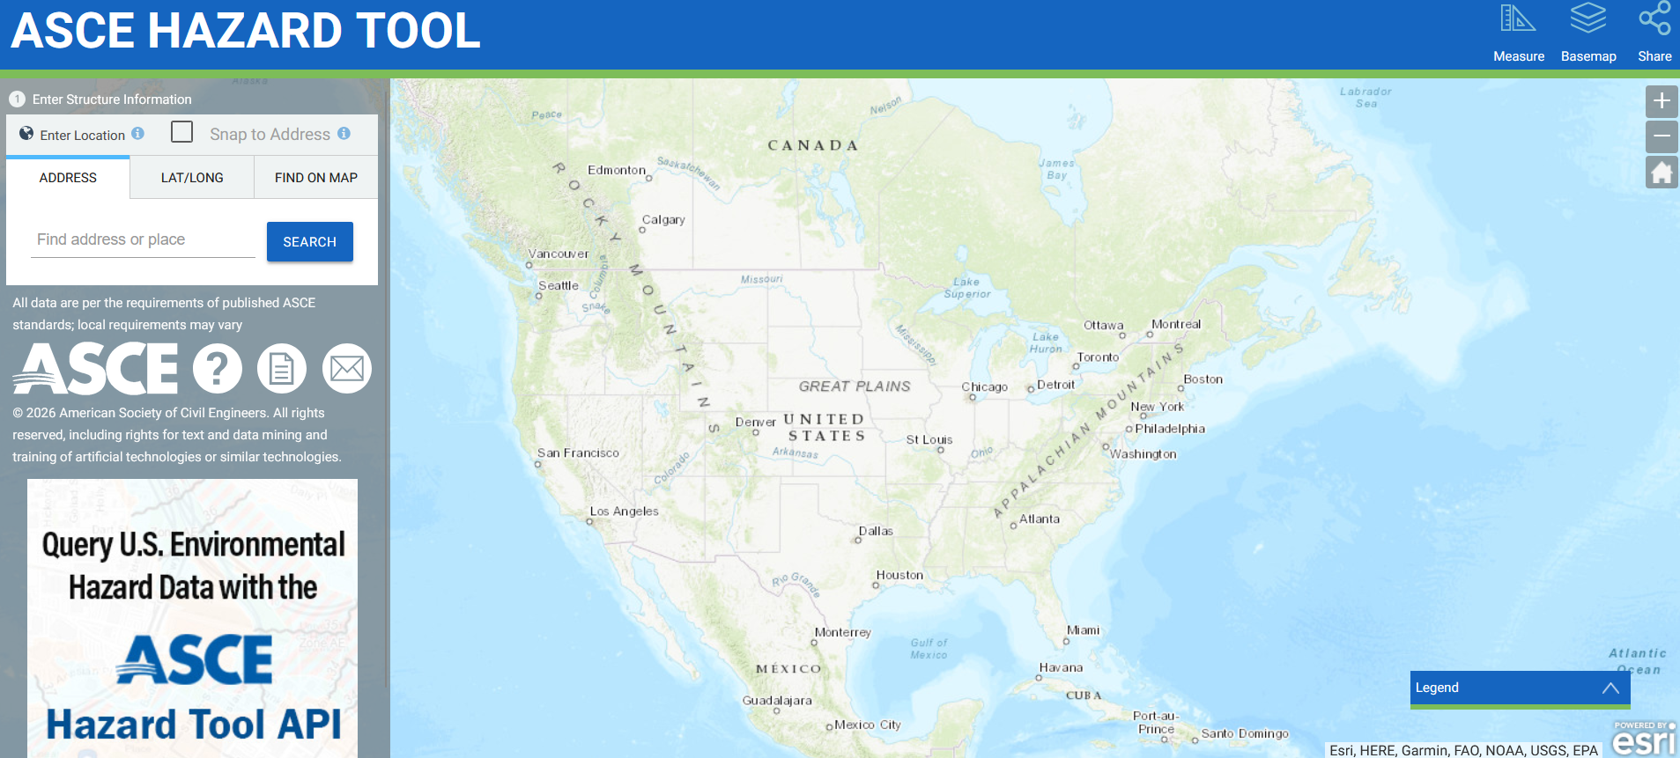
What’s new?
https://ascehazardtool.org/
Notes:
The code recommends engineers use this online tool (though it is incorrectly cited).

Slide 4
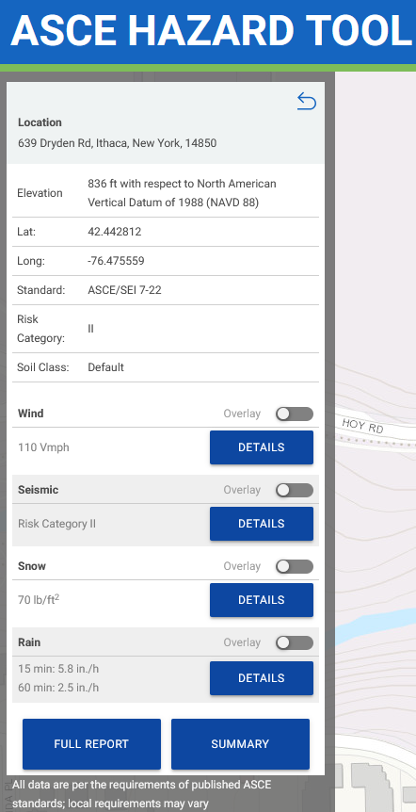
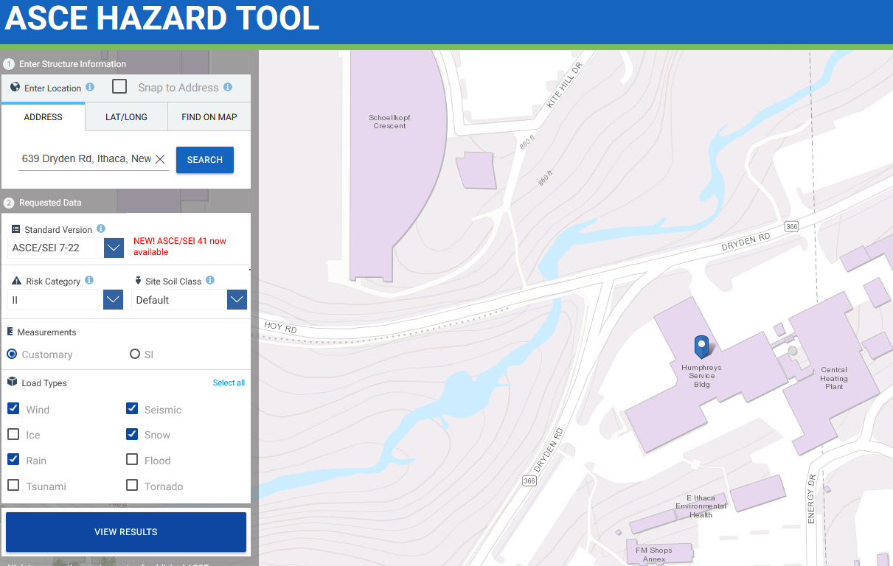
https://ascehazardtool.org/
Notes:
Put in the building’s address. Select the relevant version of ASCE 7, risk category, soil type, units, and the load types. It then provides the elevation, location, and selected environmental loading conditions.
Since the ground snow load is mapped in half mile increments and the main Ithaca campus is the size of a small town, ground snow loads vary within the bounds of campus even for buildings of the same risk category. We used to have a more consistent snow load all over campus. If it was risk category II, usually the flat roof snow was 28 psf. Risk category III was usually 31 psf. That’s no longer the case.

Slide 5
Building Code of New York State 2025 Section 1608: What’s new?
Approx. 10% to 15% higher ground snow loads
Approx. 10% to 15% increase in flat roof snow load from insulation
Reduction in benefit of a sloped roof
Incorporating the effects of winter winds into snow drift calculations
Cumulative effect of all the different changes results in anywhere from approx. 10% to 30% higher snow loads depending on the specifics of the building
Notes:
Without getting too deep into the details of the calculations and where all the math comes from, the ground snow loads are higher in our area because the new loads were developed with another thirty years of weather data and a different method for evaluating the risk of structural failure. One of the factors in the calculations is the thermal factor which is now more directly related to the amount of insulation on a roof than it was previously. This results in another approximately 10% to 15% increase in the snow loads. Sloped roofs have less of a reduction in the snow load than they used to. The calculations for snow drift now consider the wind in the winter, so those calculations changed too. Bottom line: the cumulative effect of these changes can result in a wide range of changes to the snow load, and the loads are much more individualized to the specifics of the structure in question. It could be a 10% increase (or less), or it could be a 30% increase (or more) depending on the individual conditions of the project.

Slide 6
When does this apply?
All new buildings and new additions
Replacing or adding new equipment on top of a roof
Hanging new equipment or replacing hanging equipment on the underside of the roof structure
Roof replacements because energy code requires more insulation

Slide 7
Energy Code: Path for compliance with roof replacement that has no other scope
“Alterations shall not create an unsafe or hazardous condition or overload existing building systems.” (ECCCNYS C503.1)
  State code interpretation 2026-02:
    The phrase “building systems” does include structure.
    Option to submit an engineering analysis (signed and sealed memo) to AHJ showing that compliance with energy code insulation will overload the structure. Analysis must include how much insulation the existing building structure can support without overloading the structure from increased snow.
  AHJs for town, city, and state will accept engineering analysis option.
  This allows for engineering judgement to be applied on a case-by-case basis.
Energy Code has exceptions
Notes:
Where a roof replacement has no other scope and the new roof assembly is the same weight or less than the existing system, if an engineer can prove the insulation required by the energy code will increase the snow loads on the building enough to overstress the structure, the AHJ may allow the project to move forward without adding insulation compliant with energy code. An analysis is needed to determine the maximum safe amount of insulation that can be added. If there is any other scope or the roof assembly being installed is heavier than the existing roof assembly, then existing building code comes into play, and there are additional code triggers to be considered.

Slide 8
Why does this matter?
What can I do about it?
What does the project trigger in the code? Energy Code? Existing Building Code? Both?
Strongly recommend a preliminary structural evaluation to determine if there will be load increases and how they impact the structure
  Determines the problem, the extent of the problem, and a path to code compliance
  Does not design structural reinforcement
  Clarifies the project scope which informs if the design and construction budgets are sufficient for the project’s goals
  Some projects may be simple, and the structure may have available capacity. Some projects may be complex and/or the structure has no additional capacity.
  Increased roof loads or decreased roof structural capacity may require widespread structural reinforcement on all structural elements from the roof to the foundations depending on the framing of an individual building
Signed and sealed engineering analysis for AHJ
Possibility to rethink the approach to the project

Slide 9
Purpose of Preliminary Structural Study:
Save Time and Money
Understand budget and scope before submitting FPAR
Do not cause delay in starting a project
Do not cause delay during design
Provide information on a realistic budget for design fees and construction costs before beginning design
Notes:
We know the changes to the code mean that roof related projects could have significantly higher costs than roof related projects in the past. We know we need the AHJ to approve a path to code compliance.

