Slide 1
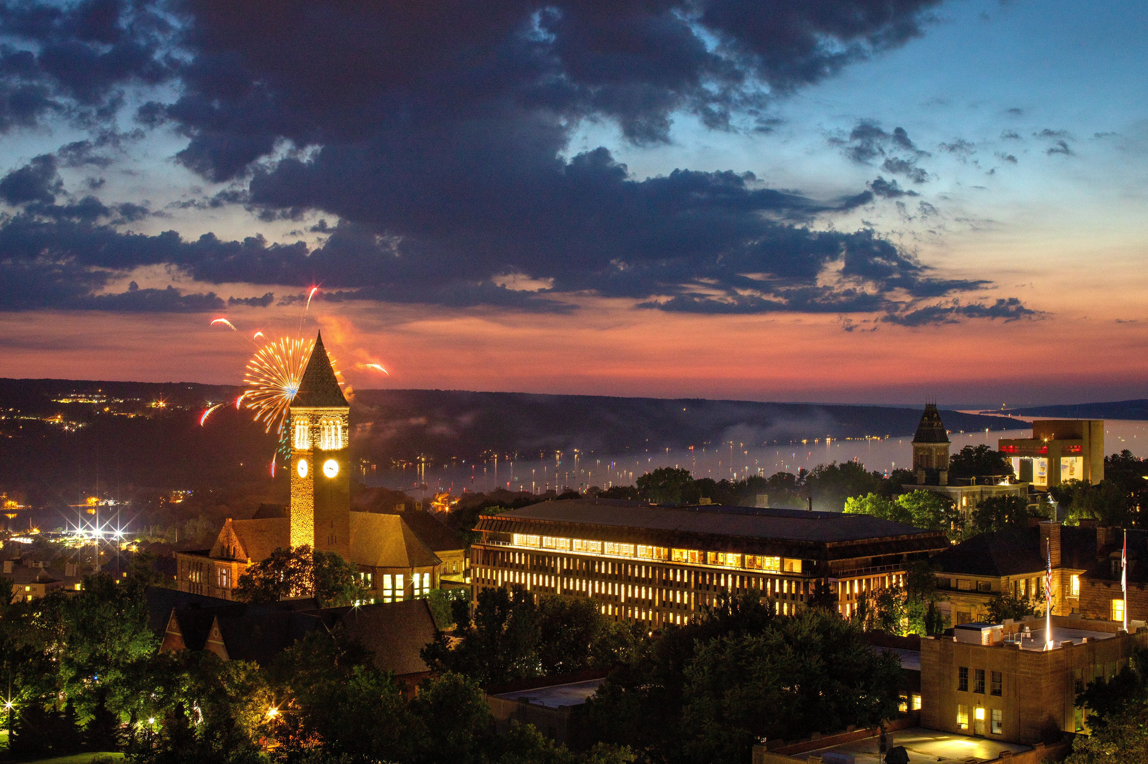

FCS Planned Maintenance
Planning Phase
Facilities and Campus Services​
April 2026

Slide 2
Agenda:
FCS Planned Maintenance – Planning Phase
What makes a successful project?
Planning Strategy
Process Management
Structured Engagement
How to Get there from here?
How do we get there from here?
Document what we Know
Engage and Document Known Unknowns
Document Learned Unknowns
Tools and Reports
Notes:
Planning Phase:
FCS Planned Maintenance - FY Plan Socialization
Process Management
Reporting and Data Management
Project Readiness:
Project Advocate & Campus Stewards Feedback loop

Slide 3
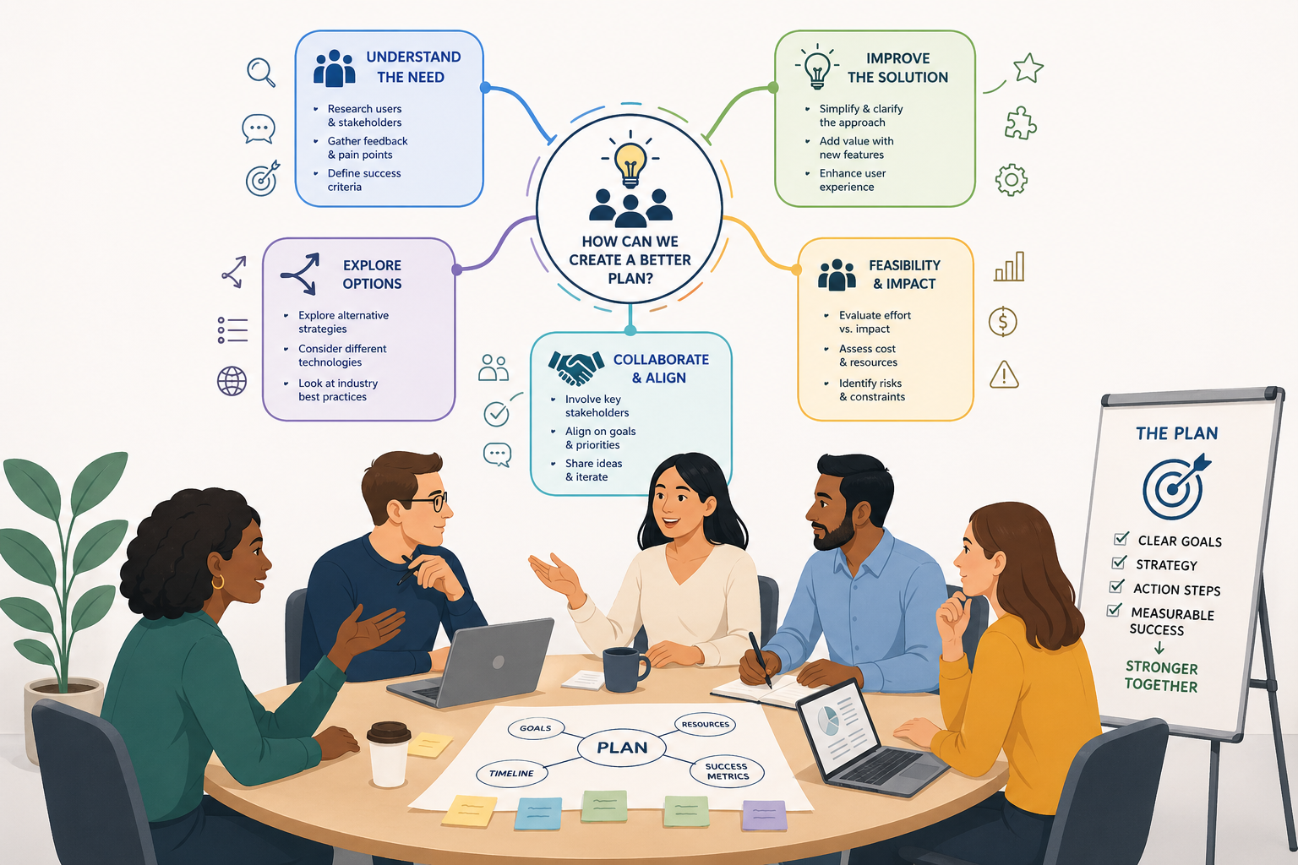
Planning Makes a Successful Project
Notes:
FCS Planned Maintenance – Planning Phase
What makes a successful project?
Clear:
Scope
Schedule
Budget
Funding Identified - Priority
Aligned Expectations!
Consistency:

Slide 4

What Does Success Look Like?
Is everyone rowing in the same direction?
What is the problem that is trying to be solved?
Image: “Clock not Flock” Cabrera Lab

Slide 5
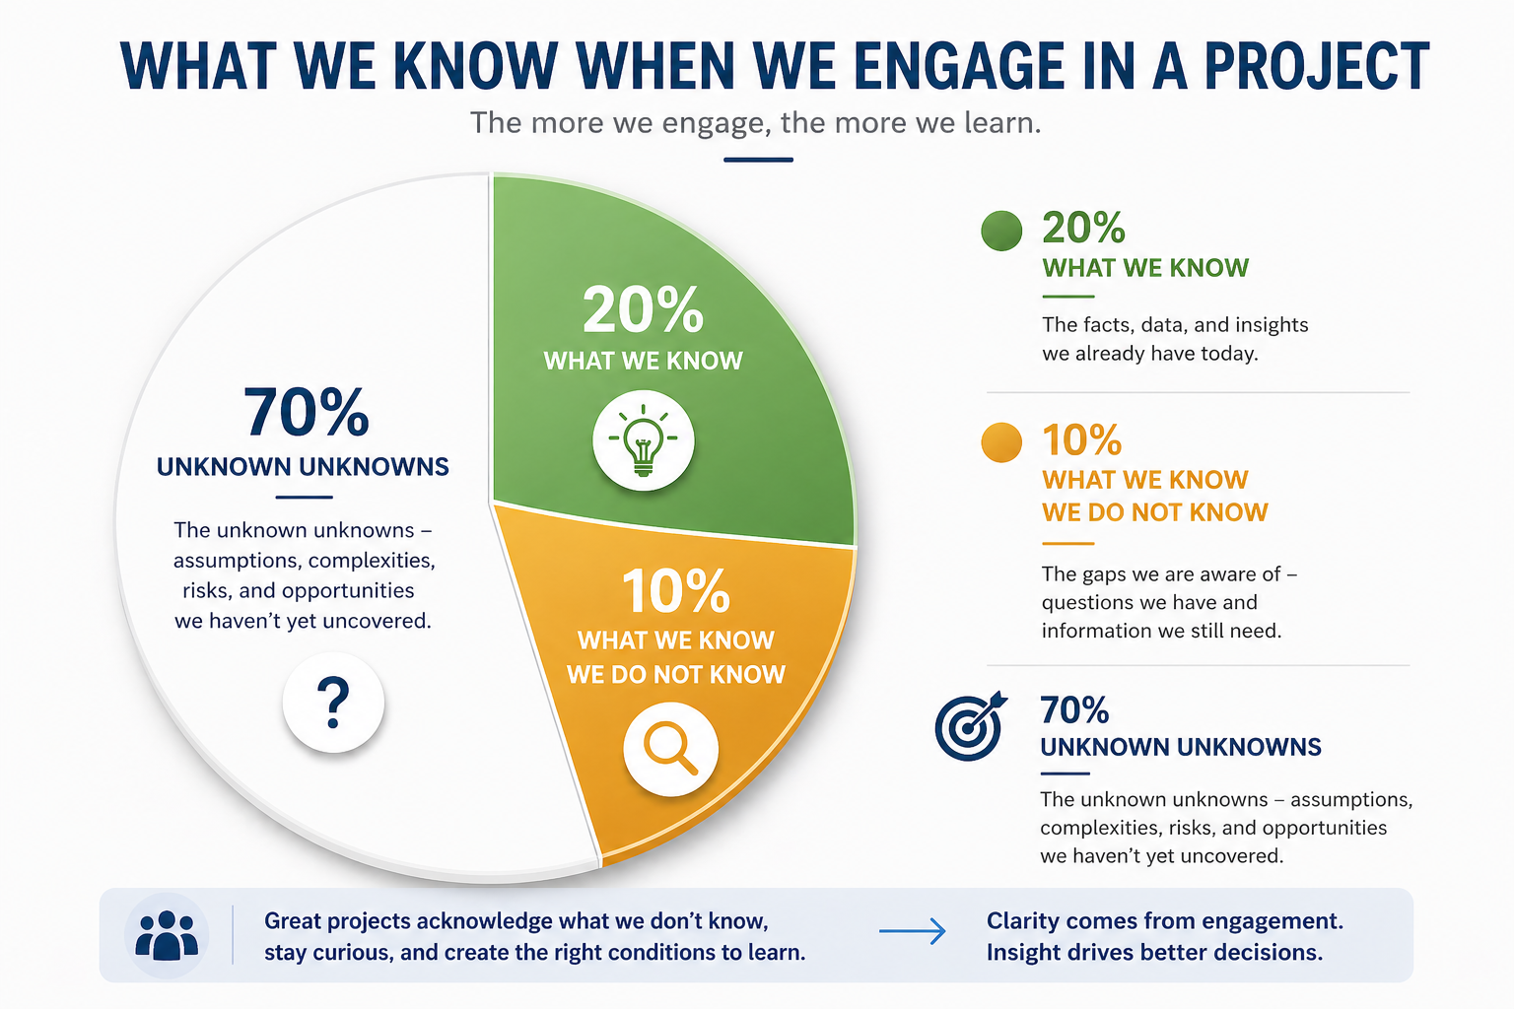
Planning: An Iterative Process
Notes:
Create the right conditions to learn!

Slide 6

Planning: Context is Queen!
Notes:
Quoting Risa Mish – A professor of Critical Thinking in Johnson School of Business Management.
“Context is Queen!”
Ask Questions? Documents them.
Make Decisions., Document them.
Leave a trail of breadcrumbs to document the context.

Slide 7
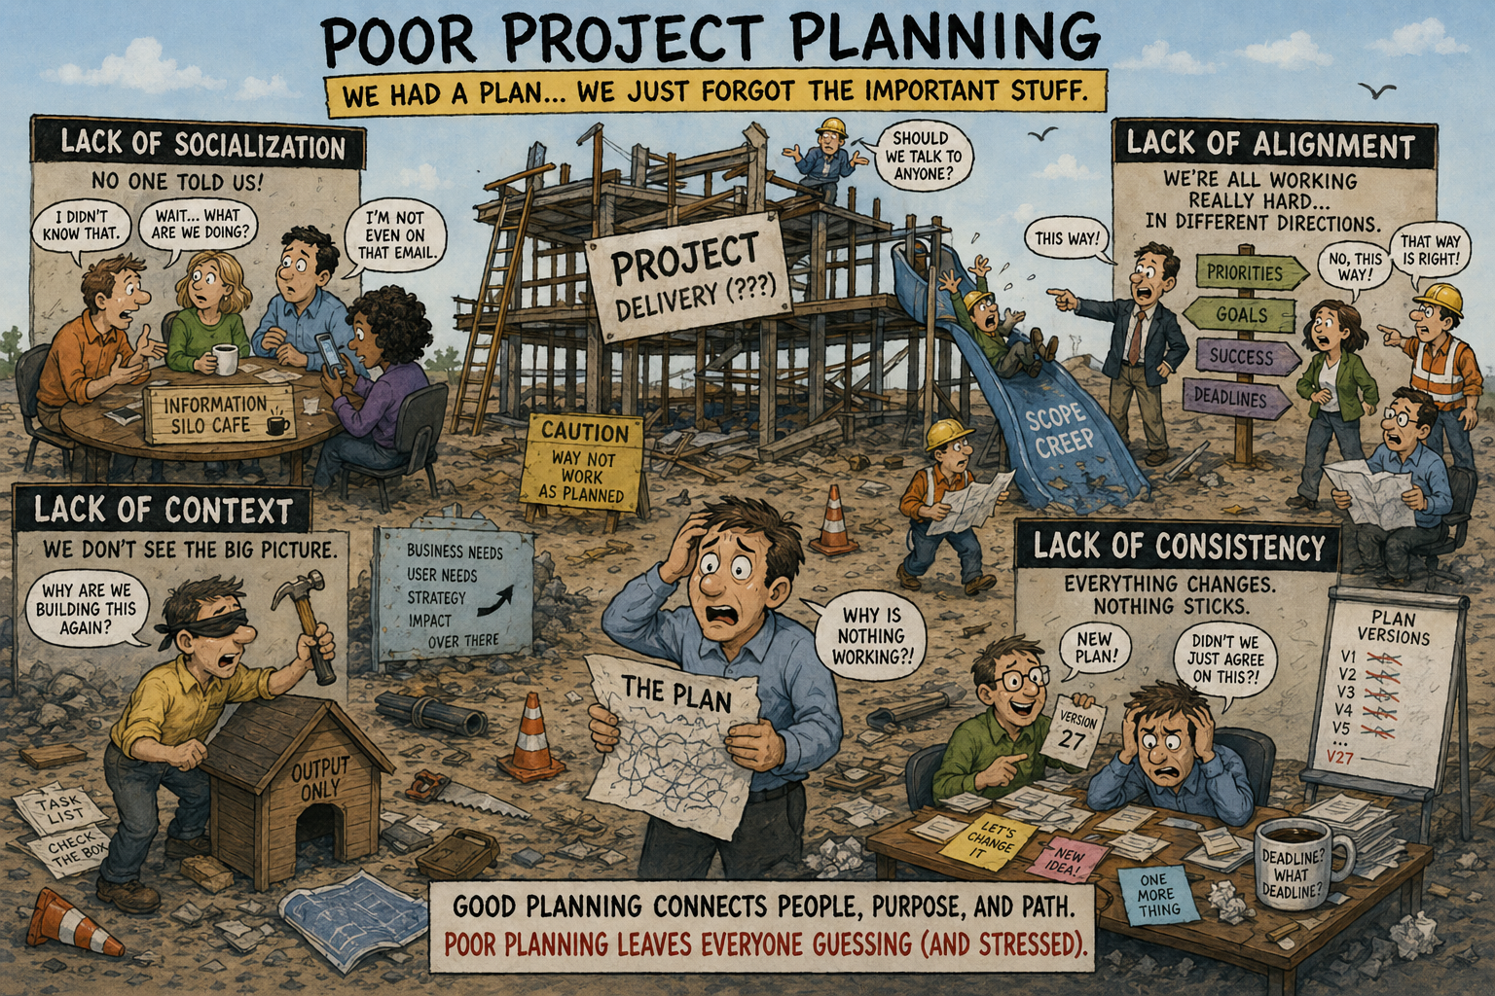

Slide 8
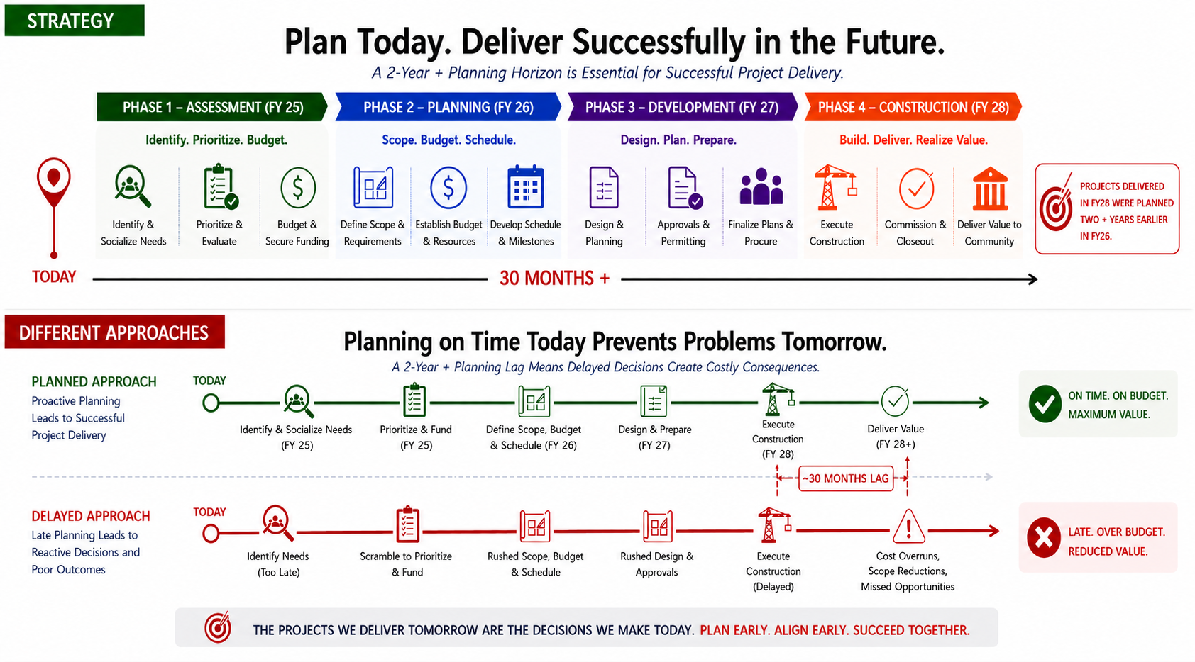
Planning: Strategy (2+Year Plus Horizon)

Slide 9
Processes Management: Structured Engagement
Jan ‘26
Feb ‘26
Mar * ‘26
Apr ‘26
May ‘26
Jun ‘26
Jul ‘26
Aug ‘26
Sep * ‘26
Oct ‘26
Nov ‘26
Dec ‘26
Jan ‘27
FY Q3
FY Q4
FY Q1
FY Q2
FY Q3
Alternating Quarterly Engagement:
Executive – FCS Execution Meeting
1st month of Fiscal Qtr. (July, Oct, Jan, Apr)
FCS Stewards – Report out Feedback engagement
2nd month of Fiscal Qtr. (Aug, Nov, Feb, May)
Campus Partners – Socialize & Feedback
3rd month of Fiscal Qtr. (Sep*, Dec, Mar*, Jun)
*Alternate: FDRT group discussion, with 1:1 direct discussion
Notes:
Planning Phase:
FCS Planned Maintenance - FY Plan Socialization
Process Management
Reporting and Data Management
Project Readiness:
Project Advocate & Campus Stewards Feedback loop

Slide 10
How do we get there from here?
Assessment Phase: Data Collection “Known Knowns (20%)”
Project Planning Update (PPU) (Scope & Proposed Funding)
Planning Scenario (Schedule)
Details Page (Order of Magnitude Budget & Additional Context)
Reporting: Tableau View of FY Planned Projects
Planning Phase: Engage & Document “Known Unknowns (10%)”
Review of Planned List: Tableau Report
Steward Engagement Input: Capture Feedback
Iterative Process: Quarterly Engagement
Document the “Unknown Unknowns (70%)” adding important context to the project.
Notes:
Project Advocates:

Slide 11
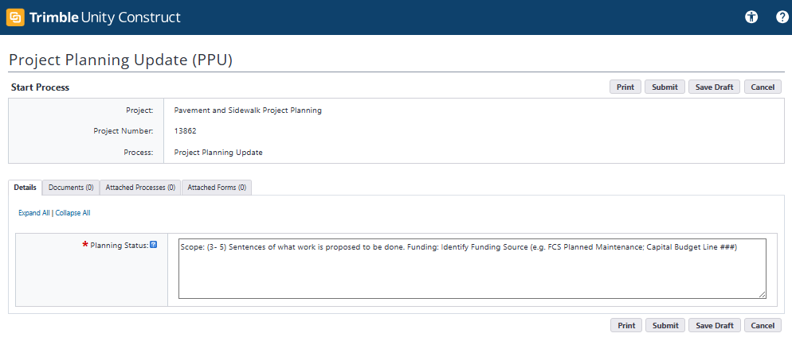
Processes: What We Know
The Details Page:
Executive Summary
Purpose & Need
Project Planning Page: (Scope & Funding Source)
Notes:
Planning Phase:
FCS Planned Maintenance - FY Plan Socialization
Process Management
Reporting and Data Management
Project Readiness:
Project Advocate & Campus Stewards Feedback loop

Slide 12
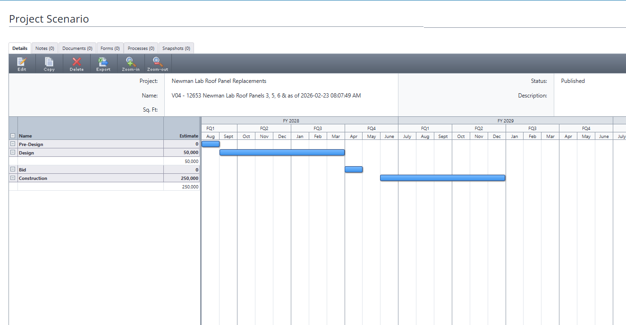
Processes: What We Know
The Planning Scenario:
Timing of Proposed Project Phases
Timing of Funding Commitments (Sources & Uses)
Notes:
The intent here is to provide some structure to the engagement to help it become more proactive vs. reactive.
Document it!
Quote or very own Alex Chevellard: (Paraphrasing a touch) “Trimble is like a back brace. It is painful to wear, but it makes you stand up straight”
The intent here is use Trimble and its reporting capabilities to stand up straight.
The intent of the soft engagement is to allow the Steward time to comprehend and think about the what is the needs and help guide the project toward a successful path.
- FE institutional: knowledge, and building code Expertise
- Allows for the initial visceral reaction to take place on their time and allow space for Curiosity Vs. Judgement

Slide 13
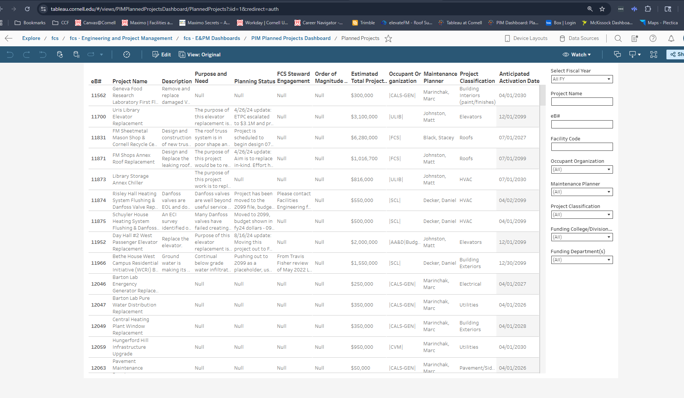
Reporting: Planning Dashboard
https://tableau.cornell.edu/views/PIMPlannedProjectsDashboard/PlannedProjects
Notes:
Planning Phase:
FCS Planned Maintenance - FY Plan Socialization
Process Management
Reporting and Data Management
Project Readiness:
Project Advocate & Campus Stewards Feedback loop

Slide 14
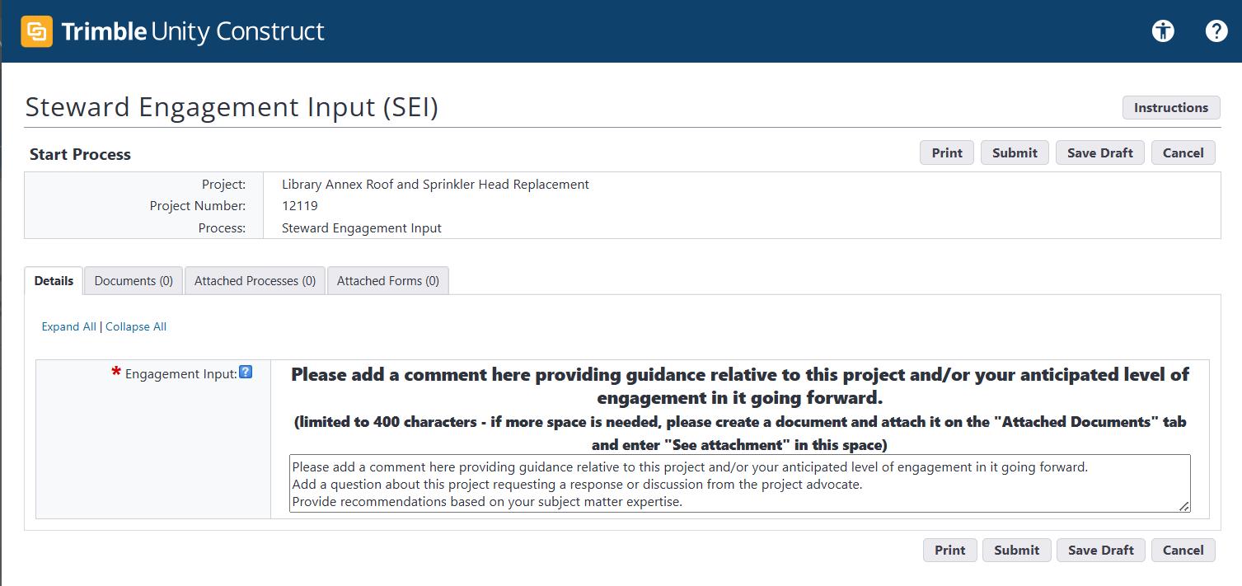
Processes: Document Known Unknowns
Steward Engagement Input:
Timing of Proposed Project Phases
Timing of Funding Commitments (Sources & Uses)
Notes:
Add a new screen shot

Slide 15
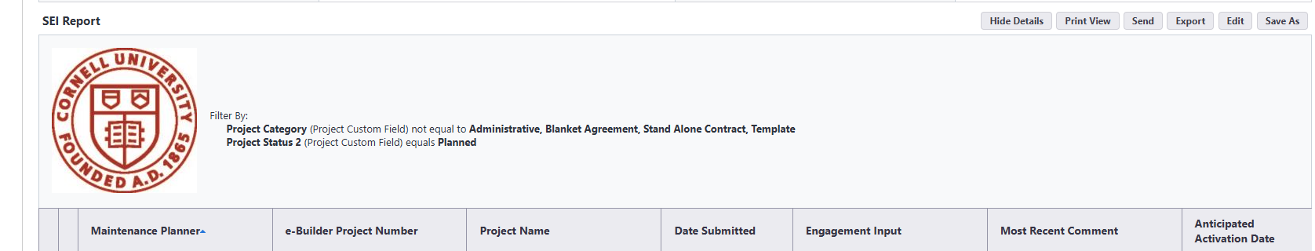
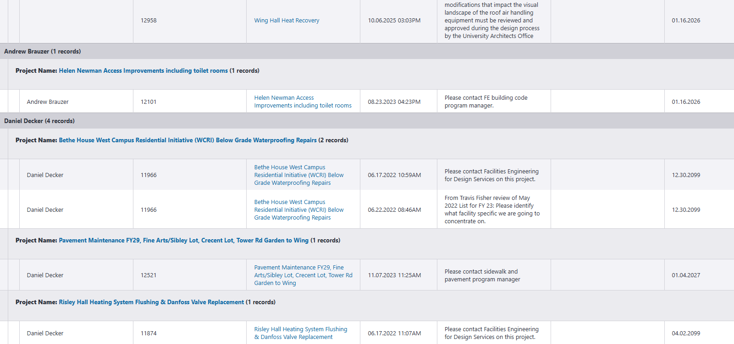
Reports: Steward Engagement Input (SEI)
Notes:
Planning Phase:
FCS Planned Maintenance - FY Plan Socialization
Process Management
Reporting and Data Management
Project Readiness:
Project Advocate & Campus Stewards Feedback loop

Slide 16
Tools & Reports
Tools: Data Entry and Collection
Details Page (Trimble)
Planning Scenario (Trimble)
Cost Estimation – Order of Magnitude Budget (Excel)
Planned Project Status Update (Trimble Process)
Steward Engagement Input (SEI) (Trimble Process)
Project Activation Checklist (Process)
Reports: Sharing of Data
Planning Tool Dashboard: (Tableau)
SEI Report (Trimble)

Slide 17
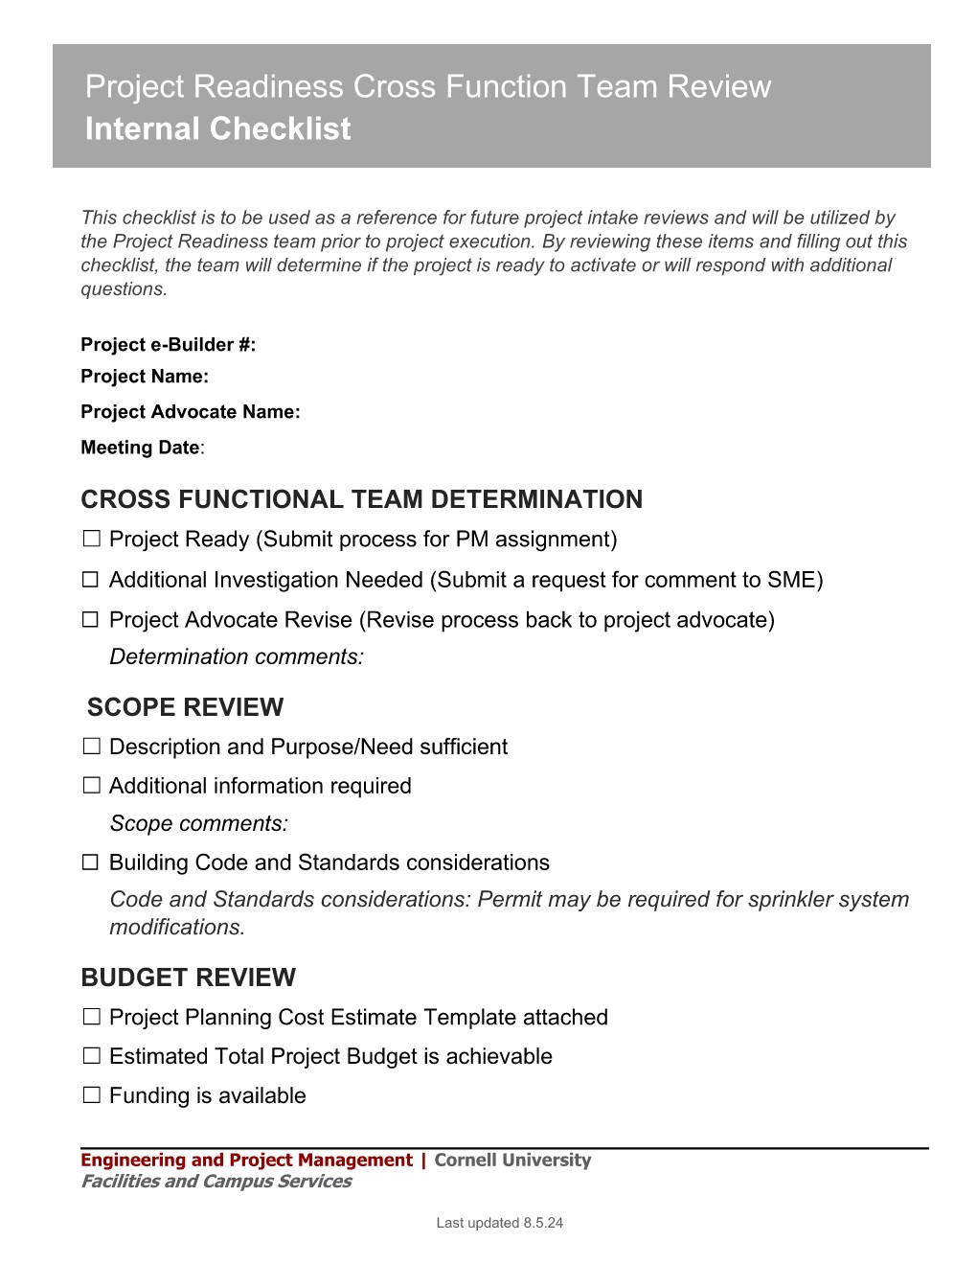
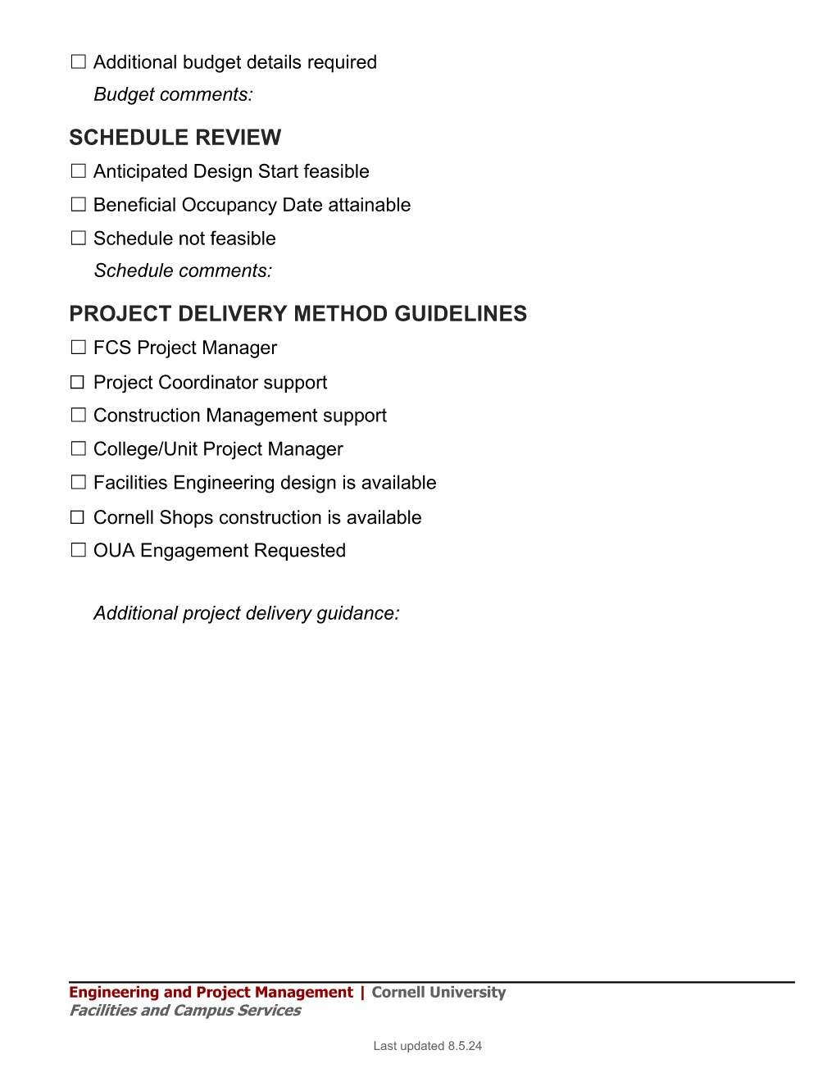
Project Readiness: Project Activation Checklist
Scope Review
Budget Review
Schedule Review
Proposed Project Delivery

Slide 18
Feedback: (FY27 Trial)
Black Box
Expectations of Review
Type of Feeback Responses

Slide 19
Questions?
Facilities and Campus Services​
April 2026

