Slide 1
OUA Updates
Stella Garber - University Facilities Data and Archives Resource Manager
Mary Wolff - GIS Data Administrator

Slide 2


Facilities Information Group
Certificate of Occupancy documentation & Room Numbering reminder!

Slide 3
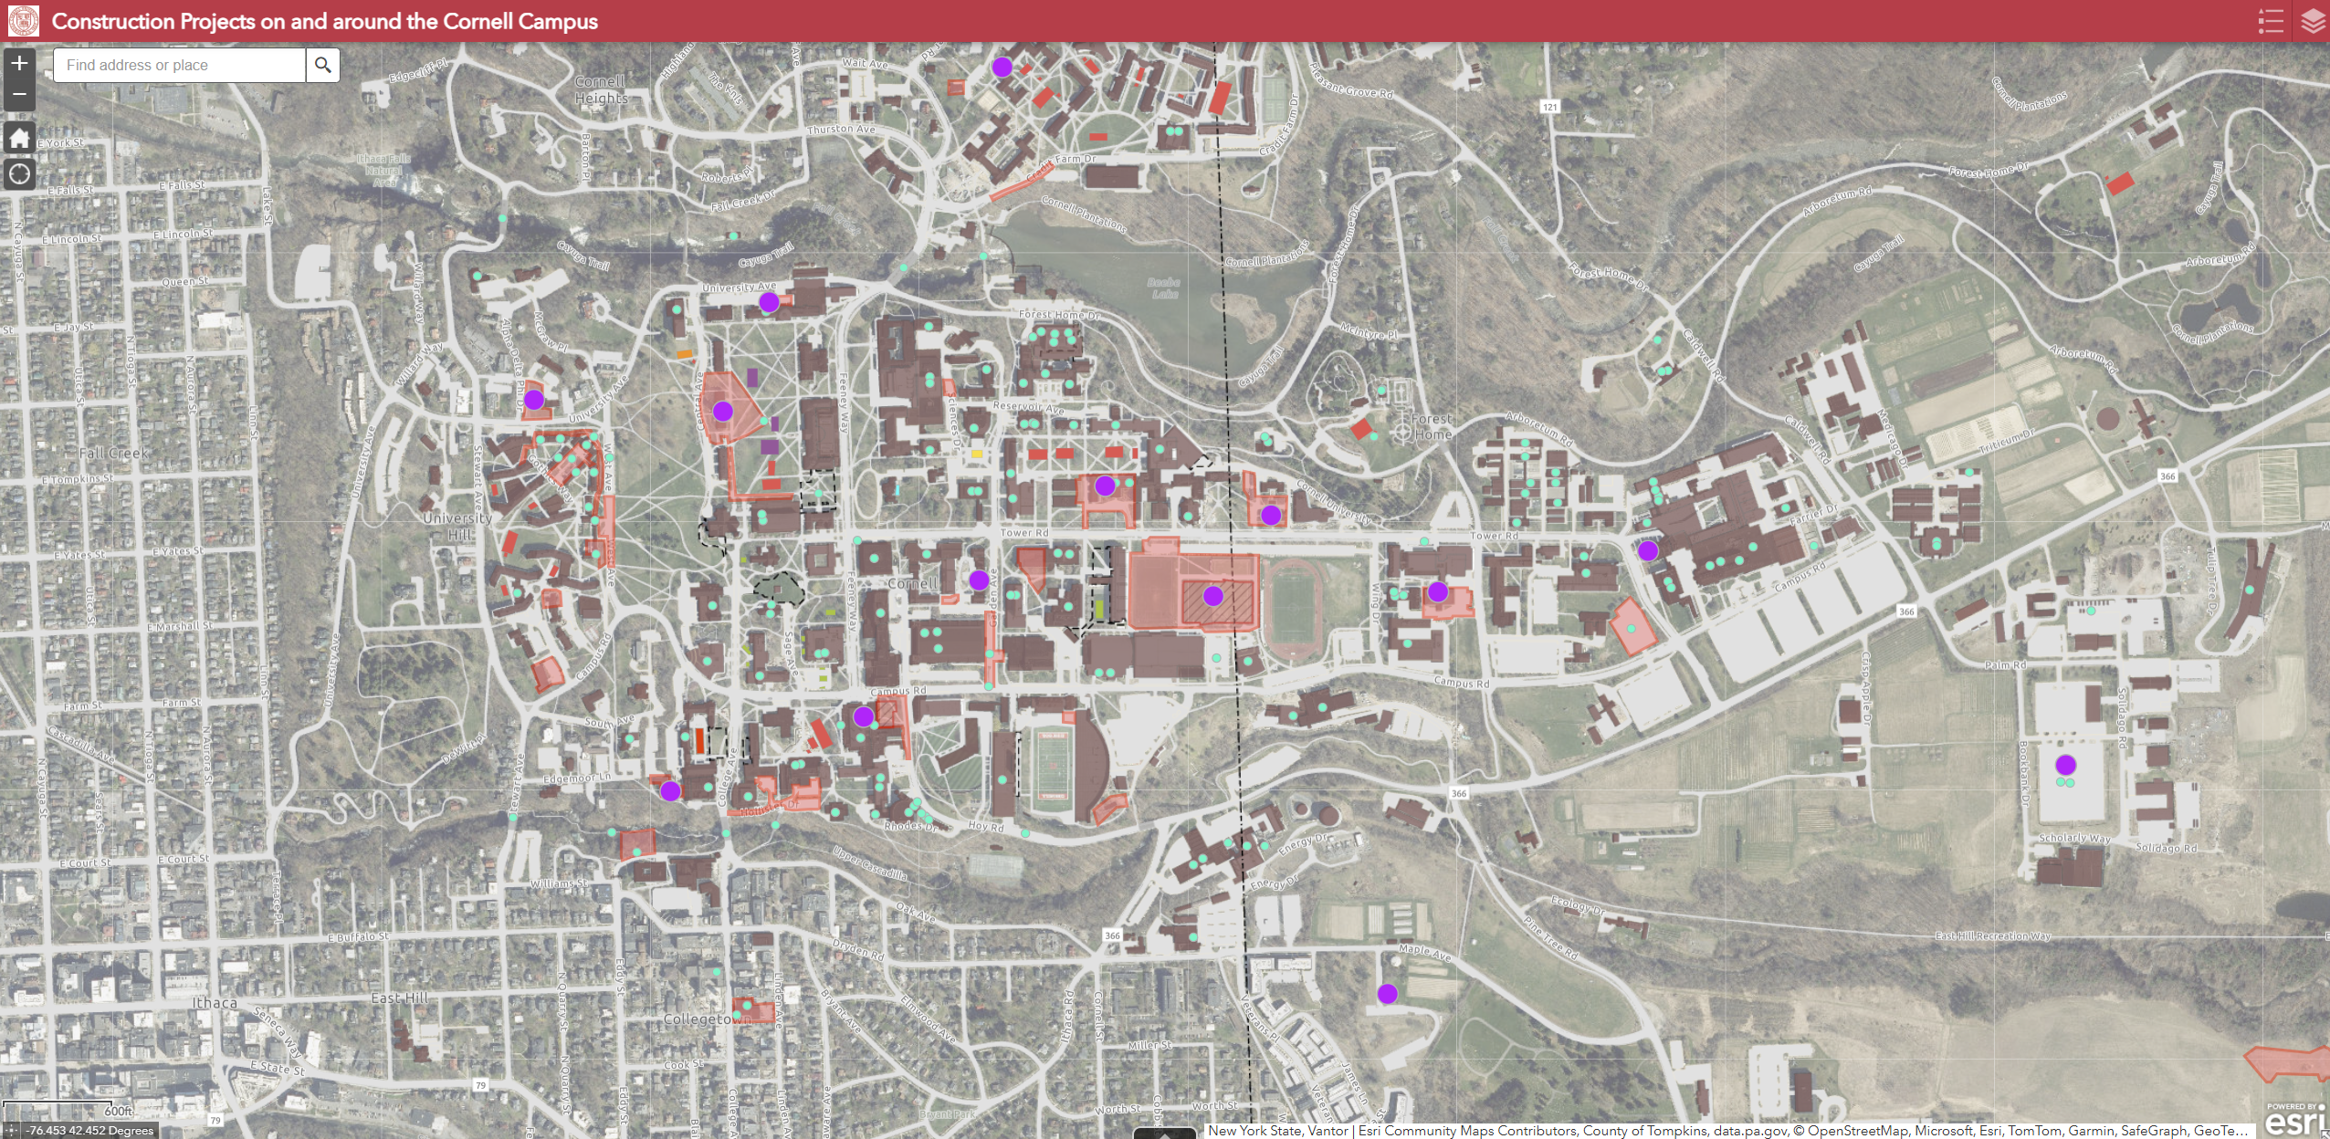
GIS Data & Mapping
Summer Construction Mapping
Notes:
https://cornell.maps.arcgis.com/apps/webappviewer/index.html?id=e7eb8bb4a2b0459c8208f3d44612c6fe

Slide 4
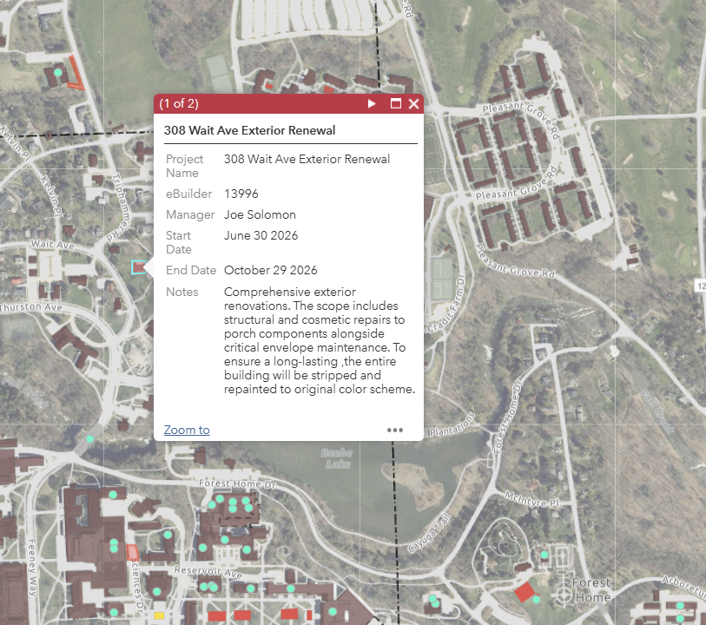
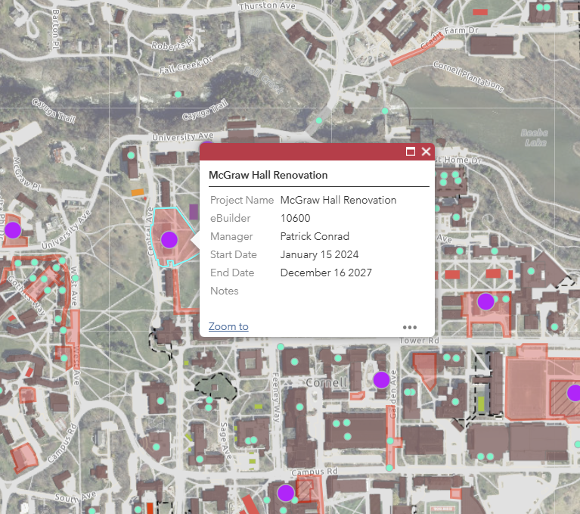
Project Impact Statements
Notes:
Large and small capitol projects via data that Jessie Dimick pulls form Trimble
Project impact statements should look like the one on the left – The impact of the project should be detailed but concise ,

Slide 5
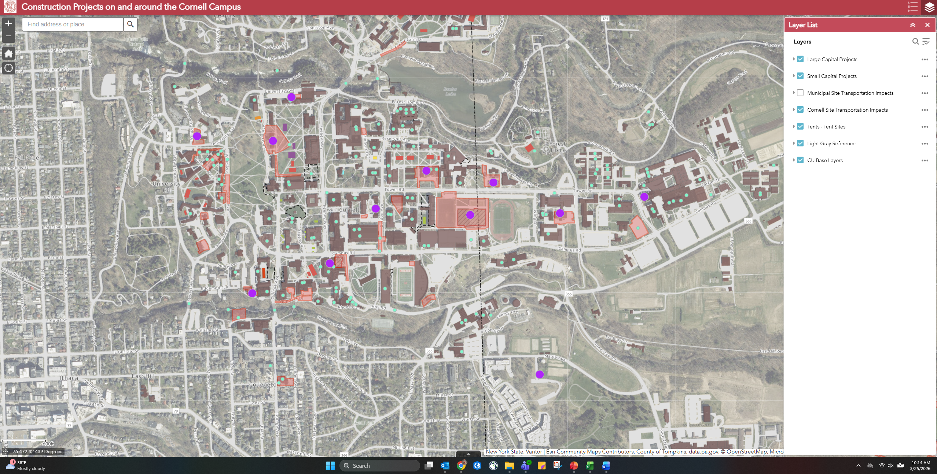
Search for Your Project

Slide 6
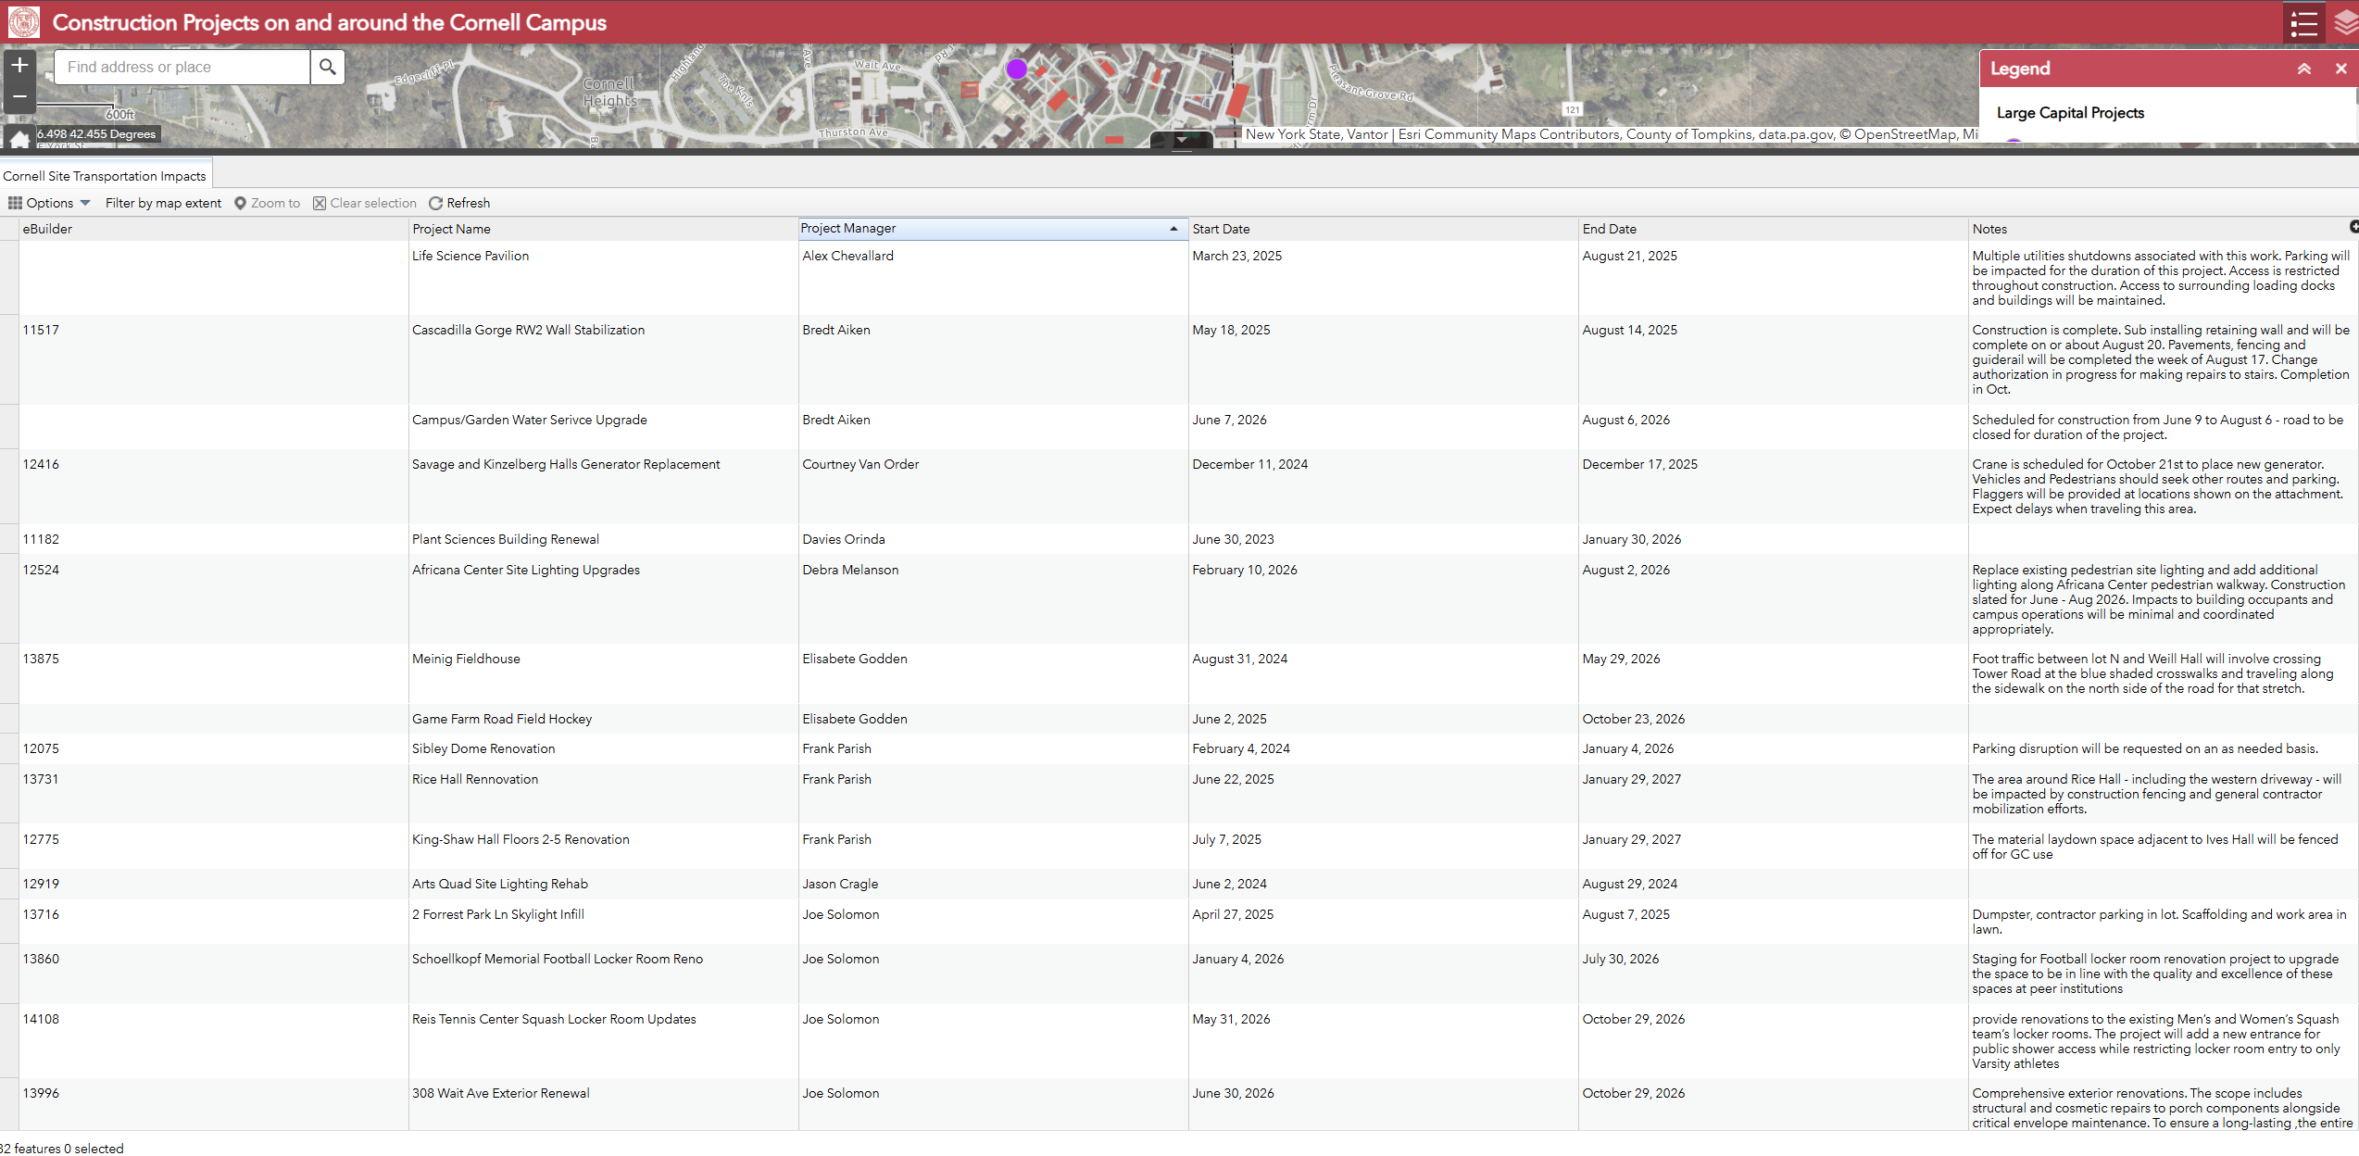

Slide 7
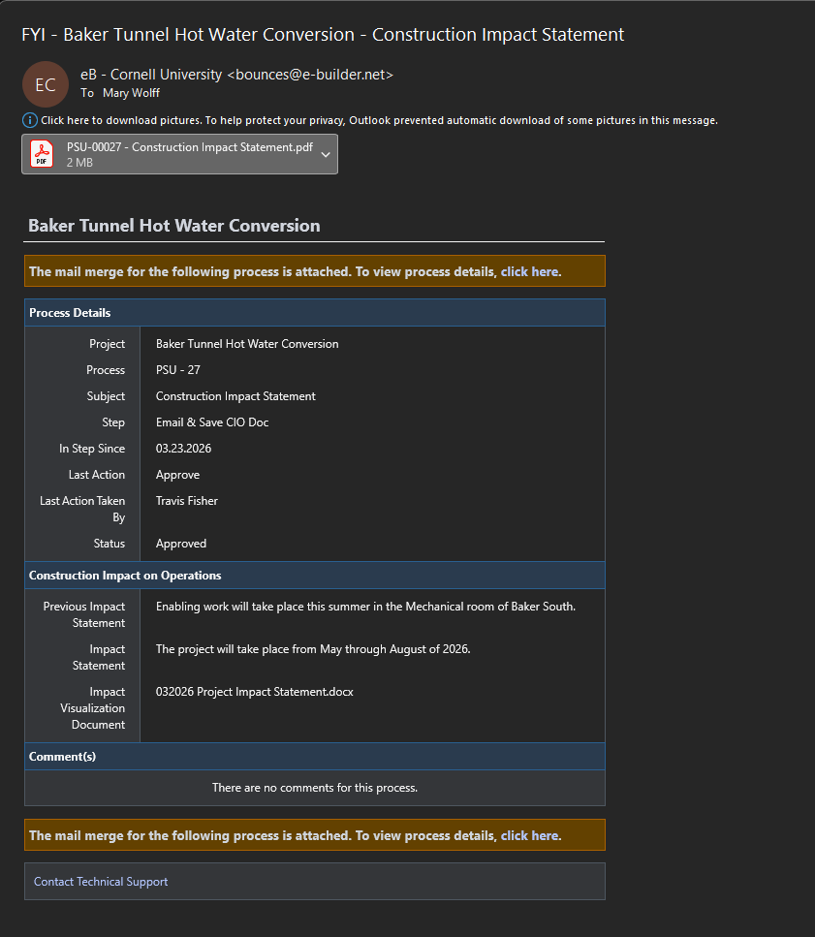
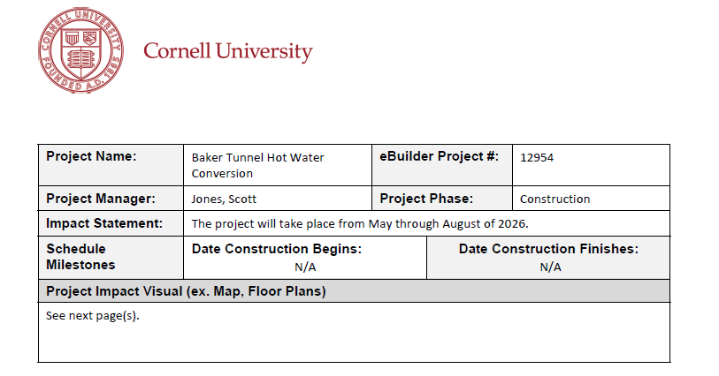
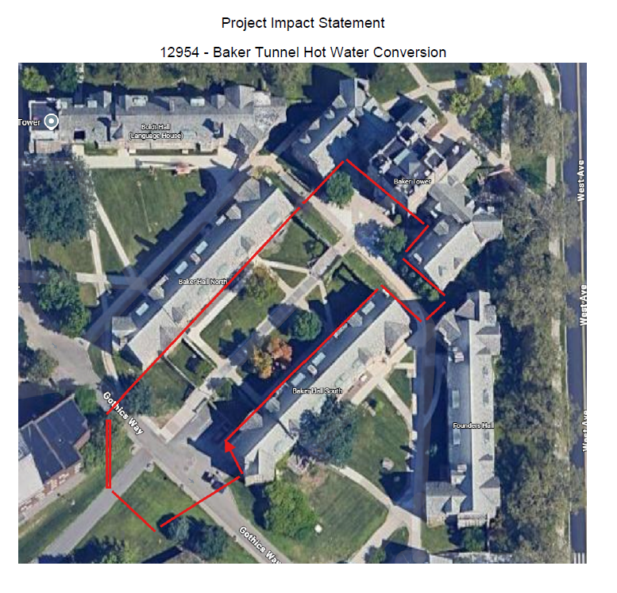
Project Impact Statement Submission
Notes:
FCS Project Impact statement submitted through Trimble come to my inbox once approved by Supervisors (Travis/Paul/Brad etc)
If your project impact layout has changed, please resend an update ASAP

Slide 8
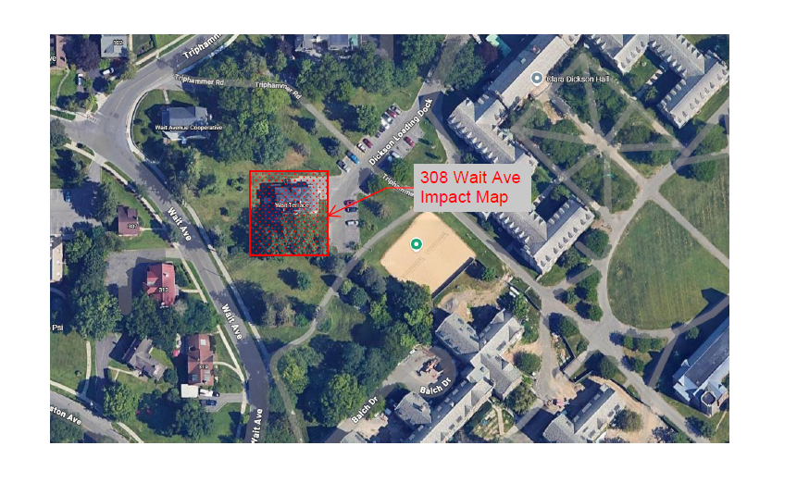
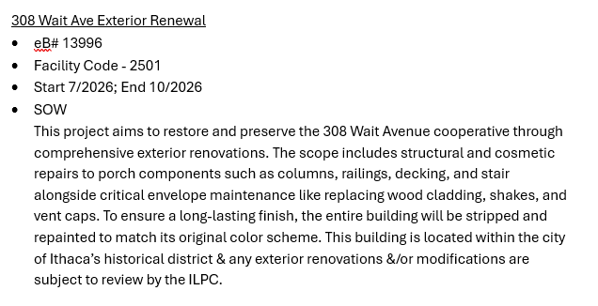
Other Project Impact Statements
Notes:
We are working on creating a connection in trible for folks who are not in FCS E&PM –but in the meantime, if you are not FCS and you know you need to submit a project statement, you can send me an email with a similar rundown of the project
Project Name/Project Manager
Trimble Number (If Applicable)
Impact Start and End dates
Statement of Work/Impact

Slide 9
Final summer project impact statements due
Wednesday April 29th
Notes:
https://fcs.cornell.edu/departments/office-university-architect/maps

Slide 10
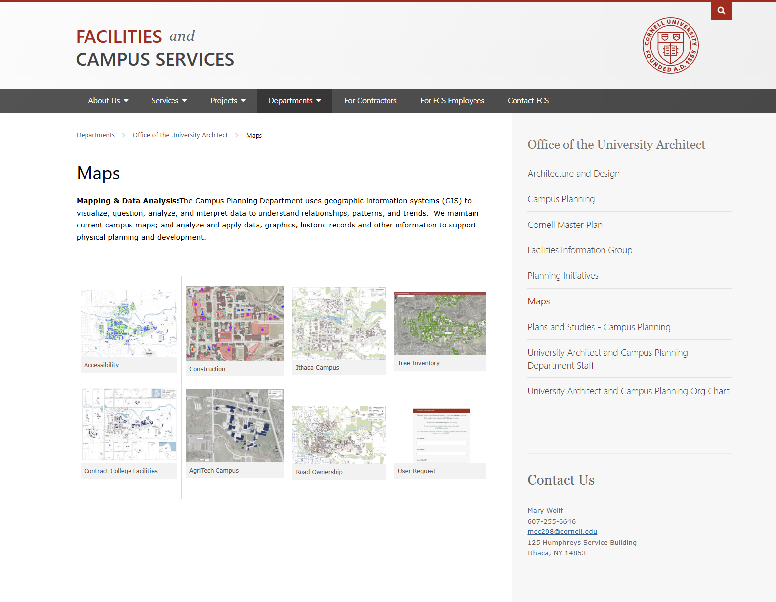
Notes:
https://fcs.cornell.edu/departments/office-university-architect/maps

Slide 11
Keep an eye out for a meeting invite to the 2026 Summer Construction Coordination Meeting – Friday May 1st 10:30am - 12:00 pm
Weill Hall Room 226

