Slide 1
Project Management Professional Development Series
March 26, 2026
Facilities and Campus Services Engineering and Project Management

Slide 2
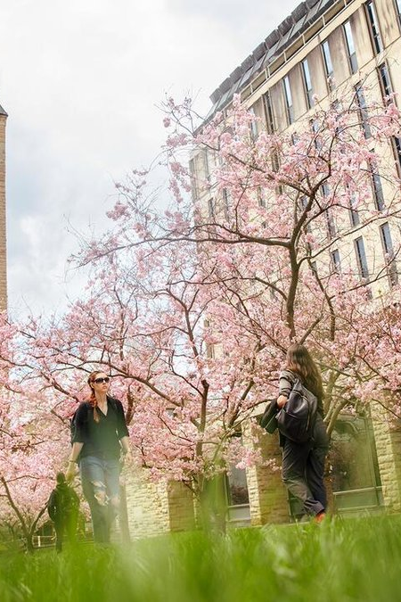
Today’s Agenda
OUA Updates
Mary Wolff and Stella Faye Garber
Abatement Program Changes
Travis Fisher and Brenda Frank
Maintainability Presentation Intro
Erik Eshelman and Matthew Kozlowski

Slide 3
OUA Updates

Slide 4
Abatement Program
Changes

Slide 5
Maintainability Effort

Slide 6
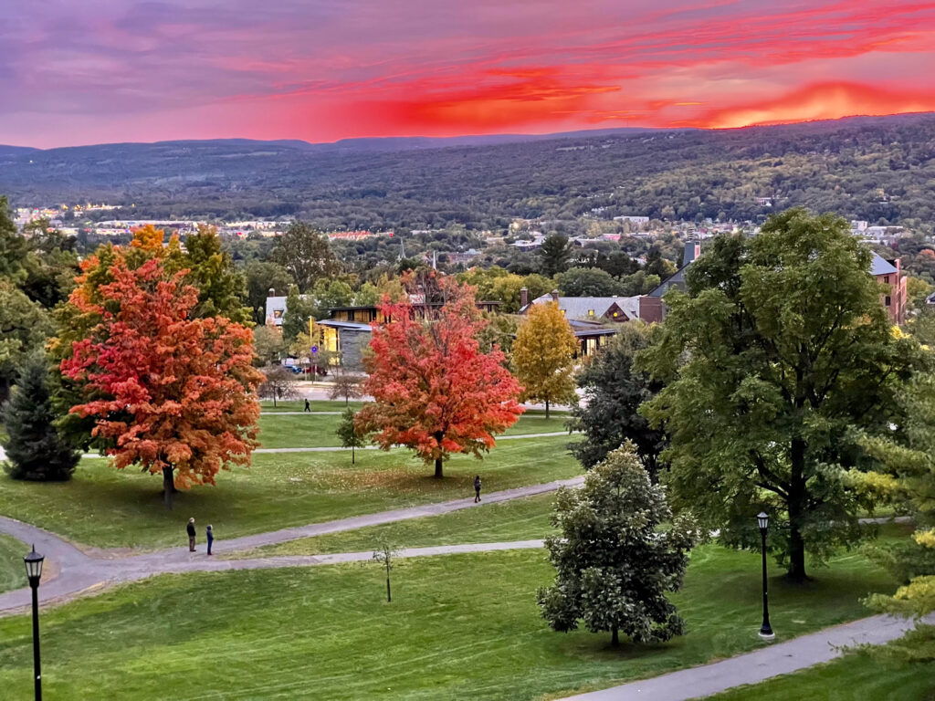
Questions?

