Slide 1
Project Planning Order of Magnitude Budget Template – Project Advocate Budgeting Tool
PMPD
January 29, 2026

Slide 2
Updates to the OMB Template
Implements the Capital Budget Office rounding guidelines
Now calculates order of magnitude (not ETPC) to align with the SPIF
Separates the design and construction amounts for easy input into planning scenarios
Can calculate with a known fixed budget or baseline construction cost
Added guidance
Created separate sheets for SUCF funded projects to break out the SUCF vs. College Contribution costs

Slide 3
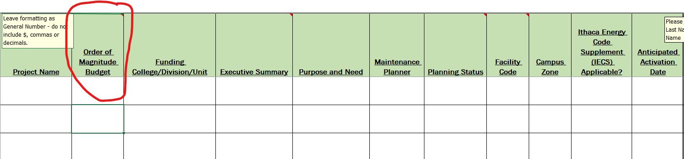
Standard Project Intake Form (SPIF)

Slide 4
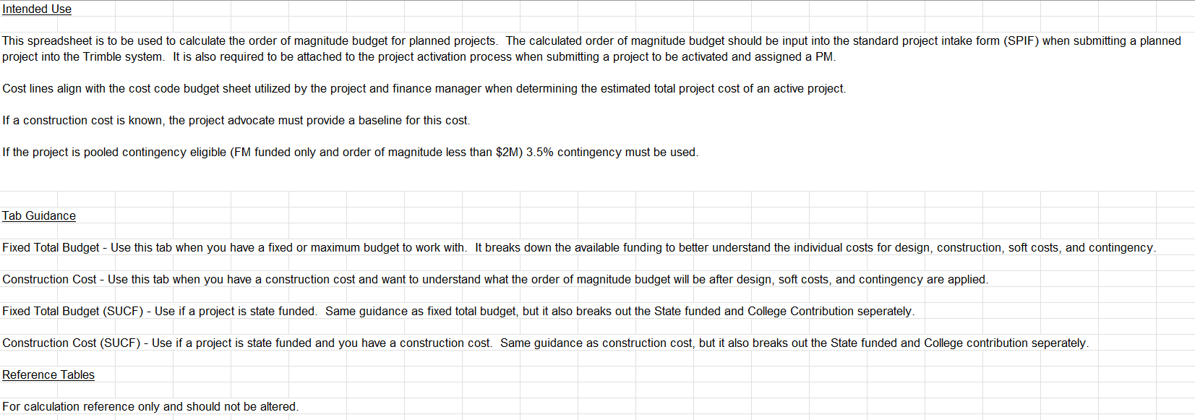
Project Planning OMB Template

Slide 5
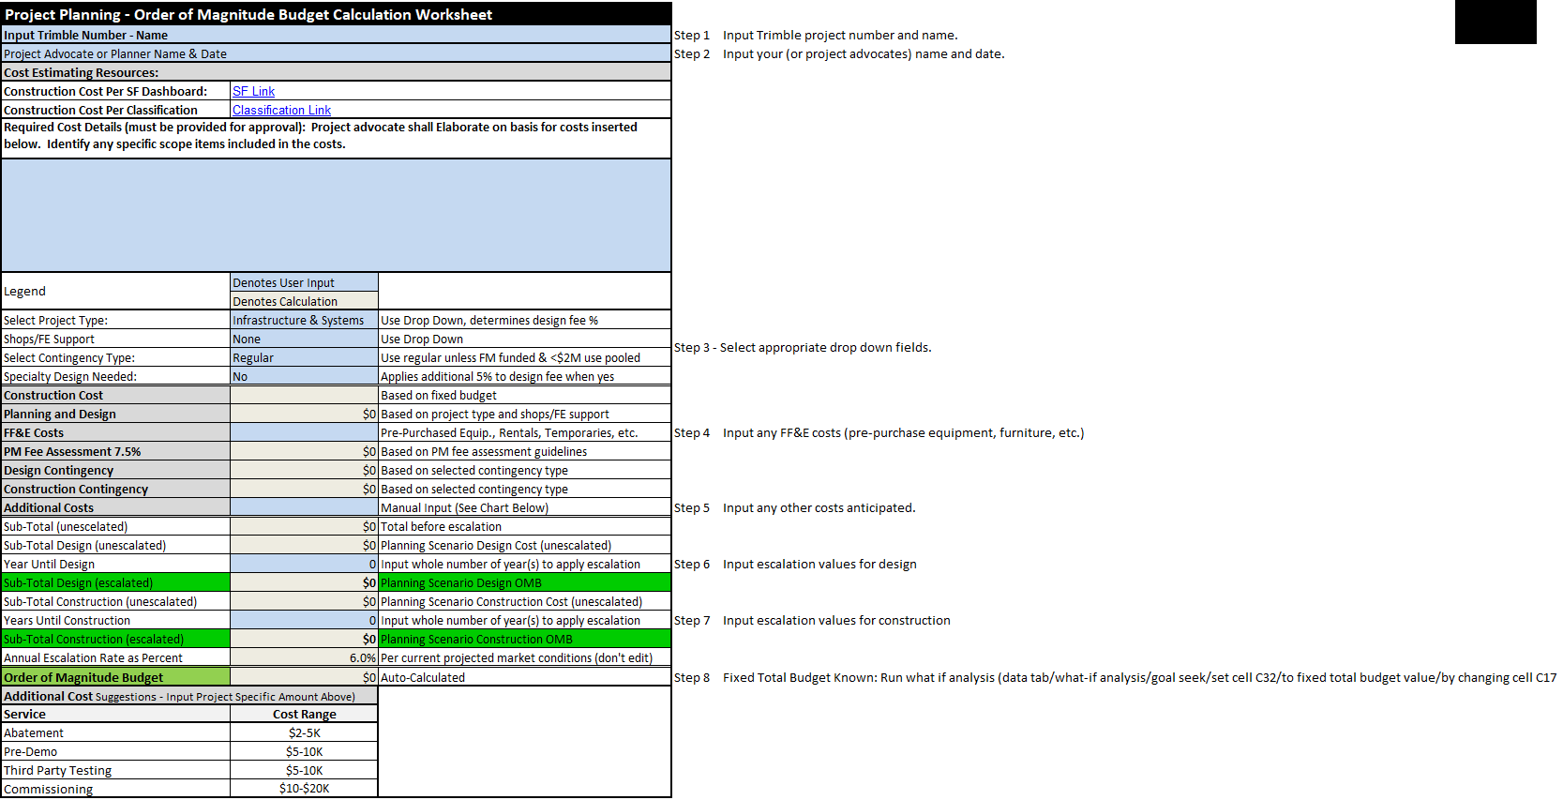
Project Planning OMB Template

Slide 6
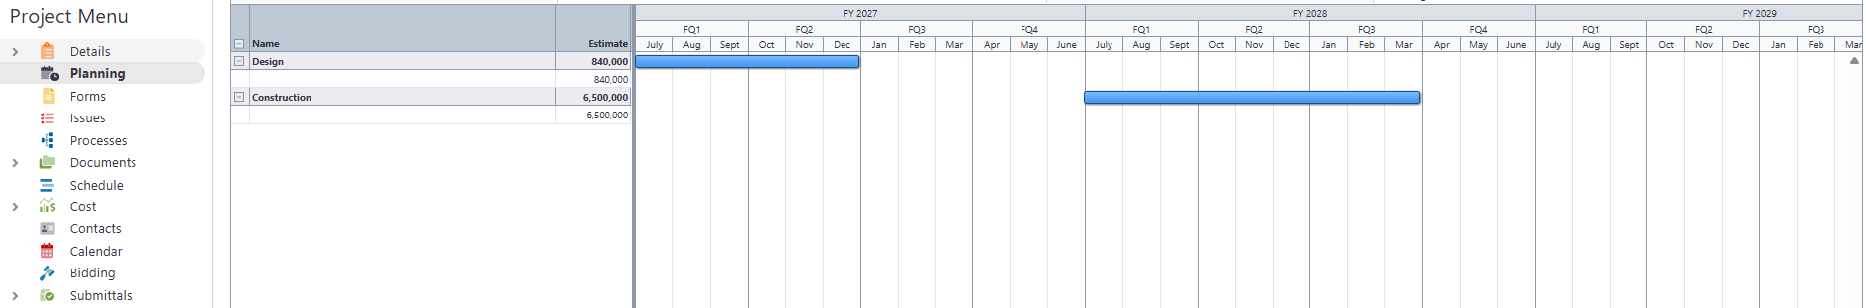
Planning Scenario

Slide 7
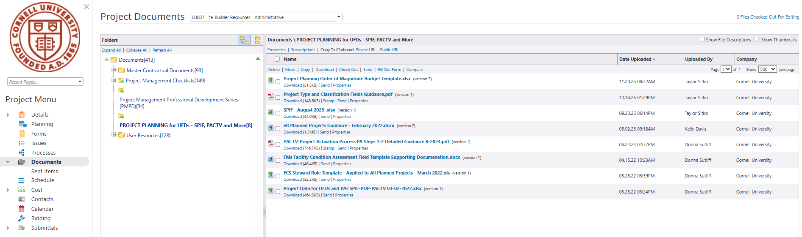
Template Location

