Slide 1
December 2025 Code Update
Michael Niechwiadowicz
Building Code Program Manager, FCS
January 29, 2025

Slide 2
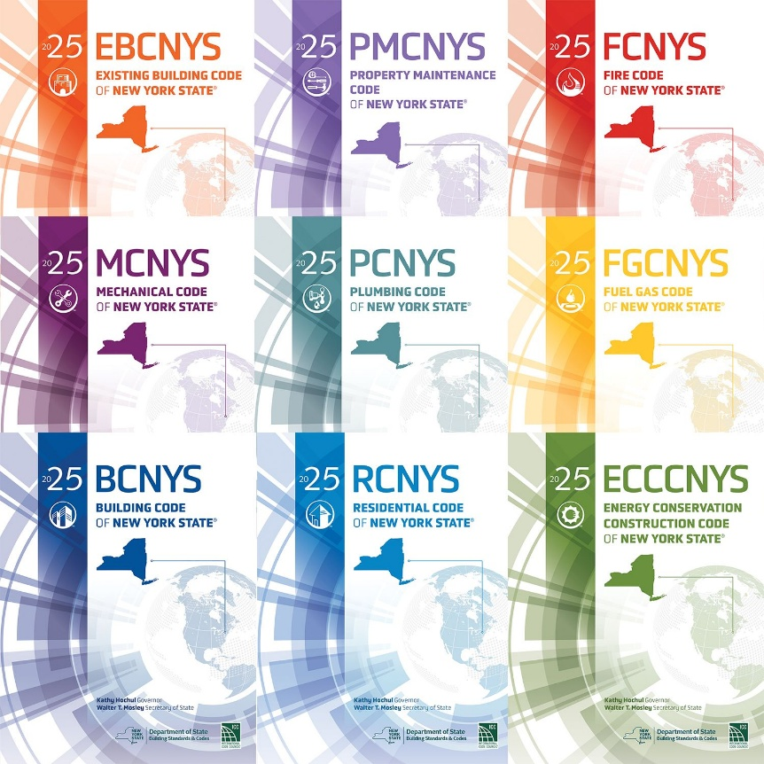
2025 NYS Codes
Adopted October 1, 2025
December 31, 2025 the 2025 NYS Uniform Codes and 2025 NYS Energy Conservation Construction Code must be used.

Slide 3
2025 NYS Codes December Update
Part 1240 Update - https://dos.ny.gov/notice-adoption
NYS Building Standards and Codes Website - https://dos.ny.gov/building-standards-and-codes
Bottom of the page sign up for notifications.

