Slide 1
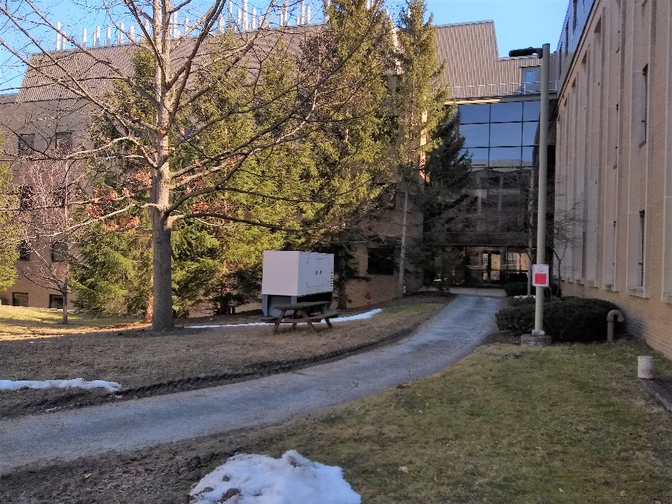
Savage Kinzelberg Generator Replacement Project
Summary: Replace 200-kW genset with a 600-kW genset.
Reason: Existing generator was undersized for the electric
fire pump and couldn’t support proposed lab reno.
Project Team: Eric Nichols – Director of Facilities
Catherine Carlson – Facility Coordinator
Marc Marinchak – Maintenance Planner
Andrew Germain – Project Advocate
Kyle Rouleau – Facility Coordinator
Courtney Van Order – Project Manager
Chris Wayman – Electrical Engineer
Quinn Olsen-Bieber – Structural Engineer
James Tofte – Civil Engineer
Randall Herko – Architect
Rick Hoglund – Welliver Maguire
Brandon Davis – Ferguson Electric
Jordan Wright – Ferguson Electric
Funding Source: FCS Facilities Management (Planned Maintenance)
Original OMB: $2,000,000
Final TPC: $1,300,000 (Estimate $100K under budget)
Est. OPC: $1,221,574
Actual Bid: $1,119,700
Est. const
schedule: February 2025 – November 2025
Actual const
schedule: February 2025 – November 2025
Photo of existing generator

Slide 2
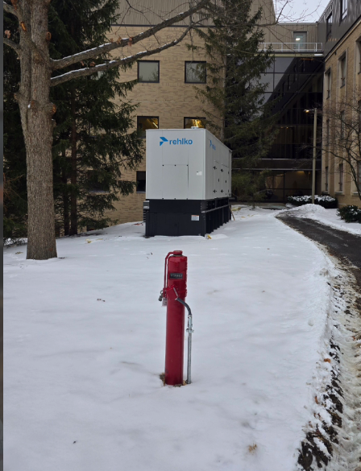
Key Challenges / Decisions
Coordination between different projects and design teams
Coordination with Stakeholders:
College of Human Ecology (CHE)
Cornell Grounds
Cornell Utilities
Cornell Facilities Management
Cornell EHS
Office of the University Architect
Siting the generator (aesthetics, softscape, building users)
Finding space for the new electrical distribution equipment
Determining how to service and refuel the new generator
Unforeseen circumstances (Newman Lab underground mech space)
Finding a new home for the filing cabinets in the electric room
Coordination to park a large crane for 2 picks
Code deficiencies (relocating a PIV that was too close to the building)
Discovered half of the Kinzelberg EM lights and exit signs were not connected
to genset
Lessons Learned \ Key Takeaways
Need to look more closely at site logistics (shoring, logistics, staging)
Achievements
We saved the white oak tree
Multiple code violations found and fixed
Project was completed on time and under budget
Photo of new generator

Slide 3
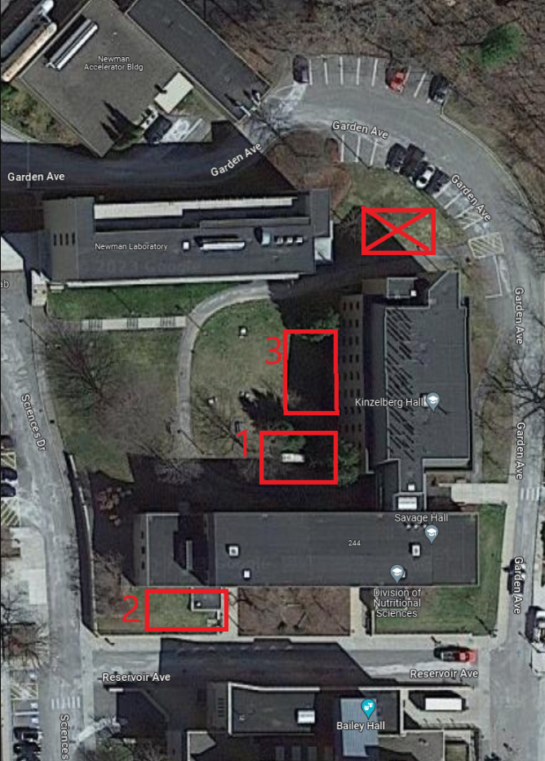
Location Options

Slide 4
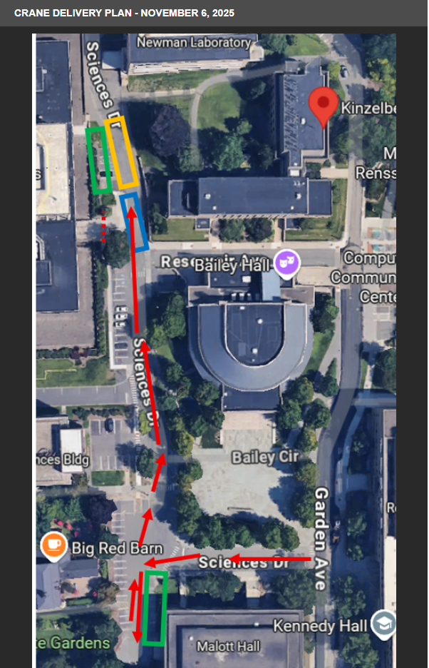
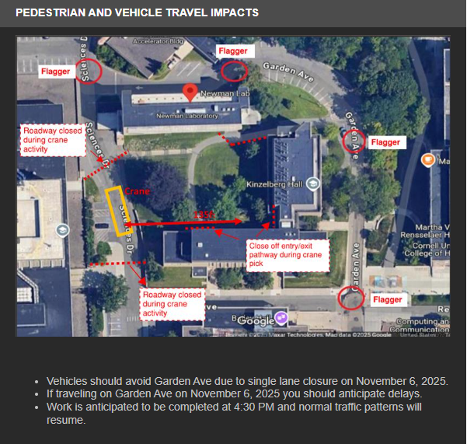
Constant Contact

Slide 5
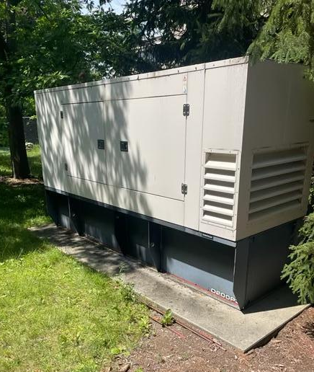
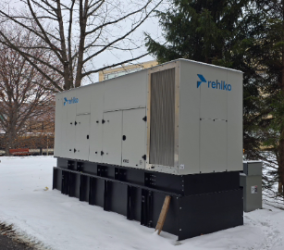
Construction Photos

Slide 6
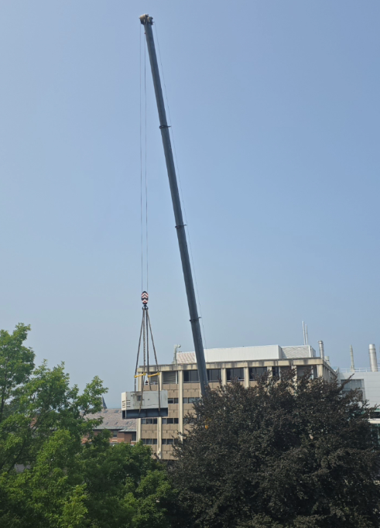
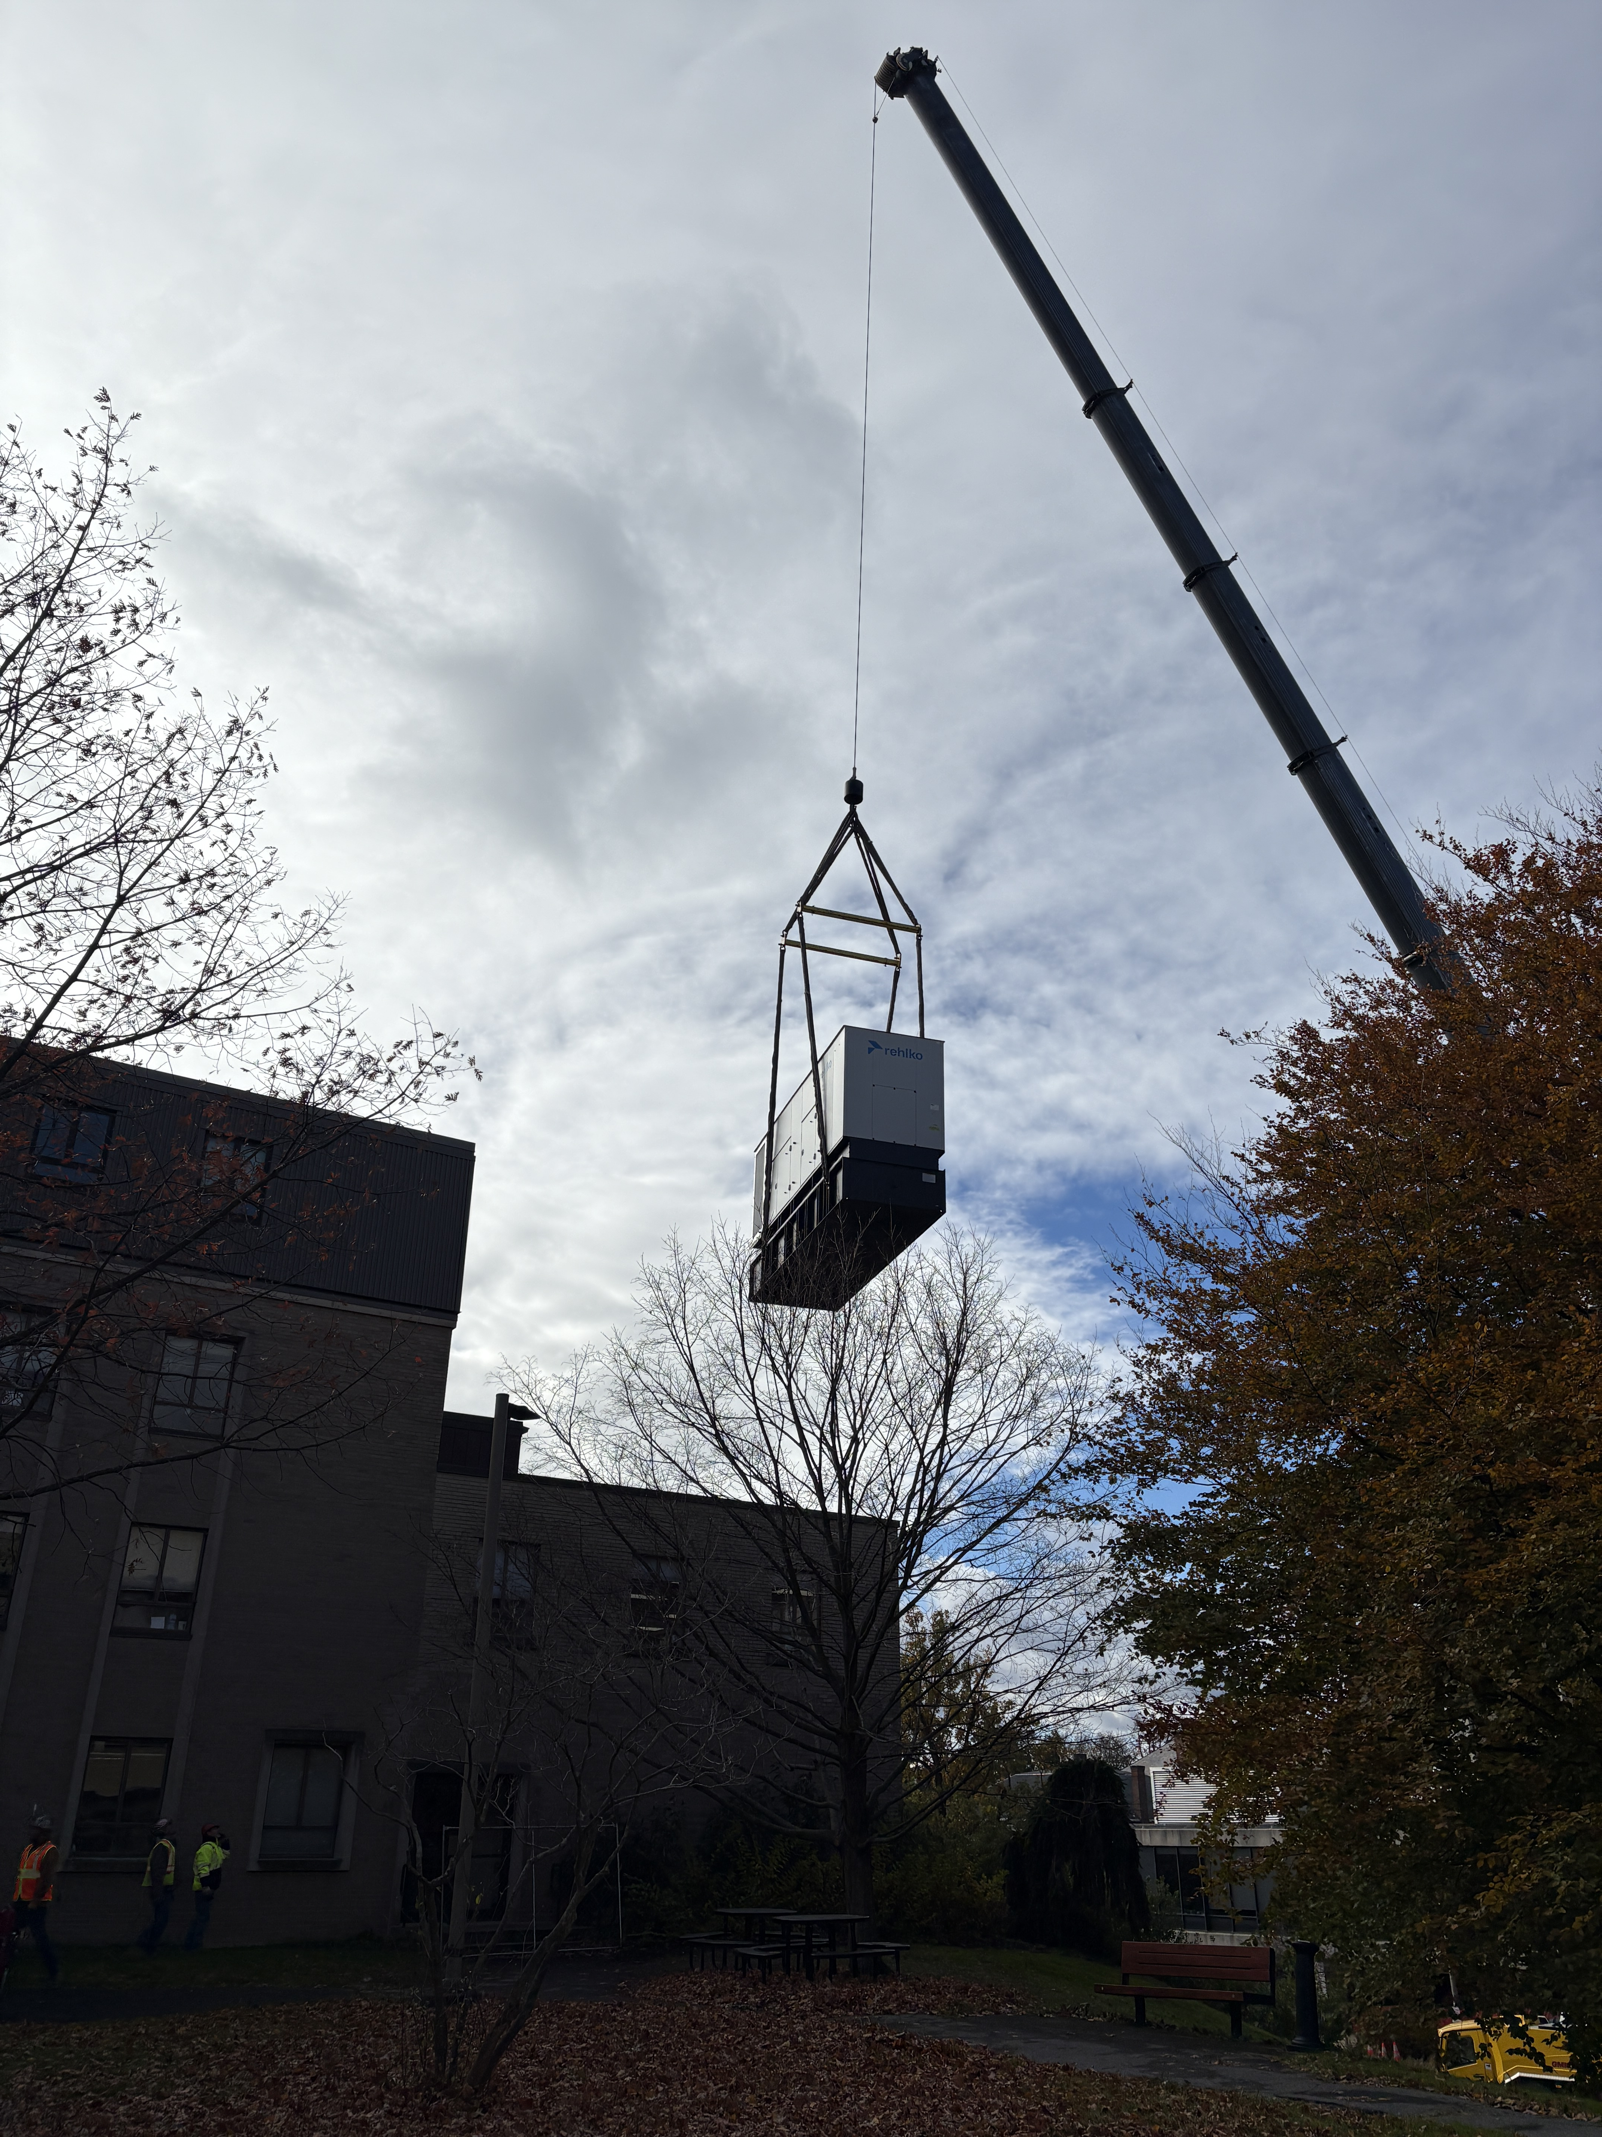

Slide 7
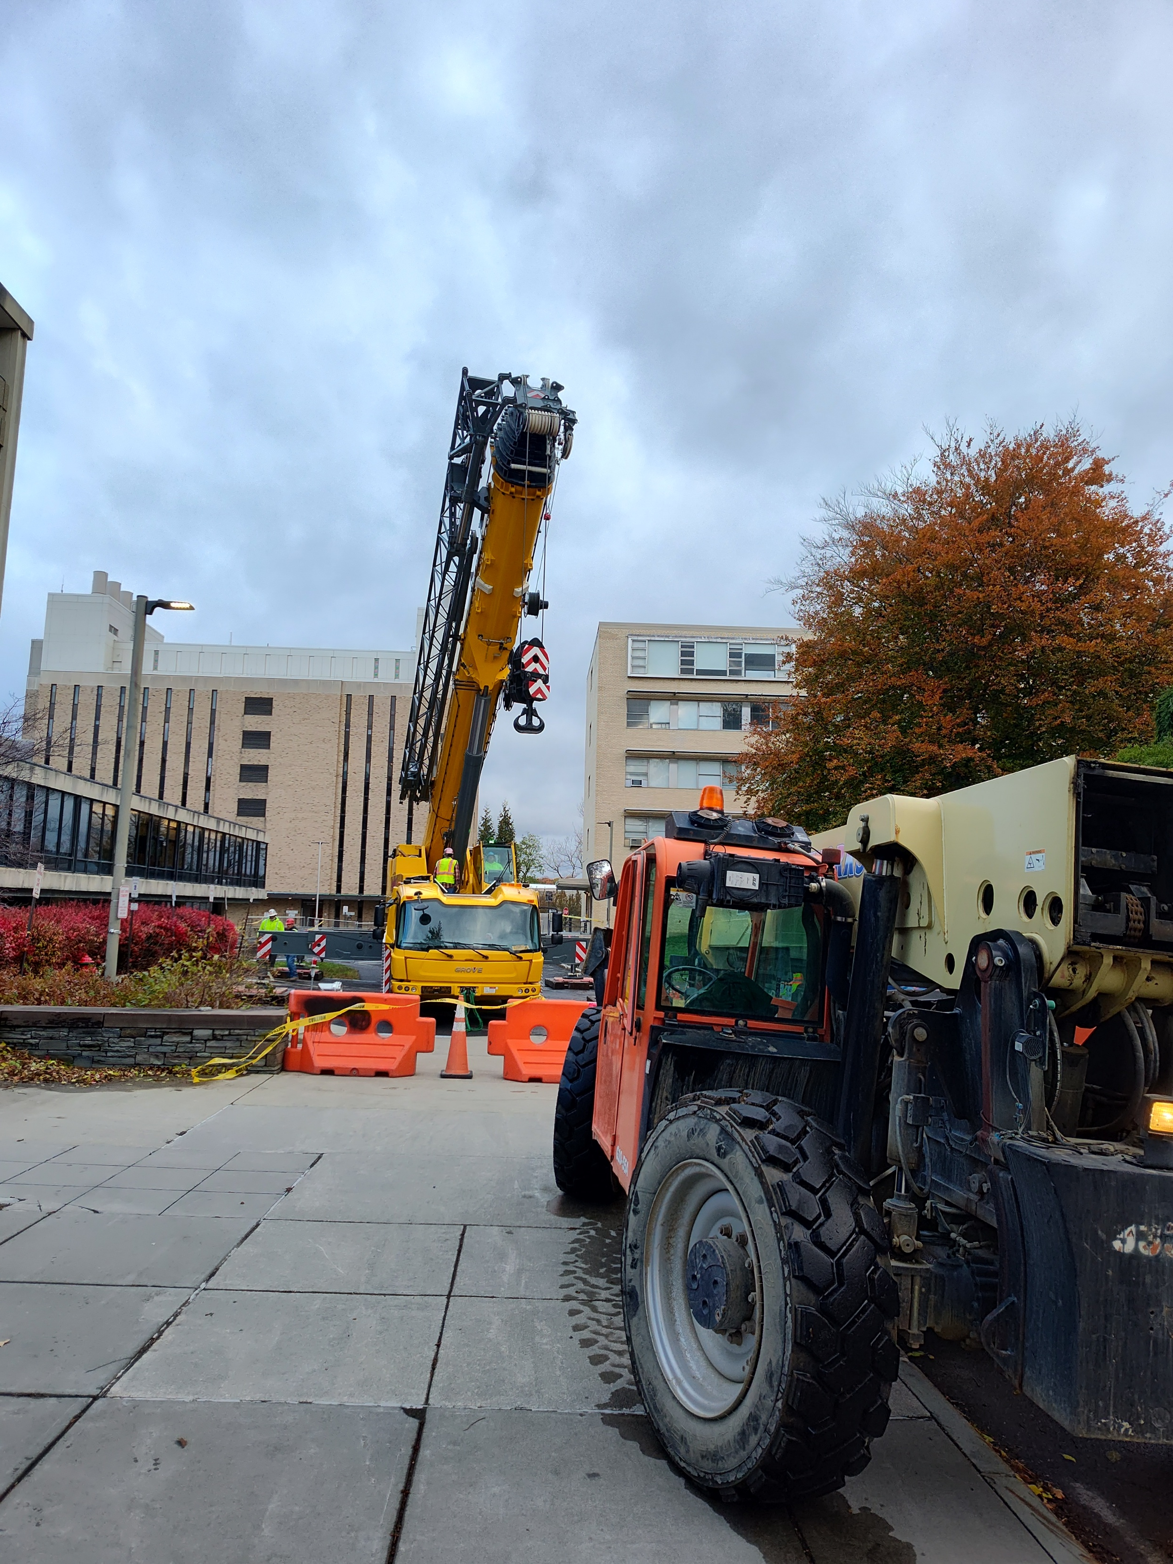
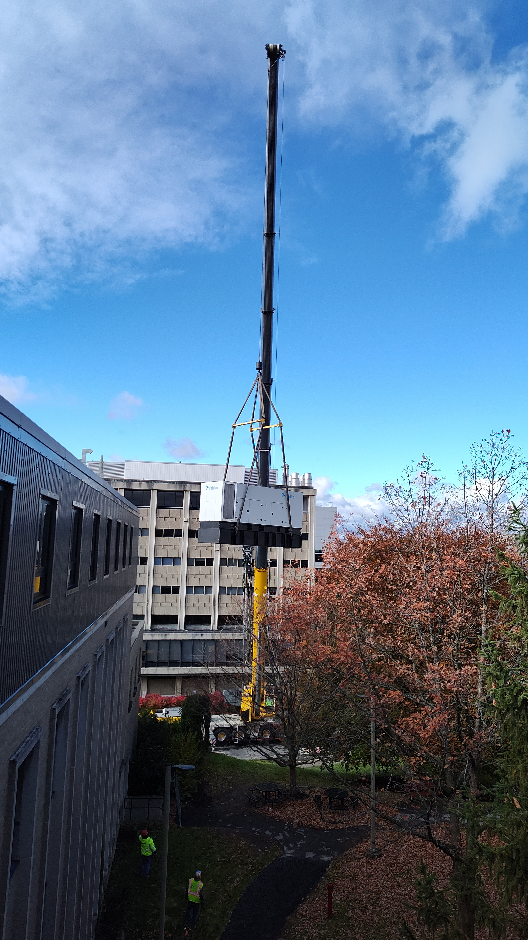
Construction Photos

