Slide 1
Project Management Professional Development Series
January 29, 2025
Facilities and Campus Services Engineering and Project Management

Slide 2
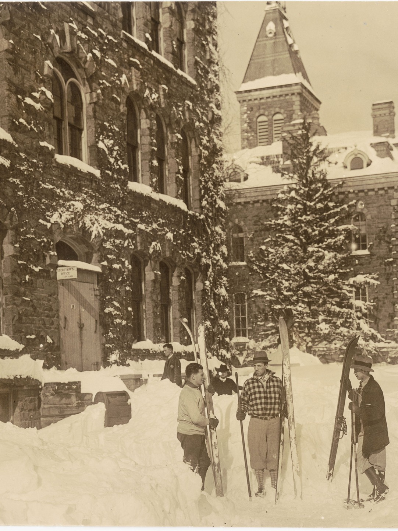
Today’s Agenda
Code Update
  Mike Niechwiadowicz
Updated Planning Cost Estimate Sheet
  Travis Fisher
Kinzelberg Generator Project Spotlight
  Courtney Van Order

Slide 3
Code Update

Slide 4
Updated Planning Cost
Estimate Sheet

Slide 5
Kinzelberg Generator Project

Slide 6

Questions?

