Slide 2
Environmental Permitting in Projects
Do’s
Don’ts
Include the environmental compliance group (ECG) in the RFP process.
Read the guidance documents in the PM resources
Ask all the questions, forward any environmental permit related discussions to ECG
Hold contractors and consultants accountable
Wait until CD’s to involve ECG/EHS
Assume consultants or designers understand or are familiar with all of CU’s environmental permits and obligations.
Hide environmental issues that come up during a project or wait to make ECG aware of an issue

Slide 3
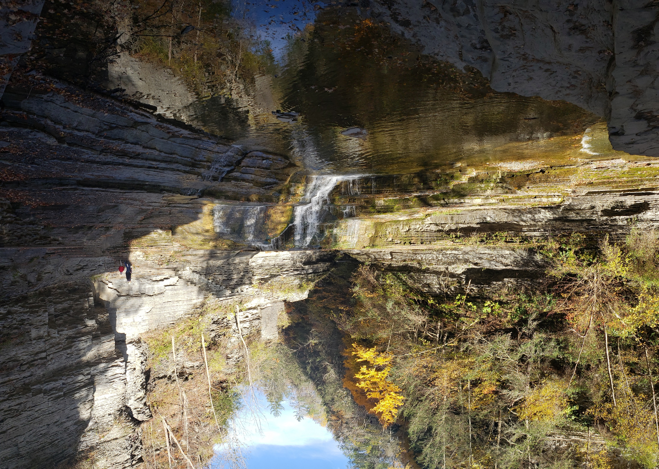
“SPDES”
State Pollution Discharge Elimination System
Cornell University Water Compliance Program Management

Slide 4
SPDES Permits
General
NEW or Renewed 2025 Permits
Concentrated Animal Feed Operations (CAFO)
Municipal Separate Storm Sewer System (we don’t directly have this permit, but have agreements or are regulated by the MS4) *renewed in 2024
Management of Invasive Species (renews in 2026)
Stream Disturbance (renews in 2026)
Freshwater Wetlands
Solar Photovoltaic Projects
Utility Right of Way
Septic Systems Private – Commercial – Industrial (PCI) –Renewed with new requirements
Construction – renewed with new requirements

Slide 5
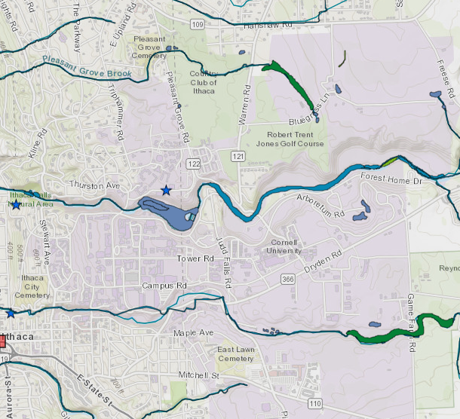
Protection of Waters
Cornell University Water Compliance Program Management

Slide 6
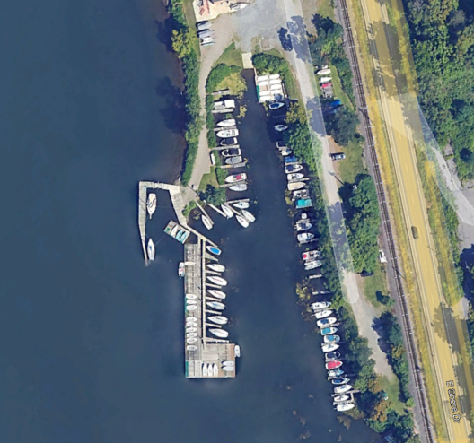
Protection of Waters
US Army Corps of Engineers
If your project will place any object into a body of water, it will require an USACE permit.
  (this includes some federally protected wetlands)
Nationwide permits (NWP) determinations have the least lead time and are more easily approved. *Blanket WQC by DEC
  All permits will need renewed for 2026, if your facility or project has one of these permits or verifications, please contact me. USACE is backed up because of the government shut down.

Slide 7
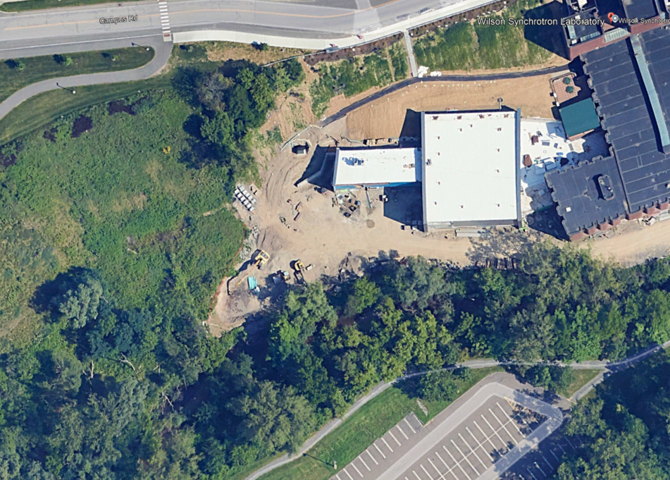
Protection of Waters
NYSDEC
Wetlands permitting has become more stringent and nuanced in 2025 in New York State. Please see October 2025 PMPD.
Stream Disturbance permits are required if working in Fall Creek (Class A water body) and other locations depending on time of year and type of disturbance

Slide 8
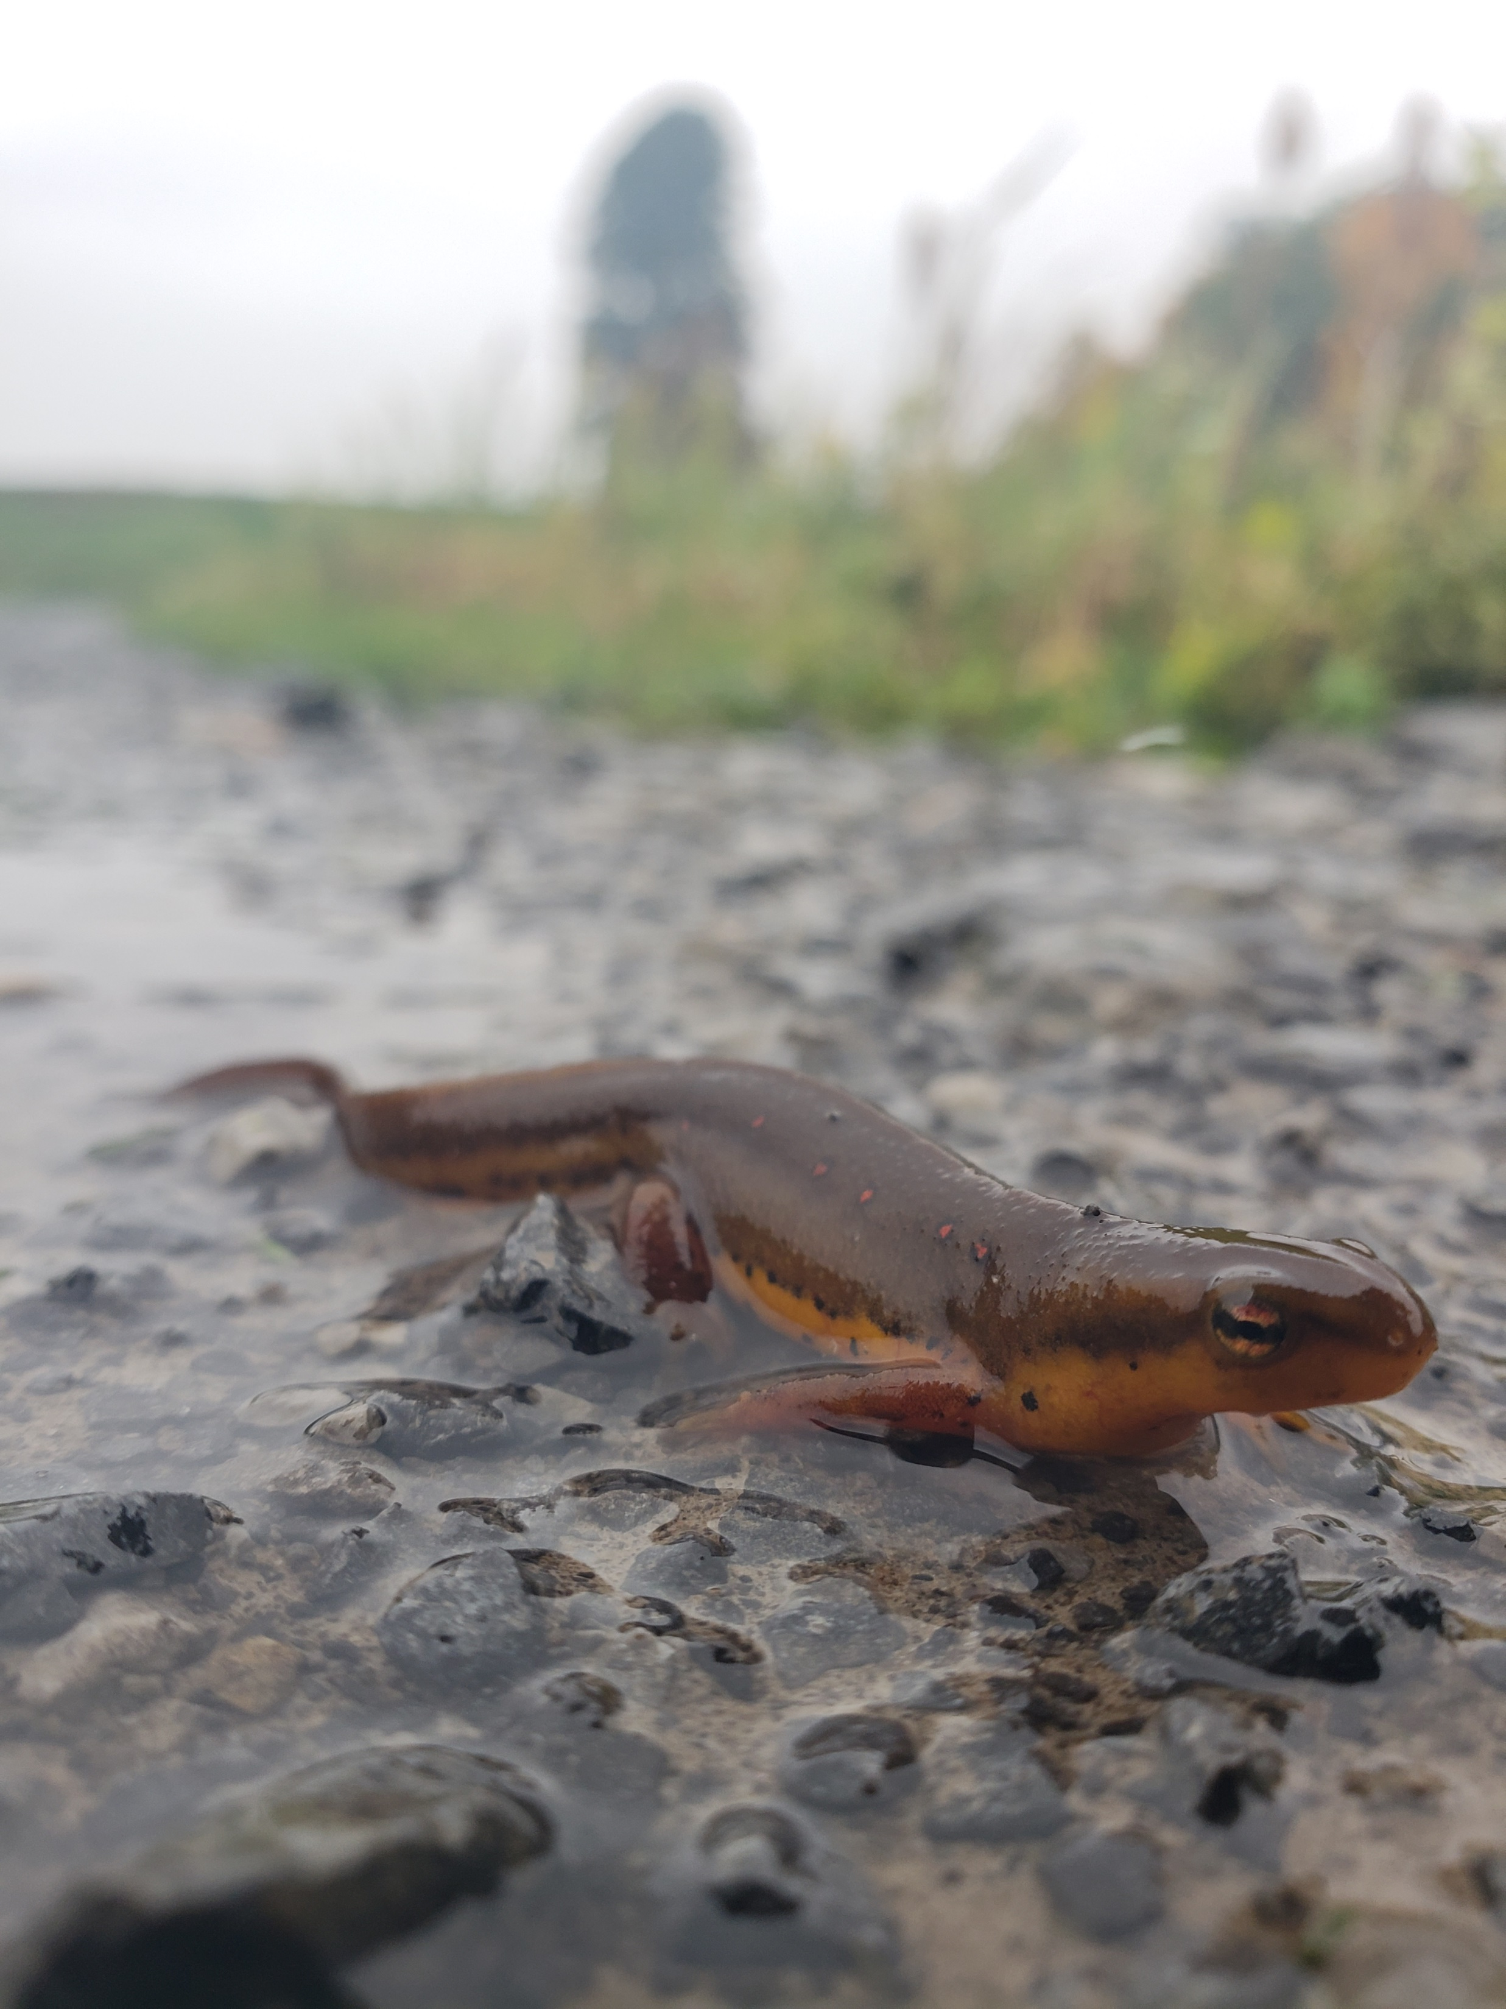
Stormwater Compliance Management
Cornell University Water Compliance Program Management

Slide 9

If your project is going to require any ground disturbance…
NYSDEC Definition: Construction Activity(ies) - means any clearing, grading, excavation, filling, demolition or stockpiling activities that result in soil disturbance. Clearing activities can include, but are not limited to, logging equipment operation, the cutting and skidding of trees, stump removal and/or brush root removal. Construction activity does not include routine maintenance that is performed to maintain the original line and grade, hydraulic capacity, or original purpose of a facility.
…make sure you have the appropriate Erosion and Sediment control plan or Stormwater Pollution Prevention Plan (SWPPP), and make sure to check the Wetlands JD Letter Coverage.

Slide 10
Four Stages of Stormwater Compliance
Design
NYSDEC Stormwater Design Manual
Construction
NYSDEC Erosion and Sediment Control Standard
Post Construction
NYSDEC Stormwater Design Manual
Redevelopment
SWPPP
NYSDEC Maintenance Manual
MS4 Operation and Maintenance Agreements
Previously developed SWPPP
Local MS4 Codes
NYSDEC SPDES Construction General Permit
Local MS4 Codes
Create SWPPP
CU Design Standards
SWPPP
👨‍💼 Project Mgmt.
📋 Facilities Eng.
✍️Contracts
💲 Finance
🗺️Architecture &
Planning
🛠️Utilities & Grounds
💧 EHS
⚖️Counsel
👨‍💼📋✍️💲🗺️🛠️💧⚖️
👨‍💼📋🗺️🛠️💧
✍️💲🛠️💧 ⚖️
👨‍💼✍️💧⚖️
Notes:
Reiterate that the SWPPP carries through the whole process and is very important
Each step relies on the previous

Slide 11
Stormwater Compliance Regulations
Construction
Post Construction – MS4
  NYSDEC Construction Permit Town of Ithaca Erosion and Sediment Control Plan, Basic SWPPP, or Full SWPPP
  NYSDEC Design Standards *Updated in 2024
  Erosion and Sediment Controls
  Weekly Inspections by a Qualified Inspector
  NYSDEC Stormwater Construction Toolbox
Operation and Maintenance
Documentation of Maintenance Activities
Reporting of Maintenance activities
NYSDEC Stormwater Management Practices Maintenance Guide

Slide 12
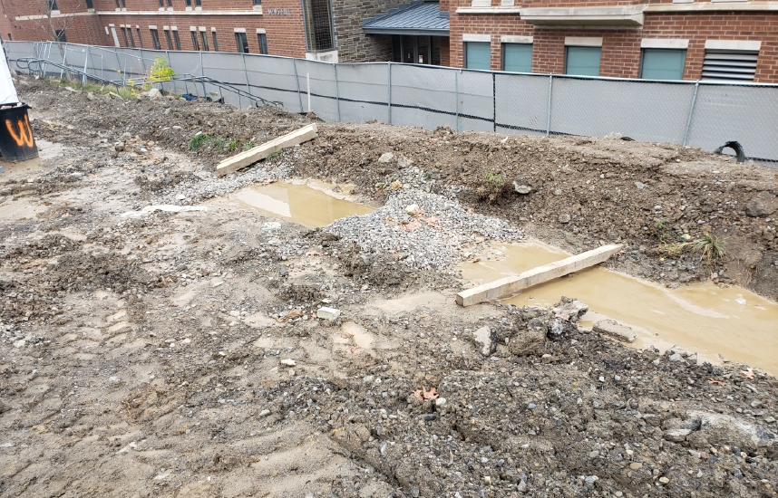
Stormwater Pollution Prevention Plan (SWPPP)
SWPPP requires design by a NYS Certified P.E.
Design per NYSDEC Stormwater Design Manual
Erosion and Sediment Control Plan for Construction Phase
O&M Plans for Permanent structure
Legally binding contract for the University
*EHS does not sign for owner/operator
Required for following disturbances
  1 acre statewide
  10,000 sq ft of additional impervious in TOI
  ½ acre of additional impervious in COI
Properly designed and maintained check dams in an E&S control
prevent sediment from being transported off of the construction
site during a heavy rain event.

Slide 13
NEW FOR 2025
As built records of all permanent practices, including operation and maintenance plans, must be submitted an in place to close the project with a Notice of Termination
Any Deficient item on an inspection report must be corrected within 5 days
“Phasing” is better defined. Any project that results in 1 acre of disturbance or more, even when different areas are disturbed through “phases” will trigger SWPPP requirements.

Slide 14

Important understandings during construction
Any project over 1 acre requires weekly stormwater inspections by a CPESC or PE, or inspector under a PE
The contractor must perform daily site inspections of Erosion and Sediment Controls and the person doing inspections must be certified…not just the owner of the company!!
Construction sequencing is a regulated activity – if a permanent stormwater control is installed out of sequence, the practice may need completely reinstalled before a Notice of Termination (NOT) can be submitted.

Slide 15
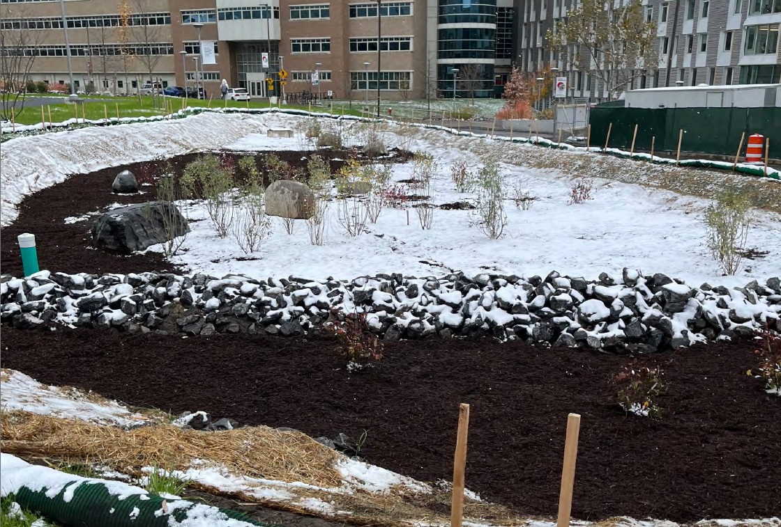
Gold Star Project - CIS
Huge thank you and kudos to Patrick Conrad and Adam Heisler for their engagement with ECG for stormwater compliance!
Inclusion throughout design, direct communication with civil design consultant
Great construction management of sequencing and stabilization throughout construction.
Communication throughout of issues, follow-up and accountability

Slide 16
Cornell EHS Resources

Slide 17
Water Program Resources
University EHS Resources
DEC and USACE
  Kara Bugis, PE, Water Compliance Specialist
    kmb388@cornell.edu
    724-840-8230
  Derek Franklin, CPESC, Hazardous Materials Associate
    dmf239@cornell.edu
    607-793-1351
Stormwater Inspection System (electronic)
CUEHS Water Compliance Program Webpage
SOP’s and Guidance Documents
Industrial Wastewater Design Manual
Stormwater Toolbox
USACE and NYSDEC Joint Permit Application and Instructions
USACE NWP – Buffalo Branch
Environmental Resource Mapper

