Slide 1
Project Charters: The Foundation of Successful Projects
Why project managers should embrace and master the project charter
PMPD Presentation
November 12, 2025

Slide 2

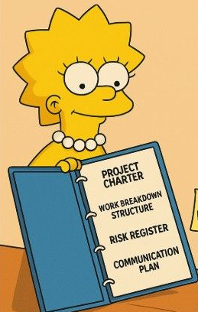
Project Charters
Step #1 in Managing a Successful Project
COMPLETE THE PROJECT CHARTER!!

Slide 3
Project Charters
What is a Project Charter?
Definition: A formal document that authorizes a project, outlining its objectives, scope, stakeholders, and high‑level requirements.
Purpose: Serves as a reference throughout the project lifecycle for alignment and accountability.
Alignment Tool with sponsors, advocates, and stakeholders
Analogy: Think of it as the “birth certificate” of the project — it officially declares the project’s existence.

Slide 4
Project Charters
Session Objectives
Understand the role and value of a project charter
Learn the components of our specific template
Identify best practices for gathering information

Slide 5

Project Charters
Benefits to Project Managers
Establishes PM decision-making authority
Stakeholder buy-in: Facilitates early agreement,
reducing conflicts
Risk reduction: Early identification of potential
constraints, assumptions, and risks.
Serves as a baseline to manage changes

Slide 6
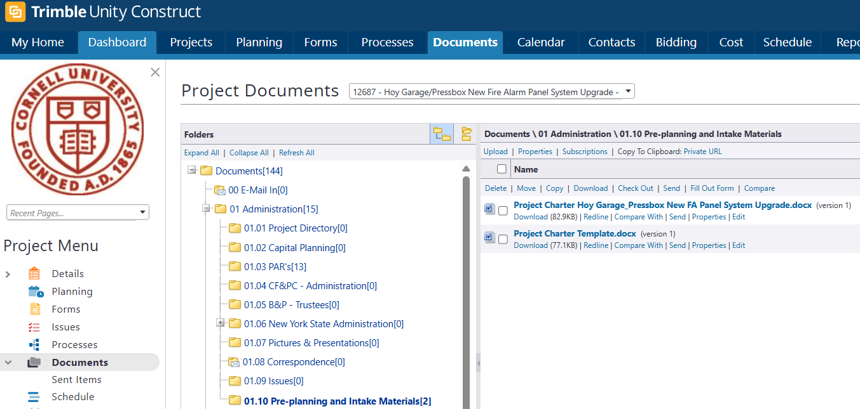
Project Charters
Where is the template?
Template is automatically loaded into your Trimble project when assigned, can be found in the Documents module, 01 Administration, 01.10 Pre-planning and Intake Materials Folder

Slide 7
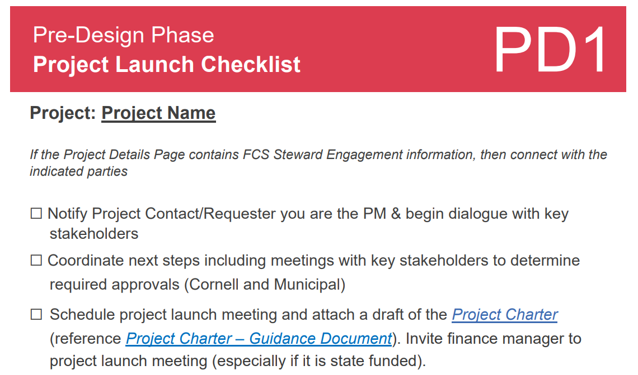
Project Charters
Where is the template?
A link to the project charter can be found in the FCS PM Checklist PD1 Project Launch Checklist.

Slide 8
Project Charters
Step #1 in Managing a Successful Project
COMPLETE THE PROJECT CHARTER!!

Slide 9
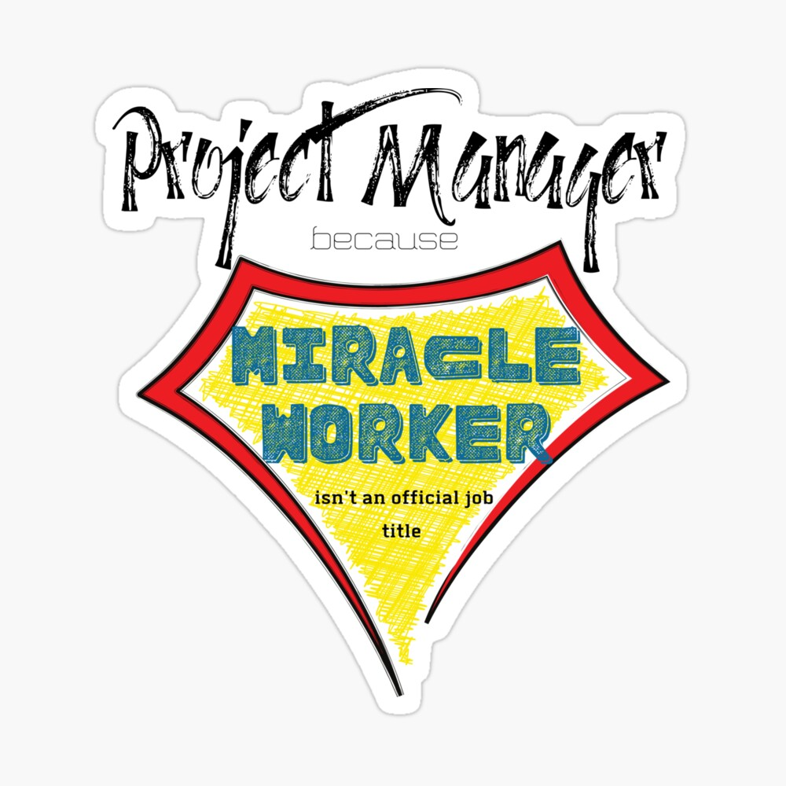
Project Charters
Best Practices
Populate using information provided by the project advocate in the PACTV process
Engage stakeholders before drafting – Use as your design kickoff meeting agenda
Keep language clear and specific
Get sign-off from all approvers before moving to planning/execution
Use the charter as a living agreement—not a shelf document
Reference for RFP’s and FPARS’s

Slide 10
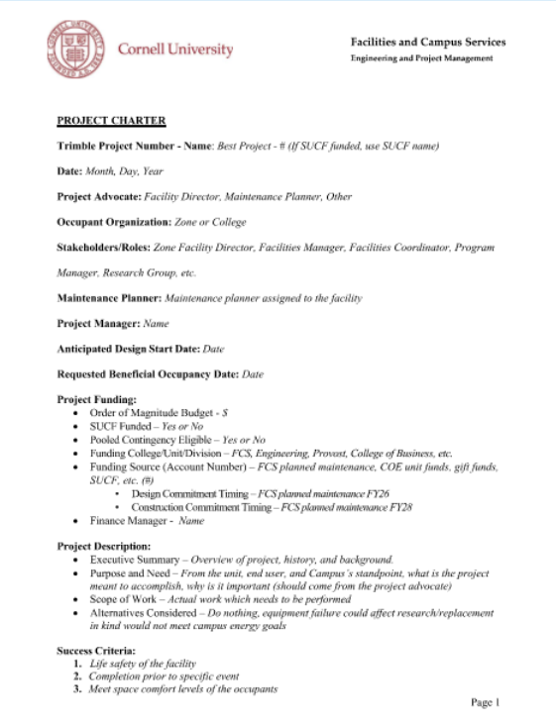
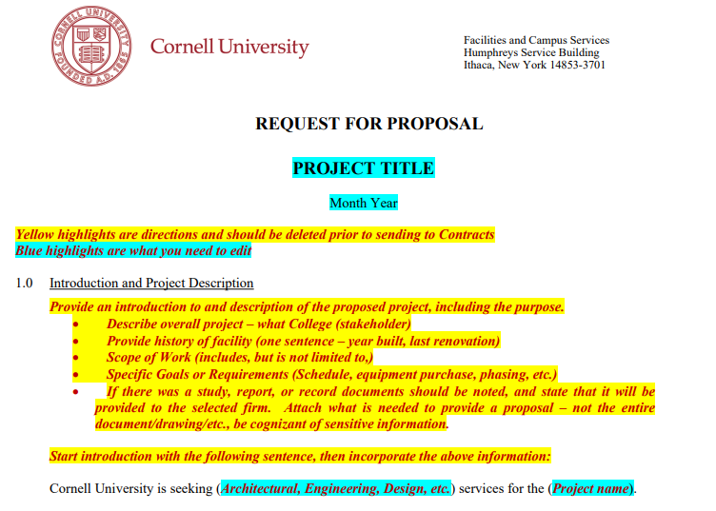
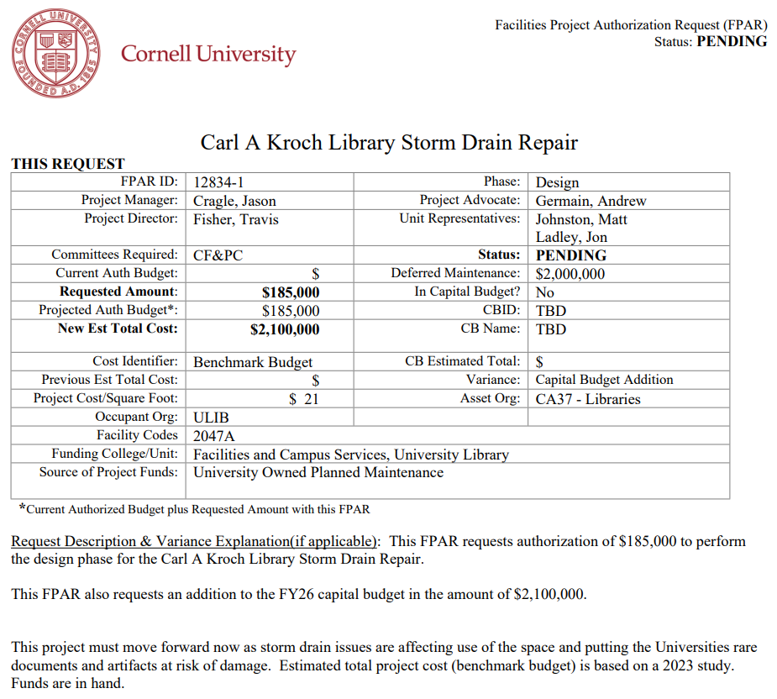
Project Charters

Slide 11
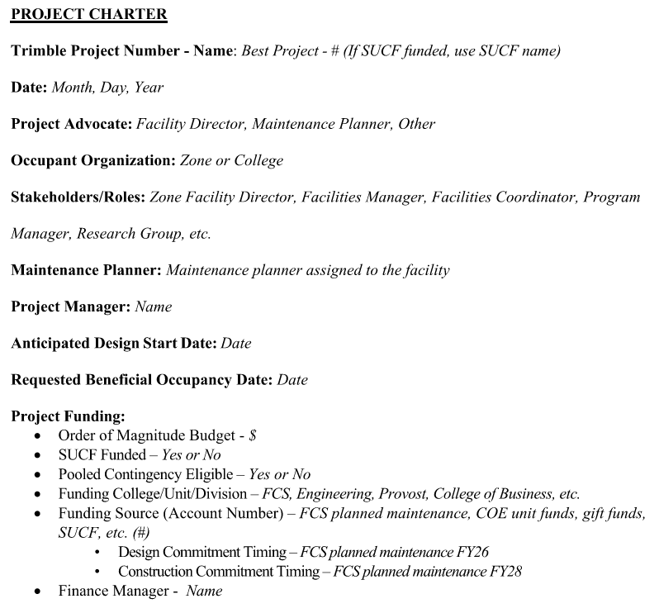
Project Charters
Trimble Data
Start of Communication Plan
PACTV
Engage finance early

Slide 12
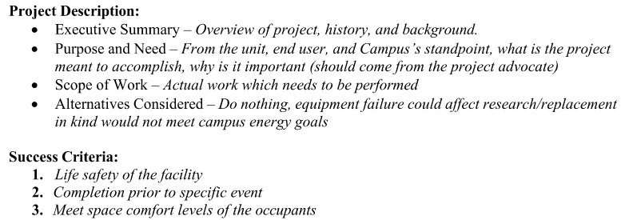
Project Charters

Slide 13
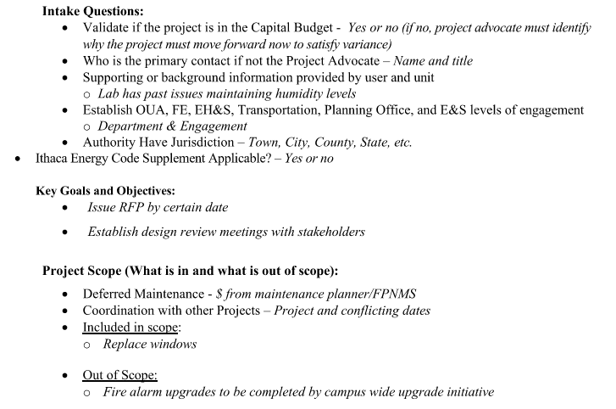
Project Charters

Slide 14
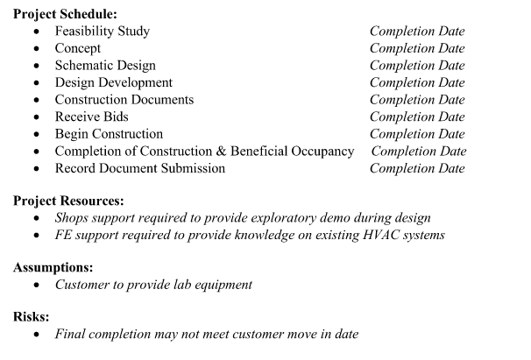
Project Charters
Slide into your RFP

Slide 15
Project Charters
Step #1 in Managing a Successful Project
COMPLETE THE PROJECT CHARTER!!

Slide 16
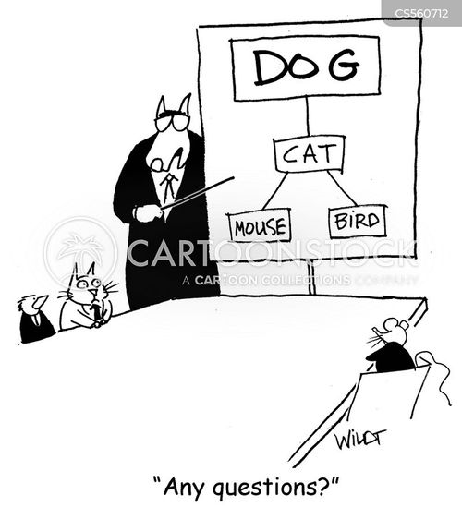
Project Charters

