Slide 1
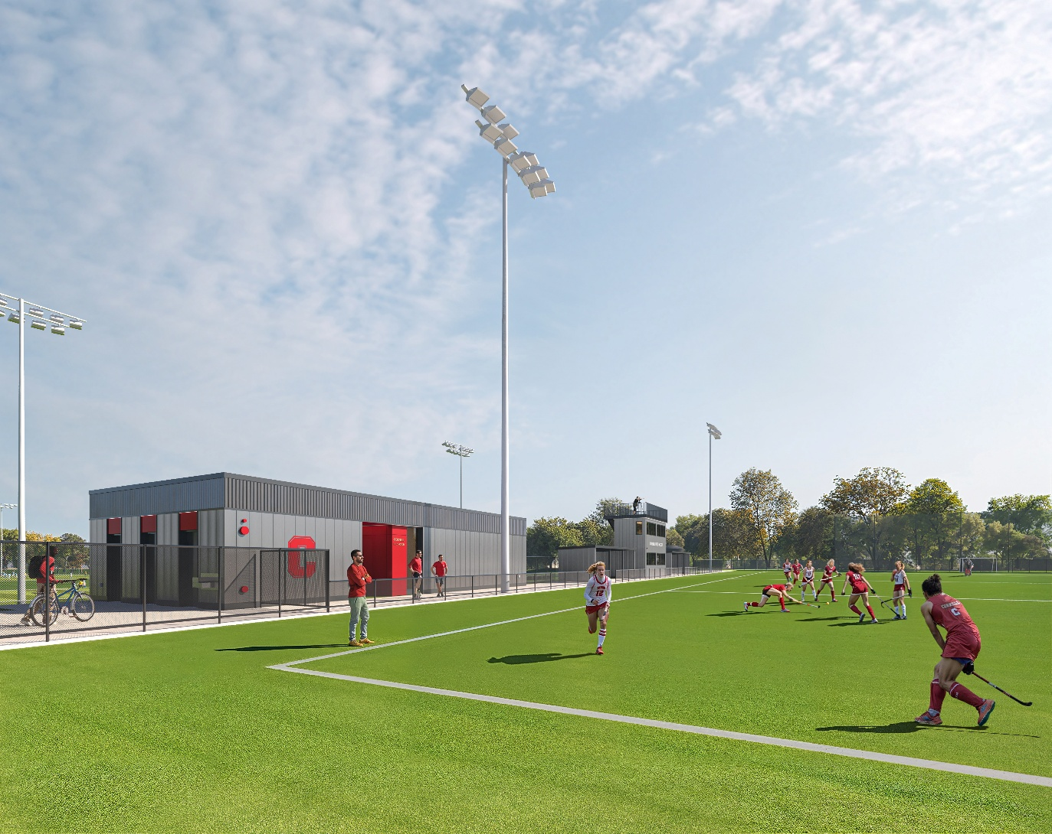
New Marsha Dodson Field

Slide 2
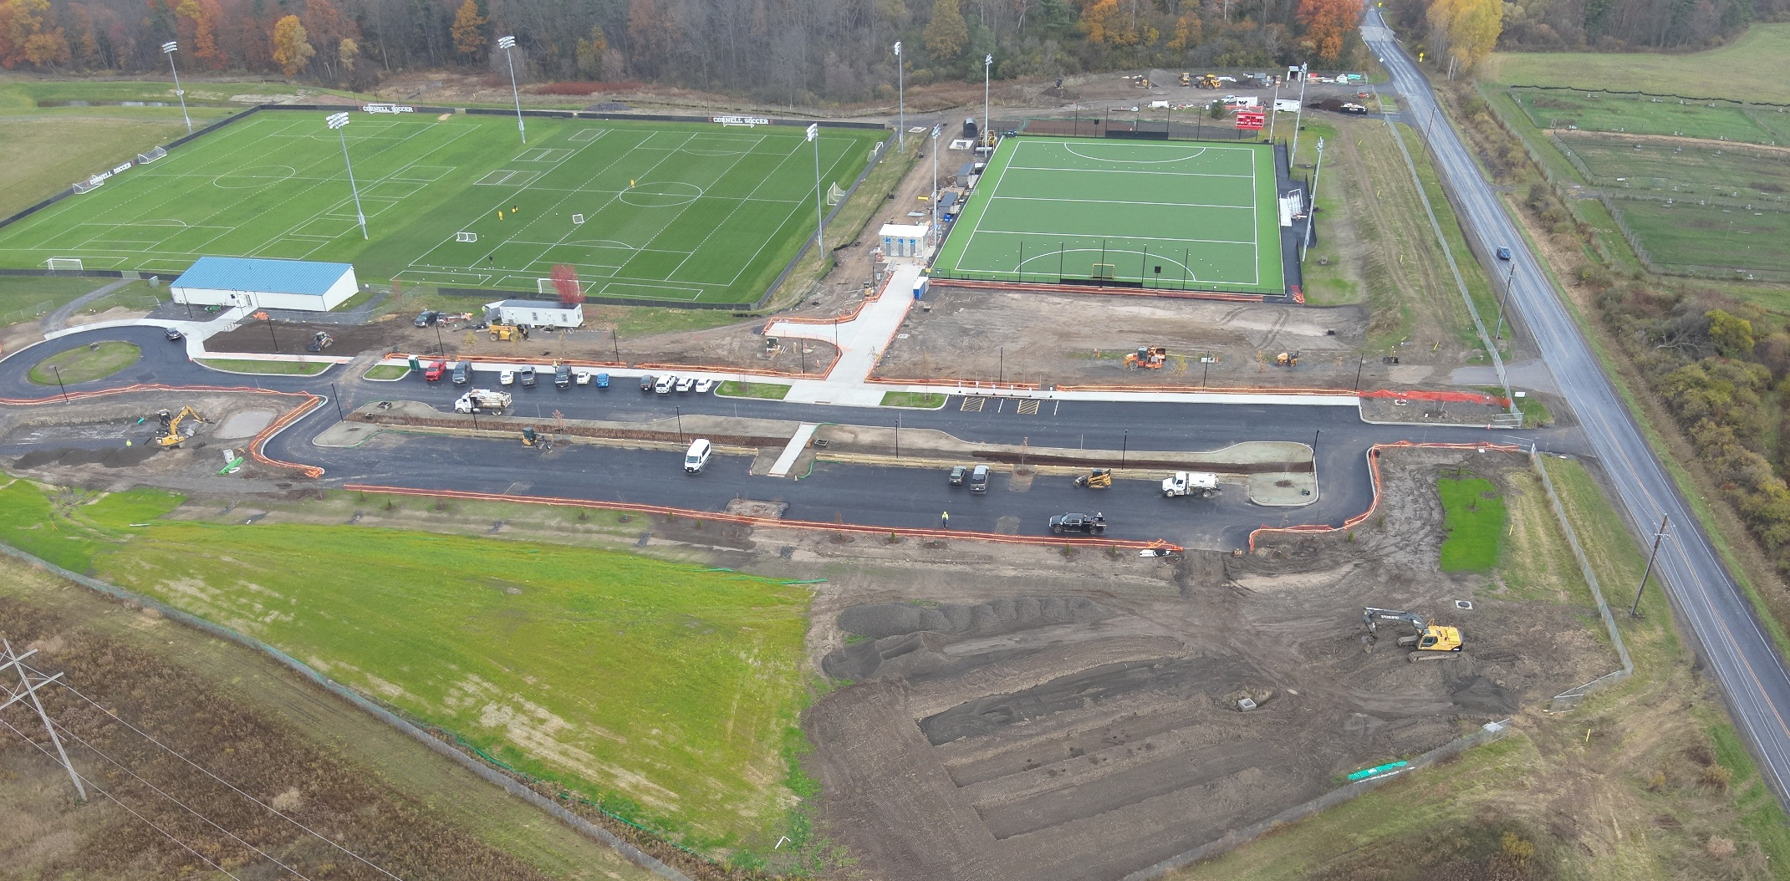

Slide 3
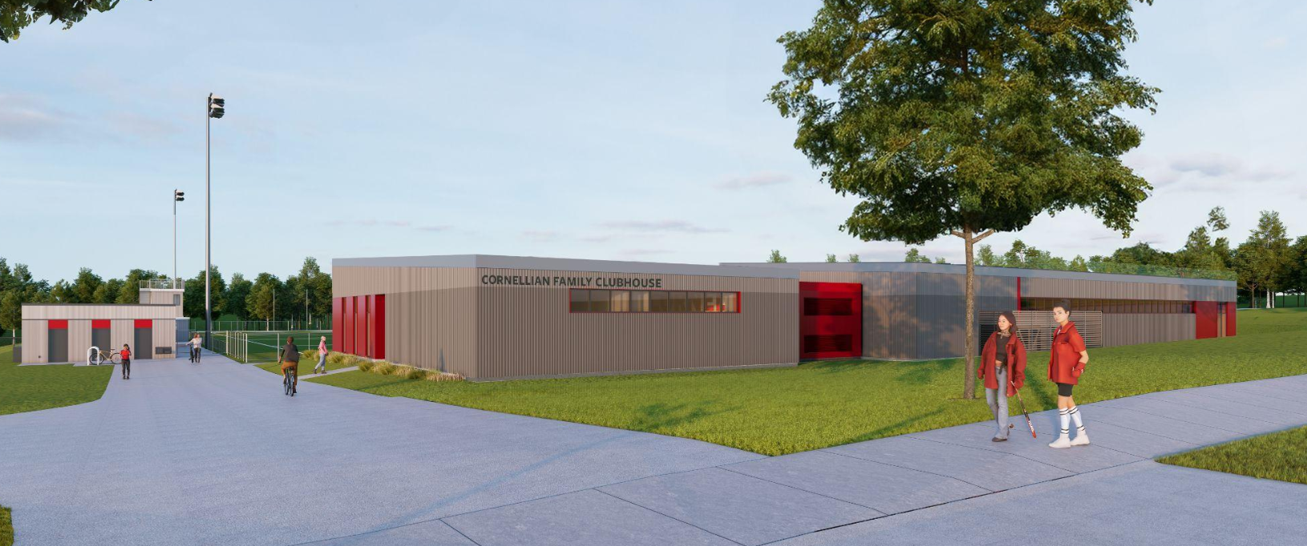
Clubhouse

Slide 4
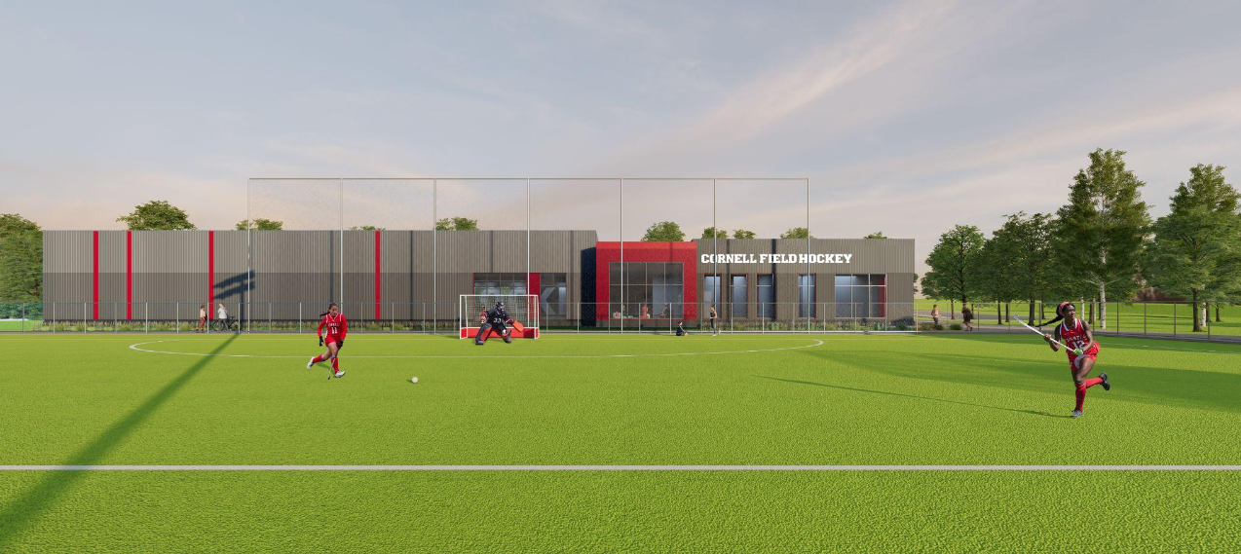
Clubhouse

Slide 5
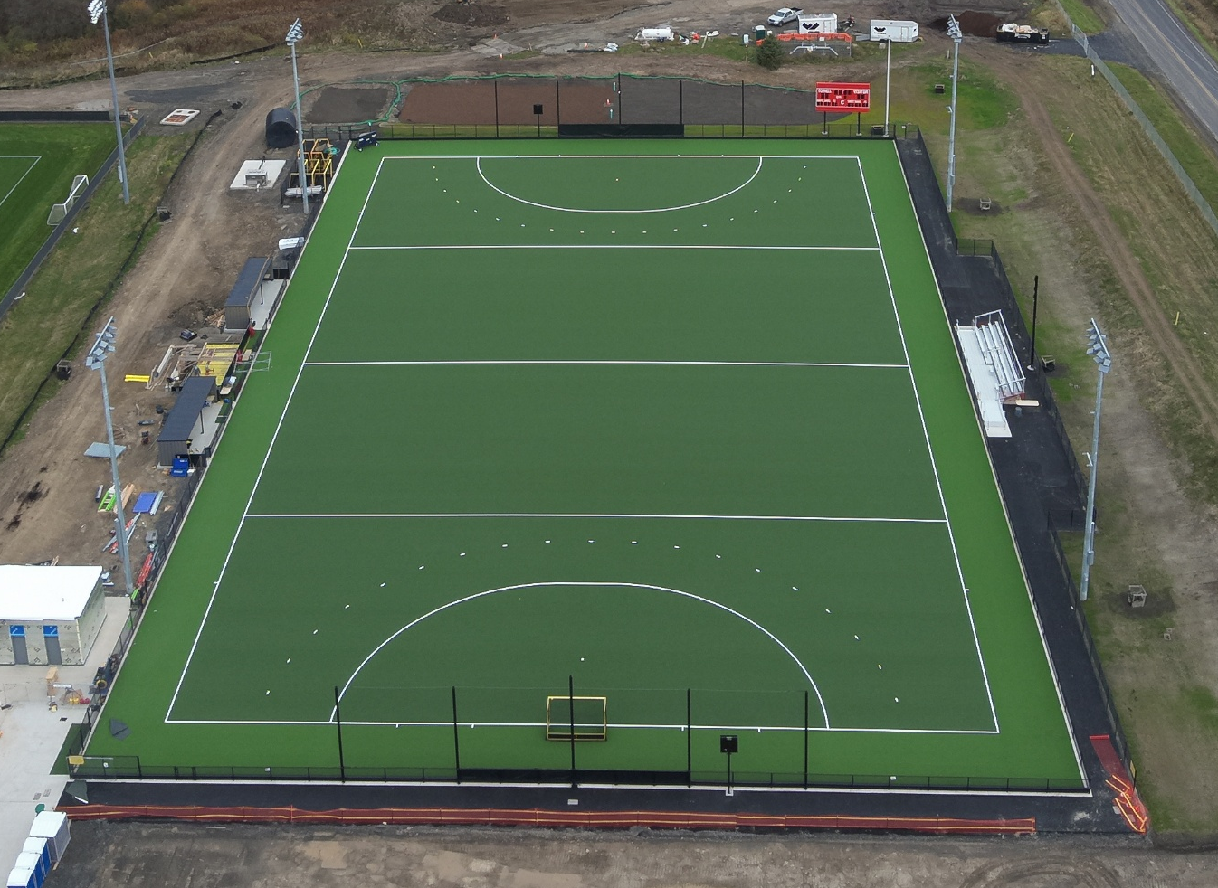
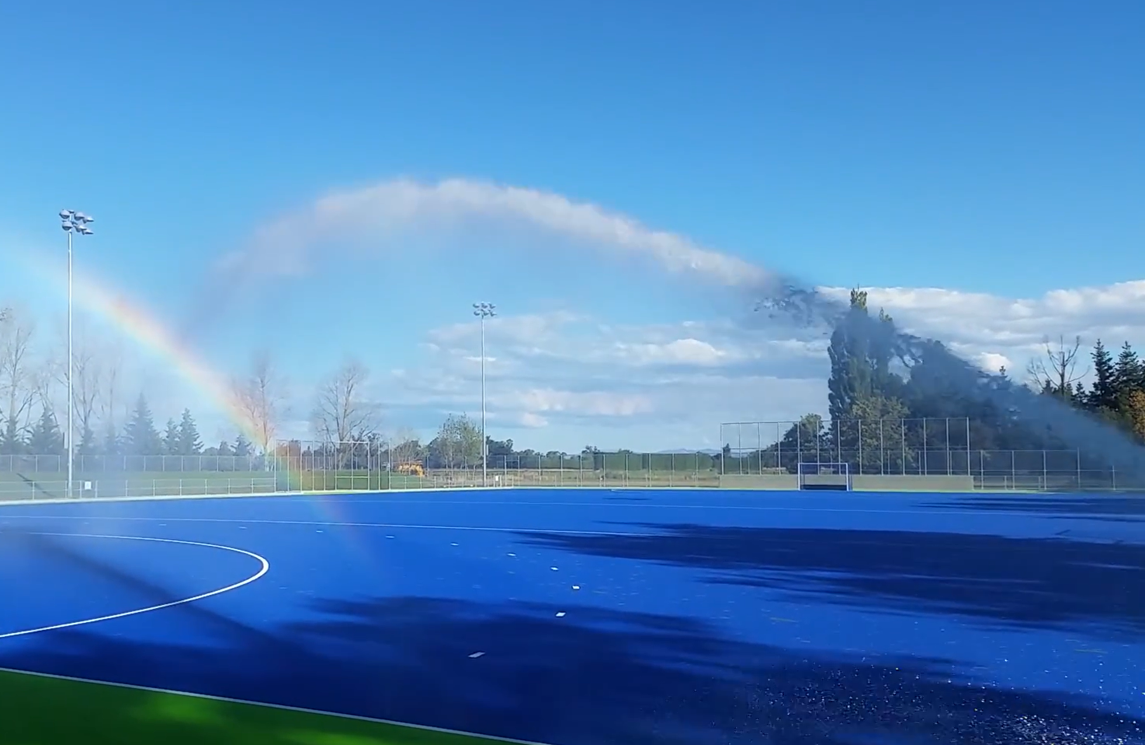
Irrigation System:
FIH Certification – 4,800 gallons in 8 minutes
^{8 Sprinkler heads}
2 run simultaneously for 4 minutes
Reduced pregame watering time by 20 minutes

Slide 6




