Slide 1
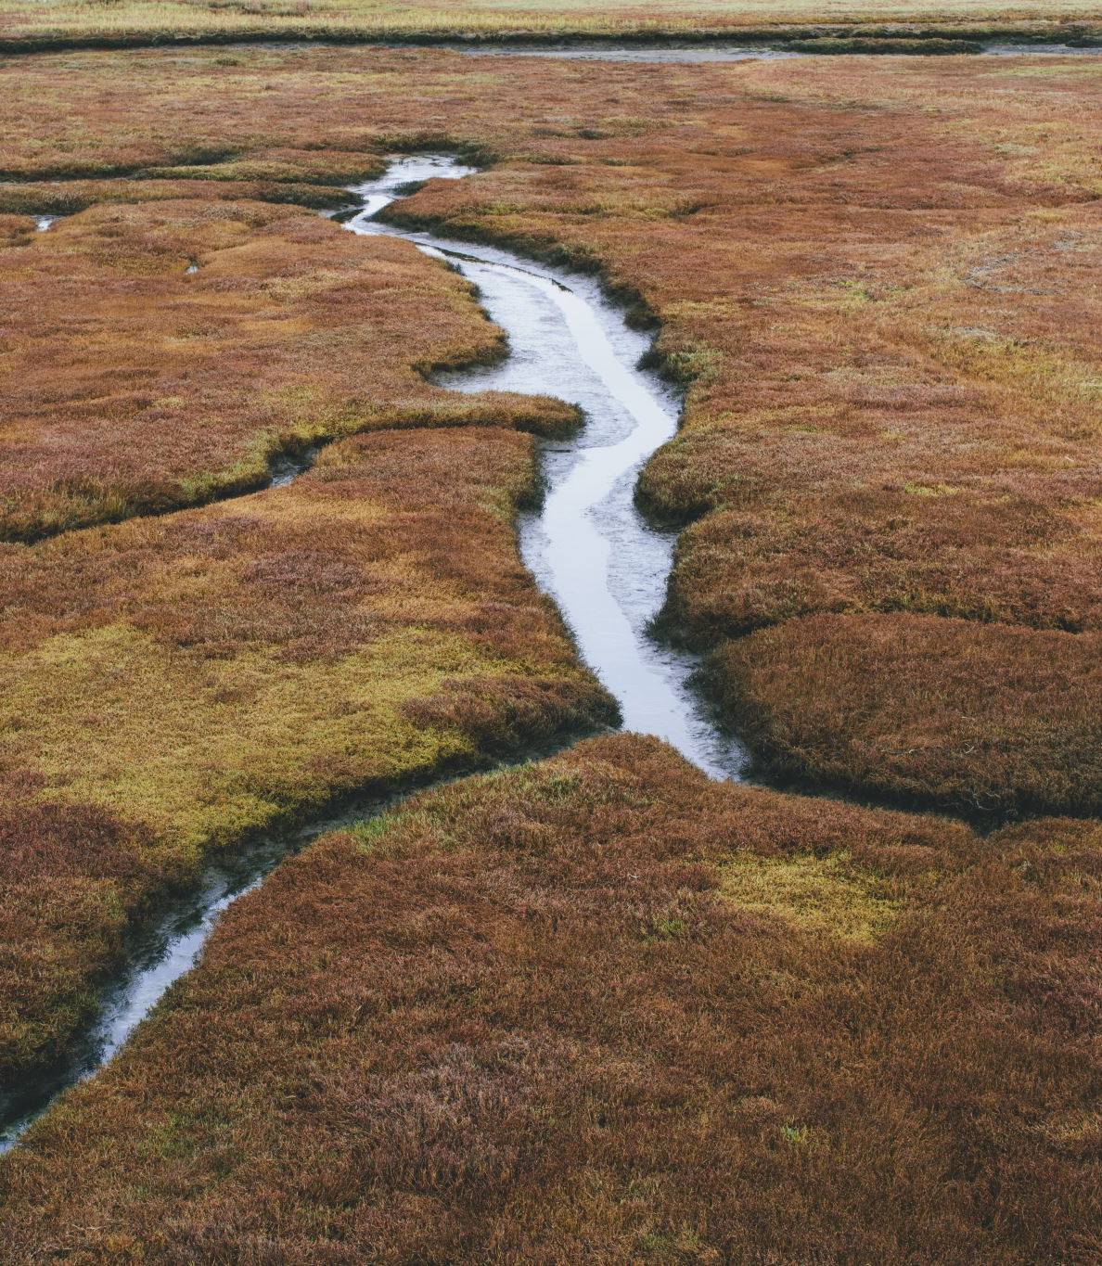
Wetlands Jurisdictional Determinations
Kara Bugis, EHS Sr. Water Program Specialist
Leslie Schill, Dir. Of Campus Planning

Slide 2

What is a wetland?
Wetlands are typically defined by vegetation, soils, and hydrology. More specifically, wetlands are areas saturated by surface or groundwater enough to support a community of plants that are adapted to life in saturated soil conditions. Water is not always present; in fact, some kinds of wetlands often appear dry. If water is present long enough during the year to influence the kinds of plants that grow, an area can be a wetland. - NYSDEC

Slide 3
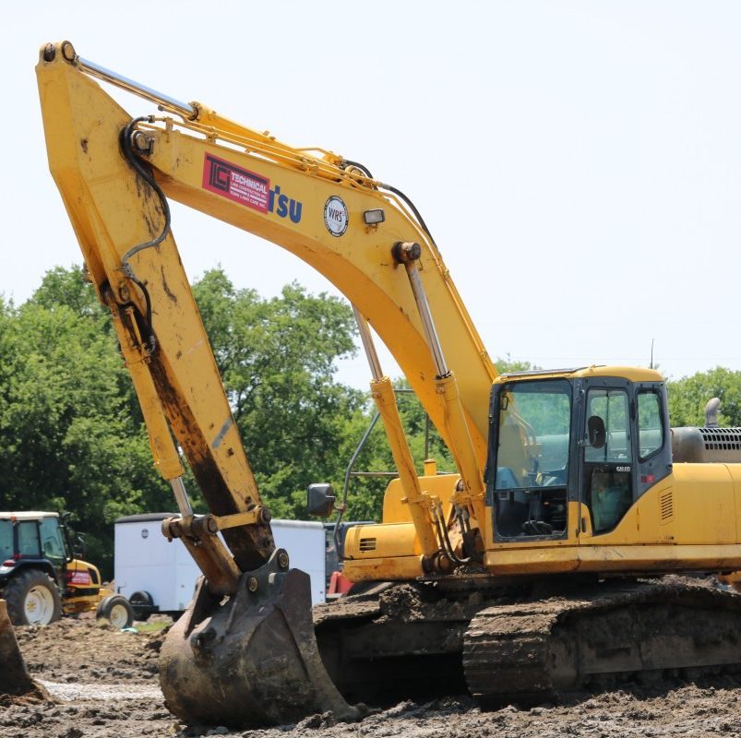
How are wetlands regulated?​
Almost any activity which may adversely impact the natural values of the wetlands or their adjacent areas is regulated. Some activities requiring a permit include:
Construction of buildings, roadways, septic systems, bulkheads, dikes, or dams;
Placement of fill, excavation, or grading;
Modification, expansion, or extensive restoration of existing structures;
Drainage, except for agriculture; and
Application of pesticides in wetlands.

Slide 4
What is a Jurisdictional Wetland?
9. "Unusual importance" shall mean a freshwater wetland, regardless of size, that possesses one or more of the following characteristics as determined by the department pursuant to regulations: (a) it is located in a watershed that has experienced significant flooding in the past, or is expected to experience significant flooding in the future from severe storm events related to climate change; (b) it is located within or adjacent to an urban area, as defined by the United States census bureau; (c) it contains a plant species occurring in fewer than thirty-five sites statewide or having fewer than five thousand individuals statewide; (d) it contains habitat for an essential behavior of an endangered or threatened species or a species of special concern as defined under section 11-0535 of this chapter or listed as a species of greatest conservation need in New York's wildlife action plan; (e) it is classified by the department as a Class I wetland; (f) it was previously classified and mapped by the department as a wetland of unusual local importance; (g) it is a vernal pool that is known to be productive for amphibian breeding; (h) it is located in an area designated as a floodway on the most current Digital Flood Insurance Rate Map (DFIRM) produced by the Federal Emergency Management Agency; (i) it was previously mapped by the department as a wetland on or before December thirty-first, two thousand twenty-four; (j) it has wetland functions and values that are of local or regional significance; or (k) it is determined by the commissioner to be of significant importance to protecting the state's water quality. NB Effective January 1, 2025
*Essentially this means if your project is within the City of Ithaca, Town of Ithaca, Village of Cayuga Heights, Village of Lansing... it is subject to this law

Slide 5
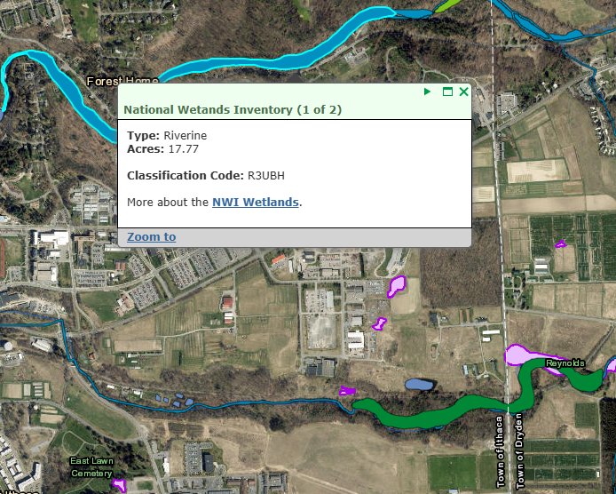
If your parcel borders this “riverine” wetland
(a.k.a. Cascadilla Creek and Fall Creek)

Slide 6
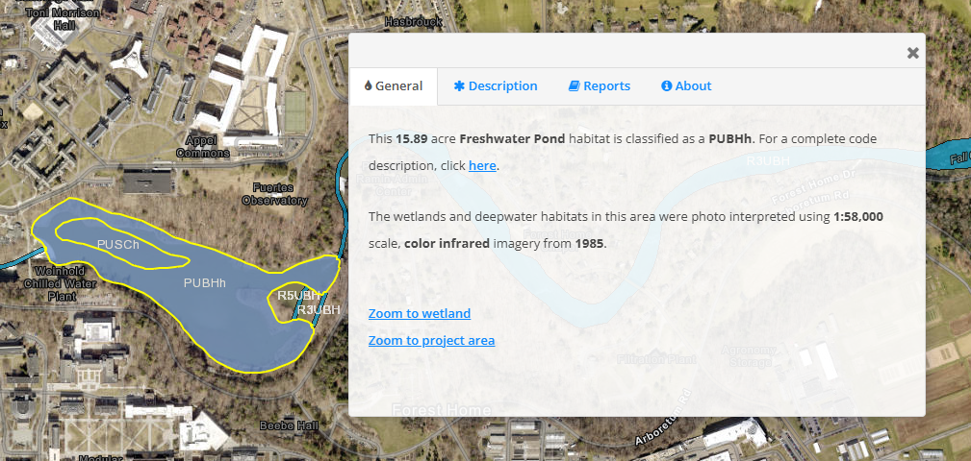
If your project is near this “freshwater pond”

Slide 7

The Regulatory Process

Slide 8
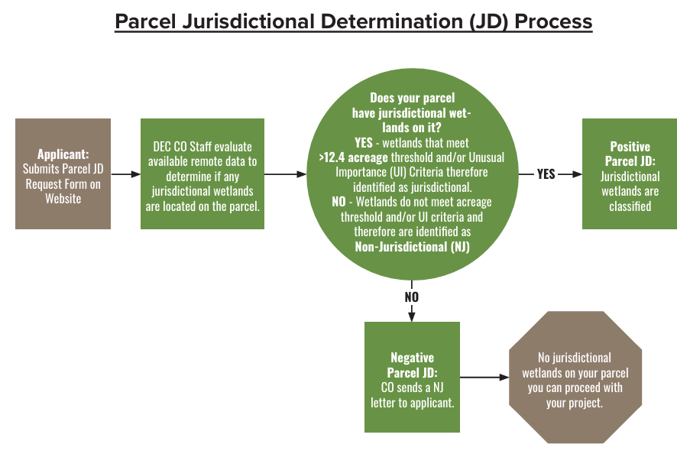
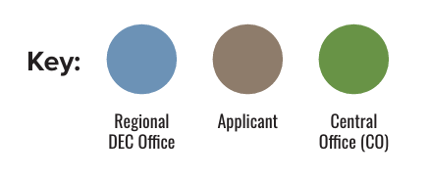


Cornell has approximately 400 tax parcels across the state.
DEC has 90 days to respond to a JD request.

Slide 9
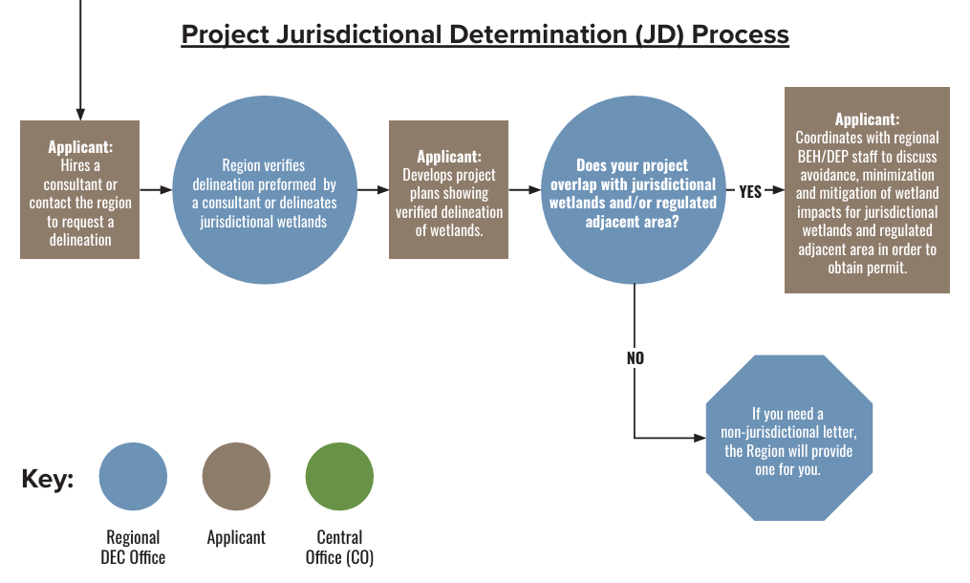
If your project does need a permit, it could take 6 months to 1 year to obtain.

Slide 10
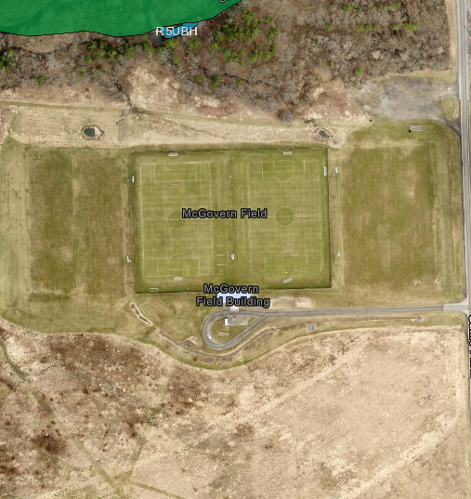
How are we addressing these regulations?
Field Hockey project at Game Farm Rd
Opted for “delineation by consultant” option to expedite the process.
Why can’t Kara do the delineations?
I’m not a biologist or a botanist.
Needed to wait for plant growth to start, so couldn’t begin until April...
Regulations came into effect in January 2025, so we were unable to have a consultant on site until end of April, report and project non-JD determination came in May.
Timeline & Cost: 5 months and $7,400

Slide 11
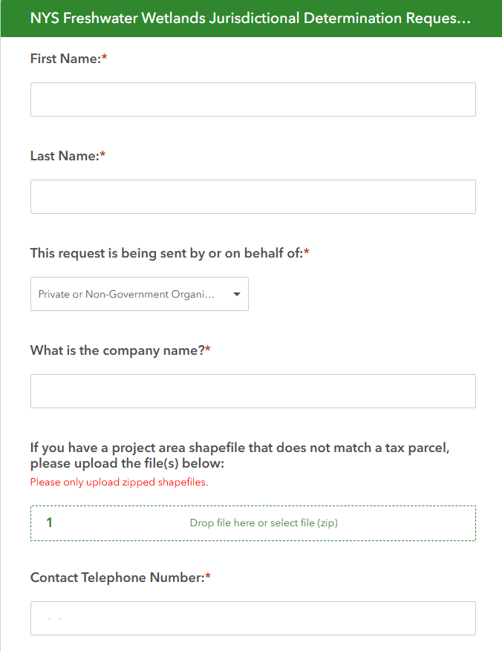
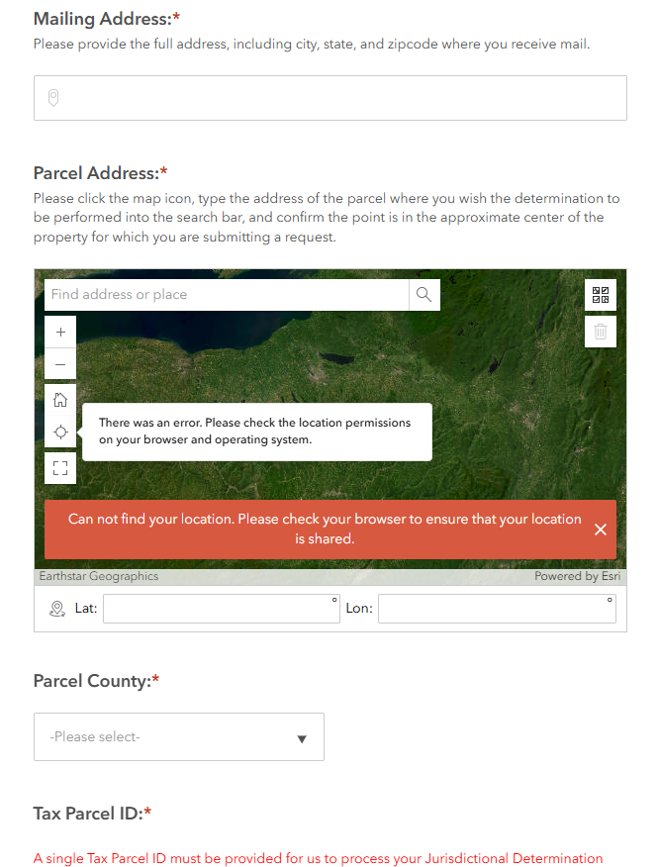
NYSDEC JD Request form
Notes:
Mary sorted out parcels and parcel numbers.

Slide 12
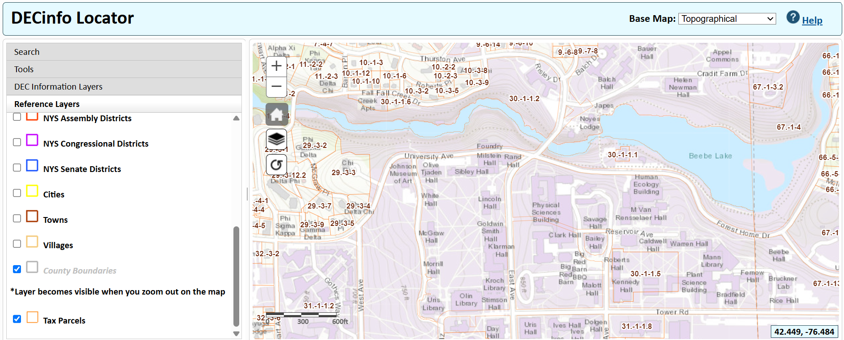
How are we addressing these regulations?
Parcel Jurisdiction Determinations
Tompkins County alone, CU has ~480 Parcels
Notes:
As mentioned earlier, CU has hundreds of parcels, and the DEC has 90 days to respond to a JD request. If the requestor doesn’t receive a response within 90 days, they’re supposed to nudge the DEC at which point they get one last chance to respond. If not, the requestor receives a non-jurisdictional determination by default for 5 years. After not receiving much response and running into some dead ends, we decided to “flood the DEC” with requests for all of our parcels. Kara couldn’t do alone with regular workload, enlisted planning dept’s help – Thank you Lisa!!! This caught their attention.

Slide 13

Collaboration with NYSDEC
Contacted by Matt Walter, NYSDEC Freshwater Wetlands Program Manager
Seeking a resolution so the DEC didn’t have to process 250+ applications.
Discussed campus development needs, regulatory hurdles encountered, discussions with all different stakeholders

Slide 14
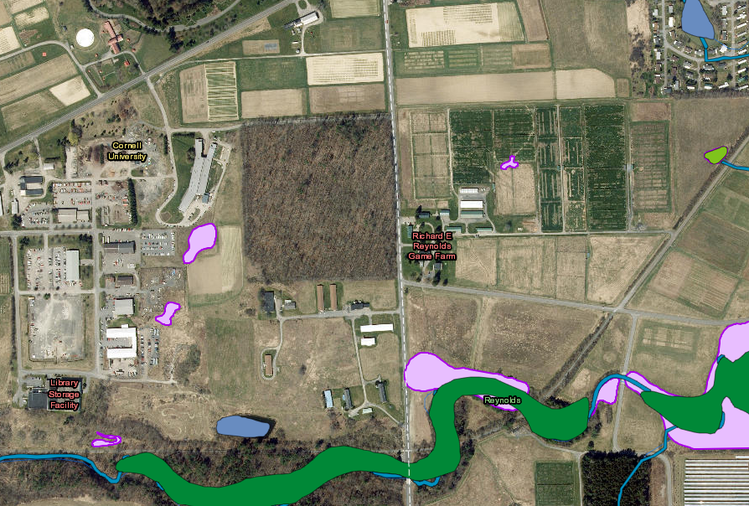
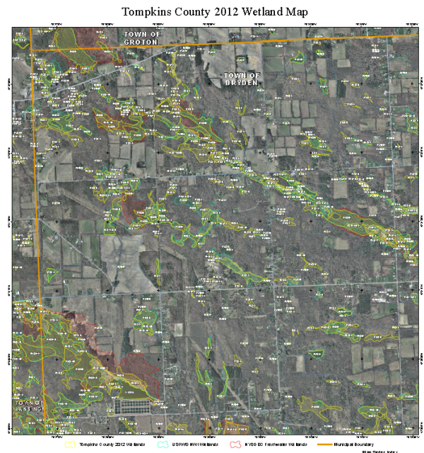
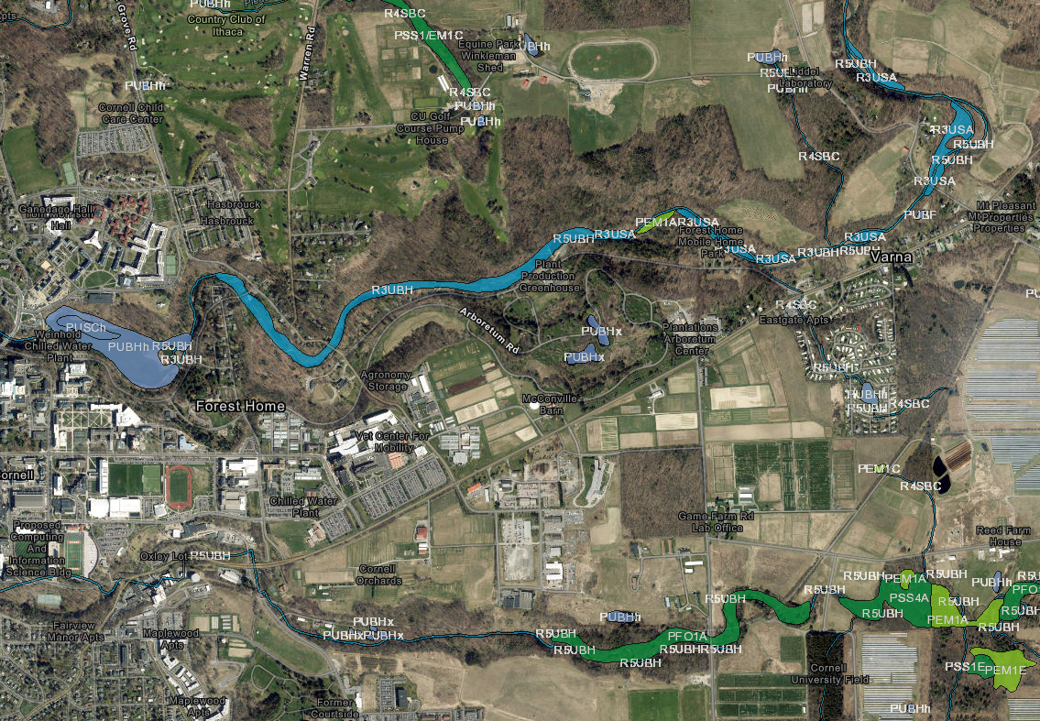
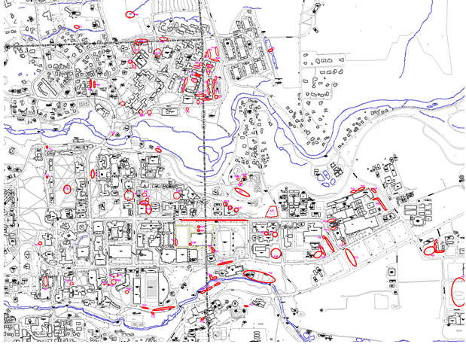
GIS Mapping
DEC Enviro. Resource Mapper (freshwater map)
TC Wetlands- 2012
US Fish and Wildlife Mapper
CU Permanent Stormwater Practices

Slide 15
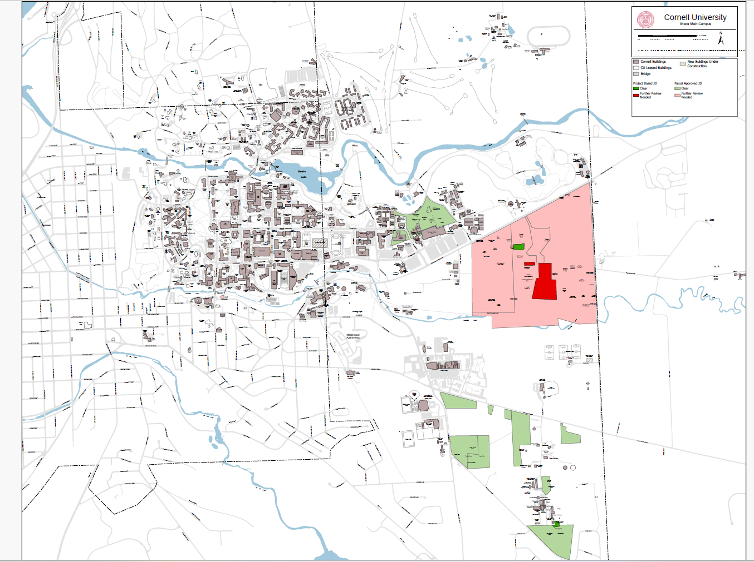
Result 1: Project-Specific Jurisdictional Determinations
DEC JD Reviews completed:
Non-Jurisdictional Determinations
Grounds Storage Facility
CALS Eagle Aviary
AHDC addition
Positive Jurisdictional Determinations requires project-specific delineation
Hydrogen Fueling Facility
Agrivoltaic Facility

Slide 16
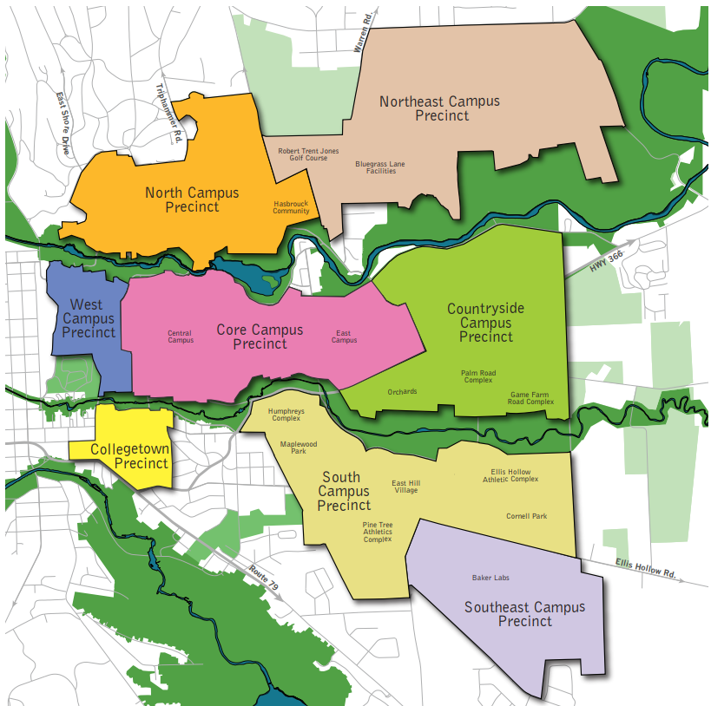
Proposed DEC Approach for the Ithaca Campus
Large swaths of campus considered in consolidated review
Focused jurisdictional review on CU lands most likely to experience development
5-year determination for entire campus that reduces time & cost for projects

Slide 17
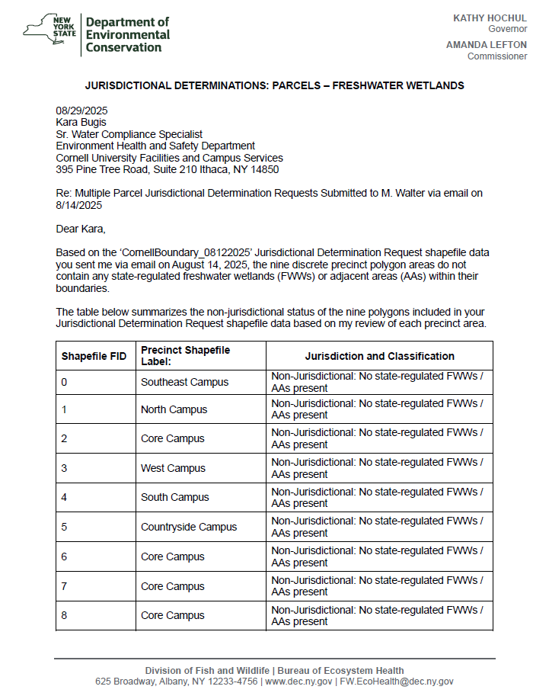
Result 2: Ithaca Campuswide Non-Jurisdictional Determination
Campus-wide non jurisdictional determination letter that reviewed/approved relevant campus precincts that are based on the Ithaca campus master plan.

Slide 18
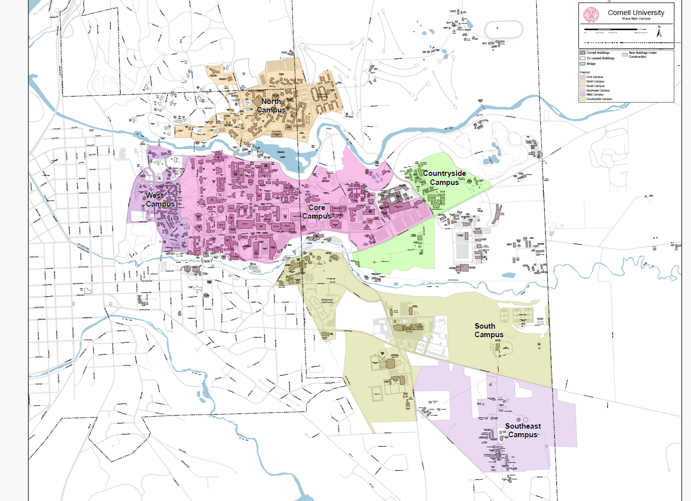
Result 2: Ithaca Campuswide Non-Jurisdictional Determination

Slide 19
Exceptions: Areas Removed from DEC Jurisdictional Review
-2 Precincts: Northeast (Golf course, NYS lands) & Collegetown
-Locations within 150' of identified waterways so removed from campus review:
Core Campus (Central + East):
Snee Hall
Ward Ctr
Wilson Synchrotron and Lab
Kite Hill Substation
North Campus
Scattered Greeks/coops in Cornell Heights
West Campus
107 Edgemoor
Countryside Campus (east of E Campus)
Botanic Gardens lands

Slide 20
DEC Jurisdictional Determinations – Q&A + Next Steps
What if my project is located outside of the Ithaca Campus? Projects in NYS are subject to the new DEC regulations. Each will have to have a parcel/project-level jurisdictional determination, based on relevant site scope.
Will Geneva campus, satellite locations take a similar approach to seeking comprehensive JD review? Still determining next steps for off Ithaca campus portfolio.
How do I get a delineation? Reach out to Kara, who can recommend local firms.
How long is a JD good for? Only 5 years. Our campuswide determination will last through August 2030.
What if there are known wetlands at my project location? The DEC has a wetlands general permit. If your project sits within areas like RTJ Golf Course, Lab of Ornithology, Botanic Gardens area, Palm Road area and others that are not covered as part of the comprehensive JD letter, reach out to understand how your project should utilize a wetlands permit.
How do I access this information during project initiation? This map and presentation that identifies exception areas will be posted to the Project Manager Resources website in the Approvals folder.

