Slide 1
Q3 Construction Report
2025 Project Bidding Look-ahead
October 15, 2025

Slide 2
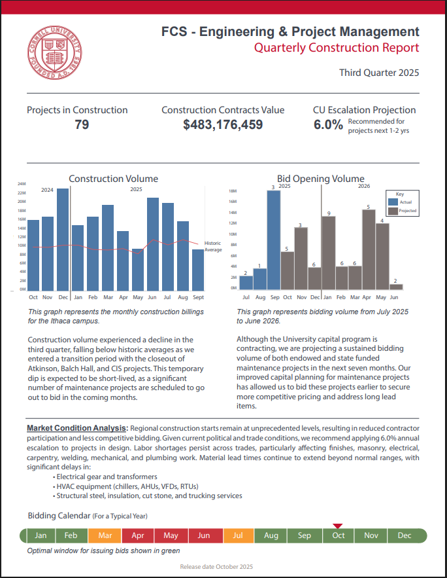
Q3 Construction Report
Key Takeaways:
79 construction contracts in place
Total $483M in construction
Significant number of maintenance projects are scheduled to go out to bid in the coming months.
6% recommended escalation
Long Lead Item Challenges:
  Electrical gear and transformers
  HVAC equipment
  Structural steel, insulation, cut stone, and trucking services

Slide 3
Project Bidding
Look-ahead

Slide 4
Capital Project Bidding Look-ahead
Next 10 Months: 41 + Projects @ $77,327,608 +

Slide 5
October 2025 (6 projects at ~ $14.8M)
Project | Est Con | Prime | Bid
Pleasant Grove Gateway | $205K | GC | Invited
Clara Dickson Roof Repairs | $8.05M | Roofing | Invited
M17081 Human Ecology Building Room 156 Boiler Replacement | $100K | Mech | SUCF
Mann Library HVAC Controller Replacement | $450K | Controls | SUCF
Uris Hall Energy Conservation Upgrades | $1.1M | Mech | Invited
Veterinary Medical Center Roof Replacement – Phase 1 | $4.9M | Roof | SUCF

Slide 6
November 2025 (6 projects at ~ $3.8M)
Project | Est Con | Prime | Bid
Martha Van Rensselaer Hall West Exterior Wall Panel Repair | $190K | GC | SUCF
Boyce Thompson Institute Greenhouse Lighting Replacement | $392.9K | Elec | SUCF
Chilled Water Plant 4 LSC Emergency Generator | $981.5K | Elec | Invited
Experimental Anaerobic Digester System | $1.1M | Site | Invited
Pavement and Sidewalk Maintenance Program: Hollister Lot & Barrier, Cradit Farm Drive, & Large Animal Research Unit Parking Lot | $1M | Site | Invited
Human Ecology Building East Path Pedestrian Access Improvements and Warren Hall | $140K | Site | SUCF

Slide 7
December 2025 (5 projects at ~ $4M)
Project | Est Con | Prime | Bid
Cornell Health Sprinkler Pipe Repair | $258K | GC | Invited
Baker Tunnel Hot Water Conversion | $3M | Site | Invited
Barnes Hall First Floor Fire Sprinkler Installation | $299.6K | FP | Invited
Barton Hall NAVY ROTC Air Conditioning Repairs | $139.9K | Mech | Invited
Comstock Hall RO/DI Water System Replacement | $300K | Mech | SUCF

Slide 8
January 2026 (3 projects at ~ $2.4M)
Project | Est Con | Prime | Bid
Bradfield Hall Lower Brick and Comstock South Façade Repair | $382.5K | GC | SUCF
Barnes Hall Performance Space Audio Upgrades | $207K | Elec | Invited
Clark Hall Energy Conservation Initiative | $1.82M | Mech | Invited

Slide 9
February 2026 (9 projects at ~ $8.8M)
Project | Est Con | Prime | Bid
Asian Summer Garden | $2.5M | GC | Invited
Malott Math Support Center Renovation | $250K | GC | Invited
Replace Coolers and Freezers - Stocking Hall East | $1.75M | GC | SUCF
Olin Hall Accessible Route and Parking | $250K | GC | Invited
Boyce Thompson Institute Sprinkler System Installation | $2.5M | FP | SUCF
CDS/RDS Ground Water Treatment Plant UV OX Replacement | $448.7K | Mech | Invited
Kenneth Post Laboratory R/O Water System Replacement | $191.3K | Mech | SUCF
Computing Communications Center Building Electrical Service Entrance Upgrade | $300K | Elec | Invited
Computing Communications Center Fire Alarm Panel Upgrade | $590K | Elec | Invited

Slide 10
March 2026 (2 projects at ~ $3.2M)
Project | Est Con | Prime | Bid
Plant Science Mechanical Room Roof Terrace Rehabilitation | $1.7M | GC | SUCF
North Campus Buildings 6-9 and Garden Ave Water Distribution Improvements | $1.48M | SITE | Invited

Slide 11
April 2026 (3 projects at ~ $8.6M)
Project | Est Con | Prime | Bid
Barton Hall Façade Renovation | $7M | GC | SUCF
Geneva Barton Lab Window Replacements and Roof Repairs | $1.1M | GC | SUCF
Tjaden Hall Heat Recovery | $491K | Mech | Invited

Slide 12
May 2026 (2 projects at ~ $1.1M)
Project | Est Con | Prime | Bid
Bradfield Emerson Complex Accessible Path of Travel | $90K | GC | Invited
Poultry Farm Emergency Generator Replacement | $1M | Elec | SUCF

Slide 13
June 2026 (2 projects at ~ $1.7M)
Project | Est Con | Prime | Bid
Myron Taylor Jane Foster Elevator Replacements | $1.1M | GC | Invited
William T. Keeton House North Wing Structural Steel Repair & Slab Water Infiltration Mitigation | $550K | GC | Invited

Slide 14
July 2026 (2 projects at ~ $29M)
Project | Est Con | Prime | Bid
Geneva AgriTech Decarbonization Phase 1 & 2 | $13M | Mech | SUCF
Geneva Food Research Laboratory Rehabilitation Phase 1 | $16M | Mech | SUCF

Slide 15
August 2026 (1 projects at ~ $53.5M)
Project | Est Con | Prime | Bid
Plant Science - Phase 2 | $53.5M | GC | SUCF

