Slide 1
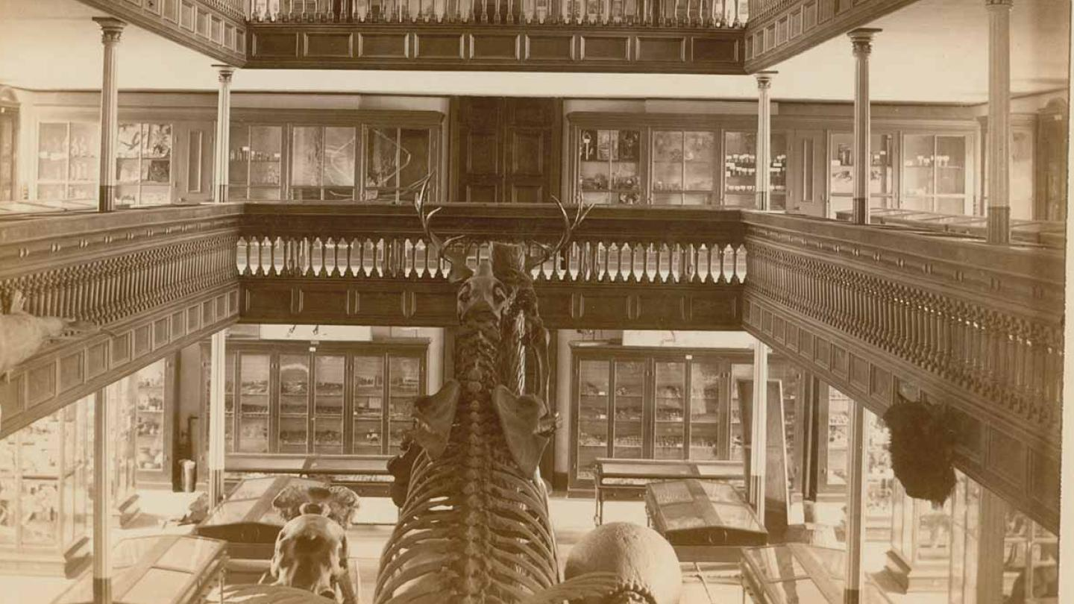
McGraw Hall
Bones in the basement
Introduction on the history of the building and the professors.
Introduction on some of the scope of work for the project.
What was discovered and decided path forward
oh great it happened again, and of course we still have a lot to remove.

Slide 2
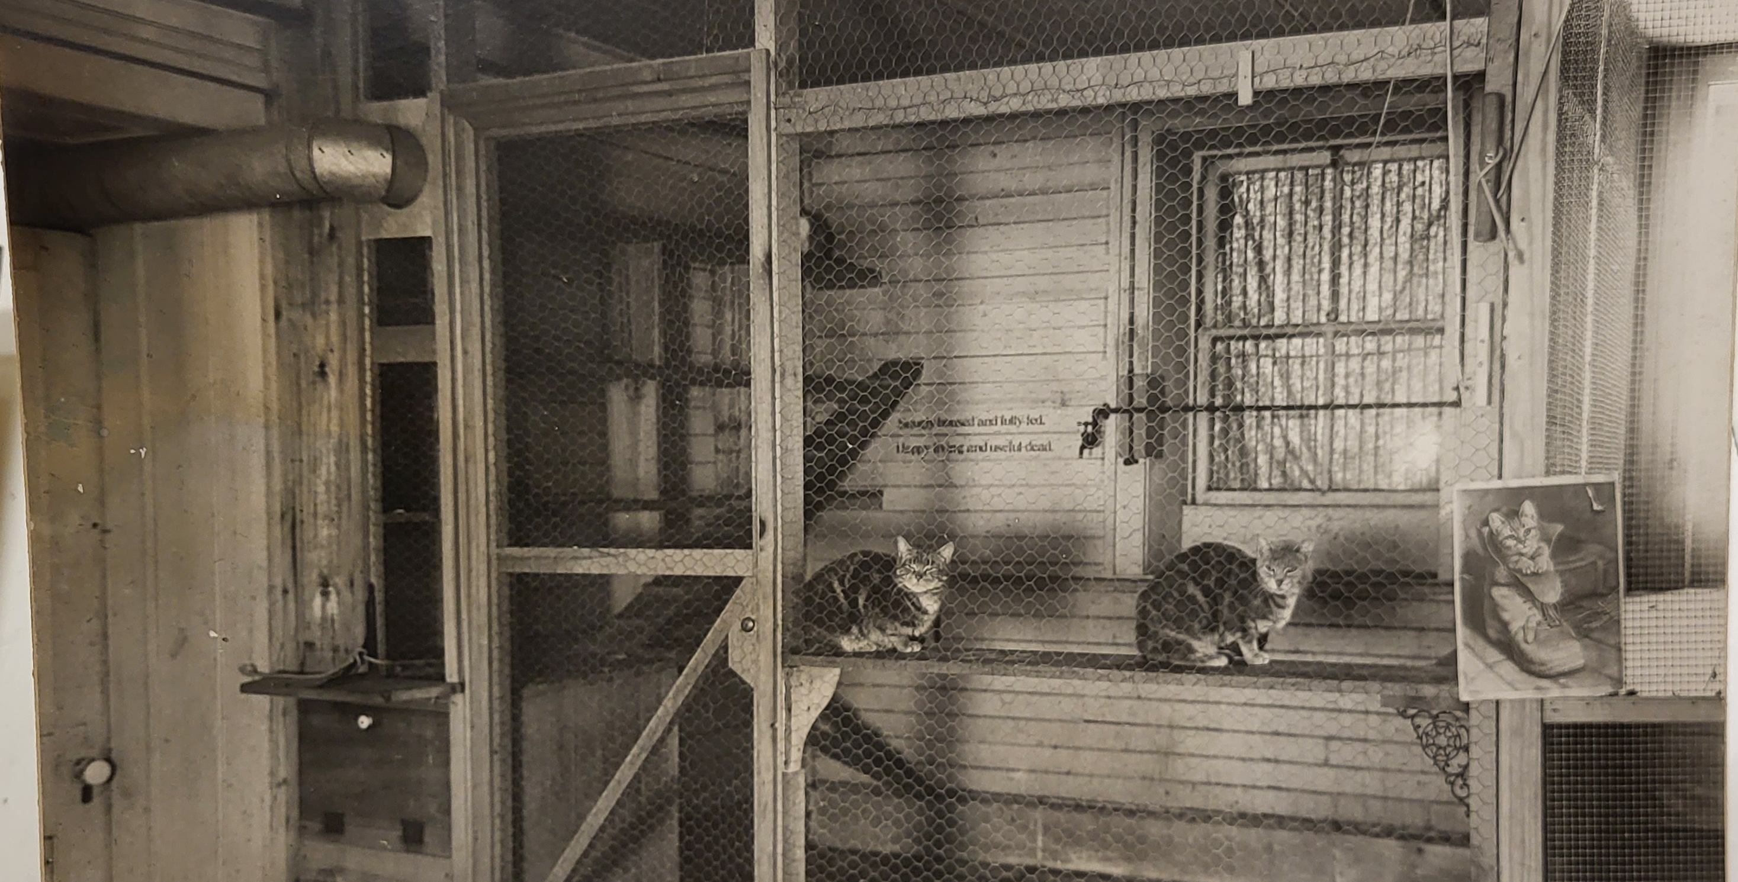
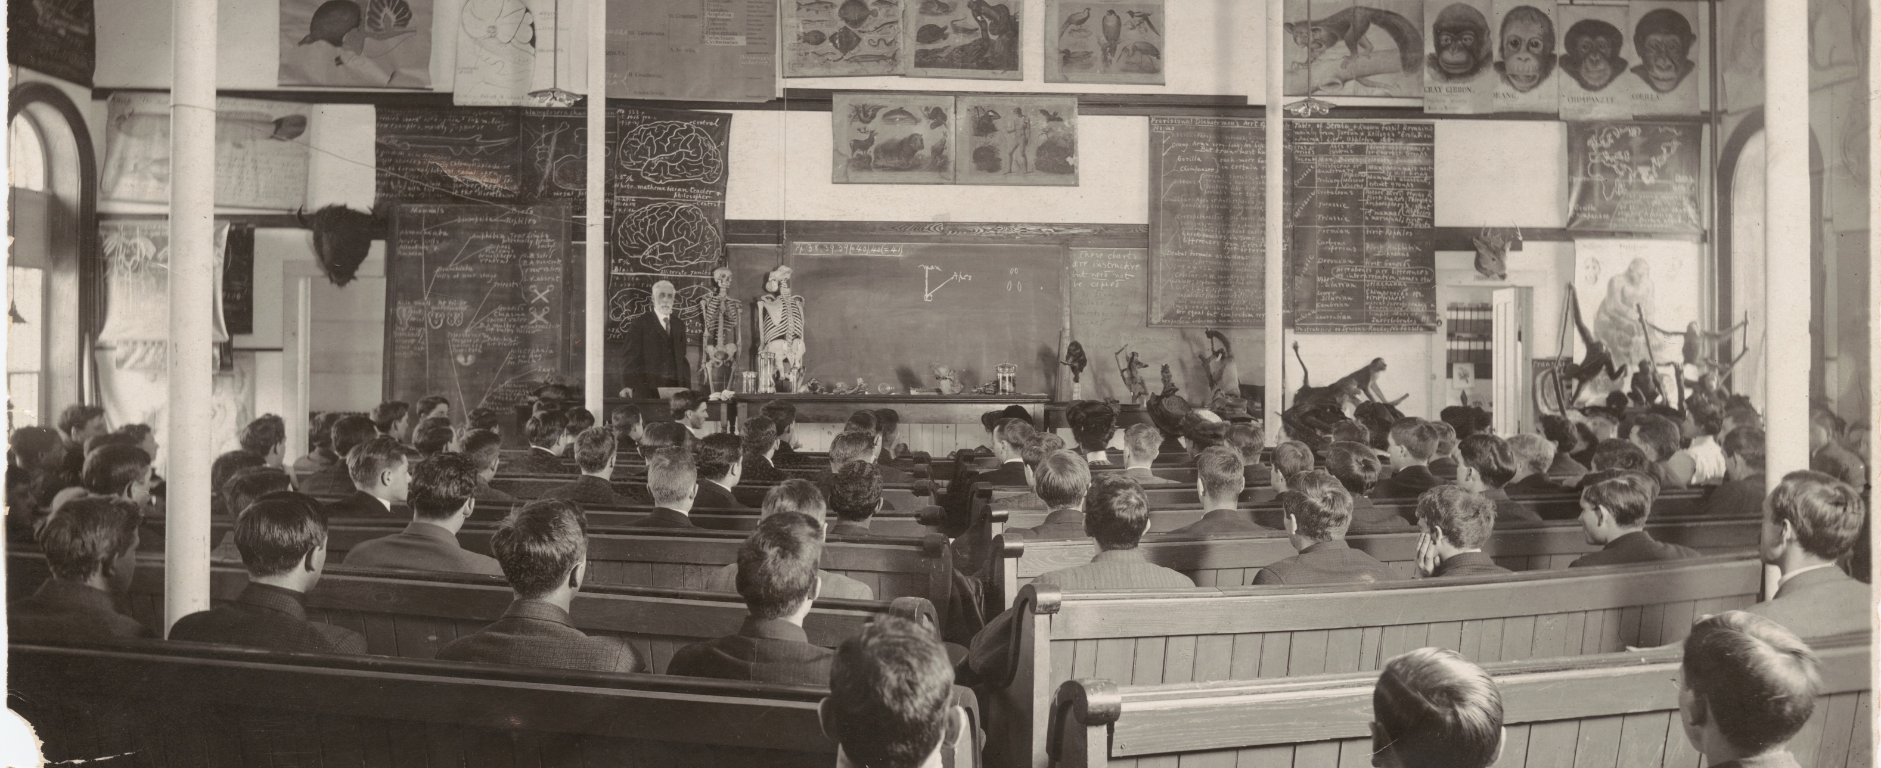
McGraw in the beginning……Bert Wilder
dirt floor allowing burying of cadavers
Animal containment- tanks with alligators, cat area, brain collection
Maybe an elephant?

Slide 3
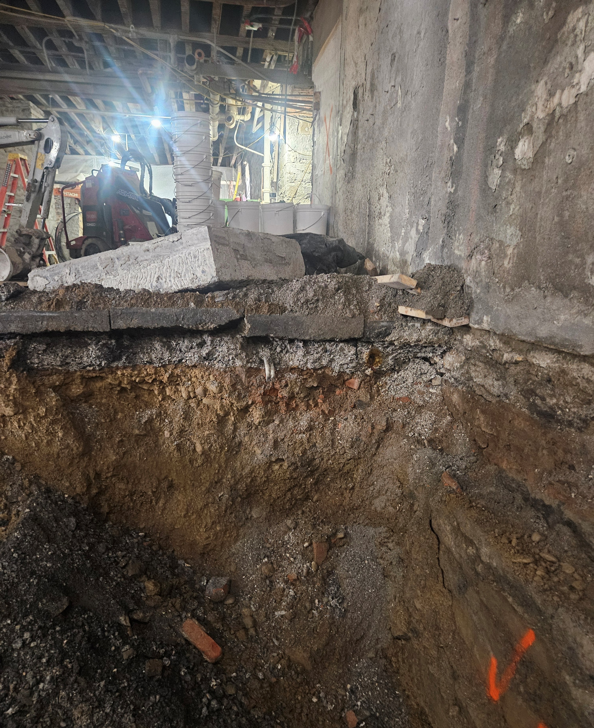
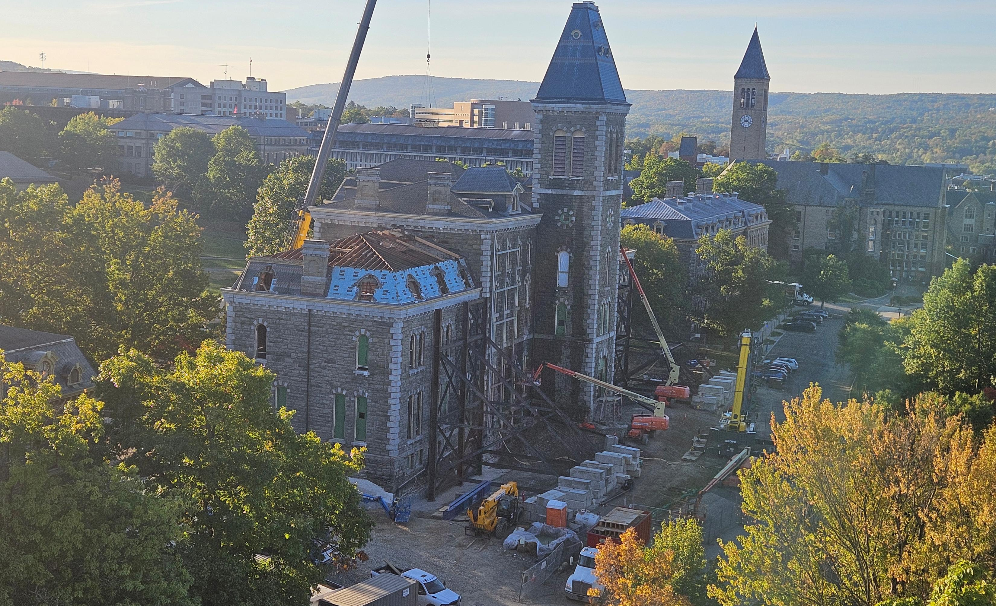
Time to get dirty
Gut renovation
Deep foundation requiring underpinning and 5 ft interior excavation
Shoring/ pinning and grouting walls/ all new structure and roofs
Interior fit out and normal reno.

Slide 4

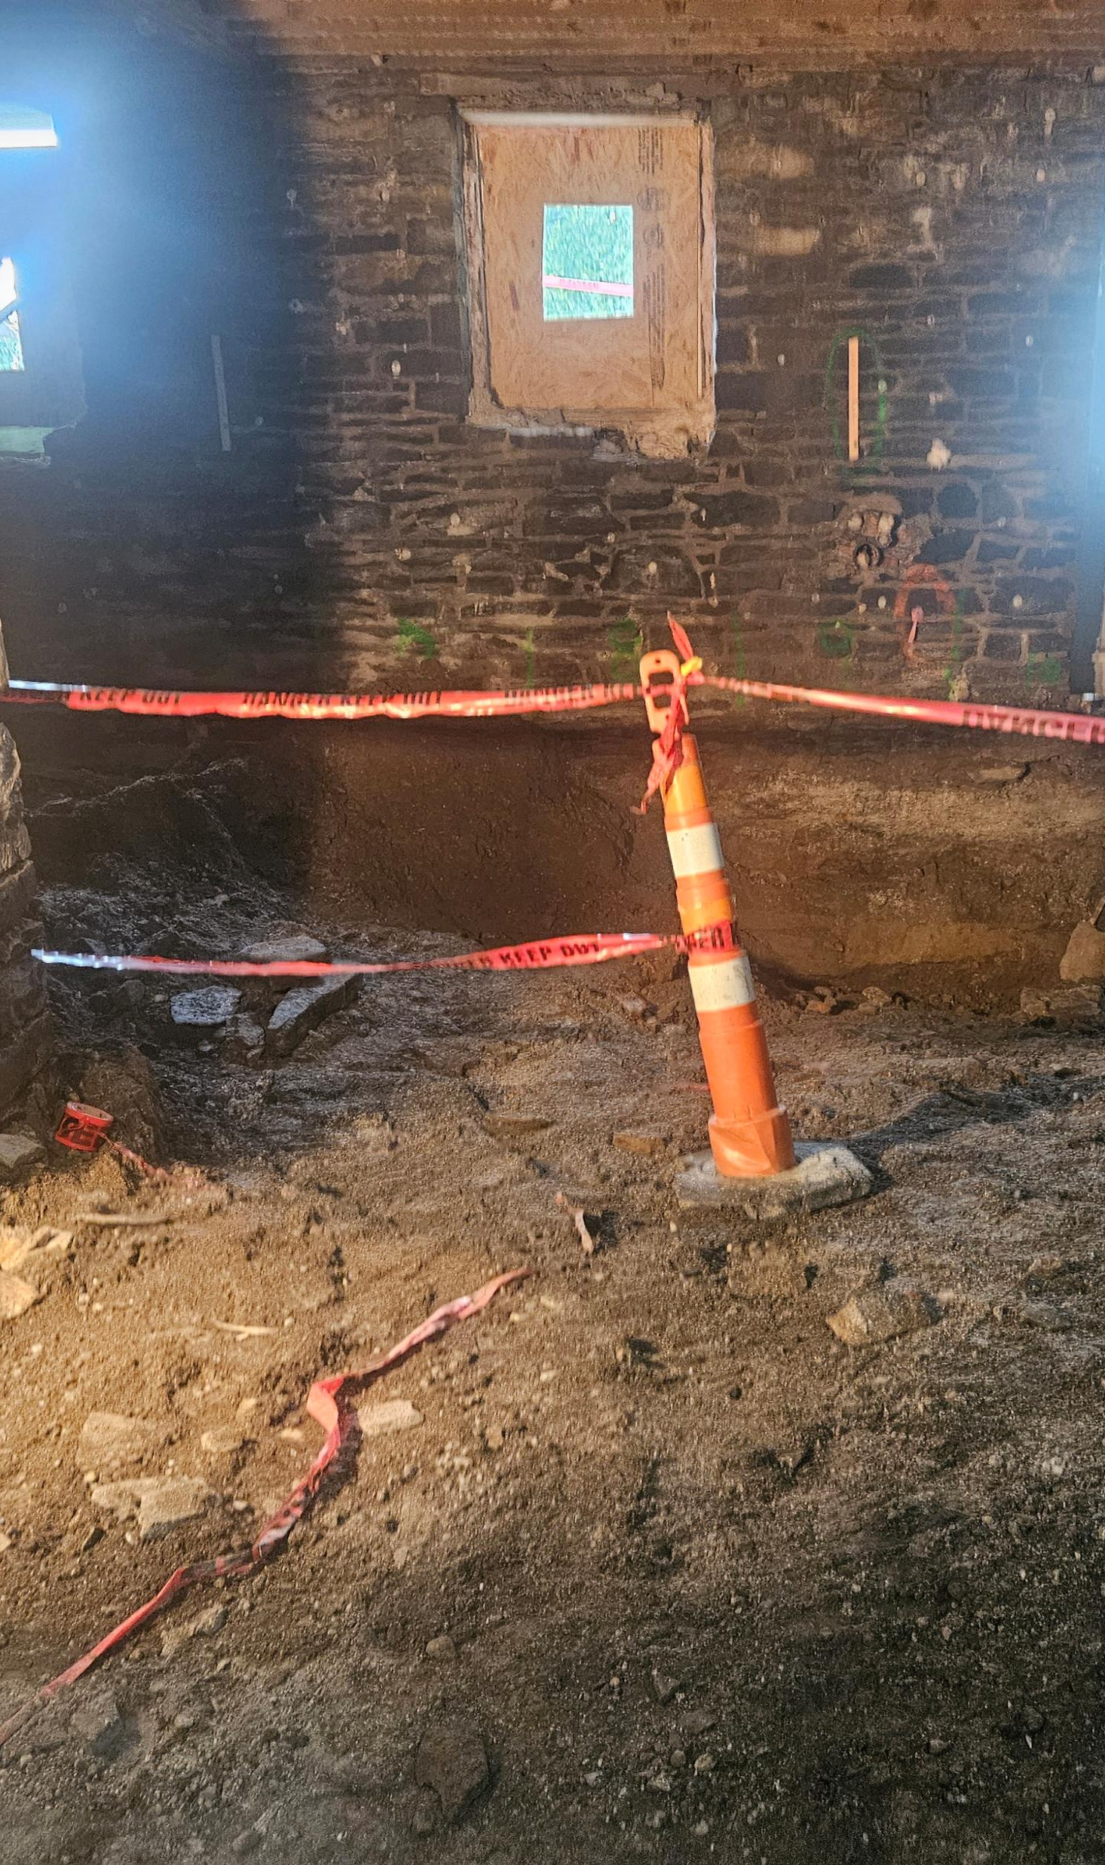
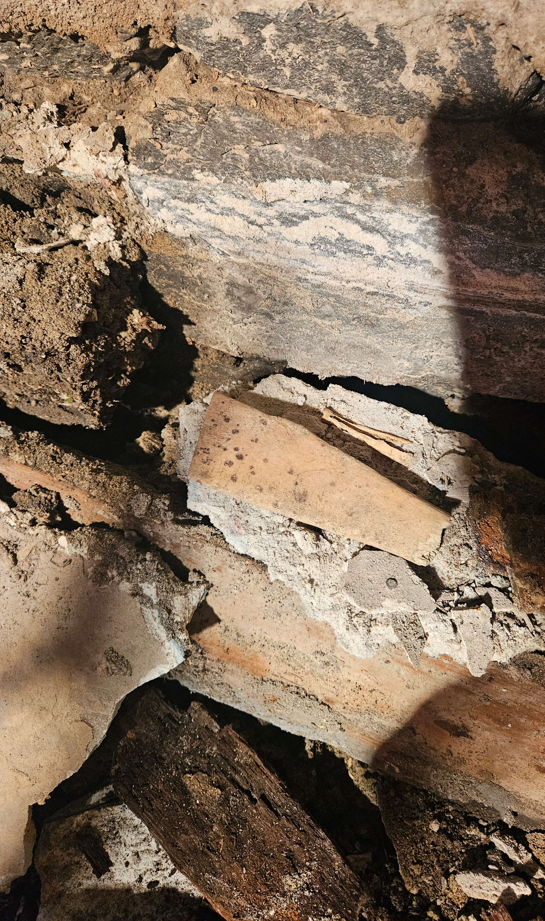
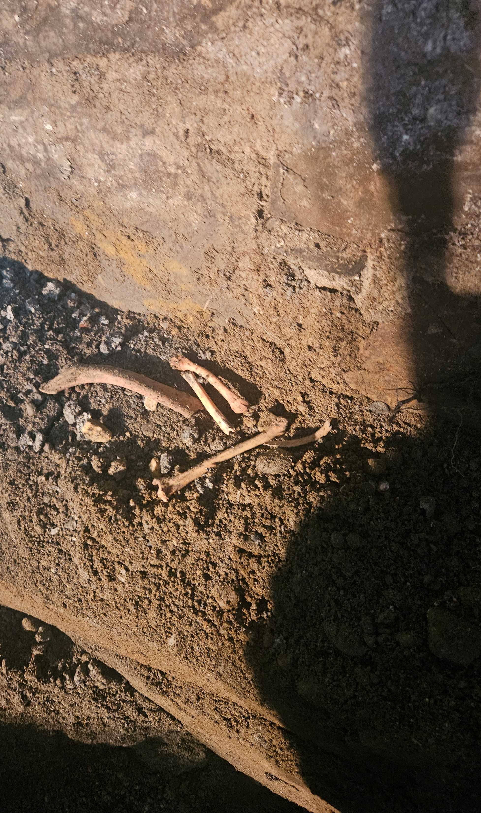
Look what we found

Slide 5
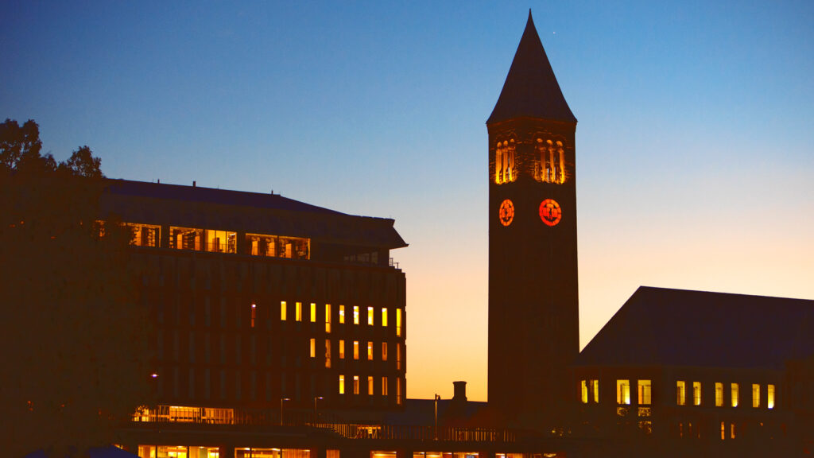
Questions?

