Slide 1
Chemical Control Areas
Michael Niechwiadowicz
Building Code Program Manager, FCS
October 15, 2025

Slide 2
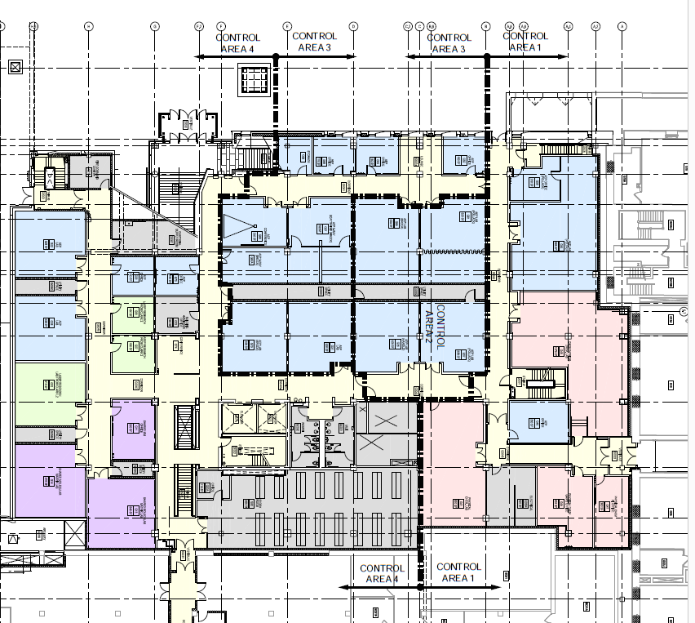
Code Compliance for Chemicals
NYS Code requires an MAQ analysis.
What information is needed to conduct an MAQ analysis?
A complete chemical inventory with locations defined down to the level of approved storage cabinets (i.e. flammable storage cabinets, gas cabinets).
An accurate hazard classification for that entire chemical inventory
An understanding of your facility's control area or laboratory suites boundaries.
An understanding of your facility's sprinkler coverage status.

Slide 3
Code Compliance for Chemicals
NYS Code requires an MAQ analysis.
What information is needed to conduct an MAQ analysis?
A complete chemical inventory with locations defined down to the level of approved storage cabinets (i.e. flammable storage cabinets, gas cabinets).

Slide 4
Code Compliance for Chemicals
What information is needed to conduct an MAQ analysis?
A complete chemical inventory with locations defined down to the level of approved storage cabinets (i.e. flammable storage cabinets, gas cabinets).
An accurate hazard classification for that entire chemical inventory.

Slide 5
Code Compliance for Chemicals
What information is needed to conduct an MAQ analysis?
A complete chemical inventory with locations defined down to the level of approved storage cabinets (i.e. flammable storage cabinets, gas cabinets).
An accurate hazard classification for that entire chemical inventory
An understanding of your facility's control area or laboratory suites boundaries.

Slide 6
Code Compliance for Chemicals
What information is needed to conduct an MAQ analysis?
A complete chemical inventory with locations defined down to the level of approved storage cabinets (i.e. flammable storage cabinets, gas cabinets).
An accurate hazard classification for that entire chemical inventory
An understanding of your facility's control area or laboratory suites boundaries.
An understanding of your facility's sprinkler coverage status.

Slide 7
Code Compliance for Chemicals
What information is needed to conduct an MAQ analysis?
A complete chemical inventory with locations defined down to the level of approved storage cabinets (i.e. flammable storage cabinets, gas cabinets).
An accurate hazard classification for that entire chemical inventory
An understanding of your facility's control area or laboratory suite boundaries.
An understanding of your facility's sprinkler coverage status.

Slide 8
What is a control area and how does it impact us?
A control area is a fire separated area within a building where quantities of hazardous materials not exceeding the maximum allowable quantities (MAQ) are used, handled, dispensed or stored.
A control area that meets MAQ is regulated by code as a Group B – Business use.
A laboratory suite is a particular type of control area permitted in higher education laboratory buildings. It is also regulated as a Group B.
If MAQ limits are exceeded, then the space is classified as a Group H.
A Group H has significantly more limitations and code requirements.
In some cases, a Group H may not be allowed in the building.

Slide 9
How is a control area identified?
A control area is a room or group of rooms separated by fire barriers from other areas of the building.

Slide 10
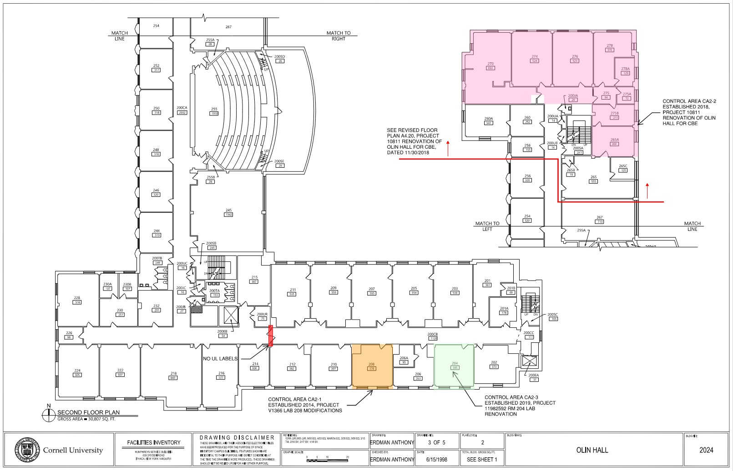

Slide 11
How is a control area identified?
A control area is a room or group of rooms separated by fire barriers from other areas of the building.
This fire barrier separation includes the walls, floor and deck above.

Slide 12


Slide 13
How is a control area identified?
A control area is a room or group of rooms separated by fire barriers from other areas of the building.
This fire barrier separation includes the walls, floor and deck above.
A fire barrier wall extends from the fire rated floor to the fire rated deck above.

Slide 14
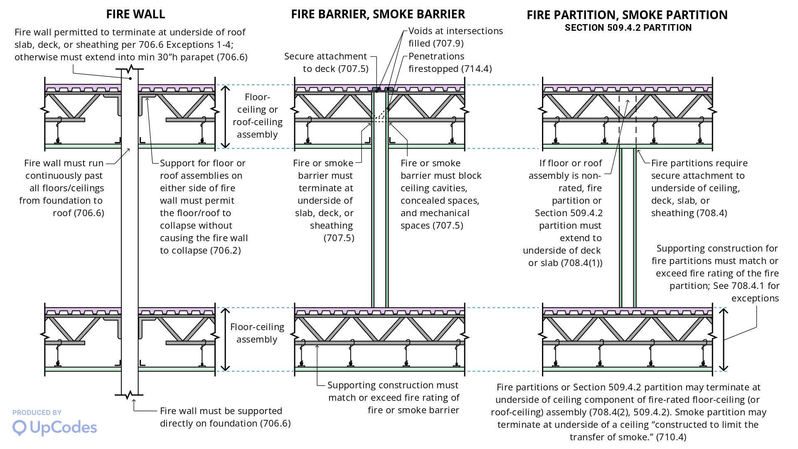



Slide 15
How is a control area identified?
A control area is a room or group of rooms separated by fire barriers from other areas of the building.
This fire barrier separation includes the walls, floor and deck above.
A fire barrier wall extends from the fire rated floor to the fire rated deck above.
The fire barrier supporting construction must also be fire rated.

Slide 16
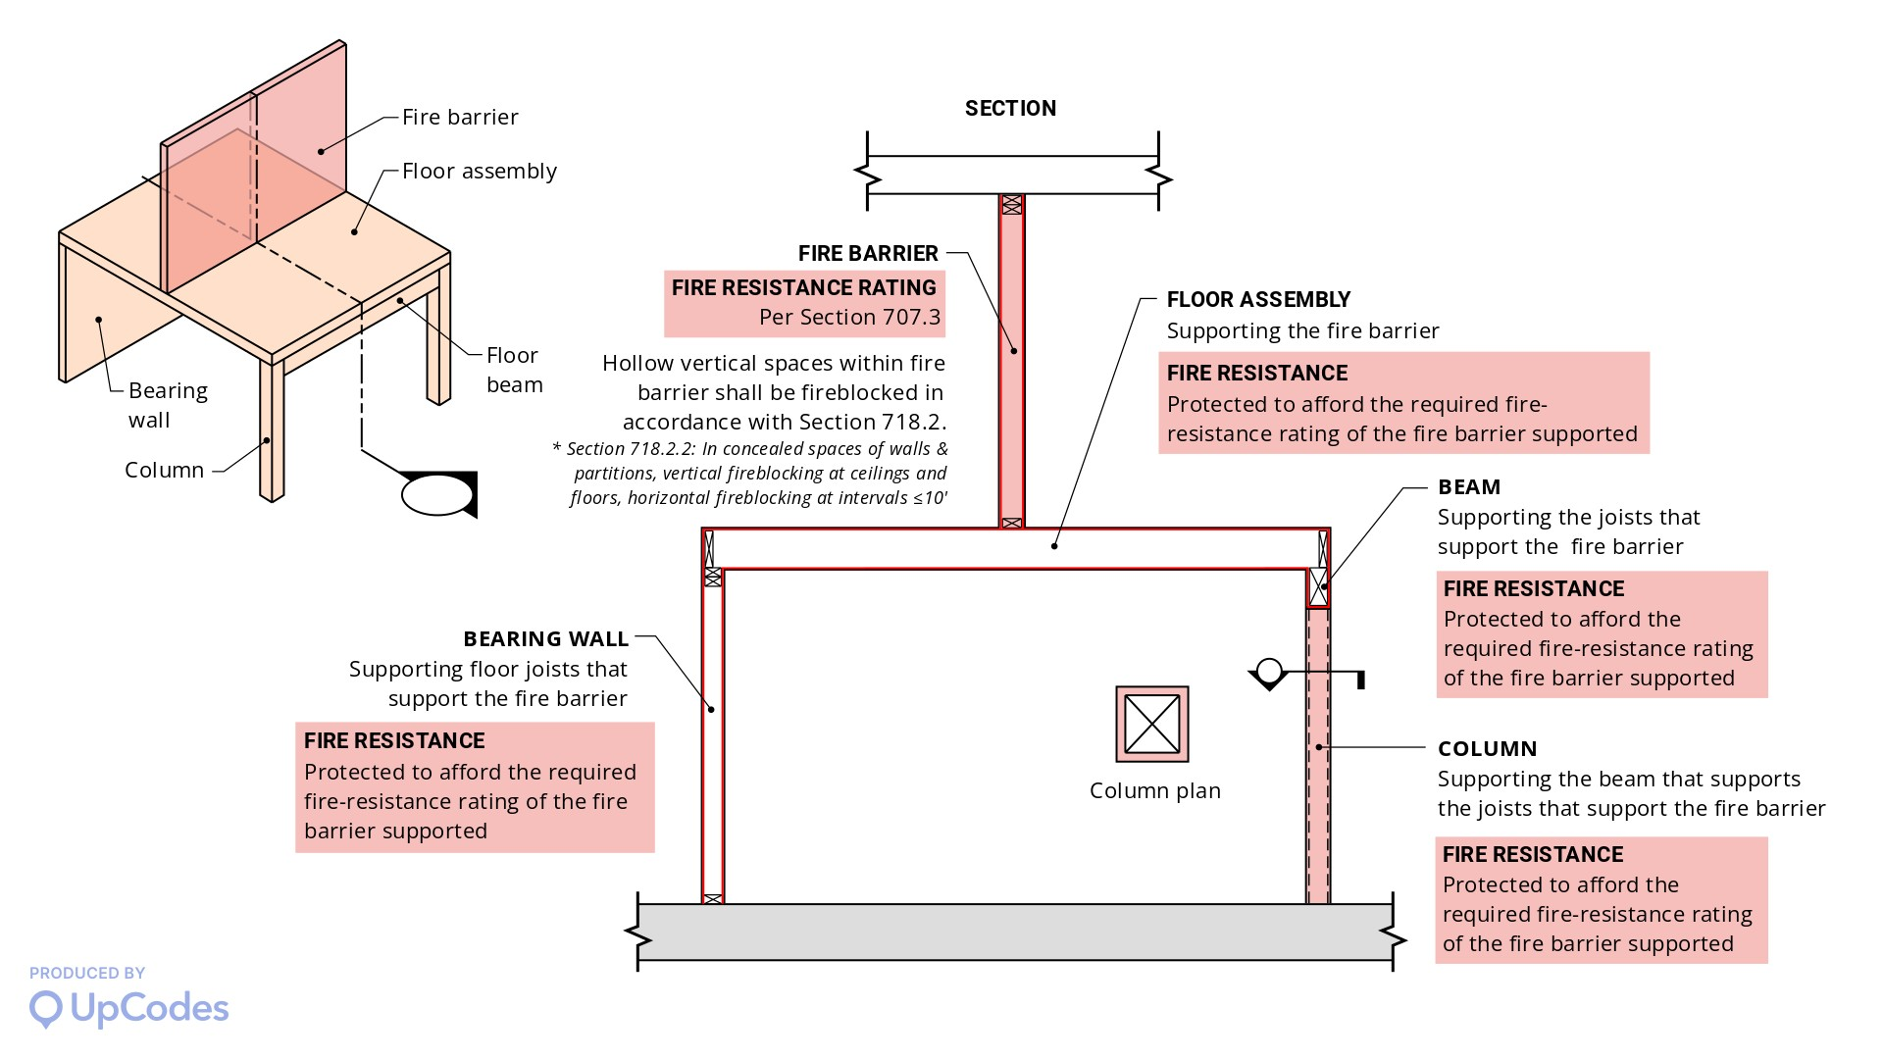

Slide 17
How is a control area identified?
A control area is a room or group of rooms separated by fire barriers from other areas of the building.
This fire barrier separation includes the walls, floor and deck above.
A fire barrier wall extends from the fire rated floor to the fire rated deck above.
The fire barrier supporting construction must also be fire rated.
All doors and openings into the control area must be fire rated.
All penetrations must be fire caulked.

Slide 18
How is a control area identified?
A control area is a room or group of rooms separated by fire barriers from other areas of the building.
This fire barrier separation includes the walls, floor and deck above.
A fire barrier wall extends from the fire rated floor to the fire rated deck above.
The fire barrier supporting construction must also be fire rated.
All doors and openings into the control area must be fire rated.
All penetrations must be fire caulked.
If there are no separations between rooms but the floors are fire rated, the entire floor could be the control area.

Slide 19
How is a control area identified?
A control area is a room or group of rooms separated by fire barriers from other areas of the building.
This fire barrier separation includes the walls, floor and deck above.
A fire barrier wall extends from the fire rated floor to the fire rated deck above.
The fire barrier supporting construction must also be fire rated.
All doors and openings into the control area must be fire rated.
All penetrations must be fire caulked.
If there are no separations between rooms but the floors are fire rated, the entire floor could be the control area.
If the floors are not fire rated, the entire building is the control area.
Remember the chemical quantities are limited per control area. If the entire building is your control area, the chemical quantities are severely limited.

Slide 20
How is a control area identified?
There are required ventilation rates.
The configuration of the ducts is regulated.
Hoods may be required.
The configuration of the hood exhaust is regulated.
Floors may be required to be liquid tight.
Chemical storage cabinets may be required.
A sprinkler system may be required.
In most cases, it is required.
The number of control areas per floor is limited based on the story that the control areas are located.
The higher the story, the fewer control areas allowed.

Slide 21
Who identifies the control areas?
Someone that understands what a control area is.
Someone that understands ventilation and exhaust requirements for chemical laboratories.
Someone that understands fire barriers and can identify proper fire barriers including supporting construction.
A qualified consultant.
We have had poor results with some consultants.
Facilities Engineering.

Slide 22
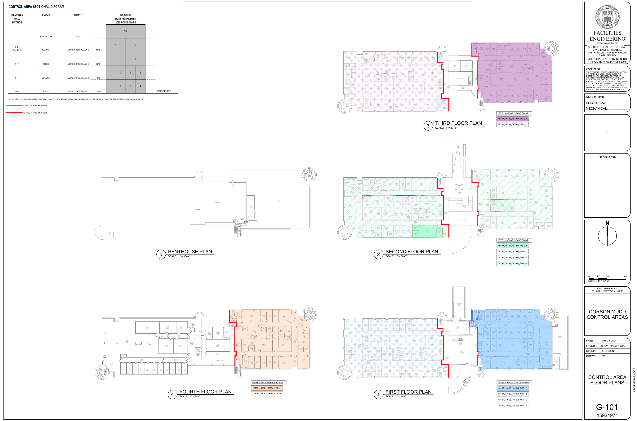

Slide 23
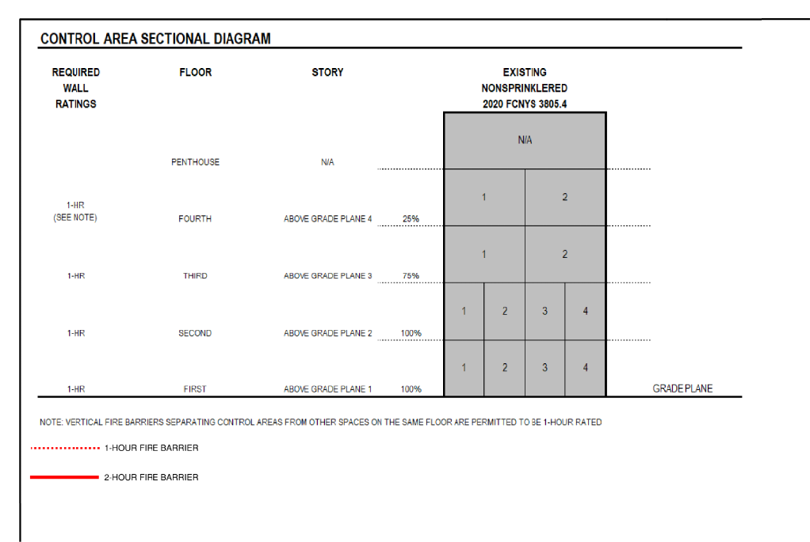

Slide 24
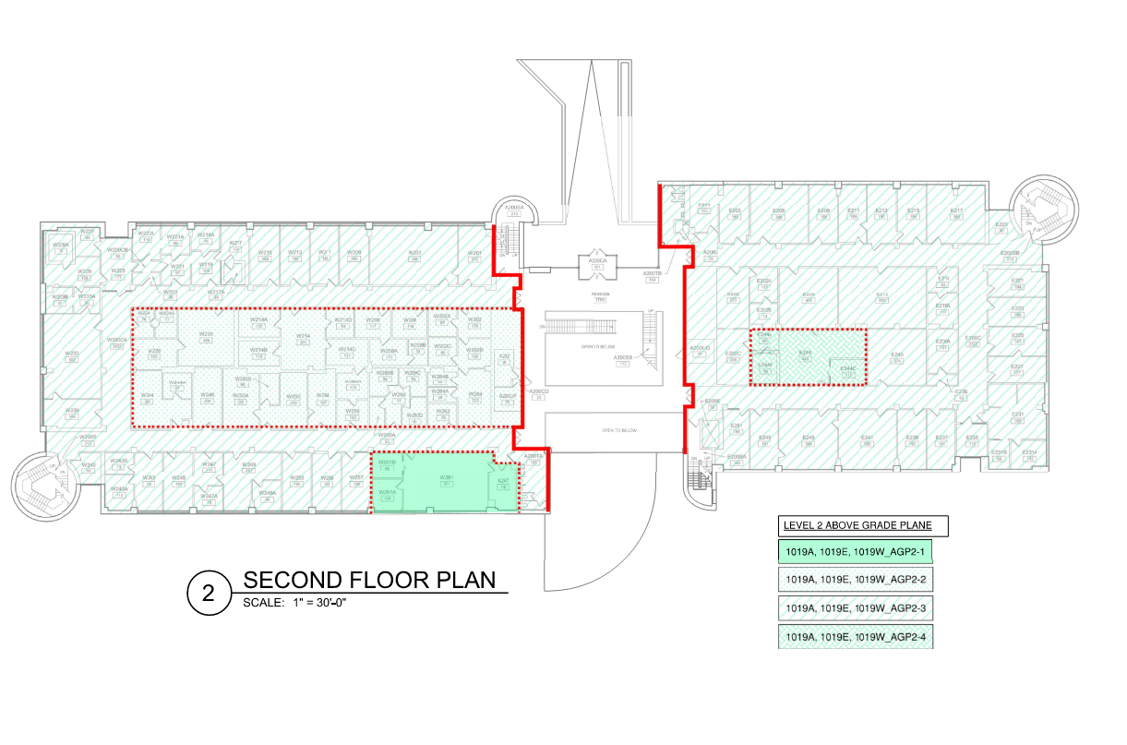

Slide 25
No Questions

