Slide 1
2025 NYS Code - Adopted
Michael Niechwiadowicz
Building Code Program Manager, FCS
October 15, 2025

Slide 2
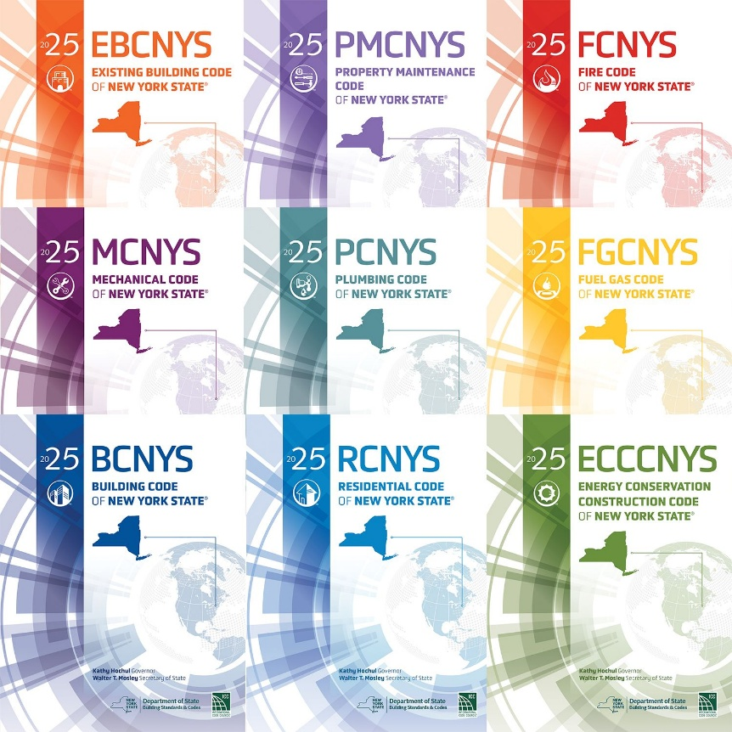
2025 NYS Codes
Adopted October 1, 2025
90-day grace period.
Applies to all the codes other than the energy code.
From October 1, 2025 – December 30, 2025, the current 2020 NYS Uniform Codes or the 2025 NYS Uniform Codes can be used.
December 31, 2025 the 2025 NYS Uniform Codes and 2025 NYS Energy Conservation Construction Code must be used.
This means if you want to use the 2020 NYS Codes you must submit the building permit with plans prior to December 31, 2025.

Slide 3
2025 NYS Codes - continued
You can view the 2025 NYS Codes on the ICC website:
https://codes.iccsafe.org/codes/united-states/new-york
The accessibility reference standard that NYS adopted is ICC A117.1-2017 with Supplement 1.
Supplement 1 covers adult changing stations.
https://codes.iccsafe.org/content/ICCA117.12017P7
There are requirements for new buildings and for existing buildings.
The new building requirements for clear spaces and turning spaces are larger.
For existing buildings, clear space and turning space requirements stayed the same as in ICC A117.1-2009.
NYS adopted a revised version of ASHRAE 90.1-2022
https://codes.iccsafe.org/content/NYSASHRAE9012025P1
All the references standards in the code have been updated to a more recent version.
Not necessarily to the most recent version, just more recent than in the 2020 Code.
The adopted versions are listed in the code.

Slide 4
2025 NYS Codes - continued
Not all the code requirements are in the Code books.
There are number of regulations in Title 19.
https://dos.ny.gov/laws-and-regulations-division-building-standards-and-codes
Part 1240 of Title 19 of the Official Compilation of Codes, Rules and Regulations of the State of New York.
This is the enacting legislation for the 2025 NYS Energy Conservation Construction Code.
It has the electrification requirement that prohibits fuel-fired conditioning equipment in new construction.
Applies to new 7-story or less buildings as well as 100,000 sf or less buildings with a building permit application date on or after December 31, 2025.
Applies to all new buildings with a building permit application date after December 31, 2028.
There are a number of exceptions.
Does not apply to buildings legally in existence prior to December 31, 2025.
This includes repair, alteration addition, relocation or change of use.
2025-7-17-rule-text-energy-code.pdf

Slide 5
Questions?

