Slide 1
RFP Lean Process Improvement
PMPD Presentation September 25, 2025

Slide 2

RFP Lean Process Improvement
Agenda
Lean Process Team
Trimble Process
Templates
Training
Implementation
Recommendations/Next Steps

Slide 3
RFP Lean Process Improvement
Lean Process Team
Bridgette Brady – Lean Process Facilitator
Brenda Frank – Contracts
Tanner Leto – Contracts
J Shermeta – OUA
Danielle Cox - CCF
Deb Melanson – E&PM
Jessie Dimick – E&PM
Jason Cragle – E&PM
Travis Fisher – E&PM
Stacey Edwards – Utilities
Brian Fish – CALS
Cole Tucker – E&S
Maddie Conklin - Finance
Goal: Improve throughput, build teamwork, enhance relationships with design & construction industry partners

Slide 4
RFP Lean Process Improvement
Considerations for RFP Process Improvement
Standards and expectations: Maintain level of professionalism with consultants and contractors and create a fair and equitable process
Schedule: Deliver projects on tight timelines
Quality: Attract the most capable service provider, consultant, or contractor in the available market
Partnership: Relationship in which we are jointly committed to the success of whatever project, process, or endeavor we are involved in.

Slide 5
RFP Lean Process Improvement
Roles
E&PM/Unit PM: Project Manager, Project Director – Prepares and reviews RFP and design agreement for submission to Contracts. Works with Contracts and Stakeholders to make any revisions necessary.
Stakeholders: University Architect, Contract College Facilities Director, Unit Representative – Reviews and comments on RFP and Design Agreement. Engages with Project Team prior to the RFP process.
Facilities Contracts: Reviews and finalizes RFP and Design Agreement for distribution to invited consultants.

Slide 6
RFP Lean Process Improvement
Sub Committee Approach
Trimble Process: Review and enhance the existing Trimble workflow and process view to streamline and improve efficiency. Clarify roles and expectations for all process stakeholders. (Brenda, Jessie, Travis, J)
Templates: Provide clarity on which Template to use, and how to use them. (Deb, Stacey, Brenda, Jason)
Training: Develop a comprehensive training program and standardized checklists for those engaged in the RFP process. This initiative is necessary to promote consistency and uniformity across all project management teams, reduce the number of revisions ("touches"), improve the quality of RFPs, and streamline the issuance process for low-complexity projects. (Danielle, Brian, Tanner, Travis)

Slide 7
RFP Lean Process Improvement
Trimble Process Committee Purpose
Define level of complexity for projects
Align project complexity with appropriate process flow
Improve Workflow Diagram
Review and adjust to Stakeholders at each step
Consolidate collaboration at each step
Reduce steps
Process View
Review and edit required information
Embedded guidance
Simplified navigation

Slide 8
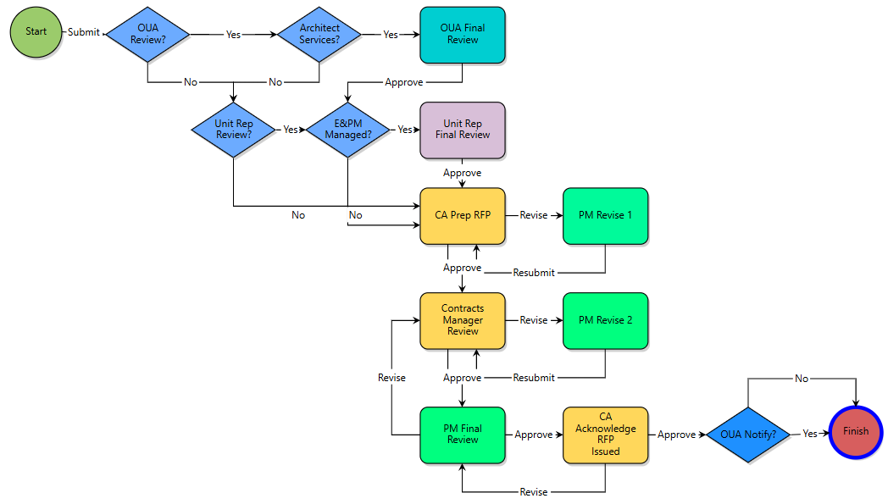
RFP Lean Process Improvement
Existing Trimble Workflow

Slide 9
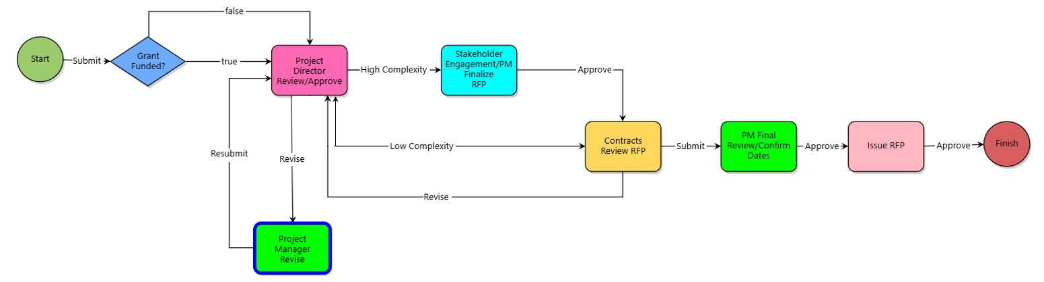
RFP Lean Process Improvement
Proposed Trimble Workflow

Slide 10
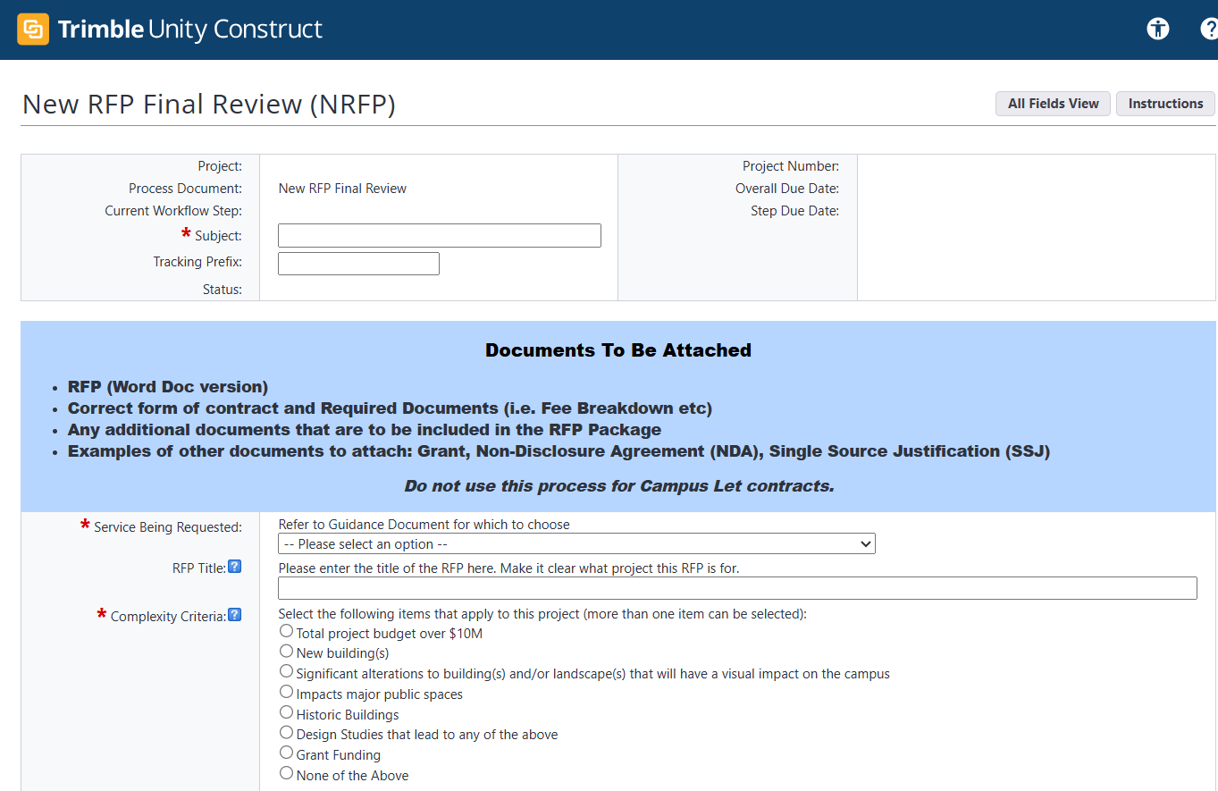
RFP Lean Process Improvement
Proposed Trimble Process View

Slide 11
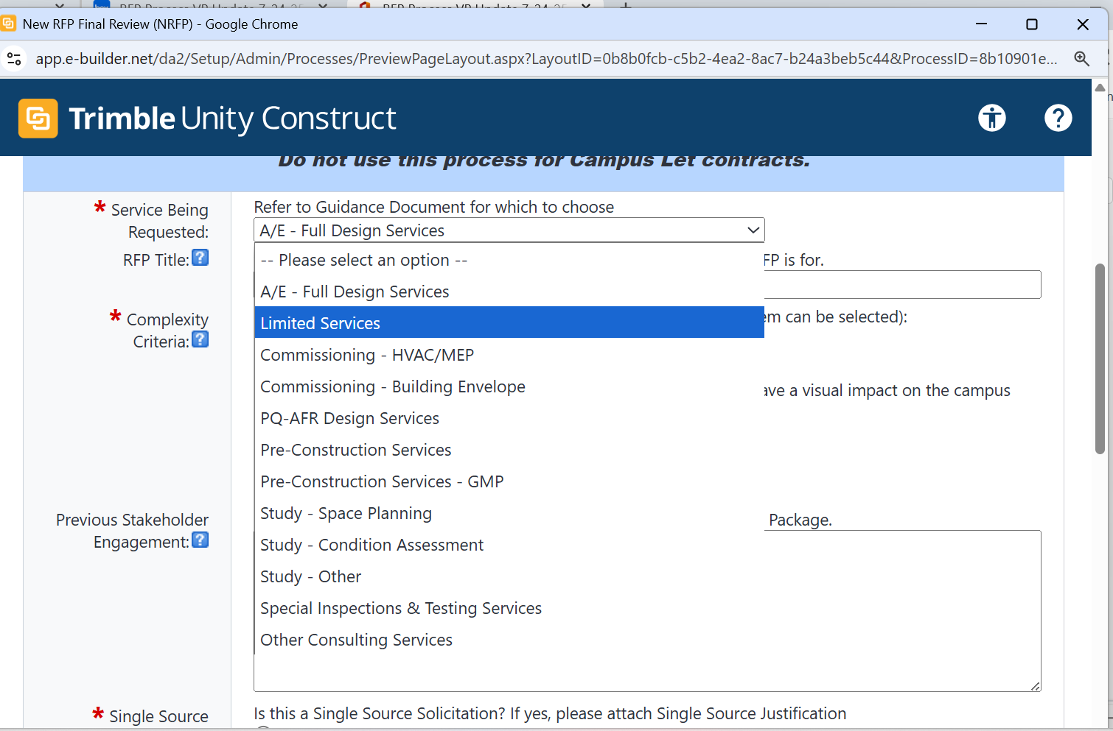
RFP Lean Process Improvement
Proposed Trimble Process View

Slide 12
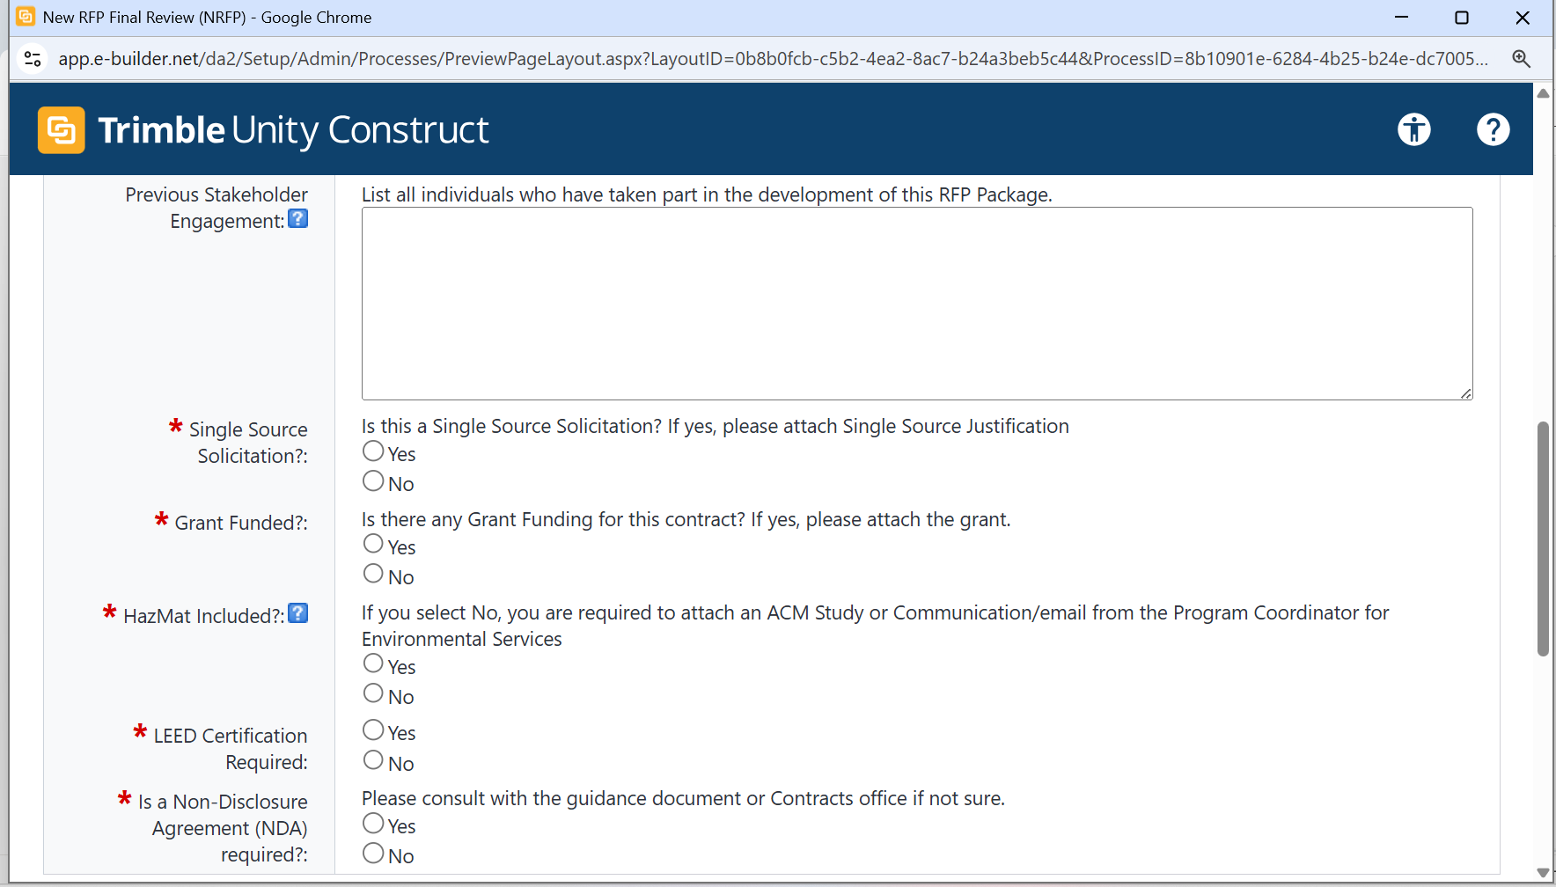
RFP Lean Process Improvement
Proposed Trimble Process View

Slide 13
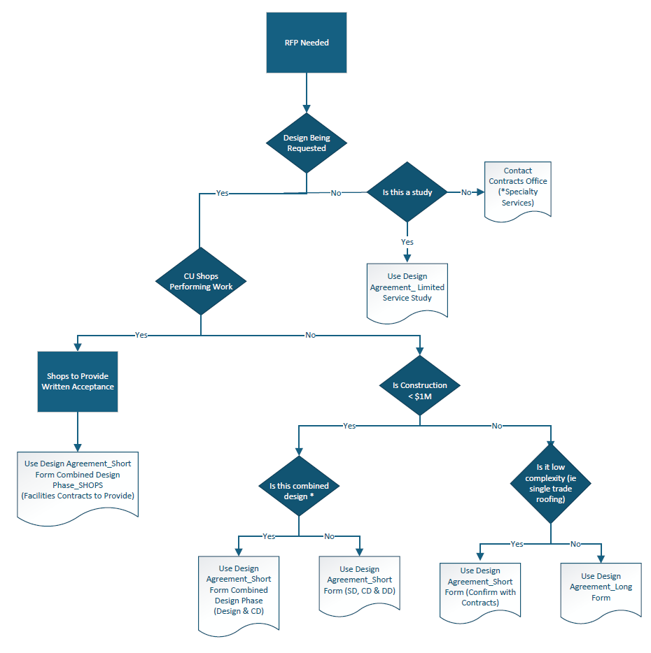
RFP Lean Process Improvement
Design Agreement Decision Tree

Slide 14
RFP Lean Process Improvement
Template Process Committee Updates
RFP Templates (Endowed and Campus Let):
Design Agreements – Architect/Engineer/Consultant
Limited Services – Study
Design Agreement Templates (Endowed and Campus Let):
Long Form
Short Form
Short Form Combined Design Phase
Limited Services
New Template for the Document Submittal Requirements
An Excel Spreadsheet replaces the cumbersome Word table

Slide 15
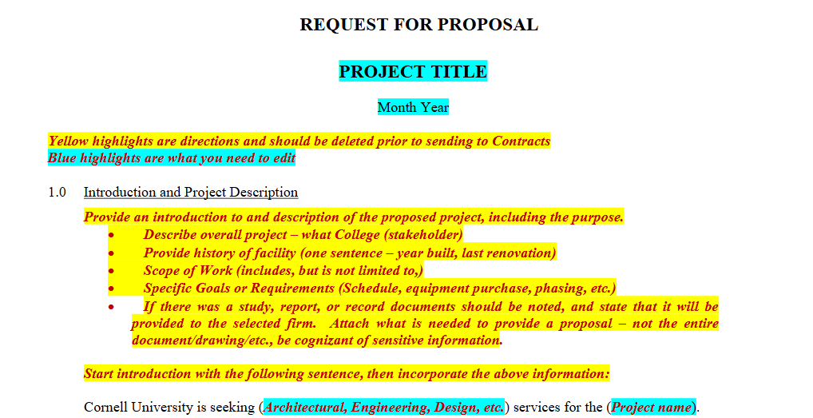
RFP Lean Process Improvement
RFP Design

Slide 16
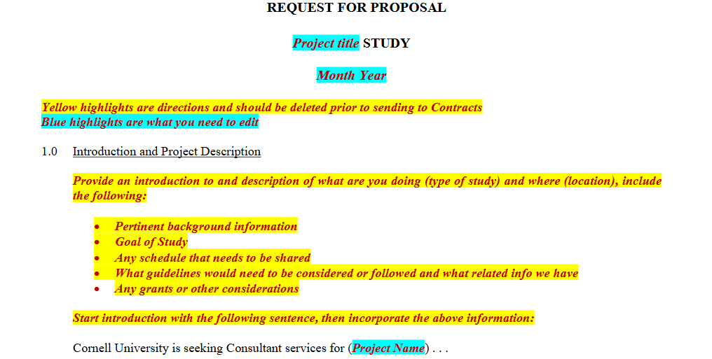
RFP Lean Process Improvement
RFP Study

Slide 17
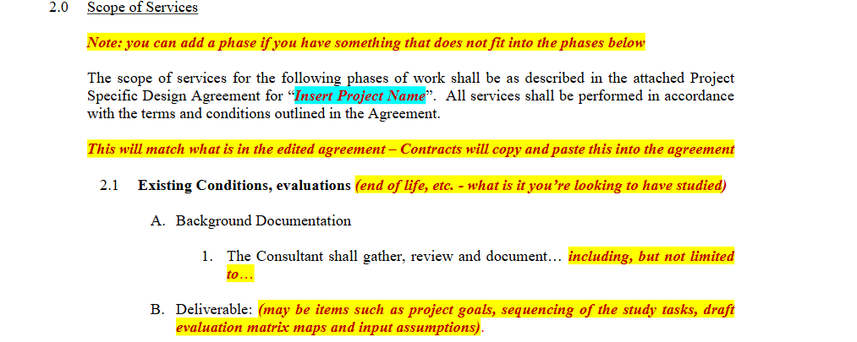
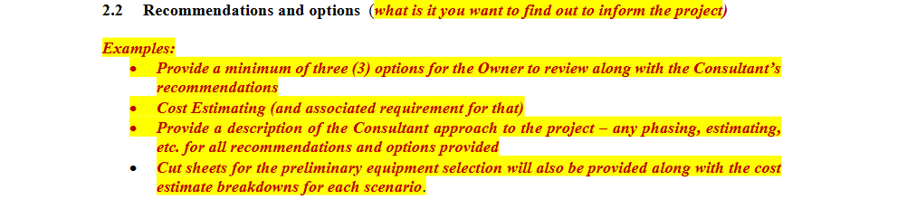
RFP Lean Process Improvement
RFP Study

Slide 18
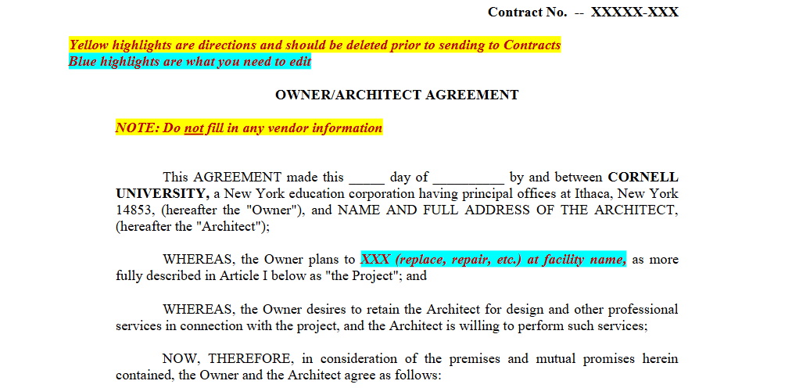
RFP Lean Process Improvement
Design Agreement – Short Form

Slide 19
RFP Lean Process Improvement
PM Training
Project Management Director to develop and execute training
Identify complexities with the project ahead of RFP submission and work with Facilites Contracts to develop proper language as needed
Emphasize the importance of grammar and clarity when drafting documents. Strong writing skills reflects attention to detail and professionalism.
Refer to Trimble Resource Guidance Document
Utilize Project Charter to gather pertinent information
Refer to and use examples in Trimble Resources of sample projects
Utilize the Consultant Agreement Decision Tree
Training for the use of the new required submissions excel sheet
If you are not sure always contact Facilities Contracts

Slide 20
RFP Lean Process Improvement
Facilites Contracts Training
Contracts Lead and Manager to develop and execute training
RFP triage process and setup for document review
Prepare the documents for successful responses

Slide 21
RFP Lean Process Improvement
Stakeholders Training
Convey direction on how to provide comments.
Identify the areas of focus for review.

Slide 22
RFP Lean Process Improvement
Implementation
New templates uploaded to Trimble on October 1st for immediate use.
Formalize the proposed Trimble Workflow and Process view
Pilot a test project with users not engaged with the LEAN process
Stakeholder Liaison Meetings
Combined FCS and Stakeholder workshop (Partnership and Collaboration)
Live RFP development (video training)
Onboarding – Using Training documents and meetings to get up to speed.
Communication plan
Ongoing Support

Slide 23
RFP Lean Process Improvement
Recommendations/Next Steps
Target implementation dates/deliverables:
Release revised templates for use (Sept)
Create pilot process flow and view (Oct)
Draft guidance (Oct)
Run the pilot (Nov)
Finalize guidance documents (Nov)
Communication (Dec)
Training (Ongoing)

