Slide 1
Project Management Professional Development Series
September 25, 2025
Facilities and Campus Services Engineering and Project Management
Notes:
August 14

Slide 2

Today’s Agenda
Upcoming Load Shed Test
  Jason Collins
Checklist/Guidance Document Highlight
  PCOs and COs Guidance
New RFP Process
  Travis Fisher and Brenda Frank
SPIF Updates
  Taylor Sitko and Travis Fisher
QA Program Snapshot
  Liesl Margolin

Slide 3
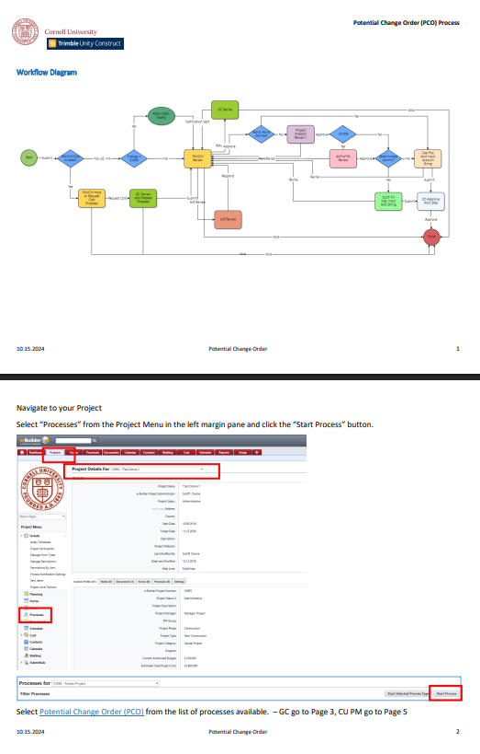
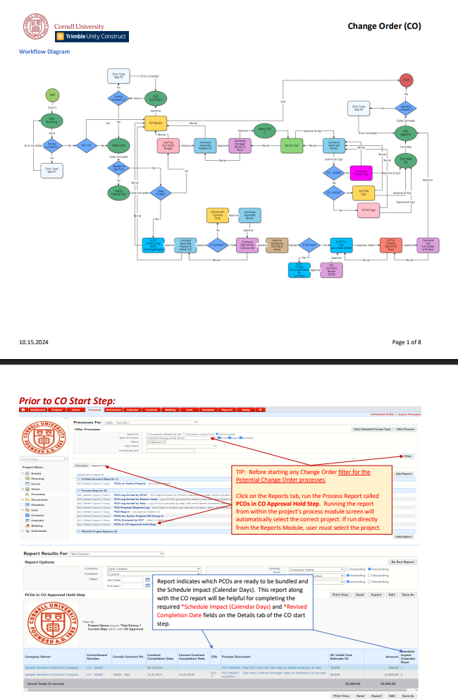
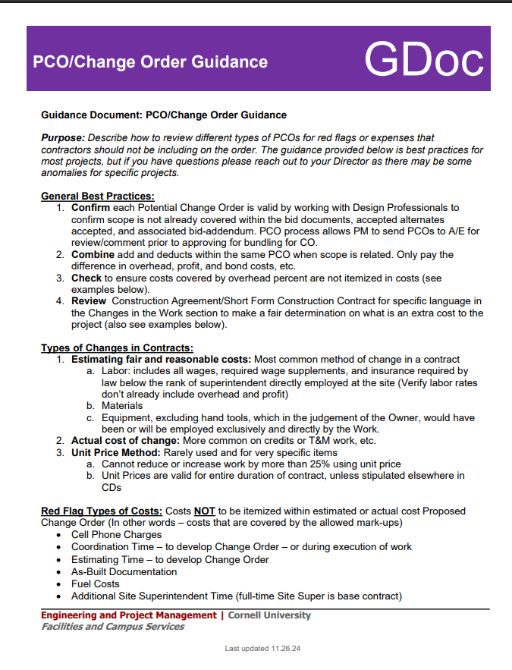
Change Order Guidance
Notes:
PCO folder – PM guidance, description samples, PCO forms
CO Folder – guidance
Our guidance - Best practices, red flags, change orders for state projects,

Slide 4
RFP Process

Slide 5

Trimble Unity Construct
(formerly known as eBuilder)
SPIF Updates - September 2025

Slide 6
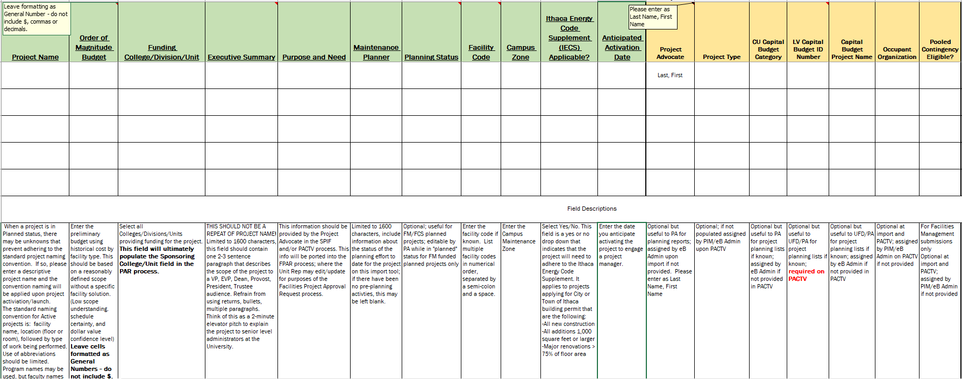
SPIF Updates
Notes:
New look with descriptions! Fill it out in the same manner but check out the new fields.

Slide 7
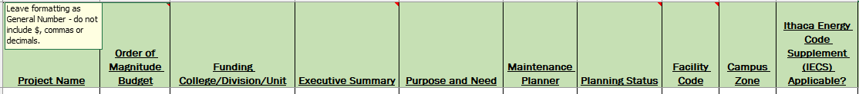
SPIF Updates
Estimated Total Project Cost field is replaced by the new Order of Magnitude Budget field
The IECS Code Supplement Applicable field is new and required
  This field is a yes or no drop down that indicates that the project will need to adhere to the Ithaca Energy Code Supplement. It applies to projects applying for City or Town of Ithaca building permit that are the following:
    All new construction
    All additions 1,000 square feet or larger
    Major renovations > 75% of floor area
The following fields are now REQUIRED:
  Purpose and Need
  Maintenance Planner
The following field is now removed:
  Activate project immediately? – please just let us know if you would like to do this
Notes:
Estimated Total Project cost field is replaced by the new Order of Magnitude Budget field
This is a new field.
Enter the preliminary budget using historical cost by facility type. This should be based on a reasonably defined scope without a specific facility solution. (Low scope understanding. schedule certainty, and dollar value confidence level) Leave cells formatted as General Numbers - do not include $, commas, or decimals. This field is entered by the Project Advocate in the SPIF and will not be edited after the project is imported.
IECS Code Supplement Applicable field is new and required
Select Yes/No. This field is a yes or no drop down that indicates that the project will need to adhere to the Ithaca Energy Code Supplement. It applies to projects applying for City or Town of Ithaca building permit that are the following:
All new construction
All additions 1,000 square feet or larger
Major renovations > 75% of floor area"
The following fields are now REQUIRED:
Purpose and Need
Maintenance Planner
We have removed:
Activate project immediately? – please just let us know if you would like to do this
*Will be updating the SPIF in Trimble folder structure within the next day and will send out an email as a follow up with all this information

Slide 8
Project Cost Development Framework
Project Development Phase
Design Phase (SD,DD & CD)
Bid
CB
FPAR
DA
FPAR
CA
Construction Phase
Order of Magnitude
Early capital planning
Sponsoring unit & FCS
Low scope understanding
Low schedule certainty
Low $ confidence level
Benchmark Budget
FPAR design authorization
Unit & FCS/consultancy
Med. scope understanding
Medium schedule certainty
Medium $ confidence level
Design Phase Estimate
Adjusted per design estimate
A/E & consultants
Higher scope understanding
Higher schedule certainty
Higher $ confidence level
Final Project Cost
Final authorization (final cost)
Contractors bid & PM final budget
Scope determined
Schedule determined
Actual cost
CB: Capital Budget Submission. Need is established but facility solution may not yet be understood.
Project Development Phase: Time period between capital budget submission and design authorization FPAR where scope schedule and budget is better defined by Units and FCS through benchmark analysis and consultancy.
FPAR DA: Facilities Project Approval Request – Design Authorization
FPAR CA: Facilities Project Approval Request – Construction Authorization
New Budget Terminology
Capital Budget
Design Phase
Bid Phase
Construction Phase
Notes:
Order of Magnitude Budget: Preliminary Budget using historical cost by facility type. Based on a reasonably defined scope without a specific facility solution.
Benchmark Budget: Opinion of internal subject matter experts informed by scope, intended schedule, and project limit lines but not yet fully informed by confirmed scope and schedule and existing conditions.
Design Phase Estimate: Cost estimate from AE Team based on design phase documents (schematic, design development).
Final Project Cost: Authorized construction FPAR value based on a contractors bid.

Slide 9
Project Cost Development Framework
 | Order of Magnitude Budget | Benchmark Budget | Design Phase Estimate (Typically Project > $10M, B&P) | Final Project Cost
Use | Early Capital Planning | First Project Approval Request (FPAR Design Authorization) | Adjust Benchmark Budget or subsequent estimate based on design effort | Final authorization
Definition | A preliminary budget using historical cost by facility type Based on a reasonably defined scope without a specific facility solution | Opinion of internal subject matter experts informed by scope, intended schedule, and project limit lines but not yet fully informed by confirmed scope and schedule and existing conditions; Risk section of FPAR used to discuss qualification of the # | Cost estimate from AE team based on design phase documents (schematic, design development) | Authorized construction FPAR value based on a contractors bid.
When Applied | At the initial project development stage – the need is established but the facility solution may not yet be understood | FPAR for design authorization | FPAR for design (revised) authorization, presented with Approval of Concept, Approval of Design, or as otherwise required during design phase | FPAR construction authorization
Developed by | In partnership between sponsoring unit and FCS for unit cost data | In partnership between sponsoring unit and FCS to respond to project parameters Limited scope feasibility, condition assessment or similar studies may inform | Consultants | Based on contractor’s bid and project managers final project budget
Project Parameter Understanding | Very Low – May be need without identified solution | Medium, preferred solution is identified but limited information may exist about existing conditions | Increasing during design phase | Fixed cost through construction of project scope. Includes 10% owner’s contingency
Basis | Subject matter experts on staff | Subject matter experts on staff and/or consultancy | External expertise | Actual bid cost
Confidence Level | Often Low | Medium | High, but may miss future market conditions for projects with a long design phase | Very high
Rounding Guidelines | < $1M: nearest $50k $1-2M: nearest $100k $2-10M: nearest $500k >$10M: nearest $1M | < $2M: nearest $50k $2-10M: nearest $100k >$10M: nearest $500k | < $2M: nearest $10k $2-10M: nearest $50k >$10M: nearest $100k | NA
Escalation | Considered in projecting project start date, but not updated each year while in capital plan | Considers start point and completion date | Included in professional estimating Informed by project schedule | NA

Slide 10
Questions?
SPIF Updates

Slide 11
QA Program Snapshot

Slide 12
Questions?

