Slide 1
Bluebeam Design Review Process
Trimble Unity Construct Presentation

Slide 2

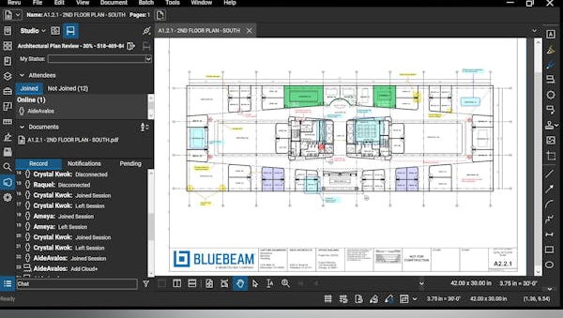
Bluebeam
Streamlined Workflow
Better Collaboration
Improved Version Control
Document Management
Notes:
Bluebeam Revu is a powerful PDF creation, editing, markup, and collaboration software designed to streamline workflows, improve project communication, and enhance collaboration among AEC professionals. Revu allows users to work with PDFs, mark them up with various tools, and collaborate in real-time using its built-in Studio feature
Project managers benefit from real-time access to up-to-date designs and markups, reducing delays and ensuring accurate decision-making. For reviewers, seamless synchronization between platforms eliminates redundant file handling, provides better version control, and simplifies the review and approval process.
This is what it looks like and Victoria will be going into more detail later in the presentation.
The integration helps teams quickly identify, mark, and resolve issues, ensuring alignment with project goals and reducing costly rework. Additionally, by centralizing data and improving accessibility across the cloud, managers and reviewers can maintain project oversight, ensure compliance, and enhance overall productivity—all while saving time and costs.

Slide 3
What do you need to get started?
As a PM: Bluebeam Revu 21 required to initiate Bluebeam session
As a Reviewer: Bluebeam Revu 21 or Bluebeam Cloud (online version)
As an Administrator: Bluebeam Revu 21 or Bluebeam Cloud
Notes:
Basics is $260/year
Core is $330/year
Complete is $440/year (What most of FCS license holders have)
Bluebeam Cloud Core subscription OR
Bluebeam Cloud Complete subscription

Slide 4
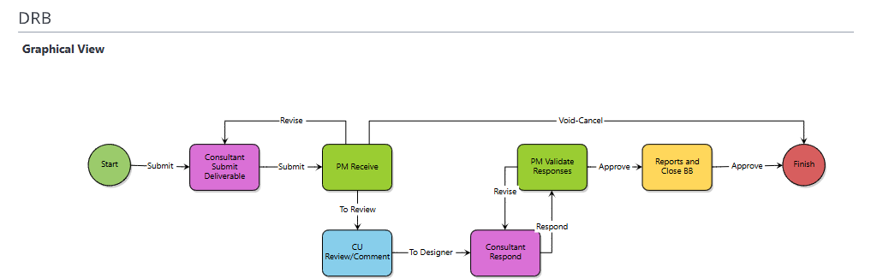
Trimble + Bluebeam Design Review
  Project Managers or Project Coordinators initiate the design review via the DRB (Design Review + Bluebeam) process in Trimble.
  PM/PC will invite consultants and reviewers to the BB session
  Admins for specific departments (ex. FE/Madison) can add participants to the Studio session.
  PM's utilize the Design Review Contact List to add reviewers.

Slide 5
Workflow Walkthrough
Notes:
Taylor PM
Jessie AE
Victoria reviewer
Carina reviewer

Slide 6
Bluebeam Design Review Key Takeaways
  PMPD follow up email will include the design review contact list, if you're not on this list and need to regularly review documents, please reach out.
  If you utilize administrators for assigning design reviews, please have them reach out for training.
  Be sure the studio@bluebeamops.com email is hitting your inbox and not junk.
  Review the guidance documents and let us know if you have any comments/changes.

Slide 7

Next Steps
Attend one of our training sessions on:
  August 18 at 2pm
  August 21 at 11am
  August 25 at 1pm
  August 28 at 9am
Invite the PMIS team to your first Design Review!

Slide 8
Available Resources
PMs and Reviewers
Guidance Document
One Pager for Reviewers
PMIS Team
Power Users
Training Sessions
Notes:
Michael Kuo
Victoria
Quinn

Slide 9
Questions?

