Slide 1
Trimble Unity Construct (TUC) (formerly known as eBuilder)
June 2025

Slide 2
Closeout/Cancellation Process Best Practices

Slide 3
Closeout/Cancellation Process
Process was updated in October 2022
Initiated by Project Manager, Construction Manager or Project Coordinator
Roles involved include FIG Rep, Capital Accountant, Contracts Manager, SUCF Finance Manager, Plant Accounting Rep, Finance Manager
Closeout a completed project
Cancel a partially completed project or one that never got started
Required for ALL Projects in eB (Capital, Small, Stand Alone Contract and Blanket Agreement Projects)

Slide 4
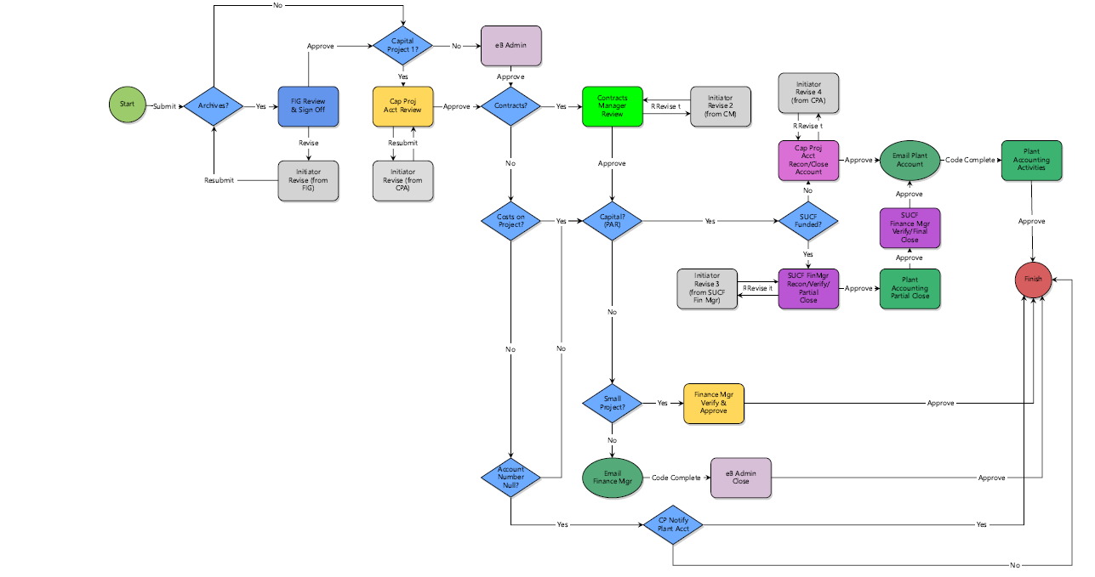
Closeout/Cancellation Process

Slide 5
Closeout/Cancellation Process
Three key questions will affect what other information will be required AND how the process will route

Slide 6
Closeout/Cancellation Process
FIG
IF Archivable Documents:
Verify all items checked in process are included in the 12 Close-Out Documents folders in Trimble
New process for the Archiving Team to be more connected with PMs and their projects.

Slide 7
Closeout/Cancellation Process
Capital Accounting
Items that are done/confirmed in this step:
Confirm Workorders and Service Requests are closed
Make sure Purchase Orders are final billed
Validate Invoices, consultant final invoice should be marked last in the IA process to indicate no further billing is expected
Validate that TA’s are marked final or First & Final if applicable
Confirm no further expenses are expected to hit the project
KFS Encumbrances are cleared

Slide 8
Closeout/Cancellation Process
Contracts
What is done/confirmed in this step?:
Ensure no open litigation (PIP, etc)
Confirm no funding still committed to any contracts
If any funding still committed to contract, an Amendment (CAA) or Change Order (CO) needs to be initiated
Exception to last bullet is Reimbursables on design agreement
If grant funded confirm all requirements have been met

Slide 9
Closeout/Cancellation Process
Capital or SUCF Accounting
What is done/confirmed in this step?:
Reconcile Trimble to KFS; SUCF projects also reconcile to SFS (State Financial System)
Submit request to close capital account
SUCF Funded projects have Partial Close step, then a Full Close later in the process

Slide 10
Closeout/Cancellation Process
Plant Accounting
What is done/confirmed in this step?:
Capitalization of expenses
Any unspent funds are returned to funding unit account
For multiple funding sources unused funding is returned on a percent-to-total basis (aligned with original funding allocations
If a project is cancelled, fall project costs will be journaled to the non-capital sub-account
Certificate of Completion/Occupancy downloaded from Trimble

Slide 11
Closeout/Cancellation Process
Certifies that all contractual obligations have been fulfilled
Archives all required documentation properly
Closes all contracts, work orders, purchase orders officially in Trimble & KFS
Closes project account(s) officially in Trimble & KFS
Communicates project closure or cancellation to Unit Representative
Updates Project Status, Project Status 2, Status Update, Project Phase, Project Account Activated?, and Close Date fields on the project details page automatically

Slide 12
Closeout/Cancellation Process
Find the Process Guidance Document here:
Documents \ User Resources \ CC - Closeout Cancellation Process
For help at any time, please email the FCS Project Management Information System(PMIS) group: fcs-pmis@cornell.edu

Slide 13
Questions?
Closeout/Cancellation Process

