Slide 1
City of Ithaca Limited Site Plan Review
City-CU process
PMPD
June 11, 2025

Slide 2
City of Ithaca Limited Site Plan First Steps
Step 1: Check in with CU Planning Office to confirm this is a City project that will be deemed a limited scope review
Alt Step 1: City of Ithaca Building Division identifies a project for limited site plan during a regular CU-City Tuesday project review meeting
Examples of projects/scopes that required limited site plan review:
Projects that result in permanent site changes:
Tree removals, landscape design projects/modifications
Addition of new site features: pavement, lighting, bus/bike shelters (depends on extent of additions)
Interior renovation projects that will result in small-moderate permanent exterior site modifications (above-grade utilities)
New building- with modest footprint (shed, storage facility)
Window, door, wall, visible roof changes to existing structures (ex. egress projects)

Slide 3
City of Ithaca Limited Site Plan Support Materials
Draft a brief narrative (1-2 paragraphs) describing the project, impacts, extent and proposed construction timing
Use google map aerial images/streetview to convey general context, building/site location, and exact project site (indicate with arrows/circles imposed on image)
Do NOT submit an entire drawing set. Instead, submit layout/landscape sheets OR develop a SIMPLE Site Plan depicting project site, include any relevant elevations

Slide 4
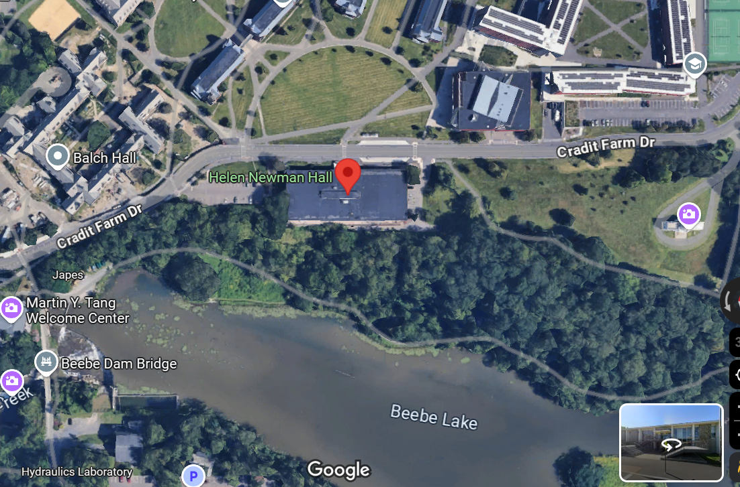
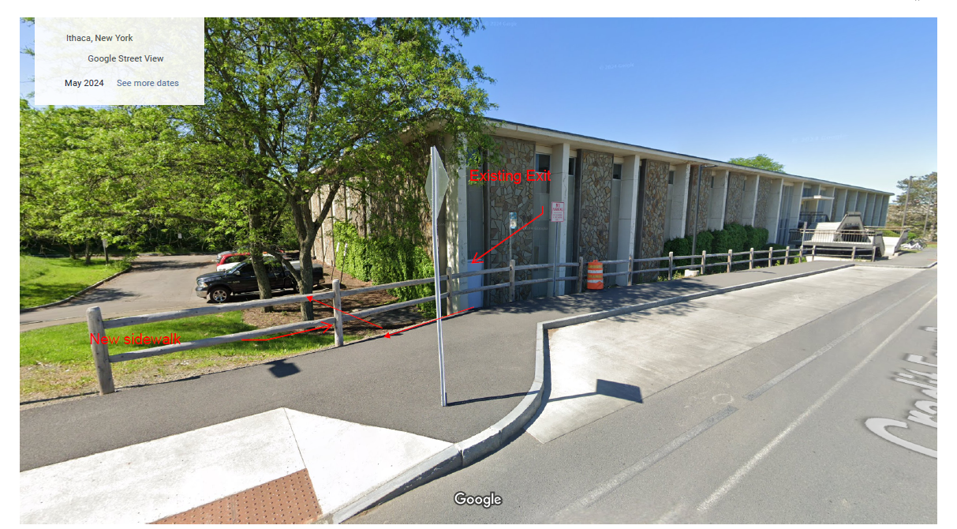
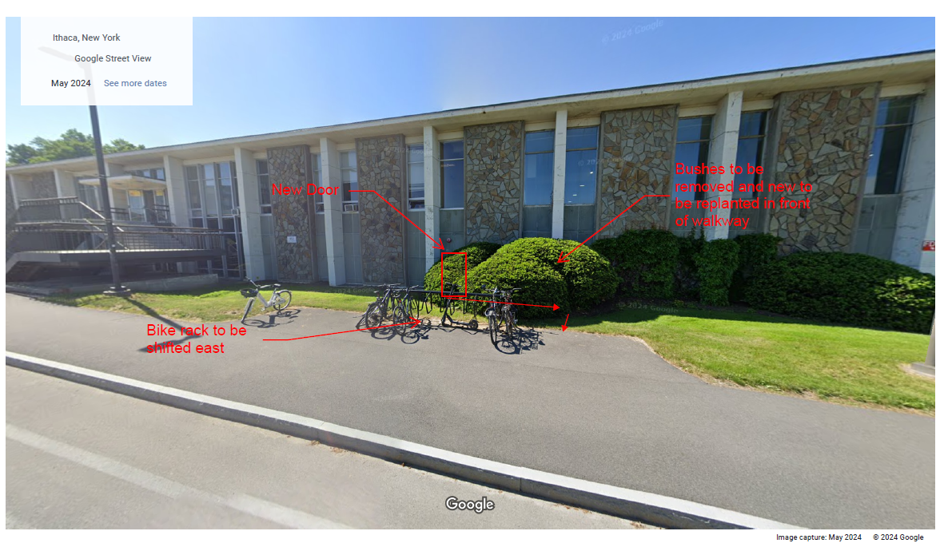
City of Ithaca Limited Site Plan Support Materials
Ex. Brief narrative: Cornell seeks limited site plan review for an upcoming project at Helen Newman Hall at 163 Cradit Farm Rd, where CU is adding a new code-required egress door to the front of the building, plus a new pathway to the existing sidewalk. This will involve moving a bike rack slightly. We will also be adding a pathway at an existing egress door that connects to the sidewalk
Ex. Google aerial images and/or street view showing general context, location, + exact project
Notes:
Ex. 2 – Carpenter Hall reno: This is an interior renovation of the lower level of Carpenter Hall, located on the Cornell Engineering Quad.
To provide more functional space, windows, louvers, and window wells are being added along with
mechanical systems. This will have limited impact to the exterior of the building, including the removal of
one tree that will be replaced in kind. Windows will be specified to match existing windows on the facade.

Slide 5
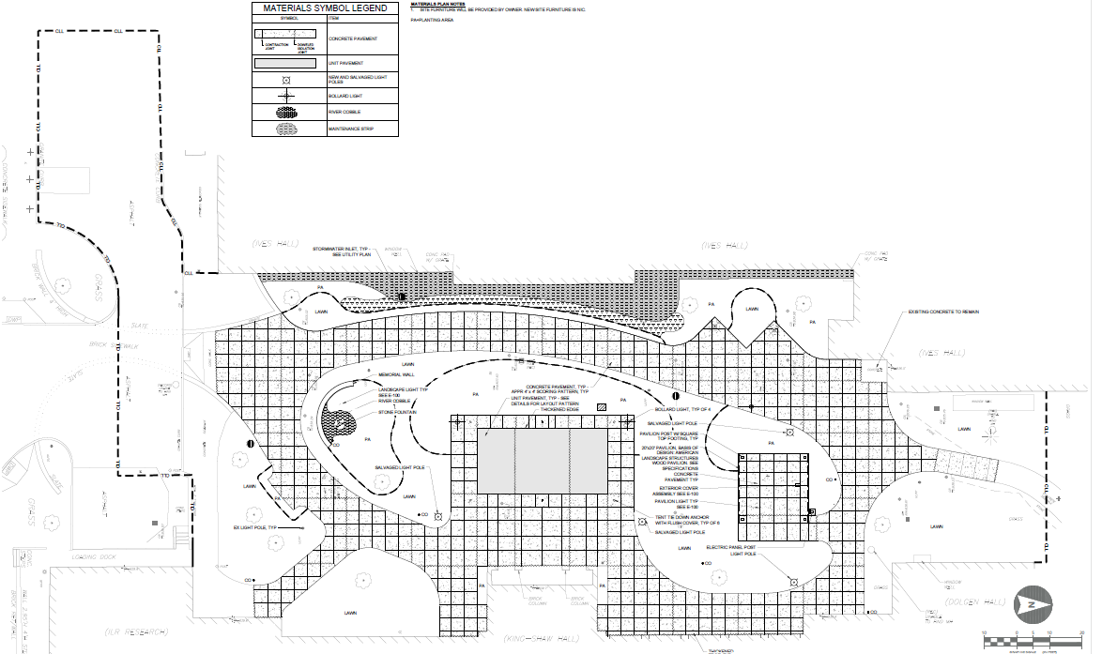
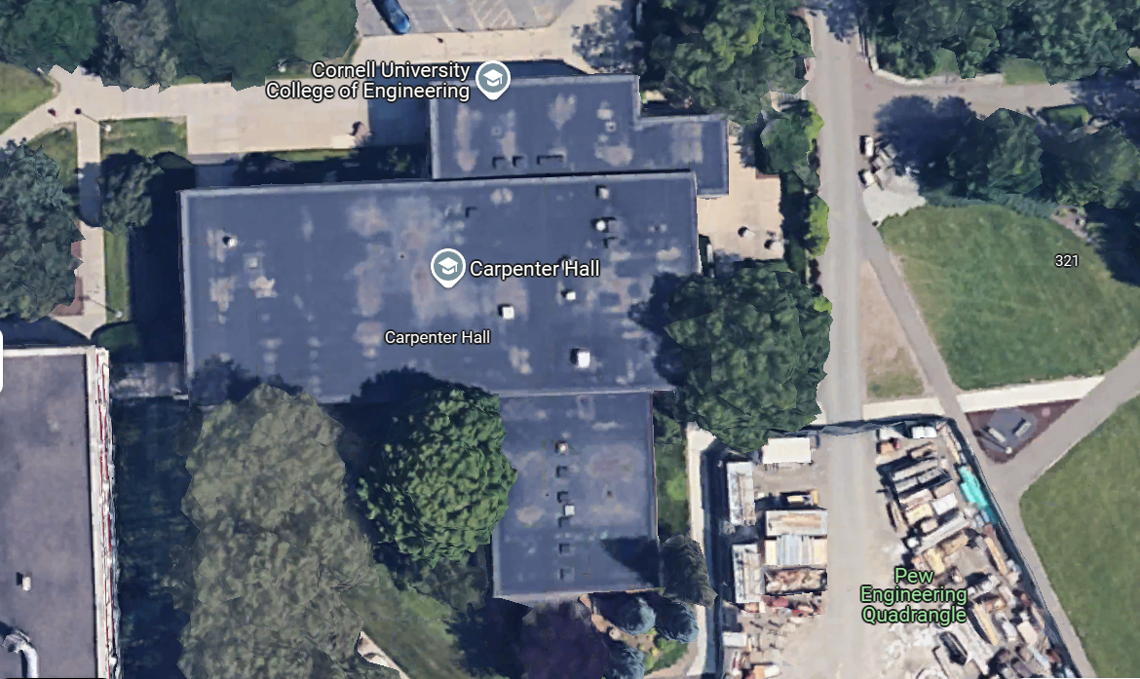
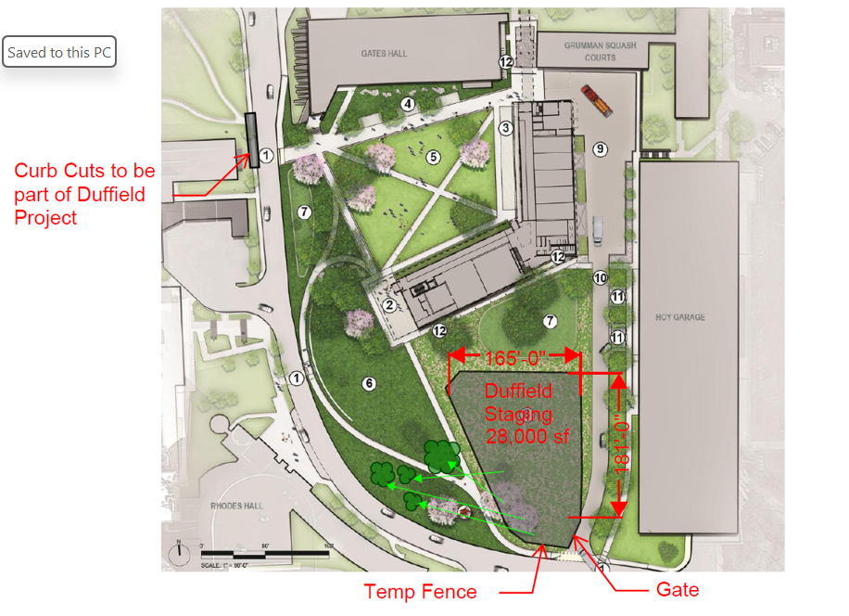
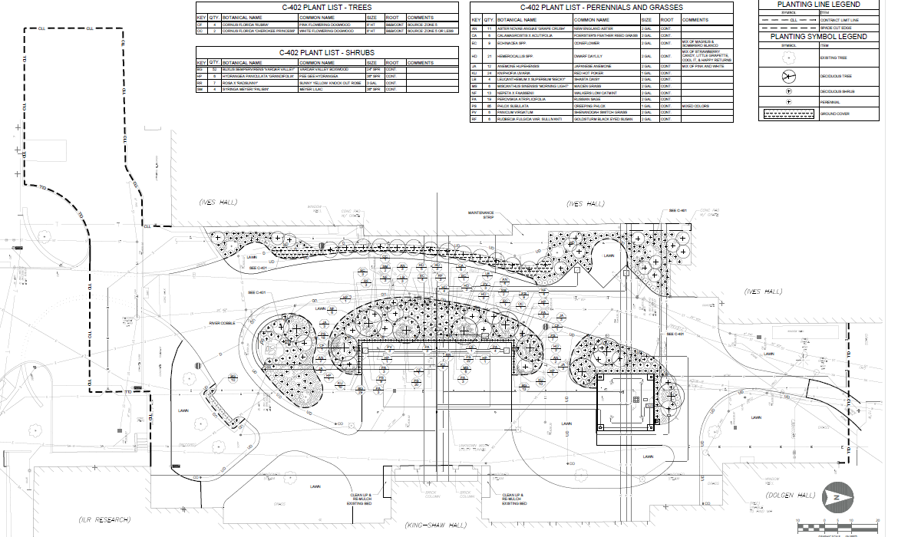
City of Ithaca Limited Site Plan Support Materials
Ex. Simple Site Plan: Options – marked up aerial or site design doc, or select bid sheets
Bid docs: hardscape/landscape
Google aerialcape
Mark up of design sheets

Slide 6
City of Ithaca Site Plan Links & Applications
Visit City’s Site Plan website https://www.cityofithaca.org/199/Site-Plan-Review-Application-Process-For
Scroll to bottom to Application form for Projects of Limited Scope
https://www.cityofithaca.org/DocumentCenter/View/16806/LSPR-App-Pkg-2024?bidId= (download this form)

Slide 7
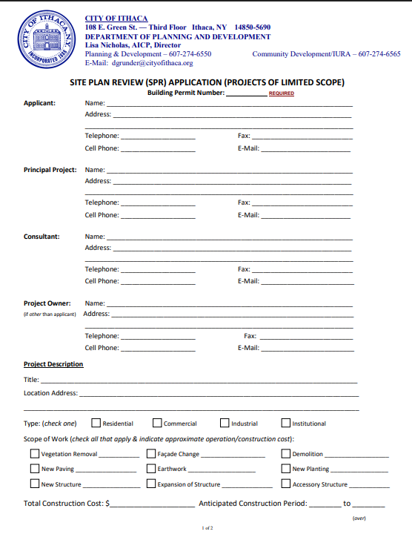
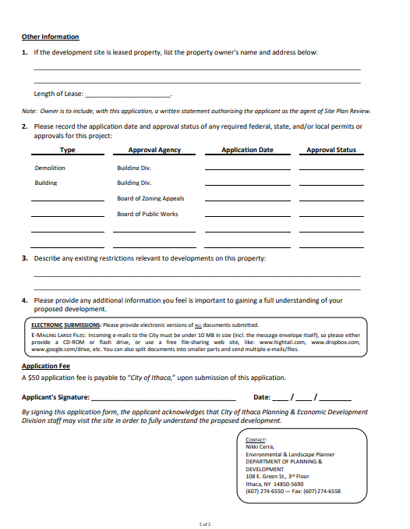
City of Ithaca Limited Site Plan Application
Always: Complete Pages 1 + 2 & Sign

Slide 8
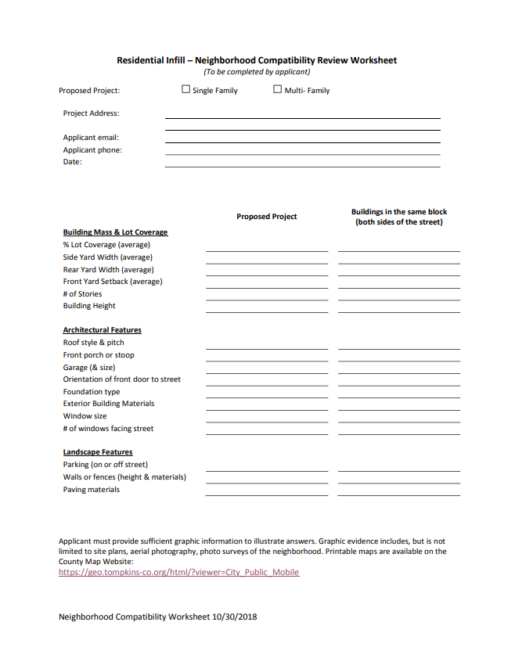
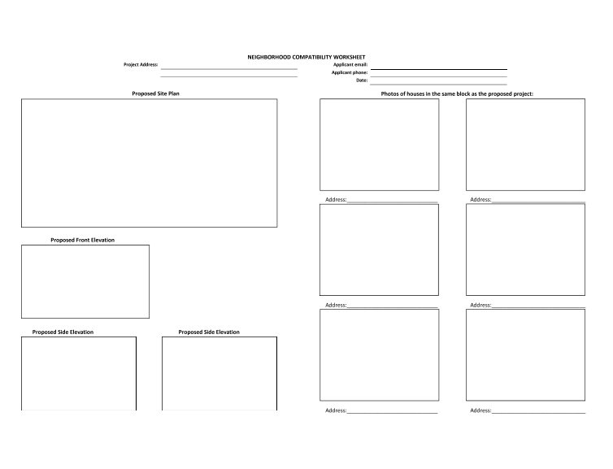
City of Ithaca Site Plan Process
Check: with Campus Planning to see if your project requires pages 3-4 (Usually not required, but depends on project location, land ownership, etc)

Slide 9
City of Ithaca Limited Site Plan Application
Example Pg. 3

Slide 10
City of Ithaca Limited Site Plan Submittal
Final Steps:
Review entire submittal package with Campus Planning
Email package to Nikki Cerra, City of Ithaca Planning Dept &cc:
Mike Aiken, City Building Division maiken@cityofithaca.org
Leslie Schill Leslie.Schill@cornell.edu
Mike Niechwiadowicz mln24@cornell.edu

