Slide 1
Project Management Professional Development Series
June 11, 2025
Facilities and Campus Services Engineering and Project Management
Notes:
August 14

Slide 2

Today’s Agenda
Room Numbering for Small and Large Projects
  Stella Garber
Closeout Best Practice
  Jessie Dimick
Recent BTC Grievances Update
  Laurie Johnston and Jared Pittman
City of Ithaca Limited Site Plan Process
  Leslie Schill

Slide 3
Room Numbering for
Small and Large Projects

Slide 4
Closeout Best Practices

Slide 5

Trimble Unity Construct (TUC)
(formerly known as eBuilder)
June 2025

Slide 6
Closeout/Cancellation Process Best Practices

Slide 7
Closeout/Cancellation Process
Process was updated in October 2022
Initiated by Project Manager, Construction Manager or Project Coordinator
Roles involved include FIG Rep, Capital Accountant, Contracts Manager, SUCF Finance Manager, Plant Accounting Rep, Finance Manager
Closeout a completed project
Cancel a partially completed project or one that never got started
Required for ALL Projects in eB
(Capital, Small, Stand Alone Contract and Blanket Agreement Projects)

Slide 8
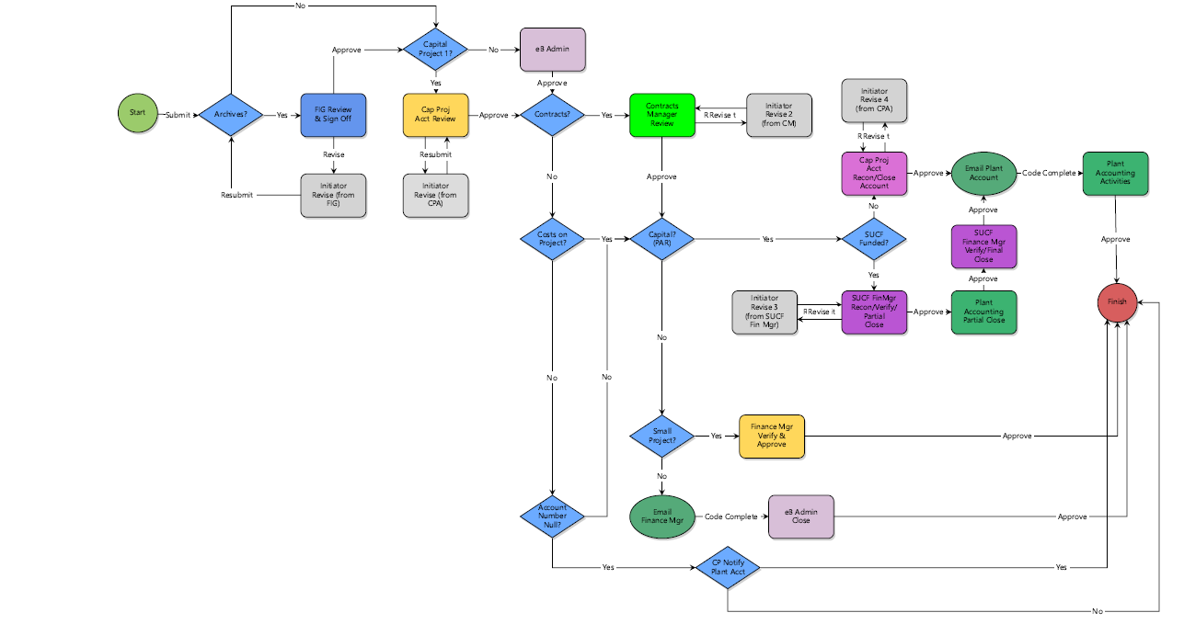
Closeout/Cancellation Process

Slide 9
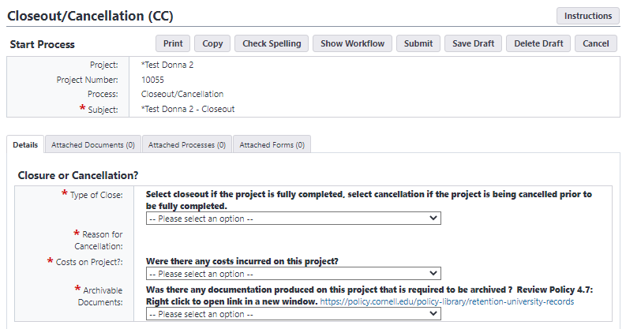
Closeout/Cancellation Process
Three key questions will affect what other information will be required AND how the process will route

Slide 10

Closeout/Cancellation Process
FIG
IF Archivable Documents:
  Verify all items checked in process are included in the 12 Close-Out Documents folders in Trimble
  New process for the Archiving Team to be more connected with PMs and their projects.

Slide 11
Closeout/Cancellation Process
Capital Accounting
Items that are done/confirmed in this step:
  Confirm Workorders and Service Requests are closed
  Make sure Purchase Orders are final billed
  Validate Invoices, consultant final invoice should be marked last in the IA process to indicate no further billing is expected
  Validate that TA’s are marked final or First & Final if applicable
  Confirm no further expenses are expected to hit the project
  KFS Encumbrances are cleared

Slide 12
Closeout/Cancellation Process
Contracts
What is done/confirmed in this step?:
  Ensure no open litigation (PIP, etc)
  Confirm no funding still committed to any contracts
  If any funding still committed to contract, an Amendment (CAA) or Change Order (CO) needs to be initiated
  Exception to last bullet is Reimbursables on design agreement
  If grant funded confirm all requirements have been met

Slide 13
Closeout/Cancellation Process
Capital or SUCF Accounting
What is done/confirmed in this step?:
  Reconcile Trimble to KFS; SUCF projects also reconcile to SFS (State Financial System)
  Submit request to close capital account
  SUCF Funded projects have Partial Close step, then a Full Close later in the process

Slide 14
Closeout/Cancellation Process
Plant Accounting
What is done/confirmed in this step?:
  Capitalization of expenses
  Any unspent funds are returned to funding unit account
  For multiple funding sources unused funding is returned on a percent-to-total basis (aligned with original funding allocations
  If a project is cancelled, fall project costs will be journaled to the non-capital sub-account
  Certificate of Completion/Occupancy downloaded from Trimble

Slide 15
Closeout/Cancellation Process
Certifies that all contractual obligations have been fulfilled
Archives all required documentation properly
Closes all contracts, work orders, purchase orders officially in Trimble & KFS
Closes project account(s) officially in Trimble & KFS
Communicates project closure or cancellation to Unit Representative
Updates Project Status, Project Status 2, Status Update, Project Phase, Project Account Activated?, and Close Date fields on the project details page automatically

Slide 16
Closeout/Cancellation Process
Find the Process Guidance Document here:
Documents \ User Resources \ CC - Closeout Cancellation Process
For help at any time, please email the FCS Project Management Information System(PMIS) group: fcs-pmis@cornell.edu

Slide 17
Questions?
Closeout/Cancellation Process

Slide 18
Recent BTC Grievances Update

Slide 19
City of Ithaca
Limited Site Plan Process

Slide 20
Questions?

