Slide 1
Project Management – Professional Development Series
Facilities and Campus Services Engineering and Project Management
May 15, 2025

Slide 2
Reminders for
CO’s and CAA’s

Slide 3
Terminations & Suspensions
Facilities Contracts issues formal letters to Contractors & Consultants.
PM submits request to Facilities Contracts email.
Termination – funds can be uncommitted.
A CO or CAA process must be initiated while the letter is being processed.
Suspension – up to one year but funds remain committed.
Suspensions are only for Consultant contracts.
This may result in additional charges from the Consultant once the project moves forward again.

Slide 4
Check Your Dates
Aways check dates when processing a CO or CAA.
Is additional time needed?
NYS Campus Let CO & CAA dates must correlate with NYS records.
Have questions, ask Contracts.

Slide 5
CO’s for “Direction Given In The Field”
Requires written follow up to backup the request.
The formal request must precede the Contractor’s proposal.
Options for written follow up:
Field Order Change Authorization Form.
Follow up via email stating direction given in the field.
Follow up by documenting in meeting minutes.
*Failure to do so puts Cornell at risk for liability.

Slide 6
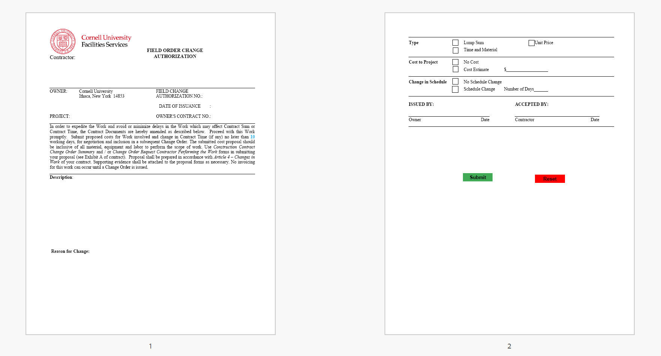
CO’s for “Direction Given In The Field”

Slide 7
Permit Fees for CO’s
Any additional permitting and regulatory fees due to Changes in the Work shall be reconciled upon project completion.
The language has been clarified in General Conditions Article 4 – Changes In Work.
Check PCO’s to ensure that no permitting fees have been included.
NYS Campus Let projects are managed by the CCF AHJ (Jim Yarbrough) and there are no fees.

Slide 8
Questions?

