Slide 1
Cornell University Design and Construction Standards AI Chat Bot
Notes:
Good morning.

Slide 2
Design-Construct-Operate Feedback Loop – Learning Organization
Design
Construct
Operate
Learn
Design Standards
Feedback Loop
Notes:
Our standards are created and updated based on a continuous feedback loop where all of you play a role.
#1 Design Standards, #2 Design, #3 Construct projects, #4 Operate and experience the project, #5 Learn
As facilities professionals we are always learning and finding ways to improve over time. This feedback loop provides the lessons learned to update our design standards and document that information for future projects.

Slide 3
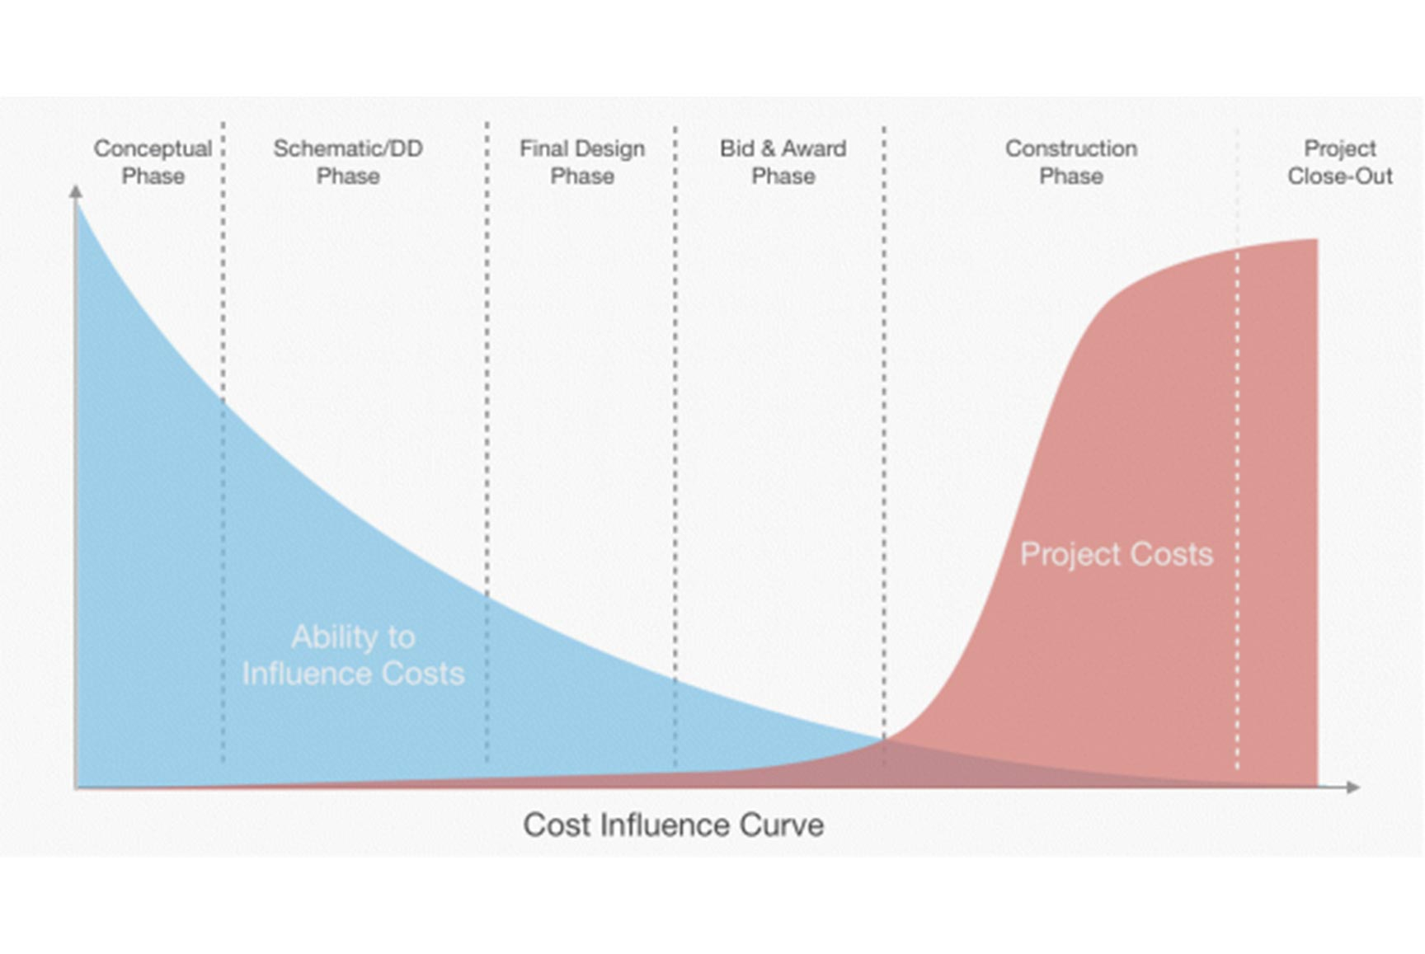
Cost and Influence Curves
Purpose of Design Standards:
Document Institutional Knowledge and Subject Matter Expertise
Document Lessons Learned and Avoid Repeating Mistakes
To Deliver High-Quality, High-Performance & Maintainable Facilities
Notes:
First – design reviews. What is the goal of a design review? As we mentioned before – 1) to deliver high quality, high performance (based on the system – for instance energy performance) and maintainable facilities. 2) We have a great wealth of knowledge in facilities at Cornell and the design review process is one way we can leverage that institutional knowledge and expertise to help projects succeed. 3). We want to optimize engagement of these facilities experts so they can effectively support projects with the limited time they have available.
I would also like to highlight one really important concept related to how we most efficiently effect change in projects. The cost – influence curve displays this relationship between the ability to influence change verses the cost of change. We want to effect change in the project as early as possible when the cost is minimal. Making a change during construction is expensive or worse yet, making the change after the project is complete is very expensive and disruptive. We want to influence the project during the concept and design phase.

Slide 4
Philosophy of Design Standards
EXTEND LIFE
REDUCE O&M
HIGH ROI
SECURITY
QUALITY
CU STANDARDS
BUILDING CODE
DESIGN REQUIREMENTS
Notes:
It is important to note that the CU Design Standards do not replace building codes and industry standards but rather explain where Cornell is going above and beyond code minimums.
This graphic represents how Cornell goes above minimum code in several area. We chose to have higher standards than building code minimum for several reasons including what is depicted in this graph:
To extend the service life (Cornell maintains buildings for centuries and we have higher expectations for the service life of systems and materials when compared to other building owners)
To reduce operation and maintenance costs and save Cornell money over the service life of the building. We are looking at the total cost of ownership, therefore lowest first cost may not be the best decision for Cornell.
Due to a high return on investment in the case of energy conservation. Cornell is a leader in energy conservation so from both an economic standpoint and a leadership standpoint, Cornell is focused on reducing energy use.
Due to higher levels of security for building access and security to keep students and research safe.
Due to higher quality level expectations for the campus with finishes, materials or level of performance

Slide 5
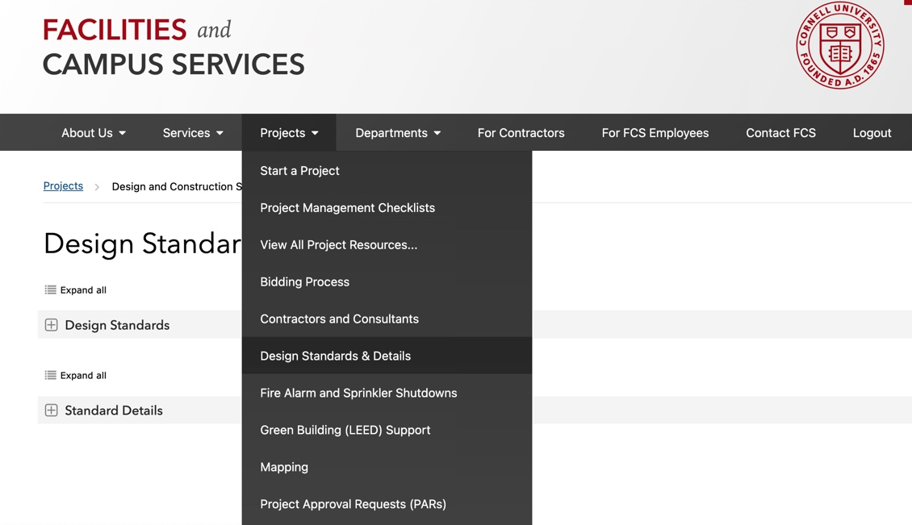
Where are the CU Design Standards & Details?
Written Standards & Guidelines
Standard Details
Standards are a contractual requirement for architects and engineers to incorporate in CD’s
Notes:
Facilities Engineering is the Curator of the Design Standards & Details.
There is a subject matter expert (SME) who leads the development of each standard.
Some SME’s are from Facilities Engineering and others are from units at Cornell like EHS, E&S, OUA, CIT, CU Police, Etc.
The SME tracks industry standards, trends, coordinates updates and gathers input from campus stakeholders.
The SME will also weigh in on variance discussions related to that standard.
It is a contractual requirement for architects and engineers to follow the University Design and Construction Standards. And it is the responsibility of the PM to ensure compliance by conducting regular design reviews. The SME’s who perform design reviews are often reviewing construction documents for compliance with the Design and Construction Standards.

Slide 6
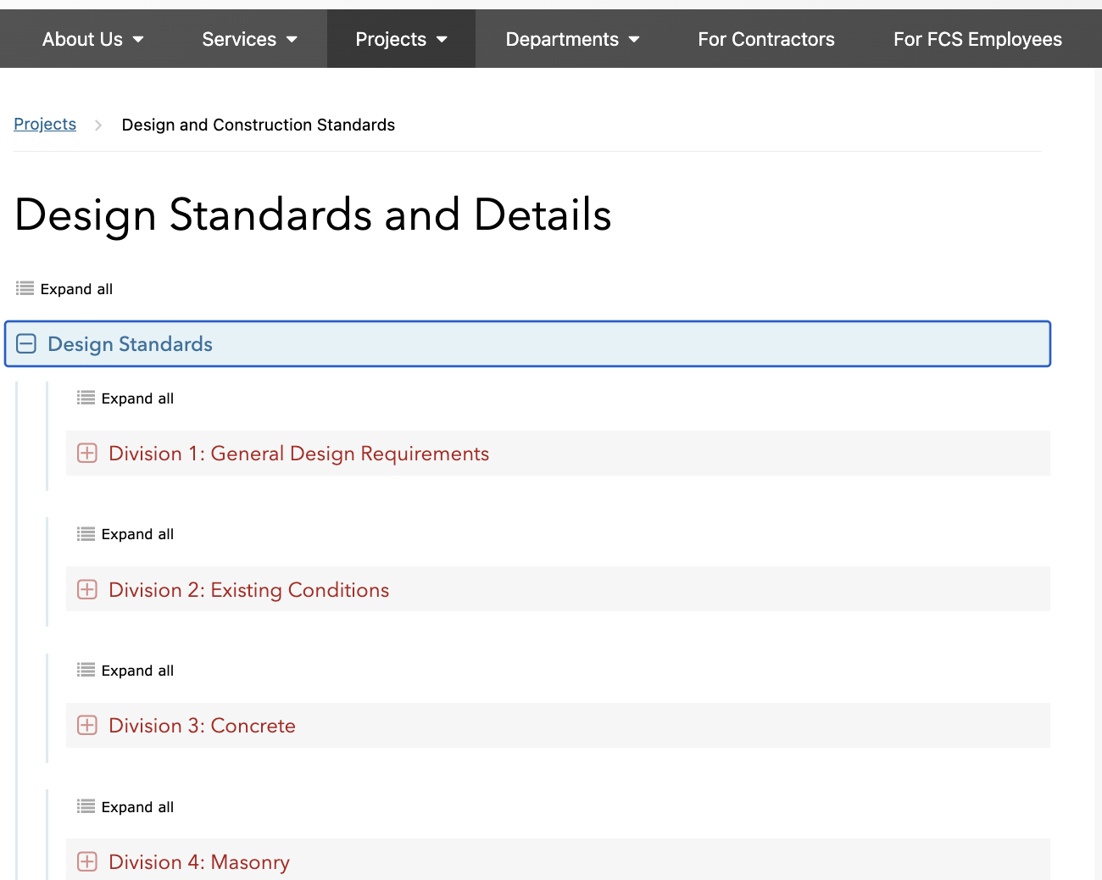
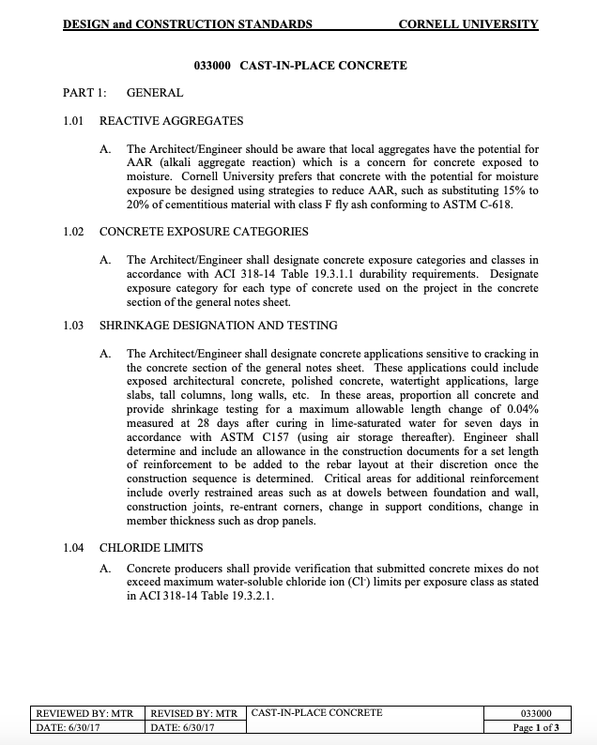
Institutional Knowledge Embedded in Standards
1,000+ pages (24 trades)
200+ drawing details
Internal & External Stakeholders
Living document
Sets Quality Standards
Best practices
Feedback loop
Notes:
Current project management processes/documentation and the use of design and construction standards are not optimized for ease of access or real-time utilization. The more we can better search and find the right answers using our current documentation, the better the outcomes for the project. Project teams face challenges in consistently accessing and applying best practices, particularly during critical decision-making points. As a result:
Errors and omissions can have an impact on project delivery schedules,

Slide 7
Learning Organization Knowledge Management
Institutional knowledge is one of our most valuable assets. Storing, growing, and sharing knowledge is critical to any organization.
An organization that can easily access, share, and update institutional knowledge is more effective
The ability to access the right knowledge at the right time, informs accurate decision-making and stimulates collaboration and innovation.
Notes:
To be successful in this arena with the scale and complexity of data and information we need to be a learning organization

Slide 8
Is There a Better Way to Interact With Standards?
YES!
FE reached out to the Cornell University AI Innovation Lab
EPM submitted a proposal for the AI Innovation Lab to create a custom AI Chat Bot
The proposal was accepted and EPM began working with a talented team from the AI Innovation Lab in the Fall of 2024
The Standards AI Chat Bot was released on the FCS Website last week.
Notes:
In the summer of 2024 with the increasing promise of AI, we began asking the question, ”Is there a better way to interact with our standards”?
It was by a couple lucky emails that E&PM was connected with the AI Innovation Lab at Cornell while they were taking applications for new projects.
This Team included Jai, Steve and Ayham who are part of the AI Innovation Lab – which you may have heard about during the faculty and staff town hall earlier this week.
Solution Overview
We propose the integration of an AI chatbot (RAG: Retrieval Augmentation Generation) into our existing systems for PM Checklists/Resources and Design & Construction Standards. The AI tool will provide immediate, context-relevant access to our resources, helping project managers, engineers, and other stakeholders make informed decisions quickly. The AI will also enhance compliance with design standards and reduce preventable errors by providing consistent, reliable answers.

Slide 9
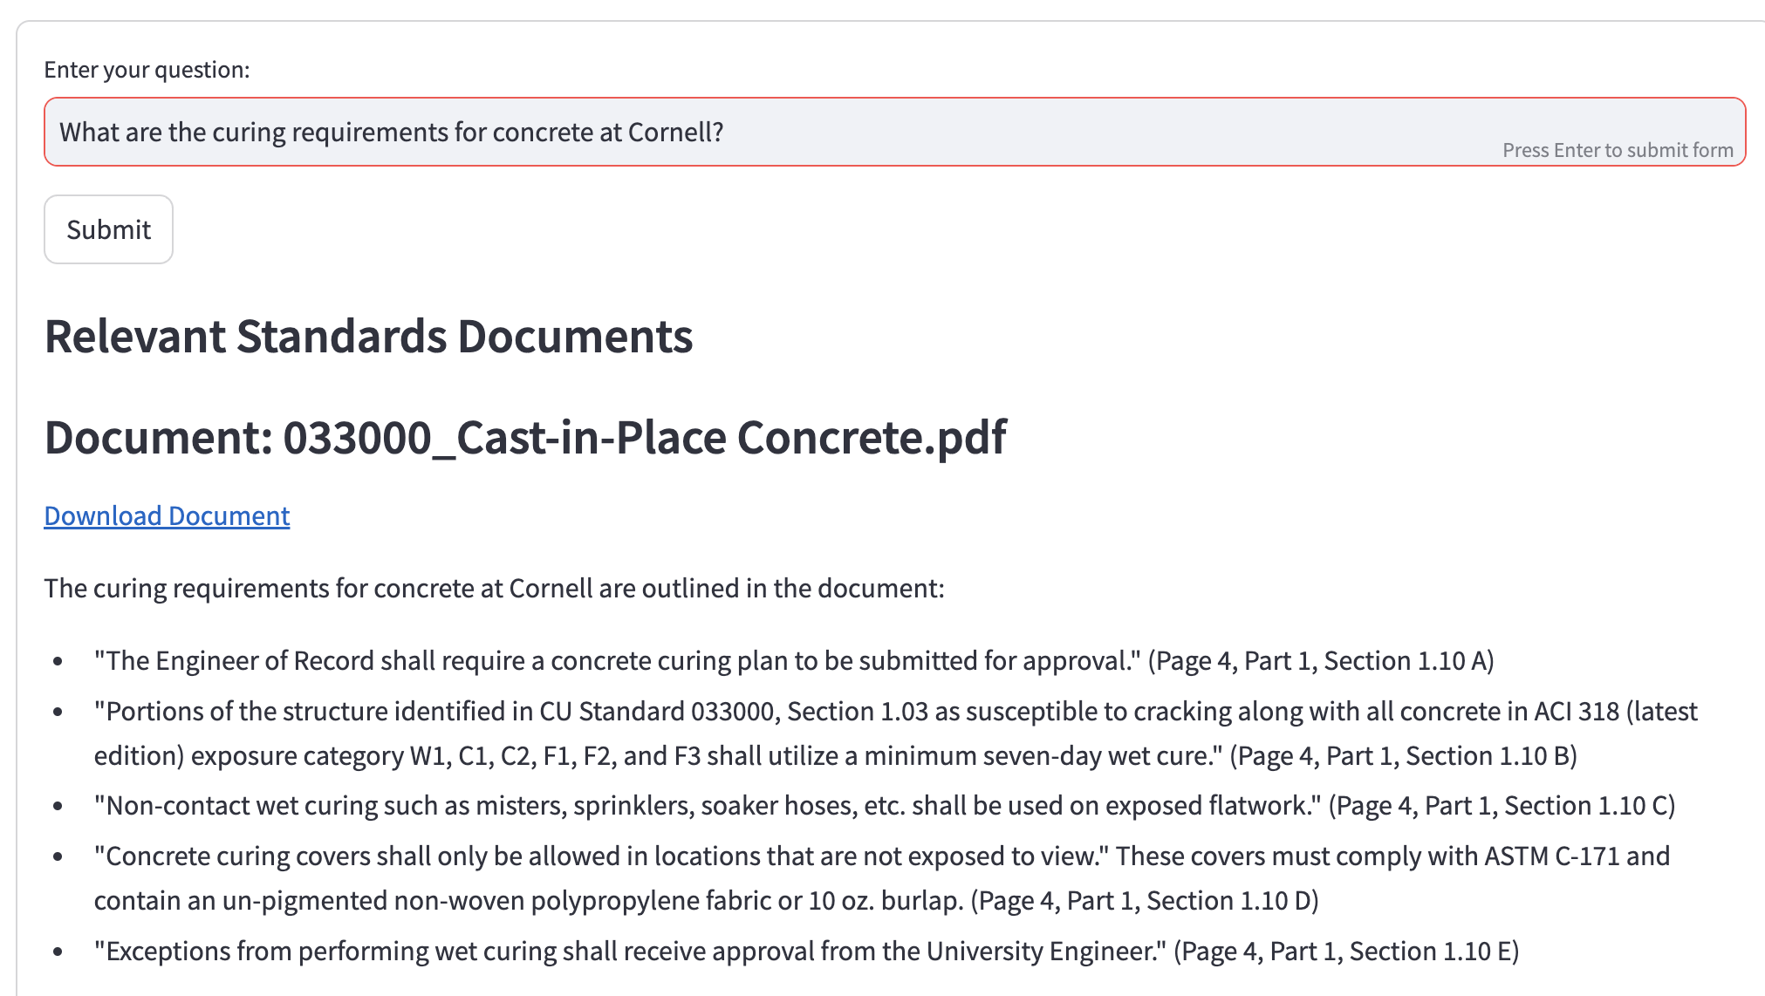
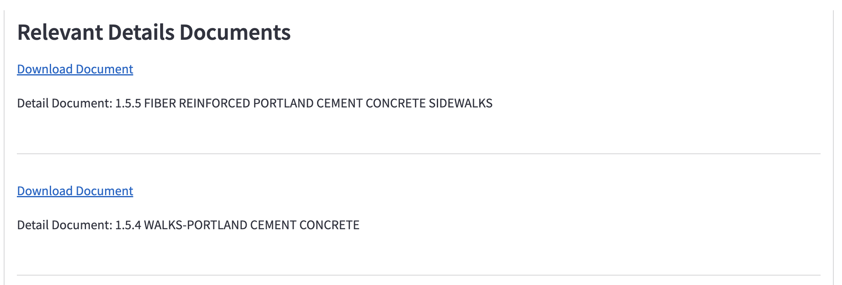
Benefits of AI-Driven Interface for Standards
The Bot only reads the standards (The Bot should not hallucinate)
Responses consider full corpus (+/- 30 second response time)
Task specific interface
Summary from multiple sources
Links to relevant documents
Increase access to knowledge
Prevent avoidable mistakes
Easy to access and useful
Saves time!!
Notes:
The AI Bot was designed to only read the design standards and details
'Responses consider full corpus' (set expectations that the response will take 30 seconds)
'Task specific interface' (bot only is designed to answer questions about the standards; each question is a new interaction; conversational history is not preserved. Don't want users to expect to have a conversation where the bot helps refine questions and provides insight based on previous interactions)
The Bot will return answers across multiple standards. For instance, if you have a question about concrete curing, the Bot will provide relevant answers pertaining to details and standards. Wherever curing is mentioned.
The response provides hyperlinks to the standard or detail because the person using the standards is still responsible to design to the standards

Slide 10
Where Can I Find The New Standards AI Chat Bot?
Click Here
Log In With Your Net ID and Password
Guests Log In With Guest Credentials For Standards

Slide 11
Standards AI Chat Bot Disclaimer
Notes:
The Cornell University Design and Construction Standards Chat Bot is a supplemental tool created to assist stakeholders in navigating and engaging with the CU Design and Construction Standards. However, the Chat Bot does not replace the responsibility to thoroughly review, understand, and apply the full Cornell University Design and Construction Standards. Users are encouraged to consult the complete standards documents to ensure compliance and accuracy.

Slide 12
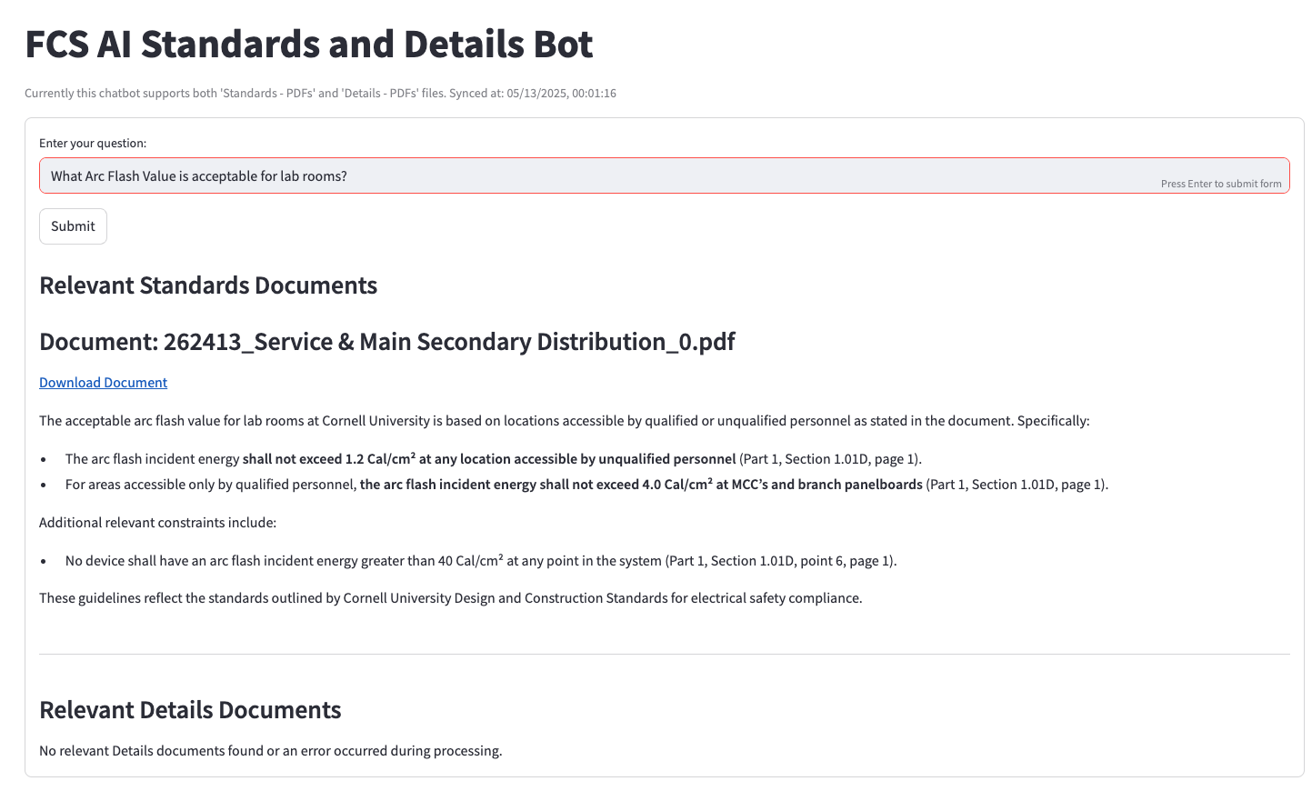
CU Standards AI Chat Bot Examples:
Notes:
What Arc Flash Value is acceptable for lab rooms?
- 1.2 Cal/cm² at any location accessible by unqualified personnel." (Page 1, Part 1, Section 1.01 D, point 5)

Slide 13
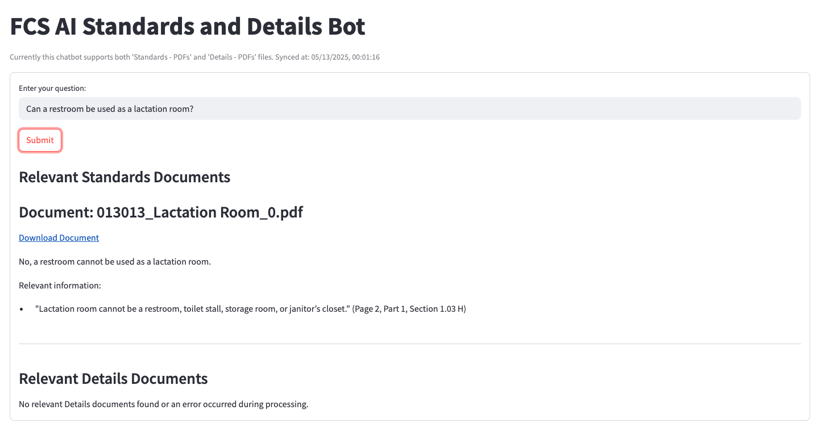
CU Standards AI Chat Bot Examples:
Notes:
“Can a restroom be used as a lactation room?”
• • The answer is no, as identified in standard 013013 Lactation Room 1.03 H “Lactation room cannot be a restroom, toilet stall, storage room, or janitor’s closet.”

Slide 14
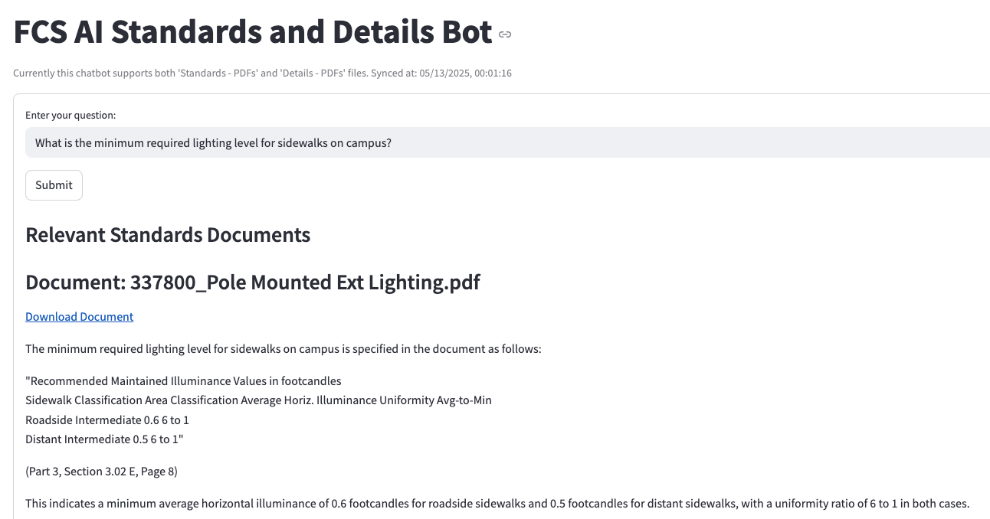
CU Standards AI Chat Bot Examples:
Notes:
• 1. What is the minimum required lighting level for sidewalks on campus?

Slide 15
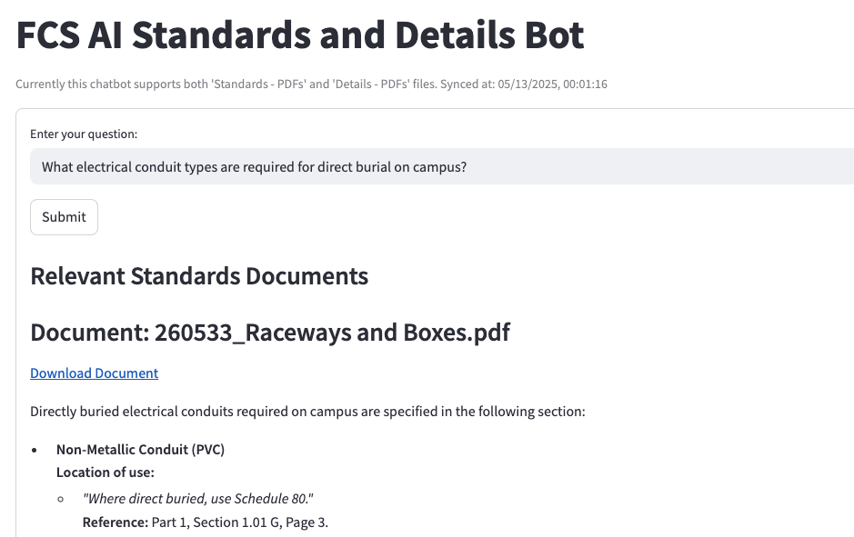
CU Standards AI Chat Bot Examples:
Notes:
What electrical conduit types are required for direct burial on campus?
• • Non-Metallic Conduit (PVC): - Schedule 80 PVC is required for direct burial applications - A minimum of 2 feet ground cover is typically required (though some utilities may require 3 feet, especially at road crossings)

Slide 16
How Was The AI Bot Designed and Created?
Two Stage Processing
Relevance Check: Initial stage focuses purely on relevance filtering using GPT-4o mini, ensuring computational efficiency by discarding irrelevant documents upfront.
Detailed Analysis: For documents flagged as relevant, a second, in-depth evaluation is performed using GPT-4o for detailed extraction of key insights, direct quotes, references, etc., designed to enhance output quality.
Customized Prompting for Precision: Task-specific prompts ensure precise, concise, and query-relevant responses, referencing specific document sections.
Multimodal Approach: To interpret engineering diagrams (for the 'Details' documents), we used AI to generate text descriptions. This helps bridge gap between image-based content and text-based retrieval. To reduce latency, we do this each time a document is updated by FE.
To optimize the response time, we try to front-load as much of the processing as we can (typically occurs each midnight). The 'Synced at:' timestamp displayed on the bot is indicative of this.
Standards Text only
Details Image + Text
Details Text Only (Description)
Documents flagged RELEVANT for detailed analysis

Slide 17
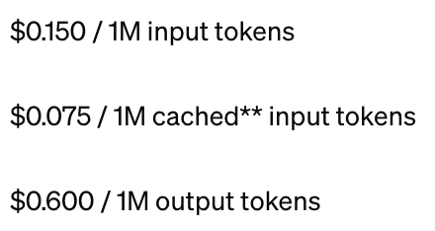
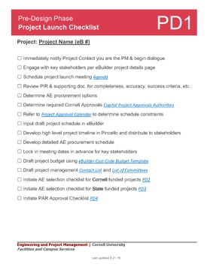
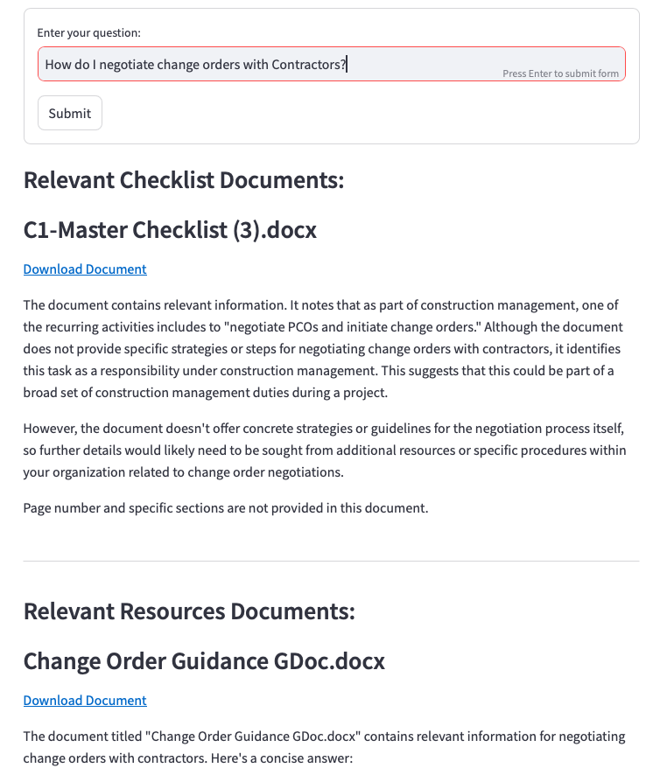
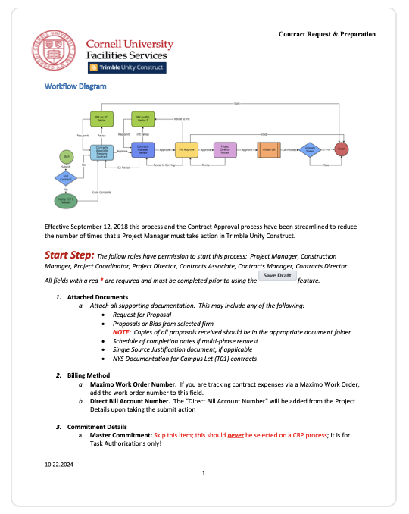
Balancing Cost, Speed, and Accuracy
GPT-4o mini processes entire document contexts, offering high accuracy but at a higher cost and latency than vector database similarity searches.
Despite this, GPT-4o mini is far more cost-effective than GPT-4o while maintaining comparable performance for this task.
Processing full contexts can be slower, but we solve this with parallelism, enabling the system to handle multiple documents at once.
Our algorithm can scale efficiently, dedicating one thread per document if necessary to optimize speed and throughput.
*Pricing of Two Models
"Retrieval" Phase
Analysis Phase
Output Phase
~60% of total processing time
~35% of total processing time
~5% of total processing time

Slide 18
Thank You

