Slide 1
PMPD Design Reviews April 16, 2025
Notes:
Good morning.

Slide 2
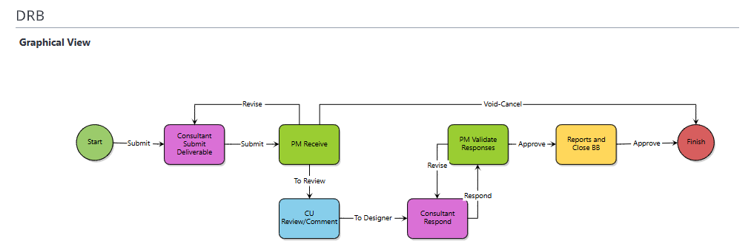
Trimble + Bluebeam Design Review
Project Managers or Project Coordinators initiate the design review via the DRB (Design Review + Bluebeam) process in Trimble.
PM/PC will invite consultants and reviewers to the session
Admins for specific departments (ex. FE/Madison) can add participants to the Studio session.
PM's utilize the design review contact list to add reviewers.

Slide 3
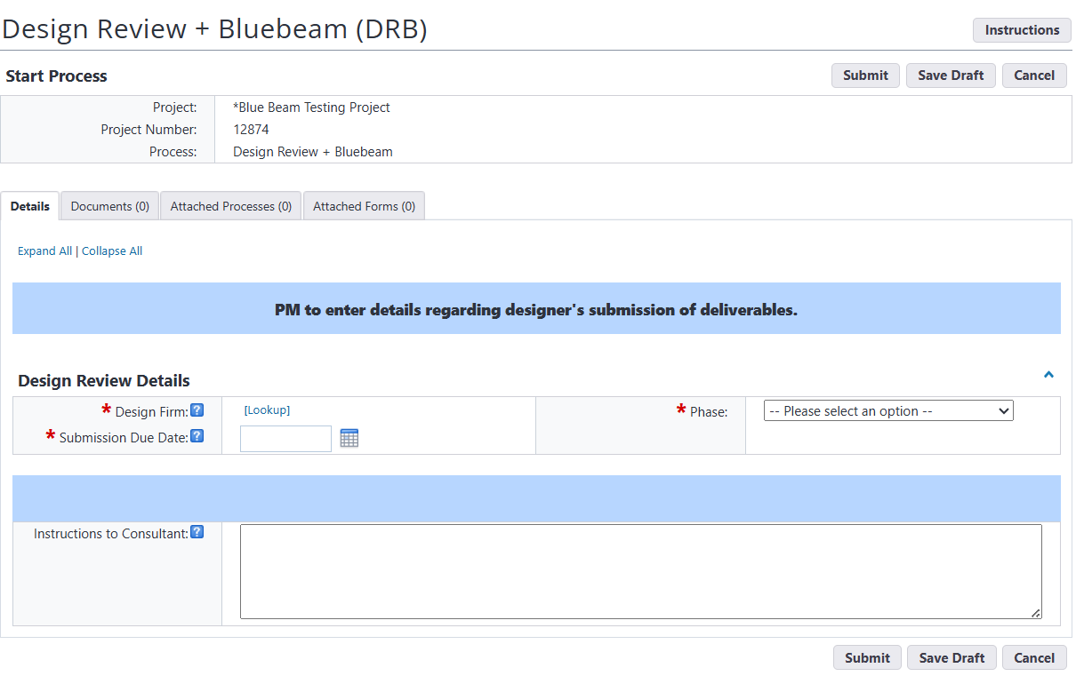
Start Step – Project Manager or Project Coordinator
DRB starts as a request to the consultant to upload their deliverables
Select the Company
Select the Phase for which the deliverable is due
Enter a submission due date
Provide instruction to the consultant regarding preference for pdfs to be uploaded
Single pdf of all drawings and single pdf of all specifications uploaded to named field fields
OR
Attach separate files broken out and labeled by division
Submit

Slide 4
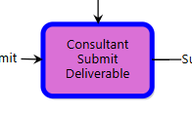
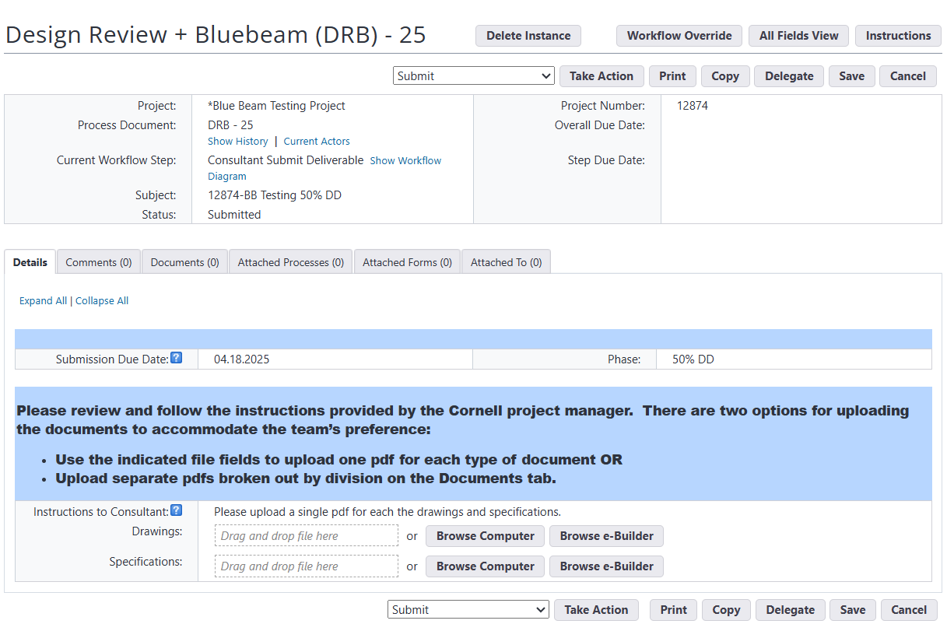
Consultant Submit Deliverables - Consultant
Consultant reviews instructions and uploads the deliverables requested
Consultant takes the Submit Action

Slide 5
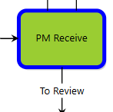
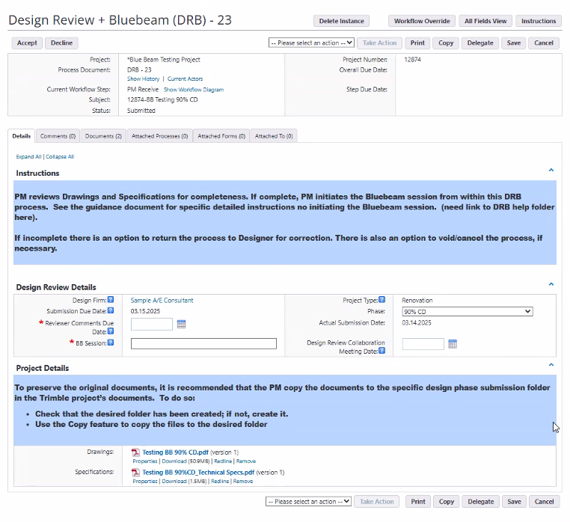
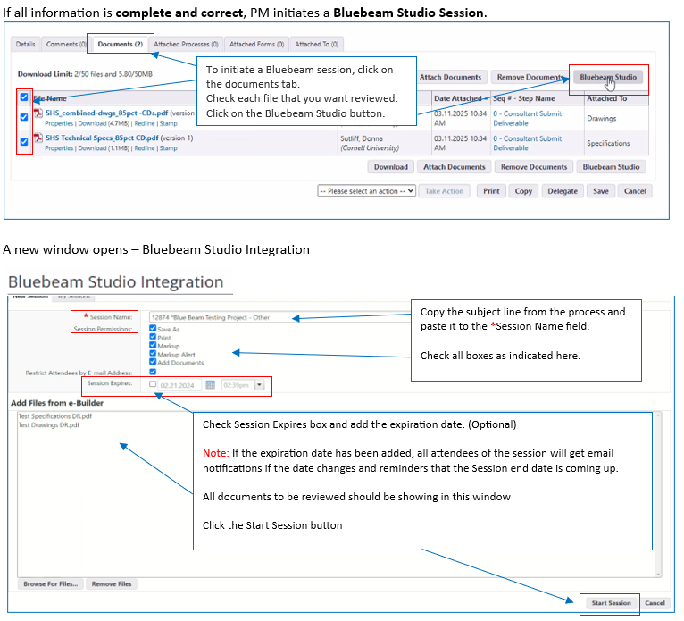
PM Receive – Project Manager or Designee
PM reviews the deliverables
May take Revise action if necessary
PM initiates Bluebeam Review Session in Trimble
PM sets session permissions in Bluebeam; recommend allowing the consultant(s) access, but deny ability to markup during the CU comment period
PM Approves – Process moves to CU Comment/Review step
Detailed information on initiating the session is available in the DRB guidance document

Slide 6
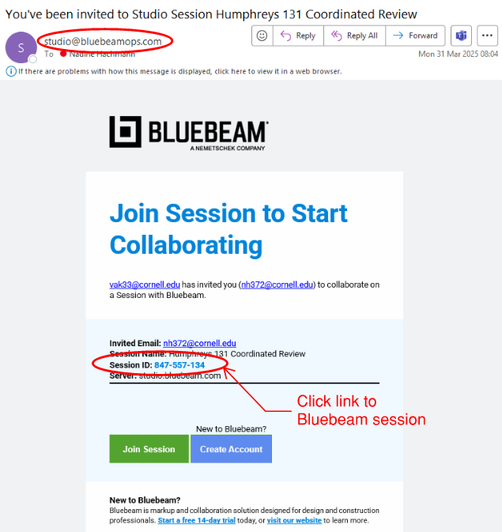
Bluebeam Invitation to Reviewers
Design Review request e-mail will not come from Trimble but from Bluebeam Studio: Look for e-mail from Bluebeam (studio@bluebeamops.com) with link to Studio session.

Slide 7
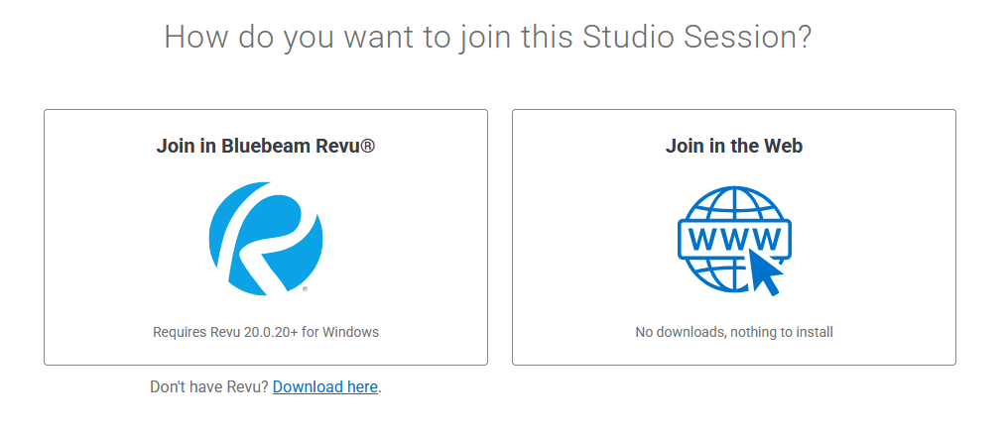
CU Review/Comment
Reviewers will be prompted to choose which platform you want to use for the review. If you have the app subscription please select on the left, if not select the web version on the right.

Slide 8
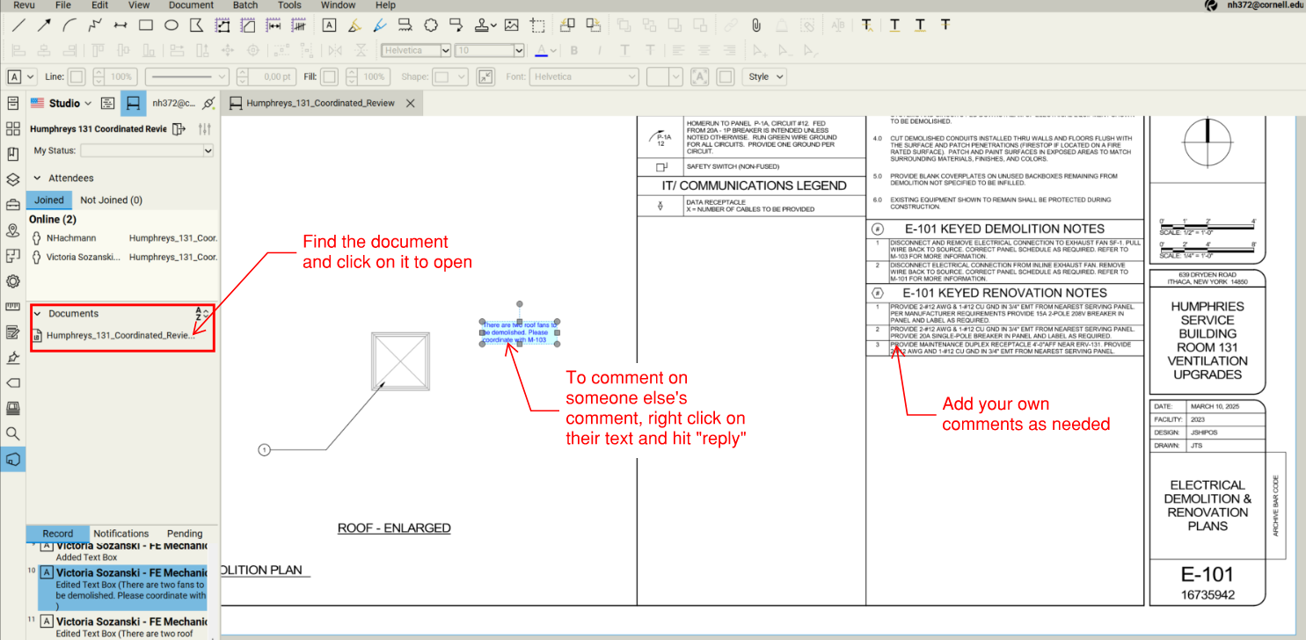
CU Review/Comment
Open the document you want (there may be more than one file in a session) to add your comments and/or reply to someone else’s comment, add photos, etc.

Slide 9
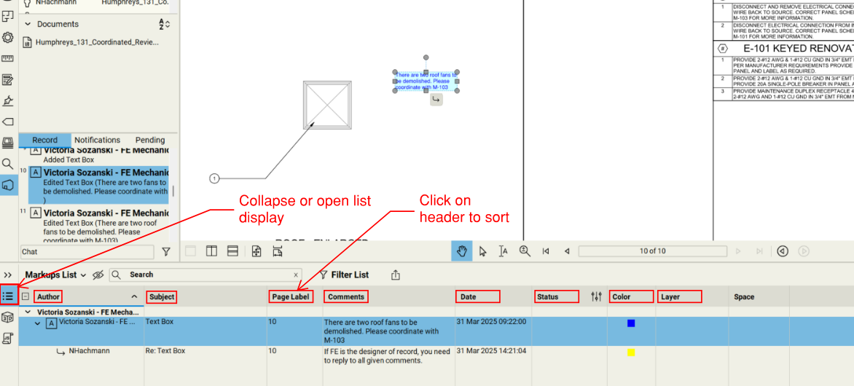
CU Review/Comment
Click on the bottom left icon to see all comments. You can sort by clicking on the header

Slide 10
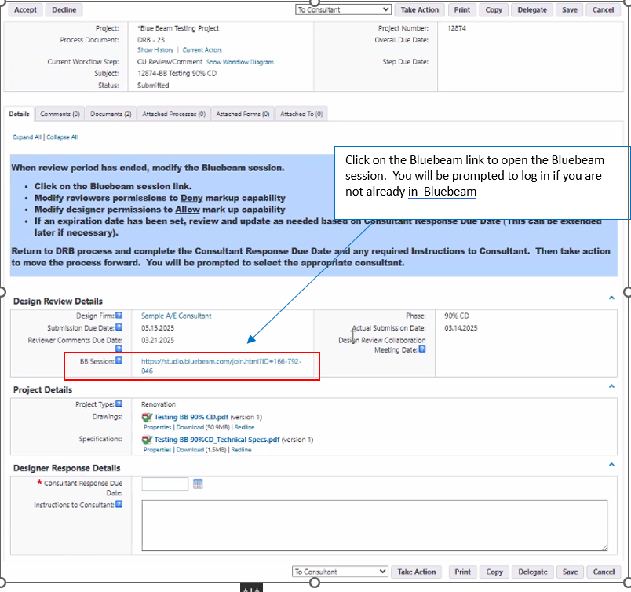
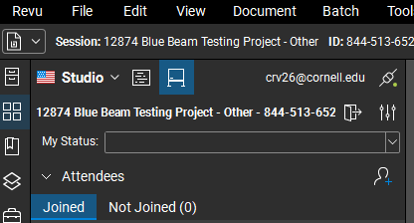
CU Review/Comment Step – Project Manager
Process remains in this step while documents are being reviewed
At end of review period, PM must update permissions in the Bluebeam session to prepare for Consultant responses
Recommend allowing continued access by reviewers but restricting ability to make additional markups
PM will enter Consultant Response Due date and may include additional instructions to consultant if necessary (recommend including a reminder that that they must take action in both Bluebeam session and Trimble process)

Slide 11
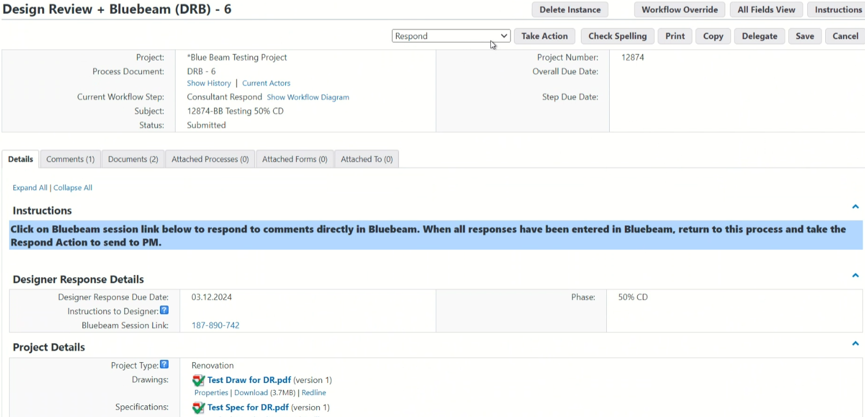
Consultant Respond
Consultant will be notified of session modification via a Bluebeam email and will also receive a Trimble process notification
Consultant will review/respond to comments in Bluebeam
Consultant will need to take the Respond action in the Trimble process

Slide 12
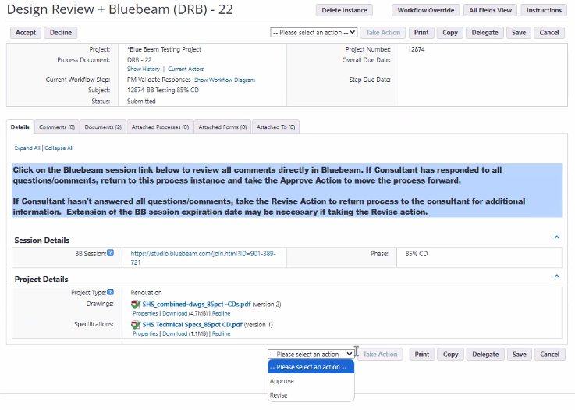
PM Validate Responses
PM receives notification from Trimble process
Link to session is available here
PM reviews consultant responses and may take a Revise action to return DRB process to consultant or take the Approve action to move the process to the Reports and Close BB step.
Detailed information on updating the session is available in the DRP guidance document

Slide 13
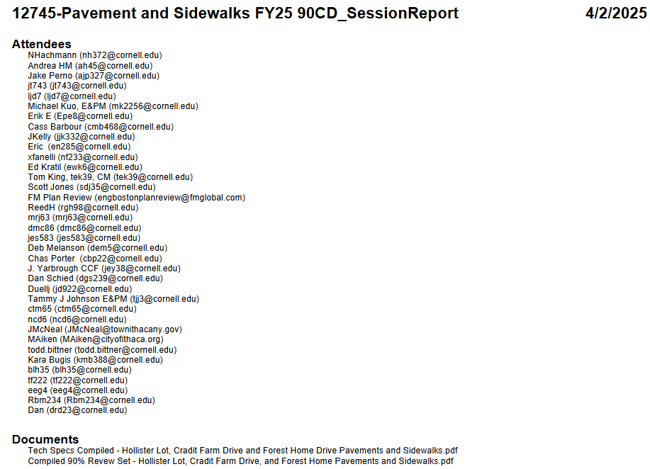
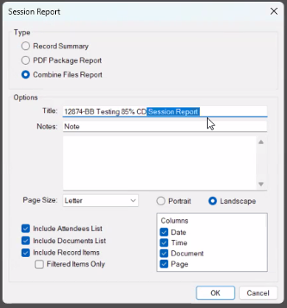
Reports and Close Bluebeam
Final report provided by PM
Dialog box from Bluebeam show below; detailed information on generating the preferred report/format is available in the DRB guidance document
Recommend copying the attendees list to send report to all participants via email (outside Trimble). A copy will also be saved in the process for the project.

Slide 14
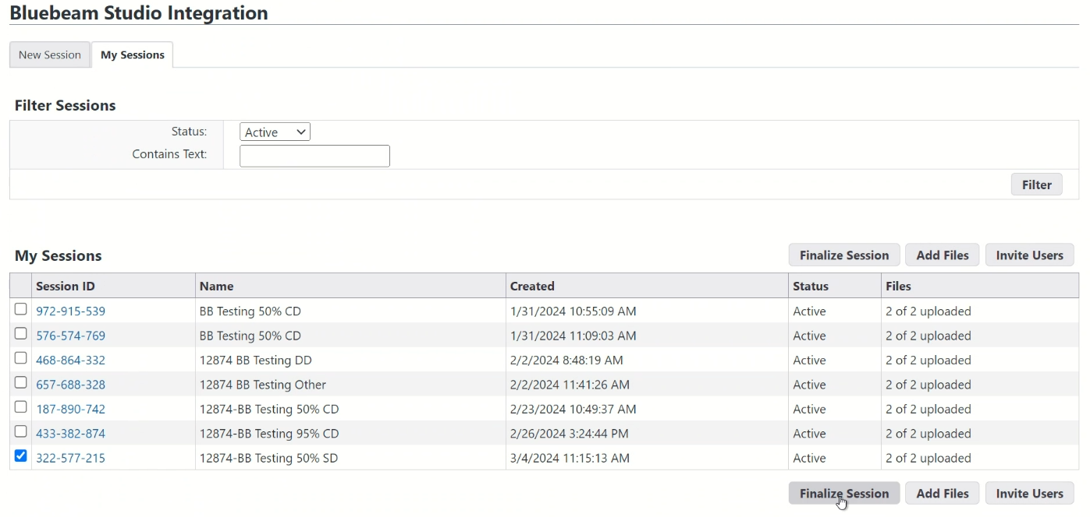
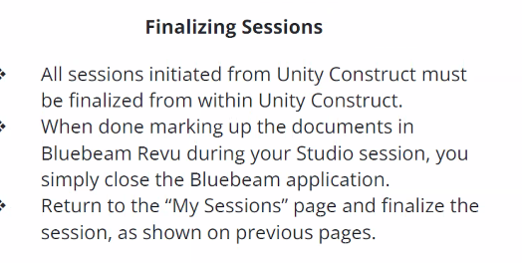
Reports and Close Bluebeam – Finalizing the Session
PM will upload Bluebeam Session Report into the DRB process and Finalize the session from within Trimble
Detailed instructions for finalizing the session are available in the guidance document
Important! NO NOT move the process forward until the files are checked back in (green check mark will no longer be visible and a new version number will be displayed)!

Slide 15
Bluebeam Design Review Key Takeaways
If you disagree with someone’s comment, contact them and discuss it, so there are no contradicting comments in the set. Thank you!
PMPD follow up email will include the design review contact list, if you're not on this list and need to regularly review documents, please reach out. https://app.e-builder.net/public/publicLanding.aspx?QS=2467efb2d88e4cdfa93c5f5c917ad174
If you utilize administrators for assigning design reviews, please have them reach out for training.
Be sure the studio@bluebeamops.com email is hitting your inbox and not junk.
Review the guidance document when it comes out and let us know if you have any comments/changes.
Working with FE Team to develop a way commenters can flag a comment as not compliant with the design standard.

Slide 16
Bluebeam Design Review Implementation
PMIS to send invite to PM's for the Studio Prime account (Bluebeam Revu 21)
Release of Trimble process guidance documents on April 17th. https://app.e-builder.net/public/publicLanding.aspx?QS=ee97268b66964fdb88b4aec6af8bb28e
Activation of the DRB process on all projects on April 17th.
When preparing for an upcoming design review, review the guidance documents and reach out to PMIS for questions.
Reviewer guidance and Bluebeam Studio interface help will be distributed.

