Slide 1
Summer Construction Update
May 15, 2025

Slide 2
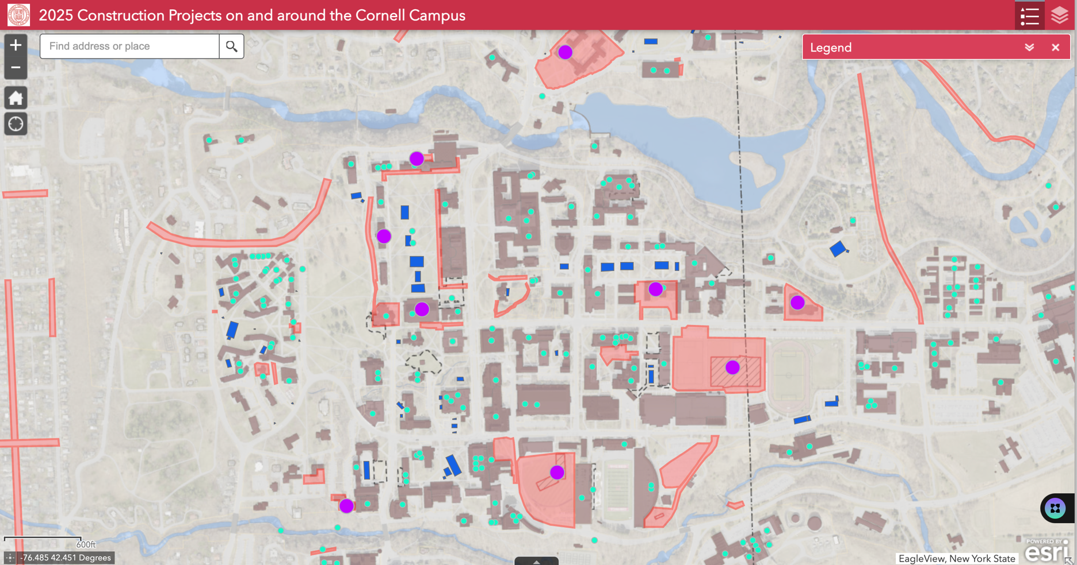
Summer Construction Update
https://cornell.maps.arcgis.com/apps/webappviewer/index.html?id=e7eb8bb4a2b0459c8208f3d44612c6fe
Notes:
114 projects in construction
$838 M in total project cost

Slide 3
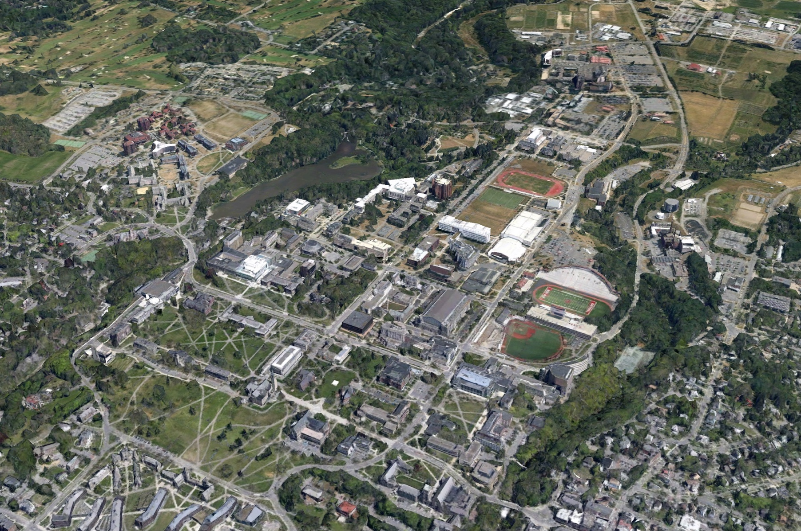
Major Roadwork & Paving
Cradit Farm Drive Paving and Sidewalks
Forest Home Sidewalks
Hollister Drive and Lots Paving
Cascadilla Fire Lane Project

Slide 4
North Campus Area
RPCC CCC Swing Space Restoration & FA
Akwe:kon Windows
Balch Hall
George Jameson & Highrise 5 Storefront

Slide 5
Arts Quad Area
Sibley Dome
Arts Quad
Site Lighting
McGraw Hall
Arts Quad
Duct Bank
Olin Library
McGraw Tower

Slide 6
Building Envelope & Roofing
VMC Roof
Clark Hall Skylight
Corson Mudd Roof
Code Project
Barton Hall Façade Testing and Inspection
War Memorial Envelope
Hughes Hall Envelope

Slide 7
Large Capital Projects
GFR Field Hockey
Life Sciences Pavilion PH 1
Plant Science Phase 1
Rice Hall
Meinig Field House
King Shaw
McGraw Hall
Duffield Hall
Expansion

Slide 8
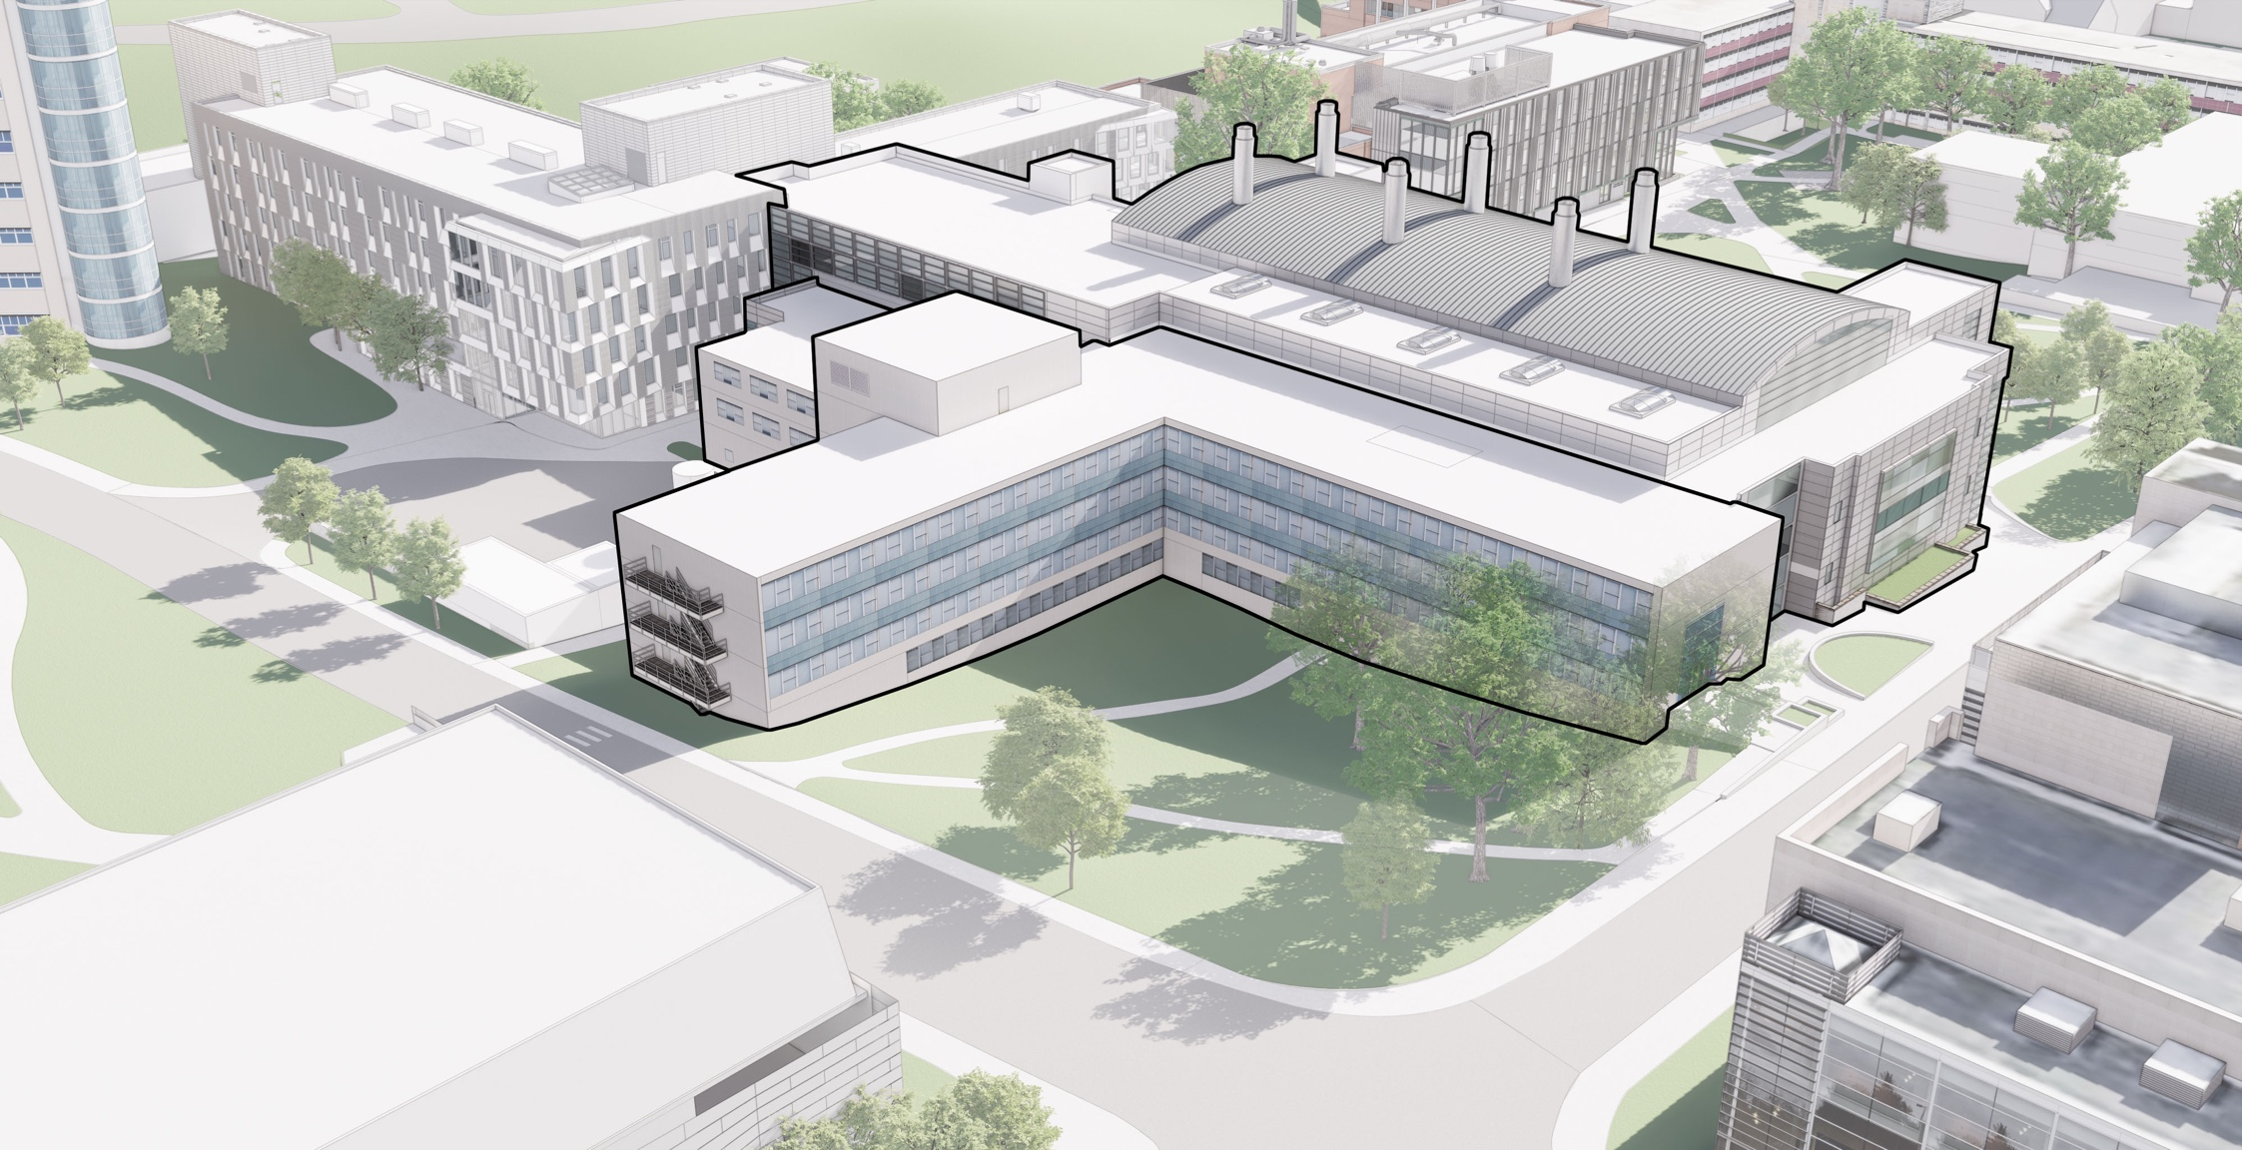
Existing View of Site from the Northeast
Upson Hall
DuffieldHall
Phillips Hall
Gates Hall
Notes:
This rendering makes the building look so much better than it does in reality. Campus Road is to the right here. If we were all together standing on the site You would feel the diminutive nature of Phillips Hall, which is dwarfed by Duffield, The Statler, and Gates Hall.
We studied ……the site to understand its capacity as we worked with researchers and faculty to understand the detailed needs for ECE and Quantum space. We realized the low area in the landscape can accommodate a large basement research space for Quantum research, a greenspace above the quantum labs, on grade with Hoy Road,. And that was what we set out to do .
We have explored two options in great detail, both intended to take full advantage of this site and prominent location to expand the footprint and impact of Duffield Hall:
The first option Renovates Phillips Hall Completely: 90,000 gsf of renovation
And adds new 23,000 GSF of new space to support ECE programs at an estimated total project cost of $78M
“We’ve done our best to scope the estimated cost but know that it will grow on an annual basis… escalation is always a consideration.”
The second Option adds more new space to support expanding programs and invests less in renovation of Phillips Hall. This approach assumes future renovation of some existing spaces within Phillips Hall, but does enough infrastructure upgrades to meet Cornells standards by replacing fire safety systems, building mechanical systems, and replaces the exterior envelope.
Program Highlights:
11,400 NSF for Quantum research
4,500 NSF Robotics Instruction & Multi-Function
Construction Cost: $60M
Project Cost: $78M
Average Cost Breakdown:
Addition: $25M
Reno: $29.5M (includes façade replacement)
Site: $4.5M
Phasing: $1M

Slide 9
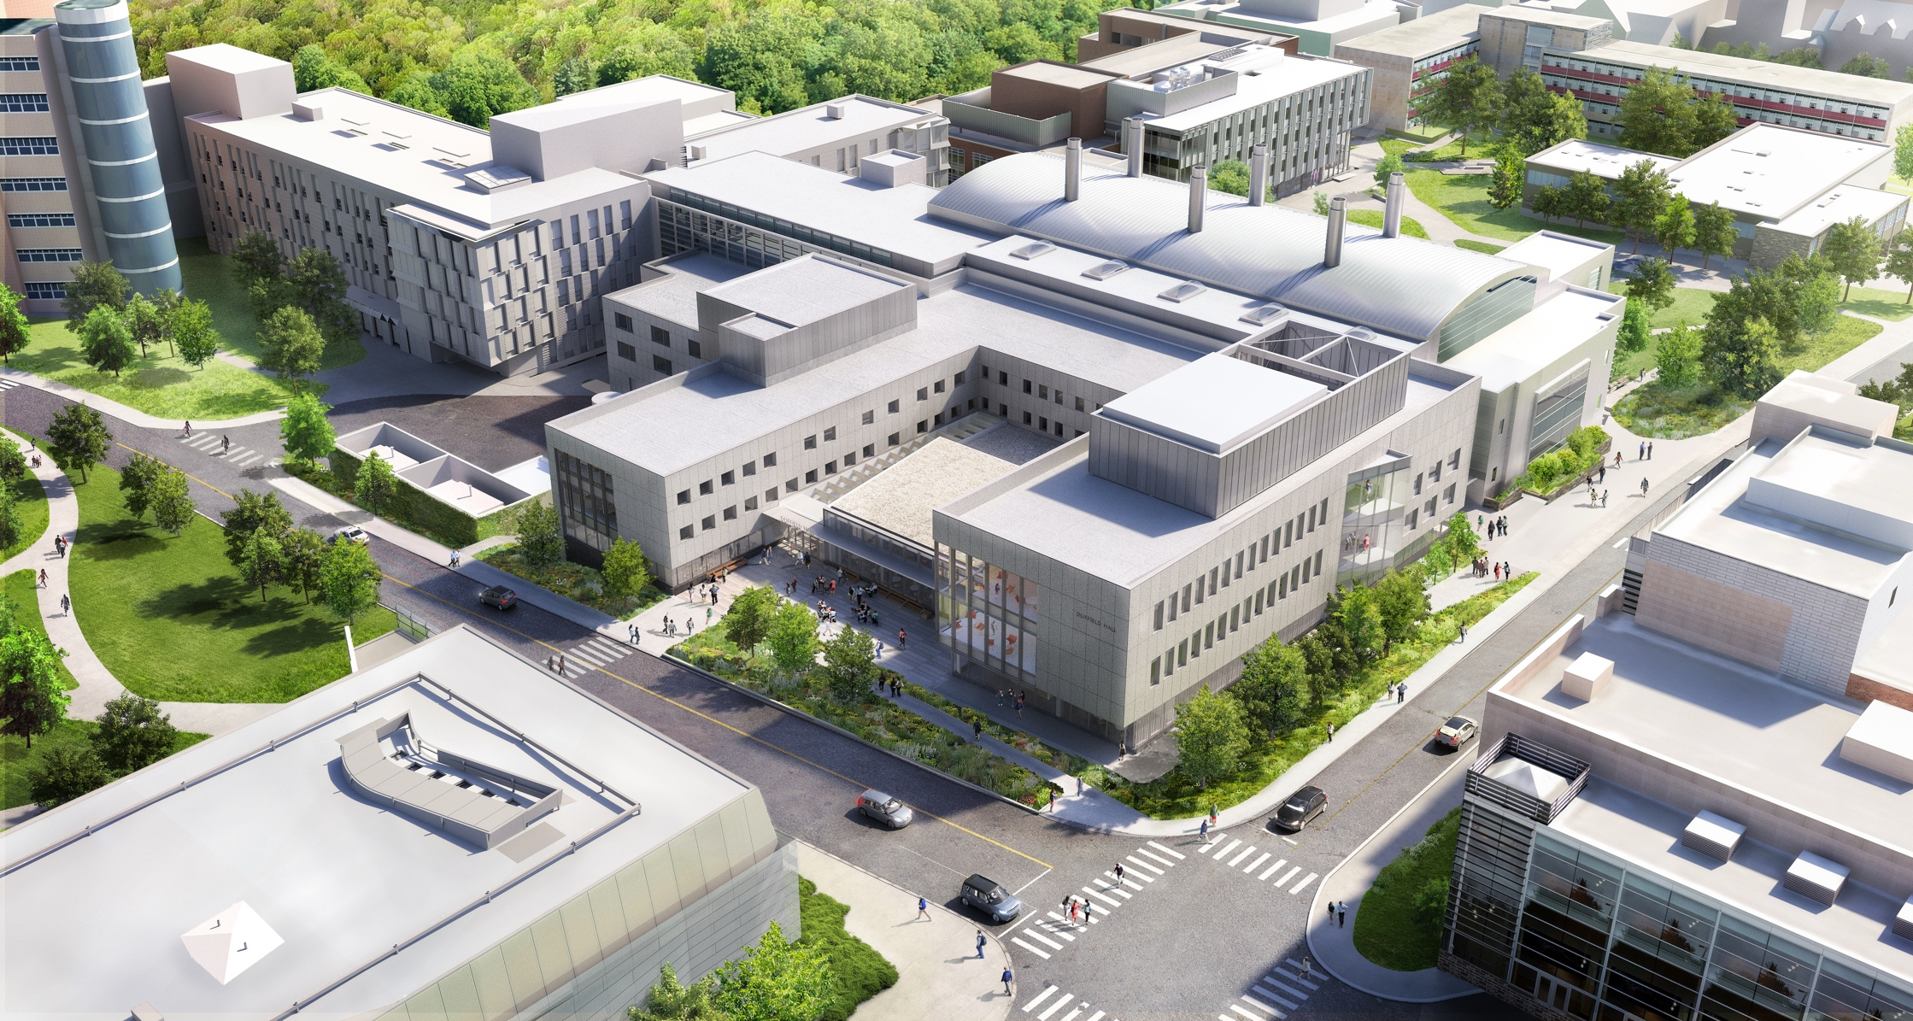

Slide 10
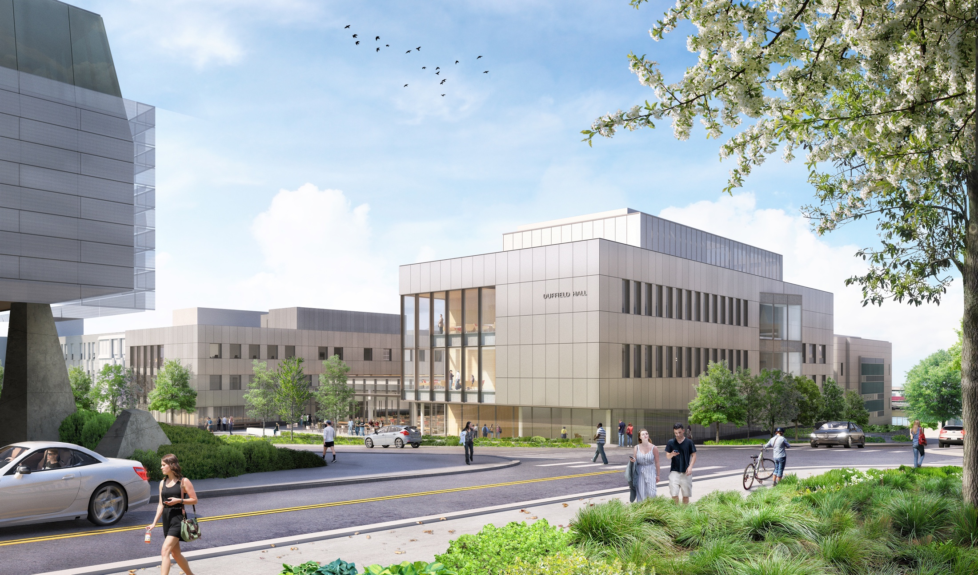
View from Campus Road Looking SW
Notes:
Looking back from the corner of Campus and Hoy Roads , towards the expanded Duffield Hall would most importantly , enable more research and provide ECE students with the space and tools thy need to succeed. The message the new building sends is equally powerful…representing the extraordinary impact of work being done by ECE faculty and students.

Slide 11
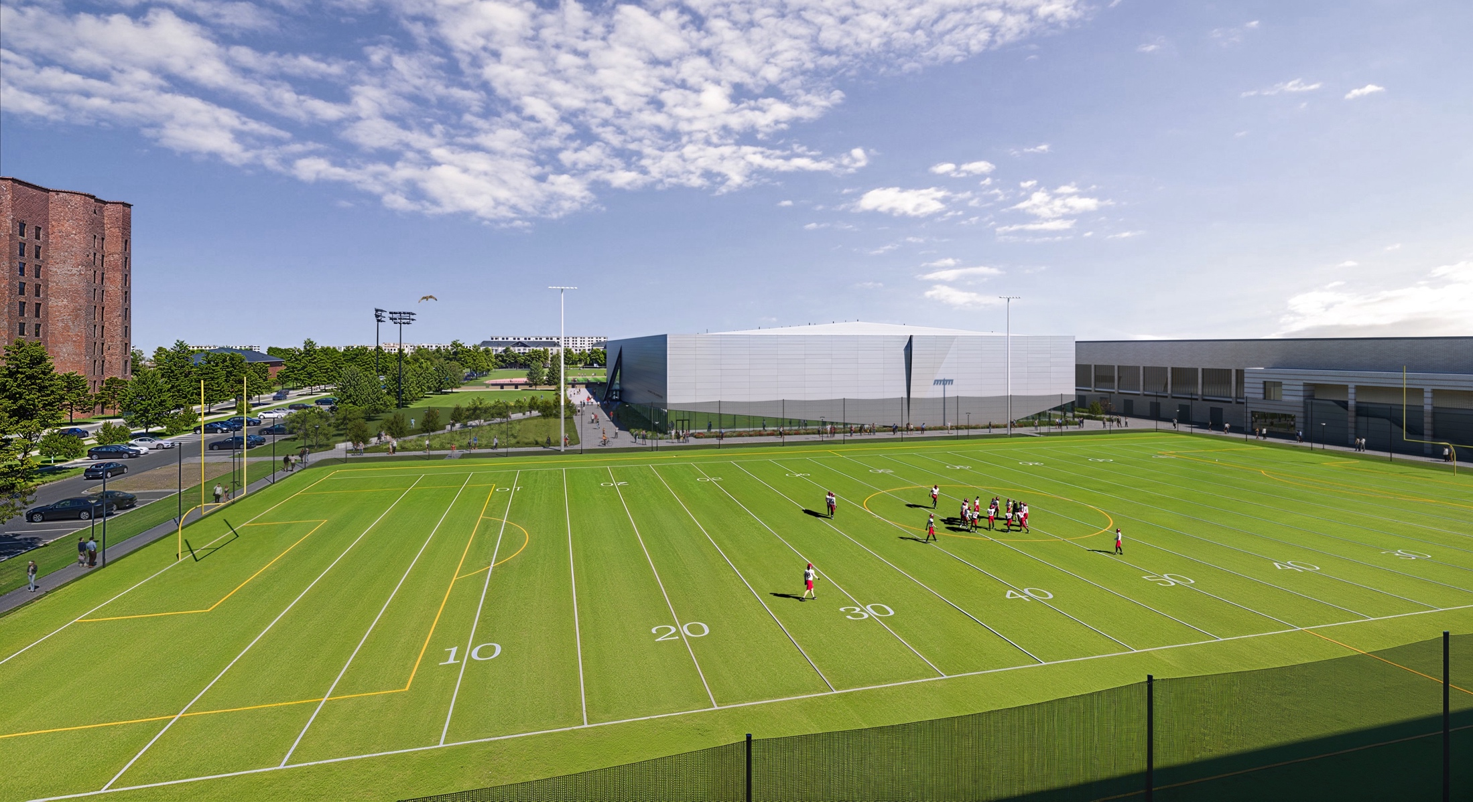
Notes:
New Recreation Field
Sized for Soccer
Artificial turf
Playing surface lighting

Slide 12
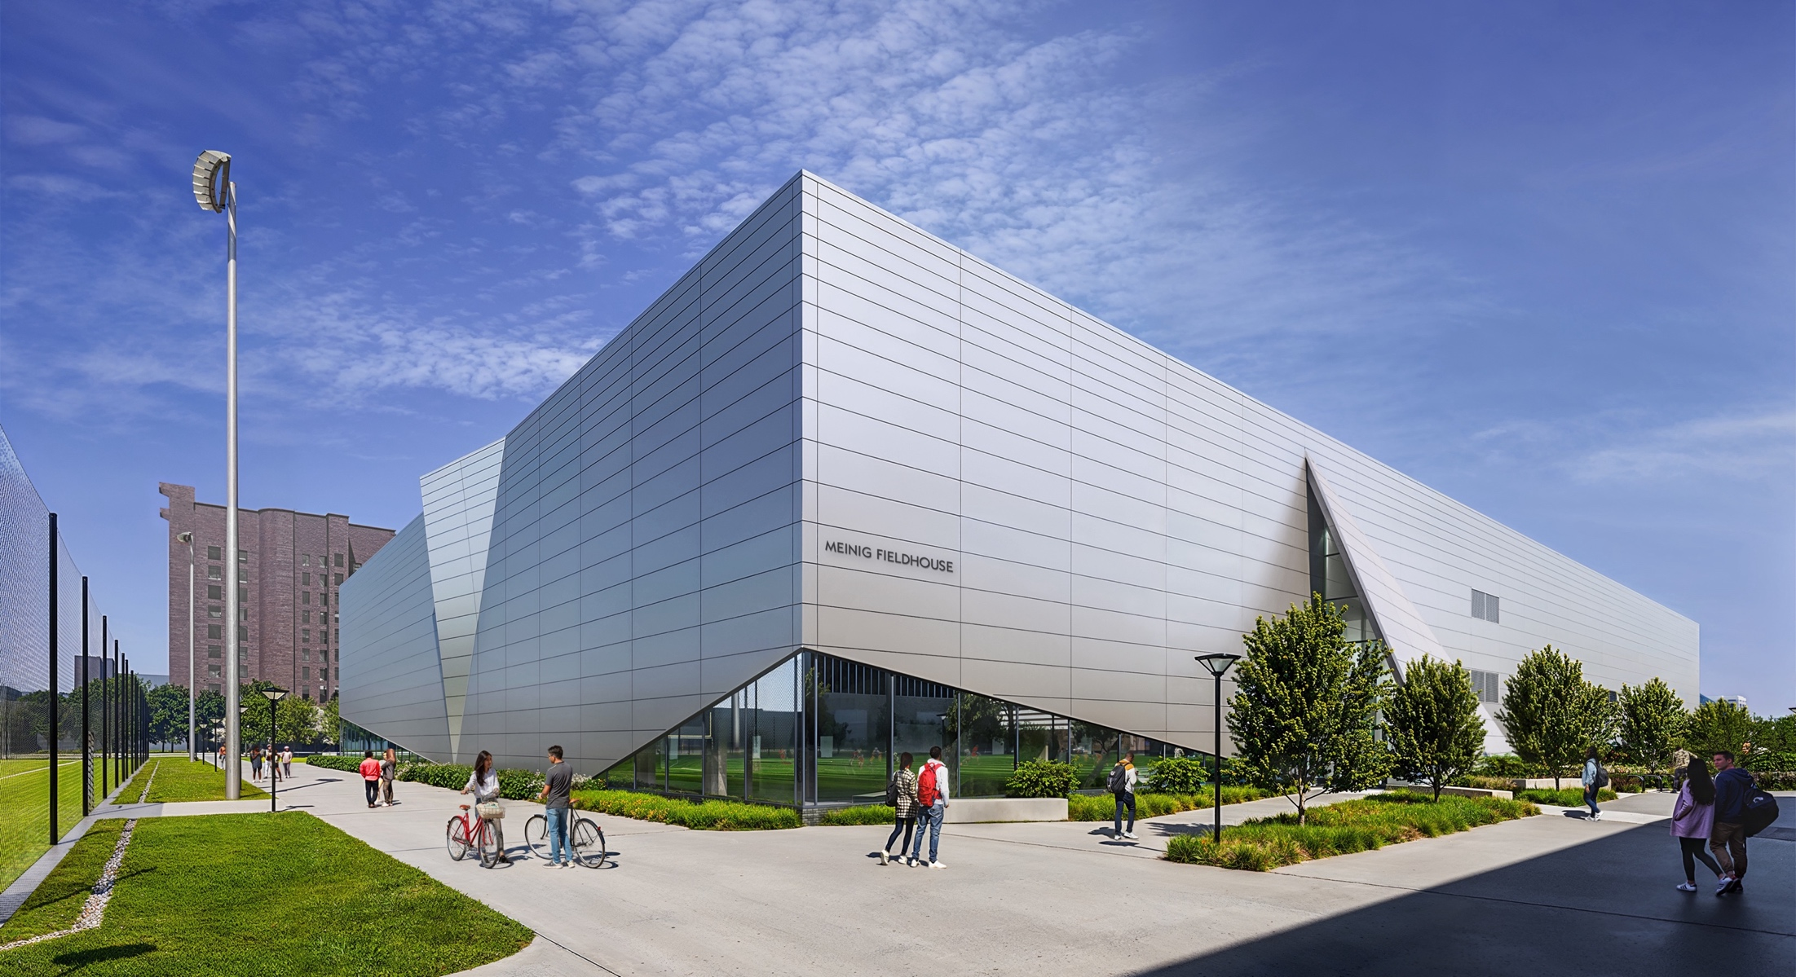

Slide 13
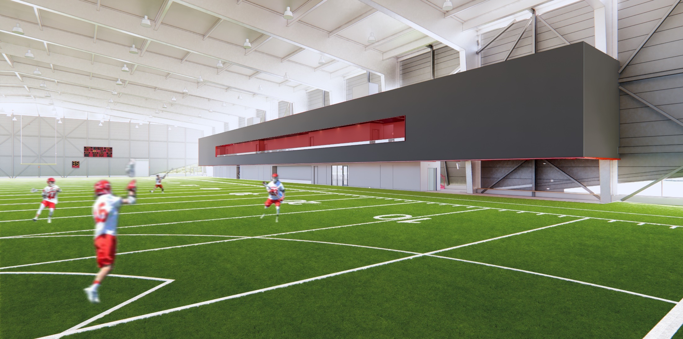

Slide 14
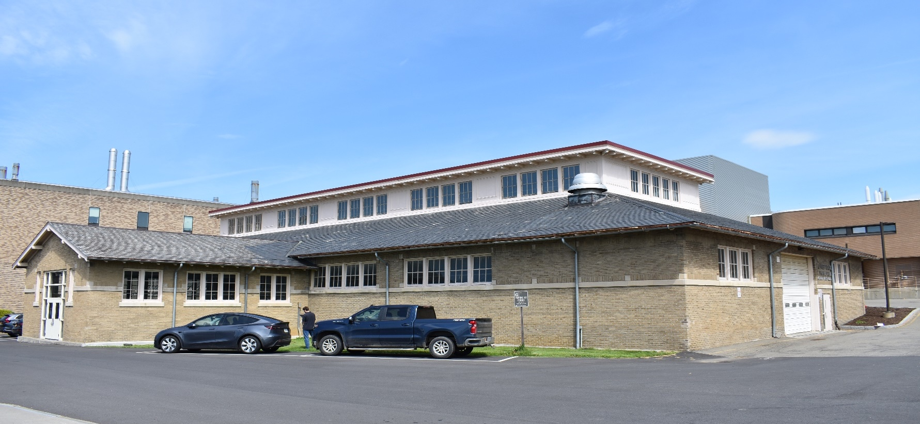
Life Sciences Pavilion
New 132,000 GSF building to provide the College with additional space to support ongoing growth in student population, faculty hiring, and research activity.

Slide 15
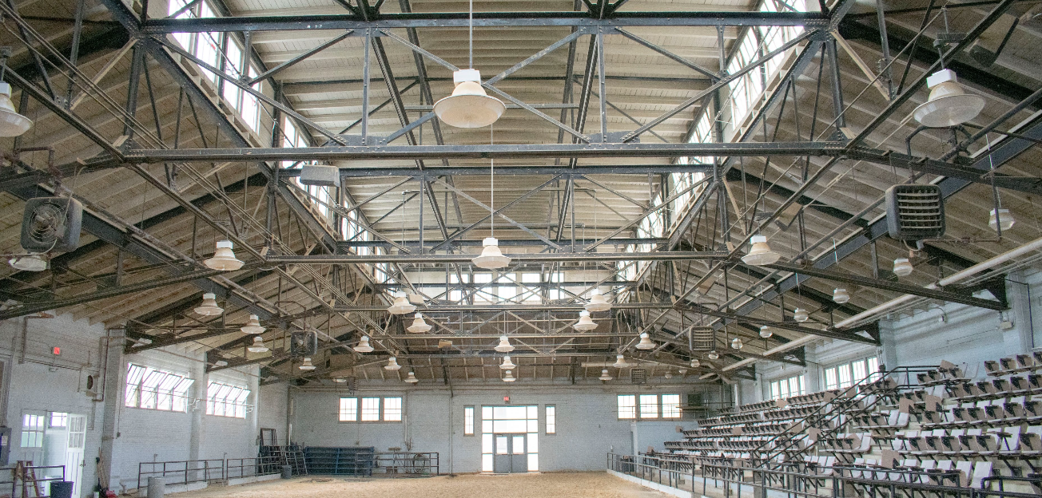
New 132,000 GSF building to provide the College with additional space to support ongoing growth in student population, faculty hiring, and research activity.

Slide 16
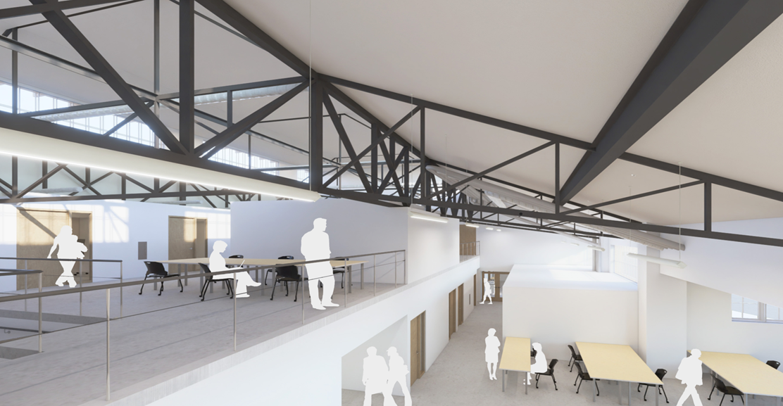

Slide 17
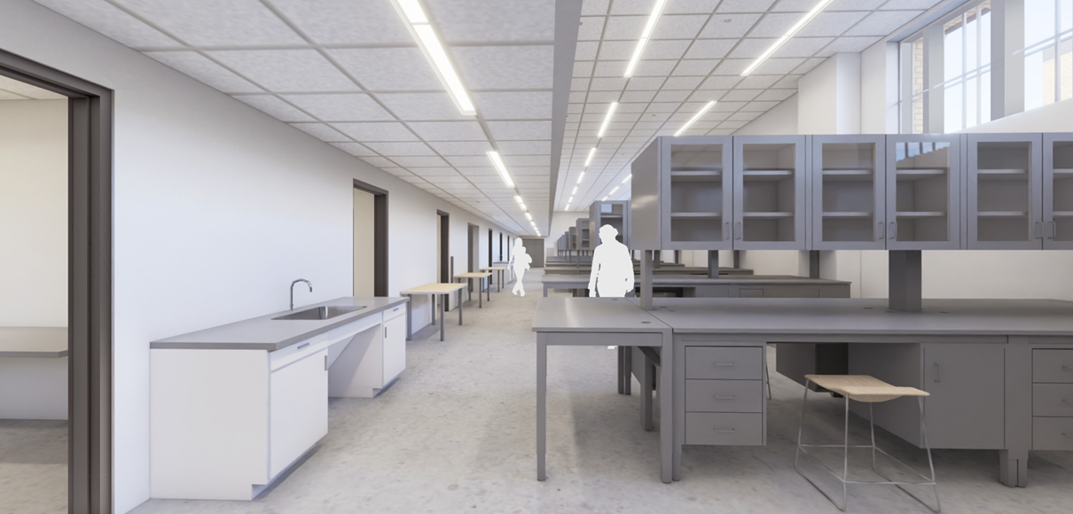

Slide 18
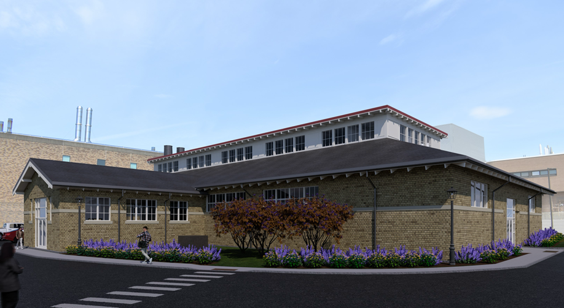
New 132,000 GSF building to provide the College with additional space to support ongoing growth in student population, faculty hiring, and research activity.

Slide 19
Construction Phase - Communication
“The single biggest problem in communication is the illusion that it has taken place.” - George Bernard Shaw
Please Err on the side of over communicating but…be clear and concise
Think early and often about the local and campus wide impact of your project (update Trimble project construction impacts statement)
Use a layered approach targeted for each type of audience
“Success with Constant Contact bi-weekly project updates for impactful projects”
Don’t forget your third-party consultants (FM Global, Commissioning Agents, Testing agents etc…)
Every project should have a project communication plan/strategy in place…that has been shared and vetted with partners and stakeholders

Slide 20
Questions?

