Slide 1
Project Management – Professional Development Series
Facilities and Campus Services Engineering and Project Management
April 16, 2025

Slide 2
Contracts Updates
Tariffs
Solicitation Period
Submission Review

Slide 3
Tariff Summary
The tariff situation is fluid and evolving.
Escalation clause has been added to General Conditions to address tariff impacts:
PM’s need to submit any requests and should not approve any of them (see process slide).
Applies only to documented tariff-related material cost increases above 10%.
Requires Cornell's approval based on provided documentation.
Adjustments processed via formal Change Order only.

Slide 4
Process
If you receive any requests or questions regarding Tariffs:
Forward to FC mailbox & copy Brenda Frank
There is a bi-weekly standing meeting to review all requests
If it is urgent, please add that to the email
Once it is reviewed and/or negotiated, Contracts will provide a formal response

Slide 5
Tariffs
Tariffs are assessed when the material enters the Country.
U.S. Customs and Border Protection collects tariffs at ports of entry.
Impact on Prices: Importers—American companies—pay the tariffs, and they pass these costs onto consumers through higher prices

Slide 6
Escalation Clause
An Escalation Clause has been added to our General Conditions:
The updated GC’s are in Trimble Resources
Purchase Orders have had their Terms and Conditions updated to reflect tariffs
This includes Professional Service Agreements (PSA’s) and RFP’s

Slide 7
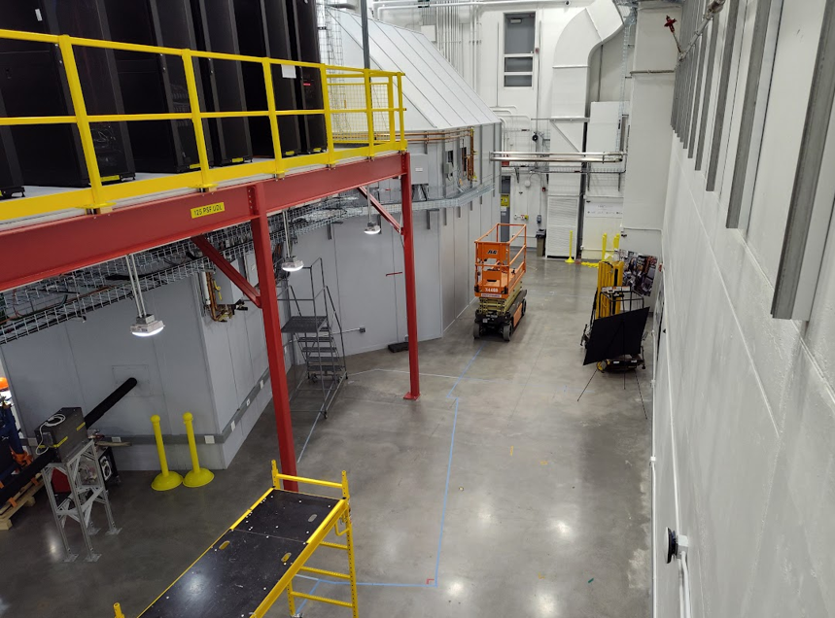
First Major Impact Wilson Lab XLEAP Beamline Enabling
Construct Cave and Hutch equipment platform mechanical, electrical, and plumbing
Bids came in 30% higher than OPC
Scope validation with the low bidder revealed a lack of participation and competition from structural steel sub-contractors

Slide 8
Solicitation Period
As a reminder, there should be no contact with any Contractor / Vendor during an open Solicitation Period.
This includes all Cornell Employees.
You should refer all of them to email their questions to facilitiescontracts@cornell.edu
Note that by communicating with them and if there is a bid protest, etc. it might lead to litigation.

Slide 9
Review your Submissions prior to sending to Contracts
Please . . .
Ensure you have all the required attachments for the process.
Make sure to flag any special circumstances (grant, schedule, etc.).
Schedules should be up to date, please do not give weekend dates.
State funded projects need # of weeks.
Notes:
We understand things are moving fast and we want to get it out fast – we want to help you – help us help you

Slide 10
Review your Submissions prior to sending to Contracts
Please . . .
Do a spell / grammar check, if you have trouble with formatting contact one of us.
Make sure information is clear, concise, and includes all scope and other information.
Ensure any contact information provided is accurate.
If you will be out of the office provide a contact for us to forward questions to.

Slide 11
Questions?

