Slide 1
Project Management – Professional Development Series
Facilities and Campus Services Engineering and Project Management
March 12, 2025

Slide 2
IDIQ Updates
Contracts has solicited and awarded new Agreements for:
  MEP Commissioning
  Special Inspections and Testing

Slide 3
IDIQ Updates
The new Agreements have been updated to Trimble.
We have updated the process and associated documents to Trimble
Please use these and not any existing ones you may have. If you do, they will be returned to you to update accordingly.

Slide 4
Time Extensions
for CO’s and CAA’s

Slide 5
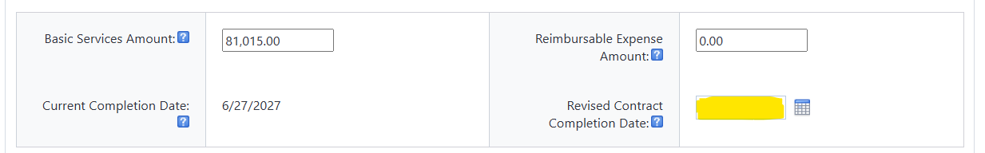
Cornell Funded
Consultant Amendments
If a project is going to run longer than the Agreement end date then it needs a time extension via an Amendment, so it is contractual.
  In the CAA process, the “Revised Contract Completion Date” field must be entered and accurate.
  Remember that Consultant Agreements need to include the one-year walk-through period.
  Have questions, contact Contracts.

Slide 6
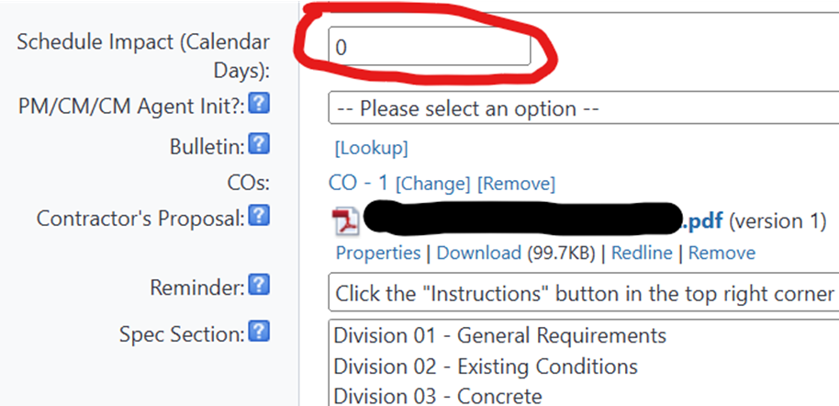
PCO’s
PCO step - Additional time shall be determined as necessary for each PCO. The number of calendar days must be added to the “Schedule Impact” field in the PCO.

Slide 7
PCO’s
Check the Contractor’s “Construction Contract Change Order Request Sheet” to see if they have a time extension included.
The information is located at the bottom of the template.

Slide 8
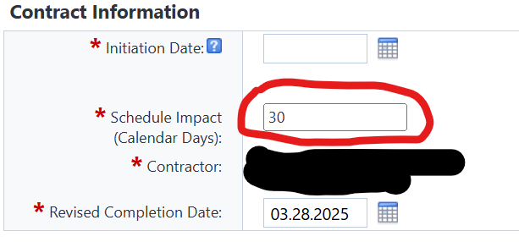
Change Orders
In the Change Order (CO) process:
  Additional time shall be inclusive of all the PCO’s in the CO.
  Fill in the “Schedule Impact” Field with the actual Calander Days the Contract will be extended.
  The actual days should reflect all extensions to the Contract including PCO’s and other items.
Note: Time extensions are Contractual.

Slide 9
Campus Let CO’s and CAA’s
The process we just reviewed applies to Campus Let Projects, however, in addition:
  Any time extensions from the date noted in the original Contract / Agreement must be processed in Trimble - whether there is a cost associated with it or not.
  If there are not any cost changes associated with the time extension you will need a written justification that is clear, concise, tied to Scope of Work, and reference the cause of the time extension for approval by the OSC.
  If you do not extend your Contract and it goes past the end date you will not be able to pay the Contractor /Consultant as the State Financial System will close the contract.

Slide 10
Tariffs
The University is currently addressing how we will be managing tariffs and will share when we have a final process.
If you receive any inquiries regarding tariffs, please send them to the FC mailbox and copy Brenda.

Slide 11
Questions?

