Slide 1
Trimble/ebuilder closeouts
FIG Archiving
FIG Archiving: facilitiesarchiving@cornell.edu

Slide 2
Archival Description
Library Annex/CULAR (Cornell University Archival Repository) Collection houses
195K total documents representing University construction for the past 137 years
Collection is owned by the University Library and managed by the Facilities Archiving Group
This resource provides a foundation for all maintenance/repairs, renovations, and new design, planning
Records were designated by the Archiving Advisory Committee
This group determines records that need to be archived in perpetuity
The list is contained in Trimble (aka eBuilder) under 00007 -*e-Builder–Administrative User Resources–CC–Closeout Process Guidance
Records held in electronic file share instead of long-term storage
CADD files, BIM, Operations and Maintenance manuals, and access to MultiVista construction photos.
Other records that are NOT archived
Furniture
Building equipment
Paint and finishes
Meeting minutes
Finance reports

Slide 3
00007 - *e-Builder Resources – Administrative
Application materials and approvals from historic commissions and/or state agencies (i.e.: ILPC)
Studies done prior to the project - including renovations and code reviews reflecting pre-construction conditions.
Concept report including Basis of Design
Schematic design report including Basis of Design
Design development report (should include a system & material narrative and Basis of Design)
Preliminary code analysis reflecting proposed changes (may be part of design phase reports)
Structural analysis including seismic analysis of existing building and proposed strengthening techniques.
Peak utility requirement (if not in LEED documents)
Energy Modeling Plan
Engineering Calculations
Specifications (with addendums)
Testing and balancing reports
Commissioning agent test & certification documents
Commissioning Report/Drawings (if there are any - these may be redundant with shop drawings)
Material test and special inspections reports
Environmental Impact Statement: Important to retain since it sets operational limits on what can be done in a building in the future.
Honors/awards received by the project (certificates)
PR materials/artifacts associated with the project (newspaper clippings, copies of event materials)
Dedication or opening, groundbreaking & final public commissioning events
Cornerstone or time capsule information (i.e., yes/no; contents)
LEED Final report

Slide 4
Record drawings-Full Size = A complete set of clean drawings that reflect how the project was built - folding the as-built revisions into the design documents, including addenda, post bid bulletins and design revisions.
These are compiled by the designer from the as-built drawings submitted by the contractor, as a record of the work. Since these are not confirmed in the field by the designer they are not "as-built" but a compiled record.
Record drawings are expected to represent a complete drawing set, not just the sheets that changed. These drawings will not be signed but will be stamped or otherwise marked by the design team as “Record Drawings” AND Dated
AutoCAD drawings and BIM Model files

Slide 5
Building permits (or any related Authority Having Jurisdiction documents)
Temporary Certificates of Occupancy
Certificate of Occupancy or equivalent: As issued by the Authority Having Jurisdiction
Materials Filed with local & state agencies for variances, site plan approval & environmental impact
Letters of Agreement (project specific): pertaining to access/use before, during or after construction, document of ownership, utility, or maintenance
Final acceptance: Document signed off on by architect/engineer/designer that project is substantially complete
Notice to Capital Planning Group of Outstanding Issues
1st day and construction photos.

Slide 6
Structural Materials (i.e. Concrete, steel, reinforced masonry) - Shop Drawings and Product Data
Special mechanical equip (i.e. Phoenix valves)- Shop Drawings and Product Data
Curtain walls, ALL windows- Full Size Shop Drawings and Product Data
Controls- Full Size Shop Drawings and Product Data
Fans- Full Size Shop Drawings and Product Data
Pumps- Full Size Shop Drawings and Product Data
Panel Boards- Full Size Shop Drawings and Product Data
Switch Boards- Full Size Shop Drawings and Product Data
Lighting- Full Size Shop Drawings and Product Data
Security Systems- Full Size Shop Drawings and Product Data
Ductwork- Full Size Shop Drawings and Product Data
Fireproofing- Full Size Shop Drawings and Product Data
Fire Protection System Records - Sprinklers & fire alarms - Full Size Shop Drawings and Product Data also including calculations
O&M Manuals

Slide 7
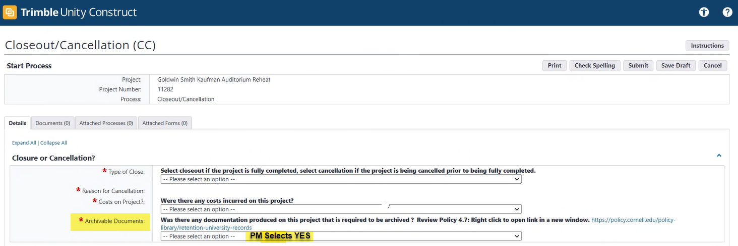
Close Out process -PM

Slide 8
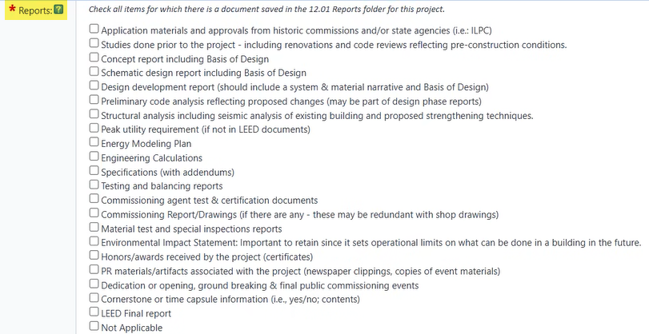
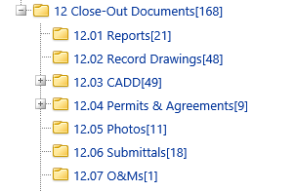
Select Archivable Documents
Archiving Close-Out Folders

Slide 9
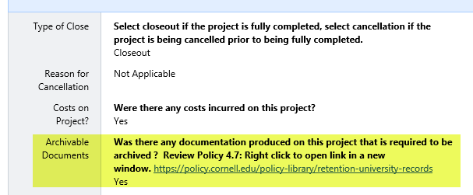
Close out process - Archiving

Slide 10
Actors will receive an email notifying “Action is Required”:
Stella Garber and Rebecca Merritt

Slide 11
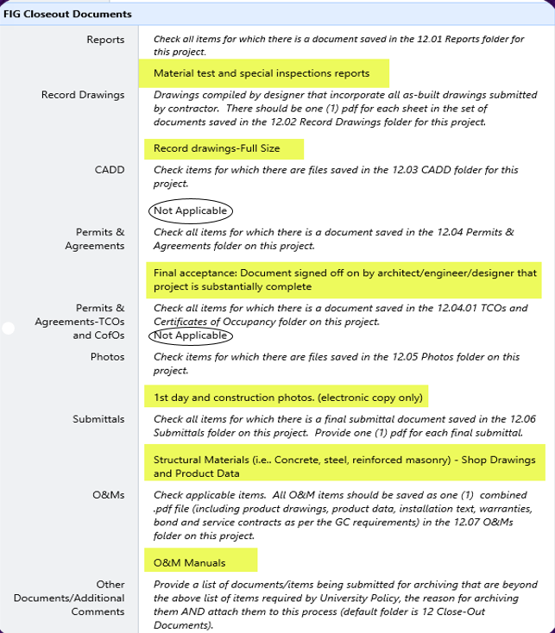
Email notice will identify the documents you have selected to be archived
FIG Archiving Close-Out Folders

Slide 12
Additional Comments Or
Specialty Documents to Archive
Example: We typically do not archive Paint Samples.
Your project used special paint or if the paint colors are important for historic reasons and the paint submittal should be archived; you would enter that information in the “Other” field and place submittal under the Submittal close out folder.

Slide 13
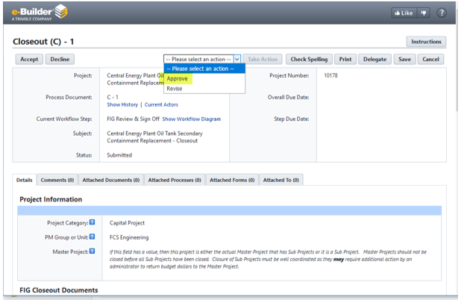
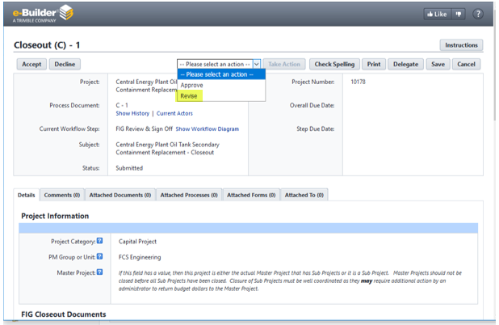
If Selected items are in closeout folders: FIG Approve
If Selected items are missing or questions: FIG Revise

Slide 14
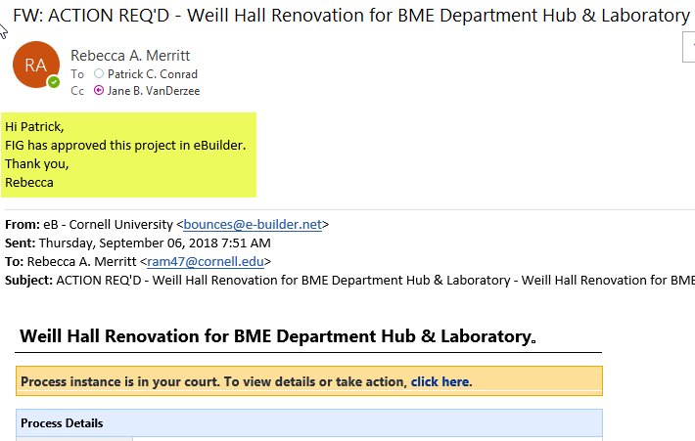
Email notice when FIG has Approved

Slide 15
If “Revised”
project will be back in your court
FIG will “Revise” and send an email with the same comment, examples:
This project is being revised because construction drawings were uploaded but the archives require Record Drawings. Please upload the Record Drawings and resubmit.
This project is being revised because you have selected to archive Schematic Design Report, but the report is not in the 12_Close Out Report Folder. Please place Schematic Design Report in the reports folder and resubmit.

Slide 16
Questions: What do you think about inviting an archiving member to your end of project meetings?

