Slide 1
Project Management – Professional Development Series
Facilities and Campus Services Engineering and Project Management
January 15, 2025

Slide 2
Where is my…?

Slide 3
The Answer
Start with the tools provided within the Trimble process.
Finding the status of your process quickly and easily.
Save time.
If all else fails, reach out to Facilities Contracts.

Slide 4
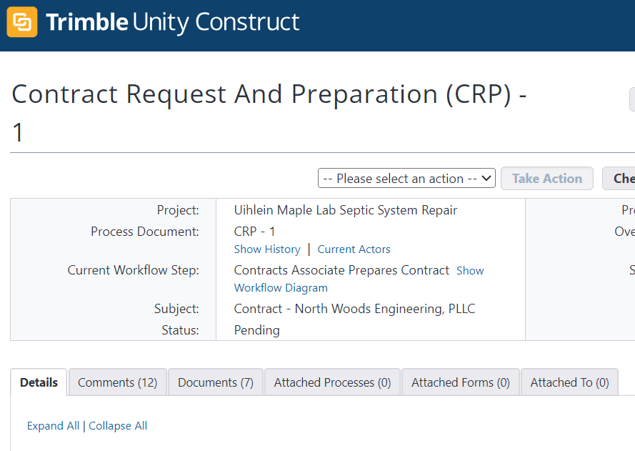
Four Key Tools
Comments
Show History
Current Actors
Workflow Diagram

Slide 5
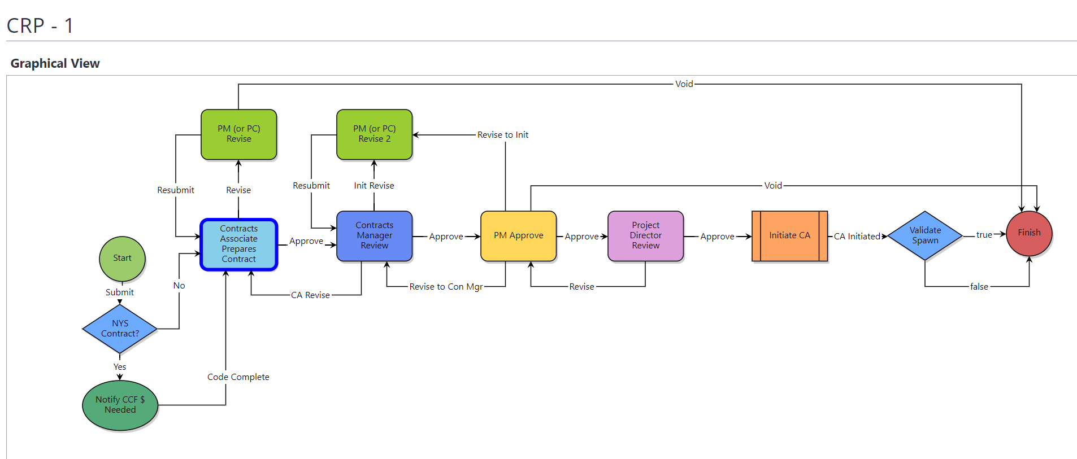
Workflow Diagram
Current Step

Slide 6
Questions?

