Slide 1
Project Management Professional Development Series
January 15, 2025
Facilities and Campus Services Engineering and Project Management
Notes:
August 14

Slide 2
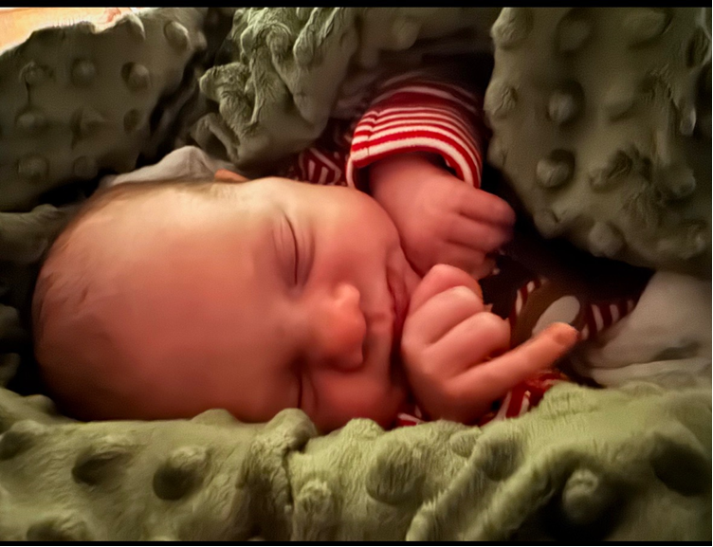
Who am I and Where is Taylor?
I am Madison Macumber
- Administrative Assistant in
Facilities Engineering
Taylor is on maternity leave, so you are stuck with me!
Baby Blake was born on Saturday, Dec 28th
6 pounds 14 ounces
19 inches long

Slide 3
Today’s Agenda
Introduction of the new incoming Access Control Program Director
Peggy Matta & David Brooks
Facilities Contracts “Where is My…?”
Tanner Letto
AutoDesk Ipad Instructions
Michael Kuo & Travis Fisher
Trimble Archives Presentation
Stella Garber & Rebecca Merritt

Slide 4
Introduction of the new incoming Access Control Program Director

Slide 5
Faciltities Contracts “Where is My…?”

Slide 6
AutoDesk Ipad Instructions

Slide 7
Trimble Archives Presentation

Slide 8
Thank you
272133
Notes:
Introduction

Slide 9
Questions?

