Slide 1
Cornell University Design and Construction Standards
Notes:
Good morning.

Slide 2
Outline
Purpose of Standards
What are the CU Standards?
Who Must Follow CU Standards?
How Do I Apply for a Variance?
Variance Process
Notes:
Review the outline

Slide 3
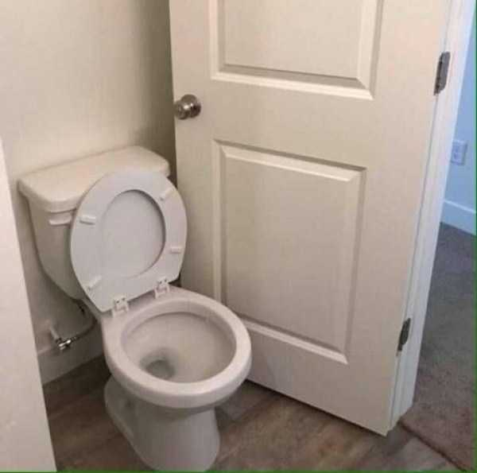
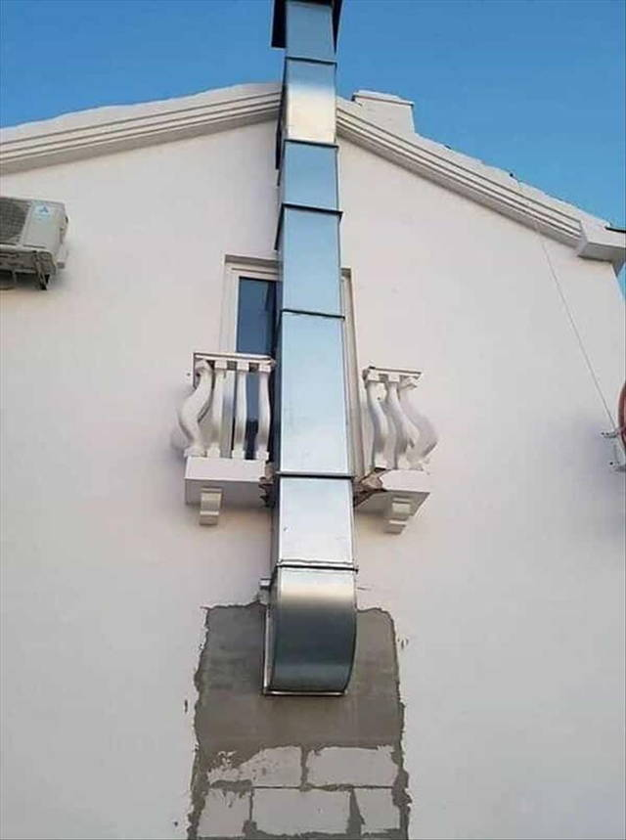
Why do we need standards?
Notes:
I thought I would start out with a few funny photos of construction fails. I am sure you have all seen funny memes making fun of construction gone wrong. Just to be clear, these pictures were not taken at Cornell. Hopefully we don’t have too many of these situations on campus.

Slide 4
Cornell is a high-tech city
100,000 Sprinklers
225 Sprinkler Systems
60 Miles of Sidewalks
100 Acres of Parking Lots
10 Miles of Roads
280 Elevators
33 LEED Certified Buildings
243,000 Ft of Steam Pipe
6,900 Under-ground Structures
145,000 Ft of Chilled Water Piping
22 Bridges
2,000,000 SF of Lab Facilities
Notes:
In all seriousness…
Cornell University is a high-tech city with a complex physical plant
To demonstrate the complexity and scale of our campus we have assembled a few statistics.
Facilities professionals hold institutional knowledge and best practices about these various systems which allows us to provide expert advice and successfully guide consultants who don’t fully understand our challenges and climate.

Slide 5
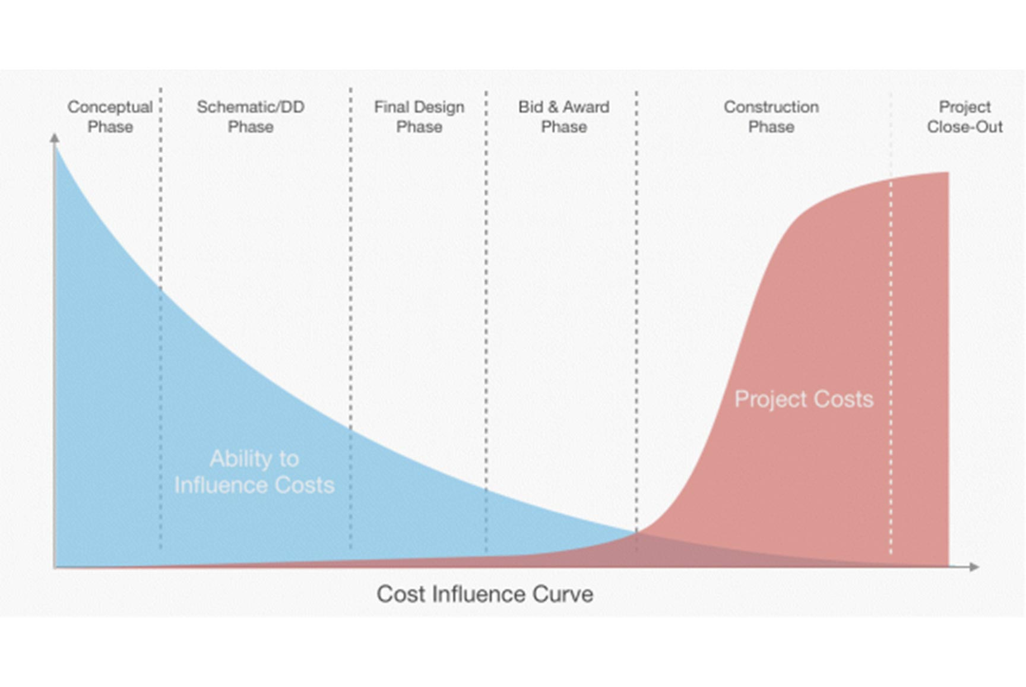
Cost and Influence Curves
Purpose of Design Standards:
Document Institutional Knowledge and Subject Matter Expertise
Document Lessons Learned and Avoid Repeating Mistakes
To Deliver High-Quality, High-Performance & Maintainable Facilities
Notes:
First – design reviews. What is the goal of a design review? As we mentioned before – 1) to deliver high quality, high performance (based on the system – for instance energy performance) and maintainable facilities. 2) We have a great wealth of knowledge in facilities at Cornell and the design review process is one way we can leverage that institutional knowledge and expertise to help projects succeed. 3). We want to optimize engagement of these facilities experts so they can effectively support projects with the limited time they have available.
I would also like to highlight one really important concept related to how we most efficiently effect change in projects. The cost – influence curve displays this relationship between the ability to influence change verses the cost of change. We want to effect change in the project as early as possible when the cost is minimal. Making a change during construction is expensive or worse yet, making the change after the project is complete is very expensive and disruptive. We want to influence the project during the concept and design phase.

Slide 6
Design-Construct-Operate Feedback Loop
Design
Construct
Operate
Learn
Design Standards
Feedback Loop
Notes:
Our standards are created and updated based on a continuous feedback loop where all of you play a role.
#1 Design Standards, #2 Design, #3 Construct projects, #4 Operate and experience the project, #5 Learn
As facilities professionals we are always learning and finding ways to improve over time. This feedback loop provides the lessons learned to update our design standards and document that information for future projects.

Slide 7
Philosophy of Design Standards
EXTEND LIFE
REDUCE O&M
HIGH ROI
SECURITY
QUALITY
CU STANDARDS
BUILDING CODE
DESIGN REQUIREMENTS
Notes:
It is important to note that the CU Design Standards do not replace building codes and industry standards but rather explain where Cornell is going above and beyond code minimums.
This graphic represents how Cornell goes above minimum code in several area. We chose to have higher standards than building code minimum for several reasons including what is depicted in this graph:
To extend the service life (Cornell maintains buildings for centuries and we have higher expectations for the service life of systems and materials when compared to other building owners)
To reduce operation and maintenance costs and save Cornell money over the service life of the building. We are looking at the total cost of ownership, therefore lowest first cost may not be the best decision for Cornell.
Due to a high return on investment in the case of energy conservation. Cornell is a leader in energy conservation so from both an economic standpoint and a leadership standpoint, Cornell is focused on reducing energy use.
Due to higher levels of security for building access and security to keep students and research safe.
Due to higher quality level expectations for the campus with finishes, materials or level of performance

Slide 8
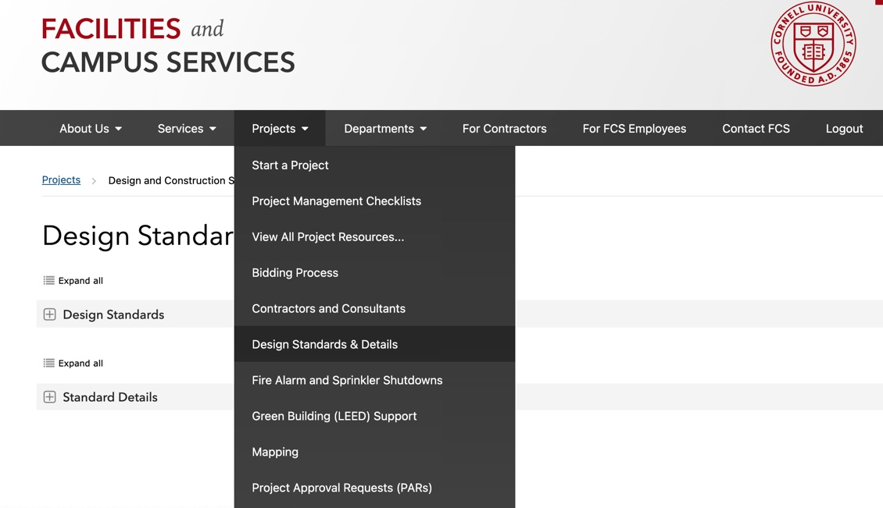
Where are the CU Design Standards & Details?
Written Standards & Guidelines
Standard Details
Standards are a contractual requirement for architects and engineers to incorporate in CD’s
Notes:
Facilities Engineering is the Curator of the Design Standards & Details.
There is a subject matter expert (SME) who leads the development of each standard.
Some SME’s are from Facilities Engineering and others are from units at Cornell like EHS, E&S, OUA, CIT, CU Police, Etc.
The SME tracks industry standards, trends, coordinates updates and gathers input from campus stakeholders.
The SME will also weigh in on variance discussions related to that standard.
It is a contractual requirement for architects and engineers to follow the University Design and Construction Standards. And it is the responsibility of the PM to ensure compliance by conducting regular design reviews. The SME’s who perform design reviews are often reviewing construction documents for compliance with the Design and Construction Standards.

Slide 9
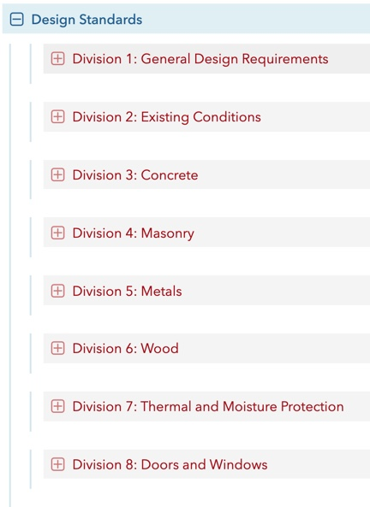
Approach
Organized by CSI Division
Division 1 – General Design
Spaces
Accessibility
Safety
Energy
Programming
Division 2-43 – Technical Divisions
Materials
Systems
Assemblies
Notes:
Standards are generally organized by CSI format for the benefit of the design professional as they create the construction documents.
Division 1 covers general design topics including space, accessibility, safety, energy and programming. Examples include: Custodial standards and Energy Efficiency and Sustainable Design
Division 2 – 43 covers technical divisions including building materials, systems and assemblies. Examples include: Door hardware, Roofing, Elevators, Electronic safety and security systems.
Most standards within each document follow typical CSI specification organization structure including:
General Requirements which covers Basis of Design Criteria, Guidelines, Submittal requirements.
Products which includes specific materials or manufacturers
Execution which describes work procedures related to the specific standard

Slide 10
The Owner/Architect Agreement
Who must follow the Design and Construction Standards?
Design Professionals are required by contract to follow the Cornell University Design and Construction Standards.
This Photo by Unknown Author is licensed under CC BY-SA

Slide 11
The Owner/Architect Agreement
“The drawings and specifications prepared by the Architect shall be in conformity with all applicable laws, building codes, governmental rules and regulations, the design and construction standards, general conditions and general requirements of the Owner and the requirements of the Program. The Owner’s Design & Construction standards establish a baseline of quality. It is the Owner’s expectation that the Architect shall bring to the Owner’s attention any deviations from these standards throughout the design process and shall obtain express written authorization prior to implementation of such deviations.”
Notes:
Page 11 of the Cornell University Short Form Contract
You will notice that the Owner – Architect agreement states that any deviation must obtain written authorization prior to implementation. So we are going to go through the standard variance process in the following slides.

Slide 12
Variance Process
When might I need a variance from the CU Design and Construction Standards?
Would create an excessive and unreasonable economic burden;
Would not achieve its intended objective;
Would inhibit achievement of some other important Cornell University mission (i.e. ; Purpose, Prosperity, Planet, People);
Would be physically or legally impractical
Notes:
These are categories similar to the building code variance categories.
Would create an excessive and unreasonable economic burden; - Many design standards are higher cost but provide lower life cycle cost (lower total cost of ownership) – This is for instances where for whatever reason there is an excessive and unreasonable economic burden
Would not achieve its intended objective;
Would inhibit achievement of some other important Cornell University mission (i.e. ; Purpose, Prosperity, Planet, People);
Would be physically or legally impractical
Design is unique and complex and there are times when it does not make sense to apply a standard. This should be the rare execption.

Slide 13
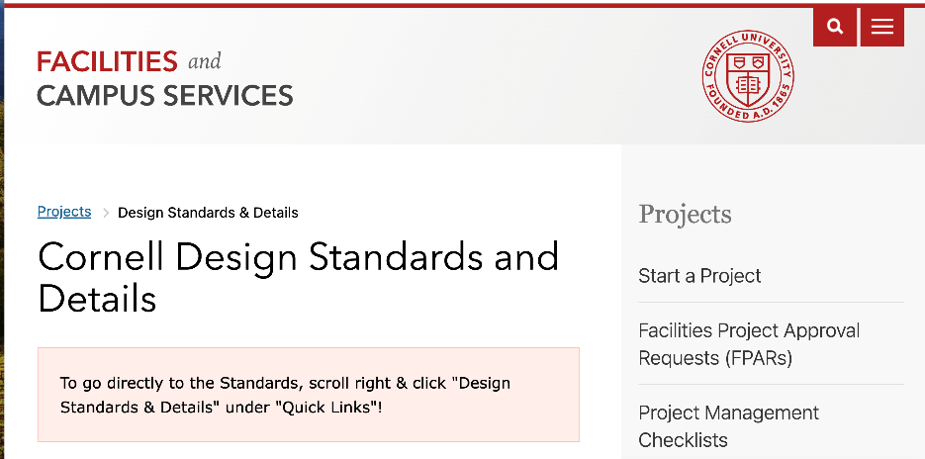
Variance Process
How do I apply for a variance from the CU Design and Construction Standards?
Follow the instructions on the CU Design and Construction Standards FCS Website.

Slide 14
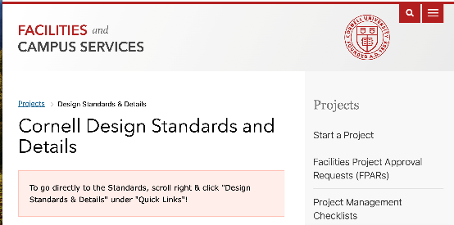
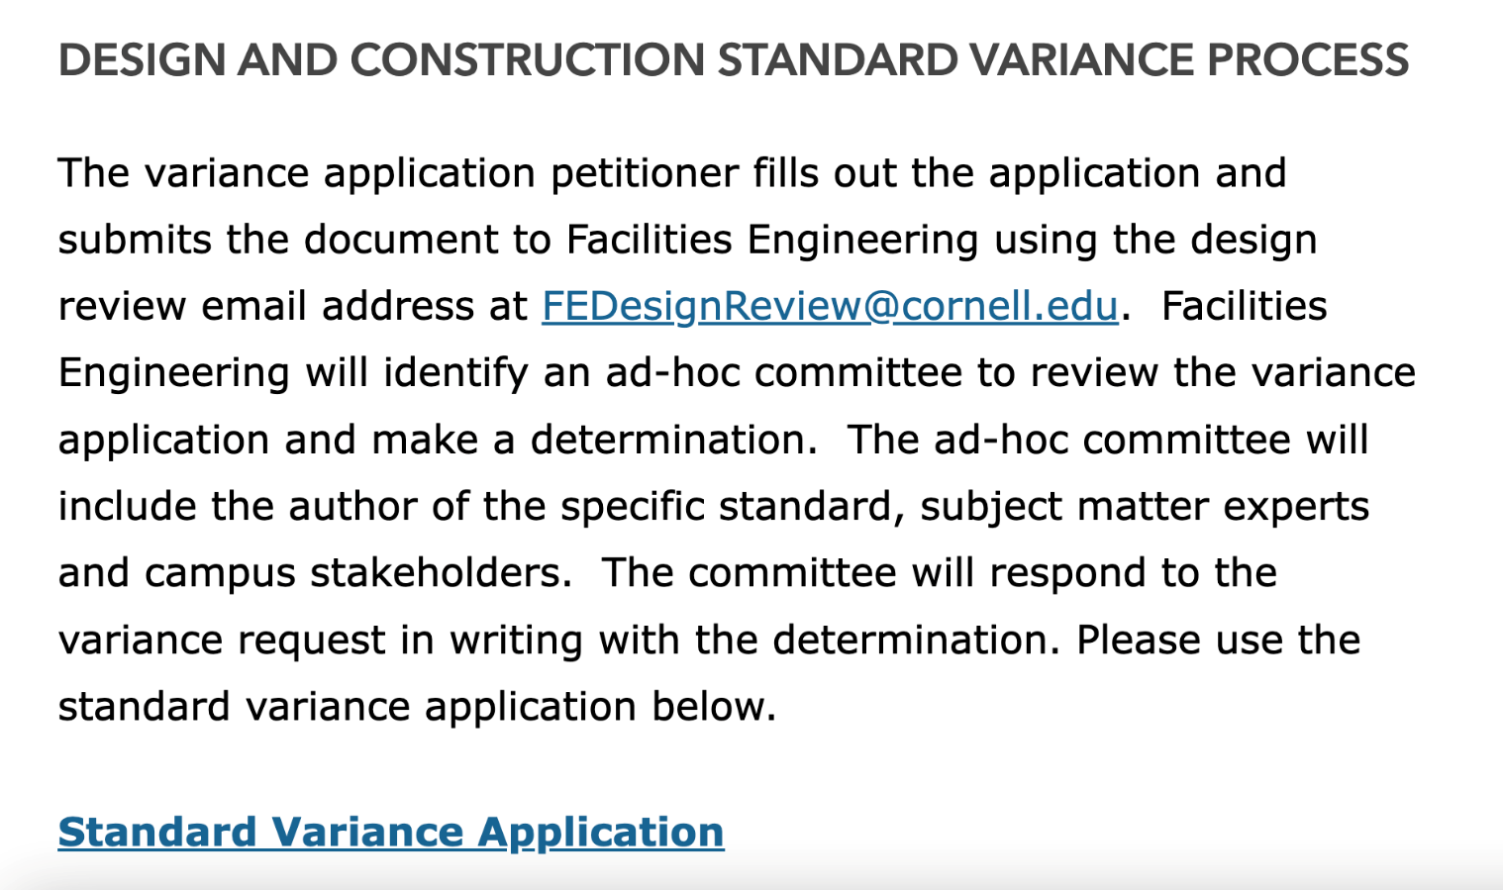
Variance Process
Bottom of the webpage
Notes:
You will find a link to the Variance Application and also see the FEDesignReview email address where variance applications should be submitted.

Slide 15
Variance Process
Who Fills Out the Variance Application?
The Petitioner – Who are they?
It depends on the variance topic and impact
For a minor item it may be your design consultant
For a major item it may be the project advocate or project director
The Petitioner should communicate in advance with FE about the variance request.
Notes:
We should not be hearing about a variance request for the first time when receiving the variance application.

Slide 16
Variance Process
Who Reviews the Variance Application?
The Standard Author & Stakeholders
Facilities Engineering will identify an ad-hoc committee to review the variance application and make a determination. The ad-hoc committee will include the author of the specific standard, subject matter experts and campus stakeholders. The committee will respond to the variance request in writing with the determination.

Slide 17
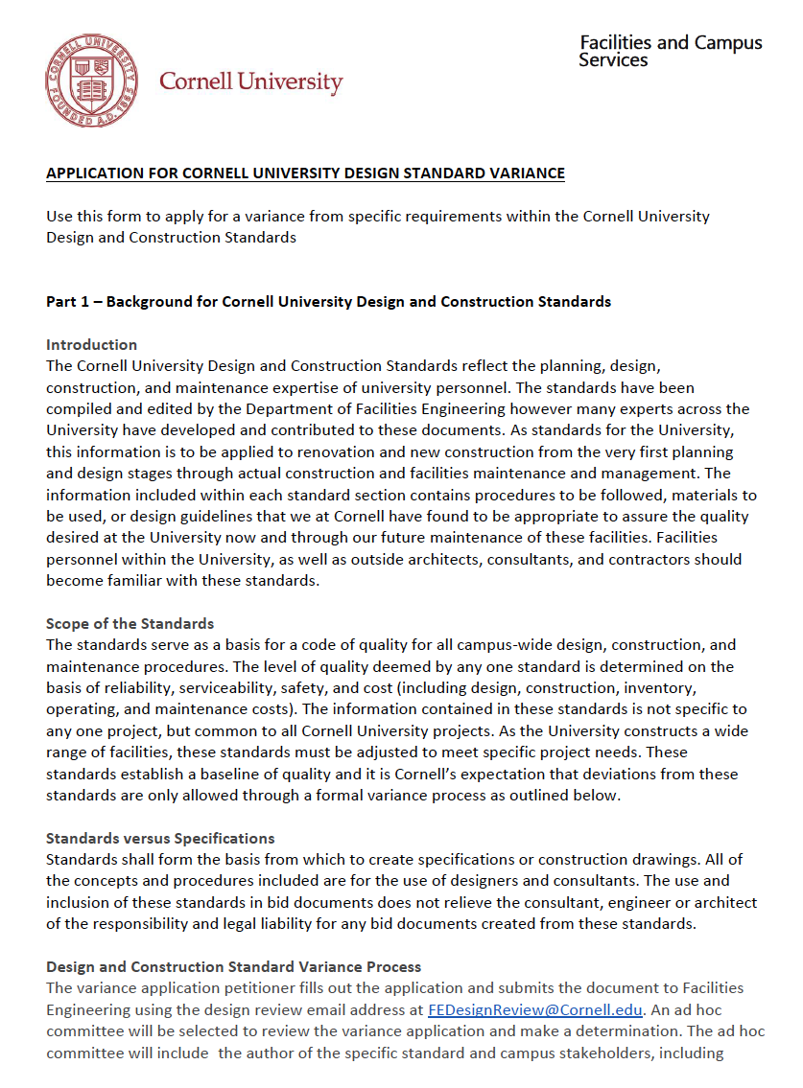
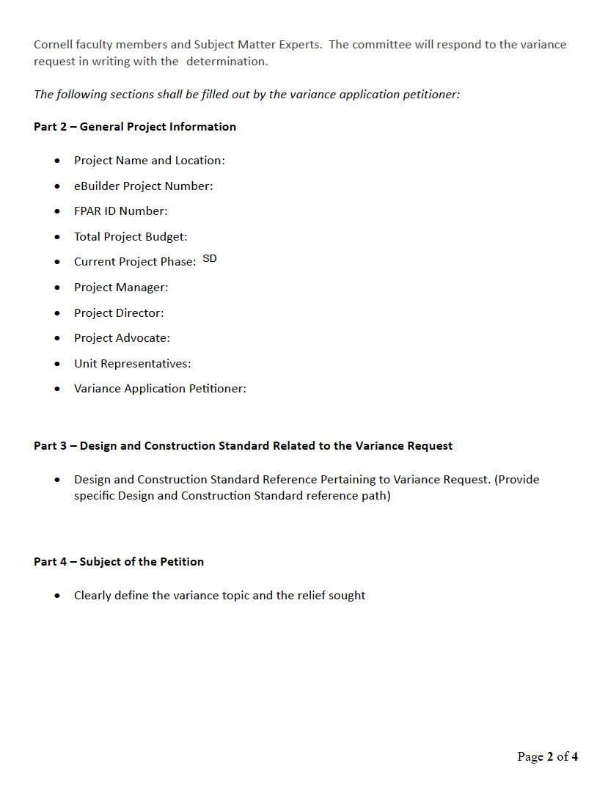
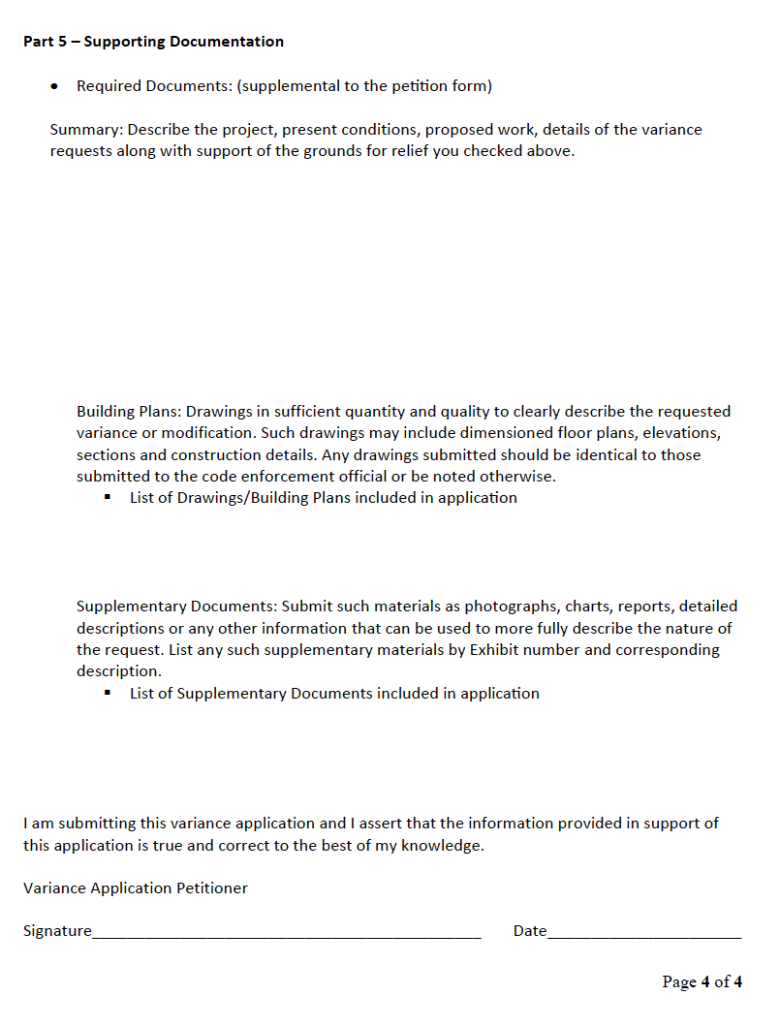
Variance Process – The Application
Notes:
The application is located on the FCS Design and Construction Standards Website as a hyperlink

Slide 18
Variance Application Sections
Part 1 – Background for Cornell University Design & Construction Standards
Part 2 – General Project Information
Part 3 – Design & Construction Standard Related to the Variance Request
Part 4 – Subject of the Petition
Part 5 – Supporting Documentation

Slide 19
Variance Application Sections
Part 3 – Design & Construction Standard Related to the Variance Request
Design and Construction Standard Reference Pertaining to Variance Request. (Provide specific Design and Construction Standard reference path)
This is where the Petitioner identifies the specific standard related to the variance request.

Slide 20
Variance Application Sections
Part 4 – Subject of the Petition
Clearly define the variance topic and the relief sought
Strict compliance with Cornell University Design and Construction Standard above would entail practical difficulties, unnecessary hardship or would otherwise be unwarranted because such (check the statements that apply and provide appropriate documentation):
would create an excessive and unreasonable economic burden;
would not achieve its intended objective;
would inhibit achievement of some other important Cornell University mission (i.e. ; Purpose, Prosperity, Planet, People)
would be physically or legally impracticable
Notes:
In this section you identify the reason for the variance petition request – Following the standard would create practical difficulties, unnecessary hardship or would otherwise be unwarranted because…

Slide 21
Variance Application Sections
Part 4 – Subject of the Petition
Describe leading alternatives considered to comply with Cornell University Design and Construction Standards and why each alternative was rejected.
Alternative #1
Explain why alternative was rejected
Alternative #2
Explain why alternative was rejected
Etc…
Notes:
Provide a narrative on the leading alternatives considered to comply with the standards and why each was rejected. This is case by case specific so I am not going to attempt to provide an example. If you encounter a variance request, you should make every effort to comply with the standards. This section allows you to explain why various compliance strategies are not feasible in the specific situation.

Slide 22
Variance Application Sections
Part 5 – Supporting Documentation
Required Documents: (supplemental to the petition form)
Building Plans: Drawings in sufficient quantity and quality to clearly describe the requested variance or modification. Any drawings submitted should be identical to those submitted to the code enforcement official or be noted otherwise.
Supplementary Documents: Submit such materials as photographs, charts, reports, detailed descriptions or any other information that can be used to more fully describe the nature of the request.
Notes:
Finally – there is a section where you can include and attach supplemental documents which support the variance request. Again, these will be case by case specific and may be helpful based on the variance requested.

Slide 23
Variance Process
Variance Application Determination
Facilities Engineering will identify an ad-hoc committee to review the variance application and make a determination. The ad-hoc committee will include the author of the specific standard, subject matter experts and campus stakeholders. The committee will respond to the variance request in writing with the determination.
Facilities Engineering will respond as quickly as possible based on the campus stakeholders involved.
Notes:
FE will respond to the variance requests as soon as possible based on the stakeholders involved. Obviously larger and higher impact variances may take more time to review and issue a determination letter.

