Slide 1
Stormwater Practices and Construction Projects
Erin Cuddihy, PE
Facilities Engineering – Environmental & Energy Services
Project Management – Professional Development Meeting
September 19, 2024

Slide 2
Outline
The need for stormwater practices
Types of stormwater BMPs (Best Management Practices)
Construction sequencing
Conversion from temporary sediment basin to permanent stormwater practice
Improving BMPs in design and construction
Closing summary
Notes:
Hello! My name is Erin Cuddihy and I’m an Environmental Engineer in Facilities Engineering, in the Environmental and Energy Services team. Today I’m presenting briefly about stormwater practices, also known as stormwater BMPs. I’ll talk about construction sequencing, temporary sediment basins, and how we can improve stormwater practices during the design and construction process.

Slide 3
Why install stormwater practices?
We build impervious surfaces – buildings, parking lots, sidewalks, roads, sporting facilities
Water runs off impervious surfaces quickly and less water can soak into the ground
Legally, we need to control:
How much water leaves the site
How fast the water leaves the site
How polluted the water is that leaves the site
Notes:
As you know, we install stormwater infrastructure as part of our facilities construction all over campus. Legally, we need to control how much water runs off the site, how fast the water runs off the site, and how polluted the water is that leaves the site.

Slide 4
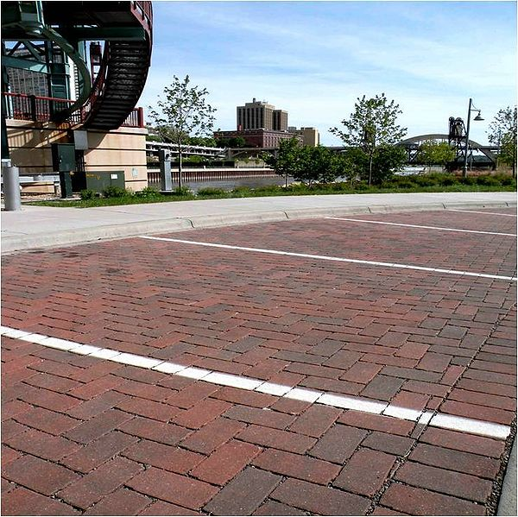
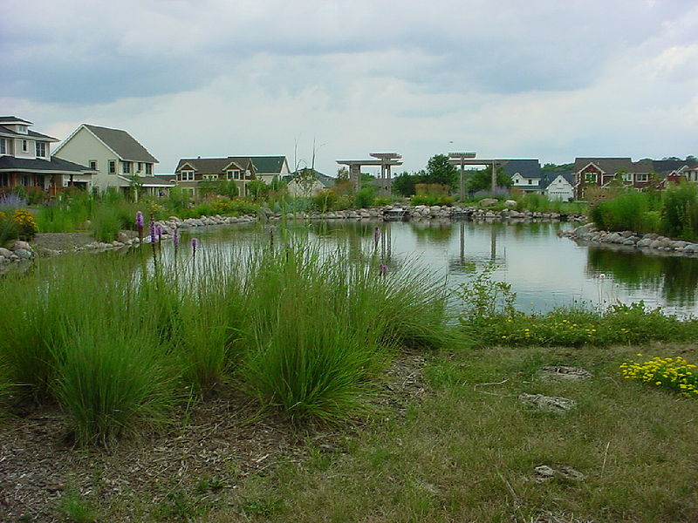
Some Types of Stormwater BMPs
Images courtesy: Minnesota Stormwater Manual, from left to right
https://stormwater.pca.state.mn.us/index.php?title=File:Center_pond.jpg
https://stormwater.pca.state.mn.us/index.php?title=File:Picture_of_permeable_interlocking_concrete_pavement_1.jpg
https://stormwater.pca.state.mn.us/images/2/2d/StormTrap_underground_storage_vault_for_water_stormwater_reuse_as_irrigation.png
Notes:
Stormwater infrastructure other than old-fashioned curb inlets, pipes, and manholes, are called stormwater practices or stormwater BMPs (which means best management practices). This category includes all kinds of infrastructure like stormwater ponds, bioretention areas, swales, sand filters, permeable pavement, and more.
Three types of common stormwater practices are shown here: a stormwater pond, permeable pavers, and underground chambers. I’ll show more types on upcoming slides.

Slide 5
What if you don’t install stormwater practices?
Improperly designed or constructed stormwater BMPs, or lack of maintenance can result in
More runoff → water overwhelming sewers → flooding in streets and buildings
Fast flowing water → eroding streambanks → water turbidity and clarity issues → detrimental to wildlife
Water polluted with phosphorus, nitrogen, heavy metals, pathogens, etc. → streams and lakes → algal blooms and other negative effects for the environment and recreation
Notes:
Here are some examples of what happens if stormwater practices are not properly designed or installed, or if maintenance isn’t performed. You can end up with flooding, erosion, and negative impacts on the environment and recreation areas.

Slide 6
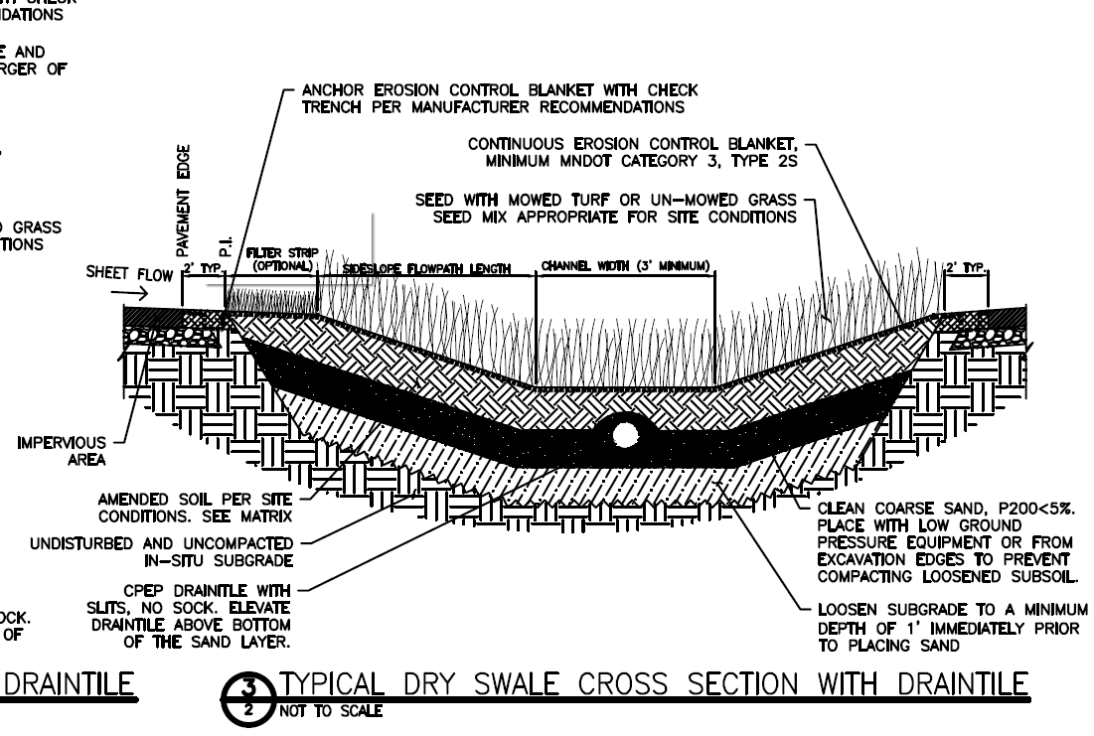
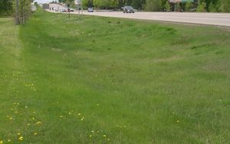
What’s inside of stormwater BMPs?
Drawing courtesy: Minnesota Stormwater Manual
https://stormwater.pca.state.mn.us/index.php?title=File:MIDS_Dry_Swale_Sections.dwg
Image courtesy: Minnestota Stormwater Manual https://stormwater.pca.state.mn.us/index.php?title=Dry_swale_%28Grass_swale%29
Notes:
On the next few slides, I’ll show cross-sections of common stormwater practices. This is a dry swale design. It has the subgrade soil at the bottom and then a layer of sand. There is an underdrain (also called a drain tile). Then a specially formulated soil that allows infiltration and there is grass on top. This design can be mowed. Although it just looks like a grassy area when it’s done, it’s not.

Slide 7
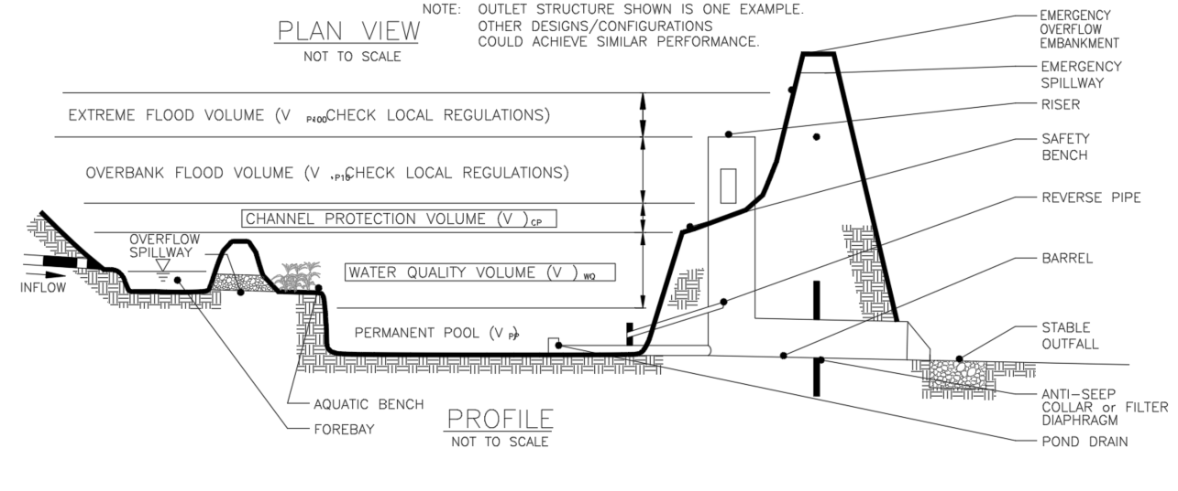
What’s inside of stormwater BMPs?
Stormwater Pond Design
Drawing courtesy: Minnesota Stormwater Manual, https://stormwater.pca.state.mn.us/index.php?title=File:Typical_pond_plan_and_profile.dwg
Image courtesy: Minnesota Stormwater Manual
https://stormwater.pca.state.mn.us/index.php?title=File:Center_pond.jpg
Notes:
This stormwater wet pond design includes a forebay at the inflow area where a lot of sediment will settle. This makes maintenance easier and keeps the rest of the pond cleaner.
There are pipes inside the pond that can clog if sediment is allowed to enter during construction. The pond is designed so that the surface can rise to a specific level and then the water will slowly outflow, but some water will always remain in the pond. If the pipes inside clog then water cannot outflow as designed which can lead to flooding or other issues.

Slide 8
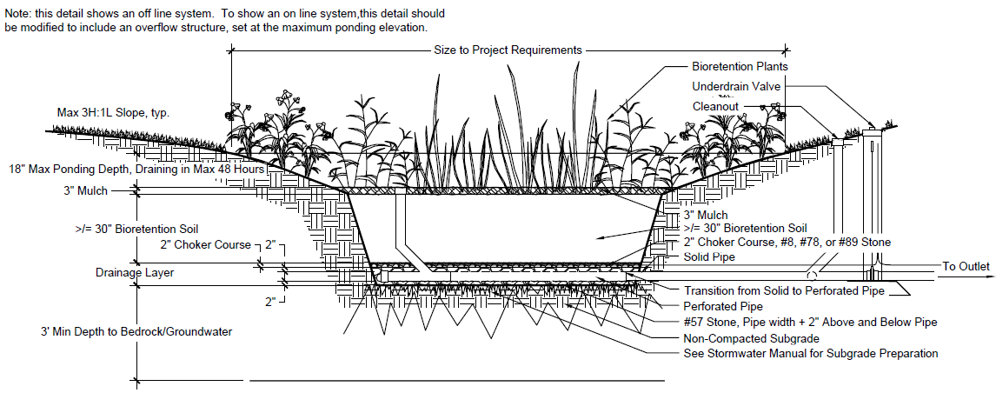
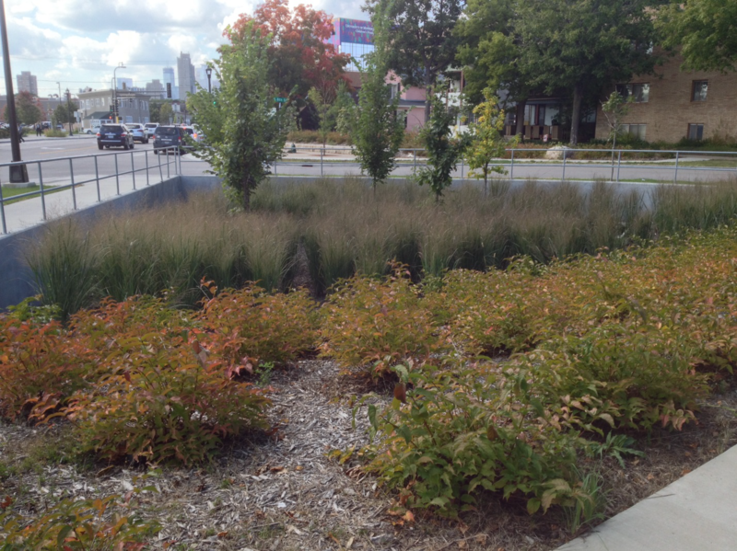
What’s inside of stormwater BMPs?
Biofiltration with Underdrain at Bottom
Drawing courtesy: Minnesota Stormwater Manual, https://stormwater.pca.state.mn.us/index.php?title=File:130724_BioR-Details.dwg
Image courtesy: Minnesota Stormwater Manual, https://stormwater.pca.state.mn.us/index.php?title=File:Finished_basin_with_simple_groupings_of_shrubs_grasses_and_trees.png
Notes:
This bioinfiltration design includes an underdrain surrounded by stone, including under the bottom of the underdrain, a thick layer of bioretention soil, some mulch, and plantings. The bioretention soil must be mostly sand, usually 75% or more, so that a lot of water can drain through. Notice the cleanout and valve.
The subgrade, which is the dirt layer at the bottom, should be non-compacted. In this design, water leaves both by infiltrating into the ground and also through the underdrain. The system is designed to process a very specific amount of water. It is designed so there is no standing water after a short period of time to avoid mosquito growth.

Slide 9
Construction sequence and techniques
AT START OF CONSTRUCTION: install silt fence, storm drain inlet protection, stabilized construction entrance, sediment trap
SITE GRADING: install silt fence around topsoil stockpile and cover stockpiles. TEMPORARY STABILIZATION of disturbed ground and slopes may be necessary if construction is going to pause. This can be straw mulch with wood fiber, fiber mats, or some other product that covers the soil and doesn’t let it wash away. Install silt logs around the excavated areas that will become stormwater features. DO NOT DRIVE HEAVY EQUIPMENT ON AREAS THAT WILL BE STORMWATER PRACTICES.
Install utilities, sewers, water services
Construct building, curbs, parking lot, driveways, sidewalks, etc.
FINAL STABILIZATION AND LANDSCAPING: ESTABLISH PLANTING ON ALL AREAS DRAINING TOWARD THE STORMWATER PRACTICE.
Install the stormwater practice layers that should not get clogged by sediment (stone, underdrain, filter fabric, planting media, plants). Operate large vehicles placing stone/soil from outside of the practice. Do not drive on the surface of the practice.
Notes:
This slide includes a typical construction sequence for site work and installing stormwater practices. If any soil/sediment/chemicals get into the stormwater practice, they can damage it permanently. It’s also important to keep the soils in the areas that will be stormwater practices loose. This means not driving on the area with heavy equipment.
At the beginning of construction, install all the sediment control equipment such as silt fences, storm inlet protection, etc.
Grade the site and cover stockpiles. Use special materials such as fiber mats to temporarily stabilize open dirt areas and slopes, especially if construction pauses. Install silt logs around the areas that will be the stormwater practices. Don’t drive heavy equipment on the stormwater practice areas.
Install utilities, sewers, water, curbs, pavements, etc. Establish plantings on the areas draining toward the stormwater practice. If grass can’t grow in time, fiber mats or another cover can keep the soil in place white the grass is establishing, to keep the soil from washing away into the stormwater practice.
After the areas draining toward the stormwater practice are planted and stabilized, then install the stormwater practice layers – geotechnical fabrics, stone, underdrains, high-sand soil. Install these materials from outside of the practice.

Slide 10
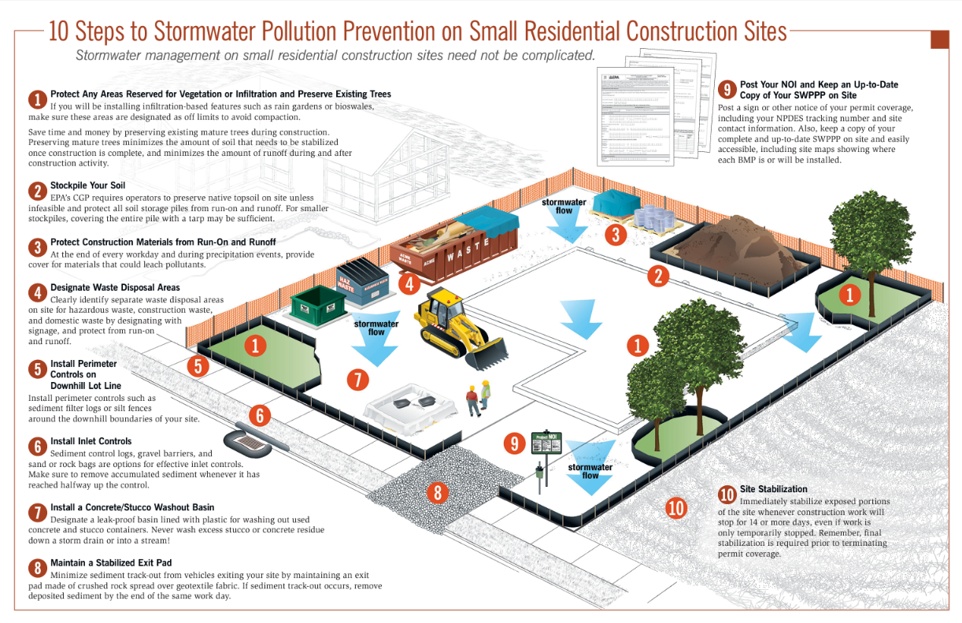
https://www.epa.gov/sites/default/files/2015-12/documents/cgp_small_lot_swppp_brochure-508_0.pdf
Notes:
This USEPA brochure is for small residential construction sites, but it can also apply to our projects.
It shows ample use of silt fence anywhere we want to protect and around the soil stockpile. If it’s supposed to rain, contractors should cover the soil stockpile with tarps to keep it from running off onto the site.
It shows silt logs around the stormwater drain inlet or catch basin. It shows a stone entrance/exit pad to catch sediment from truck tires. It’s important for contractors also to keep the street along the construction site clean so that sediment doesn’t enter the sewer system, so we don’t have clouds of dust as people drive by, and so there isn’t debris on the roadway.

Slide 11
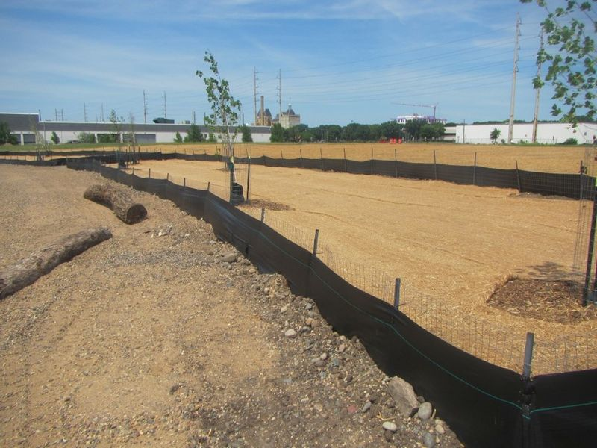
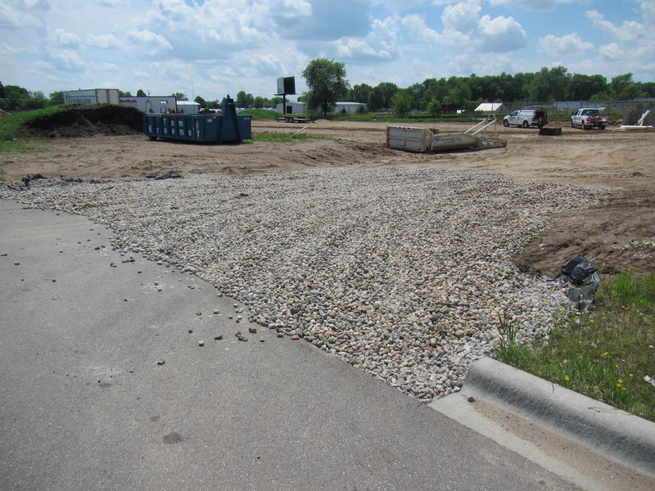
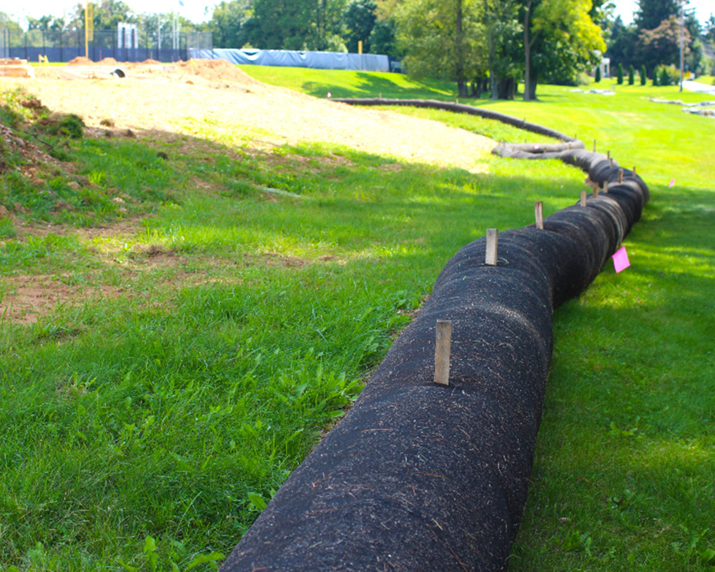
Images of Sediment Migration Prevention
If any soil/sediment/chemicals get into the stormwater practice, they can damage it permanently. Also, contractors must keep sediment from leaving the site so it doesn’t go in the storm drains on the street.
https://stormwater.pca.state.mn.us/index.php?title=File:Good_construction_1.jpg
https://stormwater.pca.state.mn.us/index.php?title=File:Tracking_good_3.JPG
https://www.geosynthetics.com/products/silt-socks/
Notes:
As I mentioned, the beginning of the project includes many stormwater-related tasks. The left photo shows the so-called “stabilized construction entrance”. This means that stone is put down for a distance along the entrance to the site. When vehicles exit the site, dirt from the tires gets caught in the stone. The street beyond the construction entrance needs to be frequently swept. Any sediment or other material that leaves the site here ends up in the storm drains.
The center photo shows a silt fence which keeps sediment from entering sensitive areas or migrating off site.
The right photo shows a silt sock also known as a silt log. These let water through but traps sediment. All of these features should be included on the drawing layout plans and the designer should include details showing how to construct them.

Slide 12
Conversion from temporary sediment basin to permanent stormwater practice
The temporary sediment basin must be designed properly by the engineer.
It must be designed to handle large storms.
Temporary sediment basins/traps can be converted to a permanent stormwater practice by excavating 12” or more below the bottom of the temporary sediment basin to start constructing the permanent stormwater practice in its place.
The sediment water (which may contain pollution) must be properly disposed.
Notes:
Sometimes contractors want to use the location of the permanent stormwater practice as a temporary sediment basin during construction. This is OK but the temporary basin must have a design. It must be able to handle large storms and have an overflow. When it’s time to convert the sediment basin to the permanent stormwater practice, the contractor must remove all of the sediment water and dispose of it properly (the design engineer should have a plan for this). It’s best practice to remove the bottom 12 inches of soil from the basin and install clean subgrade, and then remeasure the stormwater practice to be sure the size and shape are as shown in the plans.

Slide 13
Conversion from temporary sediment basin to permanent stormwater practice
Images courtesy: Minnesota Stormwater Manual
https://stormwater.pca.state.mn.us/index.php?title=File:Rake_technique_for_bioretention.png#filelinks
Notes:
When converting a temporary sediment basin to a permanent practice, remove the sediment and grade the practice properly. If infiltration is planned, rake the bottom to decompact the soil.

Slide 14
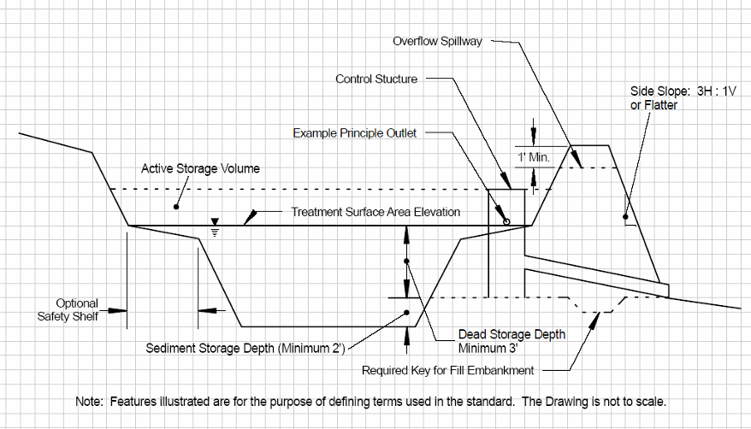
Construction sediment basin design example
Sediment basins are designed to be left in place until the contributory drainage area is stabilized
Sediment trap is a similar design for smaller areas
Drawing courtesy: Wisconsin Dept. of Natural Resources
https://dnr.wisconsin.gov/sites/default/files/topic/Stormwater/1064SedimentBasin.pdf
Notes:
Here is an example of a sediment basin design used during construction. Not all basins need to use this design, but they do all need to be thoughtfully designed by the project engineer.

Slide 15
Optimizing Stormwater BMPs - in Design
How can we make sure stormwater practices are designed properly?
Discuss how the stormwater practice will be installed with the designer during the design process. We want the design to be installable and maintainable.
We can check that the SWPPP (Stormwater Pollution Prevention Plan) the designer writes includes a clear construction sequence.
Environment, Health & Safety team will present on SWPPPs and stormwater regulations at the November PMPD
Notes:
Cornell staff should work with the designers early in the project to make sure the design is constructable from the outset so we can ensure we can remain on schedule and provide a good quality product. FE is here to help with this. Sometimes the design can be tweaked. For example, by swapping out 4” or 5” concrete sidewalk for a thicker slab that would allow small trucks to drive on it during construction, an adjacent stormwater practice could be installed later in the project. This would also allow Cornell to maintain the practice more easily in the future.
We should also check that the SWPPP includes a clear construction sequence and enough detail about the temporary and permanent stormwater infrastructure. Environment, Health & Safety will present on SWPPPs at the November PMPD meeting.

Slide 16
Optimizing Stormwater BMPs – in Construction
We should check in with the contractor at important points during construction:
Pre-installation meeting
When rough-grading of the BMP is complete
When the area draining to the BMP is stabilized and planted
When important features of the stormwater practice are installed
To do field testing upon construction completion
Notes:
It is good to check in with the contractor at multiple points during construction. At a pre-installation meeting to look at the plans. Is the area that drains to the BMP location the same size as shown in the drawings? Are the storm sewers the underdrain will connect to shown on the drawing?
When rough grading of the BMP is complete. Does the size and shape match the plans? Ensure the perimeter of the practice is protected with silt fence or silt logs so runoff can’t enter.
Check in when the area draining to the BMP is stabilized and planted. If grass can’t grow quickly, it may be necessary for the contractor to put down mats that keep the soil in place temporarily.
Check in when important features of the stormwater practice are installed, such as inlets, outlets, pipes, etc. Check that soil mix, soil compaction and density are per the specs. Check that the slopes are correct and that plantings are the correct type and number.
Check in when the practice is constructed to do field testing.

Slide 17
Summary
Stormwater practices are complex under the surface
Construction and maintenance are crucial for function and longevity
We should review the stormwater design and SWPPPs as early in the design process as possible to catch any issues before they impact the construction schedule
Notes:
In closing, the stormwater practices we build sometimes look simple and can just look like gardens or grass but under the surface they are complicated and can be easily damaged. We can work together to ensure the design is as constructable as possible.

Slide 18
Stormwater Contacts
Environment, Health and Safety
Stormwater Compliance and Inspection
Kara Bugis, PE, Water Compliance Specialist​
kmb388@cornell.edu​
607-255-0805
Derek Franklin, CPESC, Hazardous Materials Associate​
dmf239@cornell.edu​
607-793-1351​
Facilities Engineering​
QA/QC Assistance
Erin Cuddihy, PE, Environmental Engineer
ecuddihy@cornell.edu​
607-254-2441
Notes:
If you have questions about stormwater practices, you can contact me, Kara Bugis, or Derek Franklin. Kara and Derek deal with stormwater and SWPPP compliance and inspection. I am assisting with stormwater QA/QC and review stormwater design and construction drawings. Please feel free to reach out. Thanks for your time today!

Slide 19
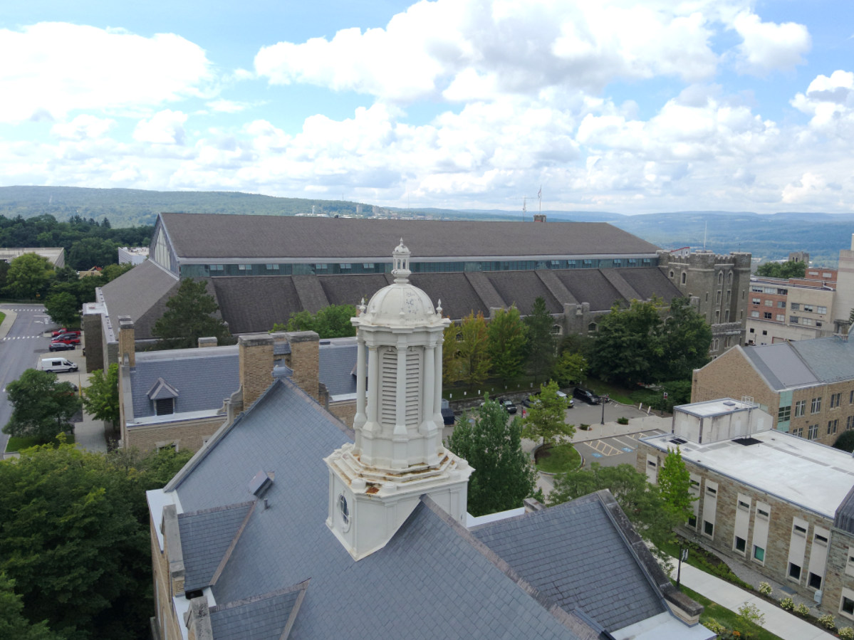
FYI – Facilities Engineering Drone
Facilities Engineering has a new drone!
Model: DJI Matrice 30T – photo, video, and thermal
Notes:
Before I go, I just wanted to let you all know that Facilities Engineering recently bought a new drone. It’s a DJI Matrice 30T and it does photos, video, and thermal imaging. I got certified as a commercial drone operator and have been flying it on various sites on campus. Let us know if you have a project you need aerial views for – roof inspections, parking, whole project sites. The camera has a great zoom and we are pleased with the results so far. The photos here are from King-Shaw Hall and show the view from where the drone was flying, and the zoom from that distance. Let us know if you have something you need photographed. Thanks for your time today!

