Slide 1
Bid Review & General Reminders

Slide 2
Bid Prep (BP) Attachments
Front End Word Documents
Technical Specifications and Drawings
Asbestos Reports
OPC/Estimate
Electronic Bid Scope
Other (SWPPP, Geotechnical, Surveys, etc.)
For Campus Let –DOB 1184, MWBE requirements
Notes:
- Make sure that you edit and remove any unnecessary lines from the Bid Scope Template

Slide 3
Document Updates
Updated the General Conditions to include Supplemental Condition verbiage and Assumption of Risk verbiage
Supplemental Conditions document is no longer required
Please add a comment or note in the BP if during your walkthrough the Contractors will be using any Cornell equipment
Two versions of GC’s, one for Cornell funded and one for Prevailing Wage projects
Notes:
- Will have a future PMPD regarding the use of waivers

Slide 4
When Prevailing Wage is Needed
If your project is in a State-owned building or on State-owned land, regardless of funding, you need to use Prevailing Wage
BTC is not required for these projects
If there are grant or tax rebate, etc. then BTC is required as well as PWR
The Find Facilities Information site can tell you if the building or area your project is in is State-owned

Slide 5
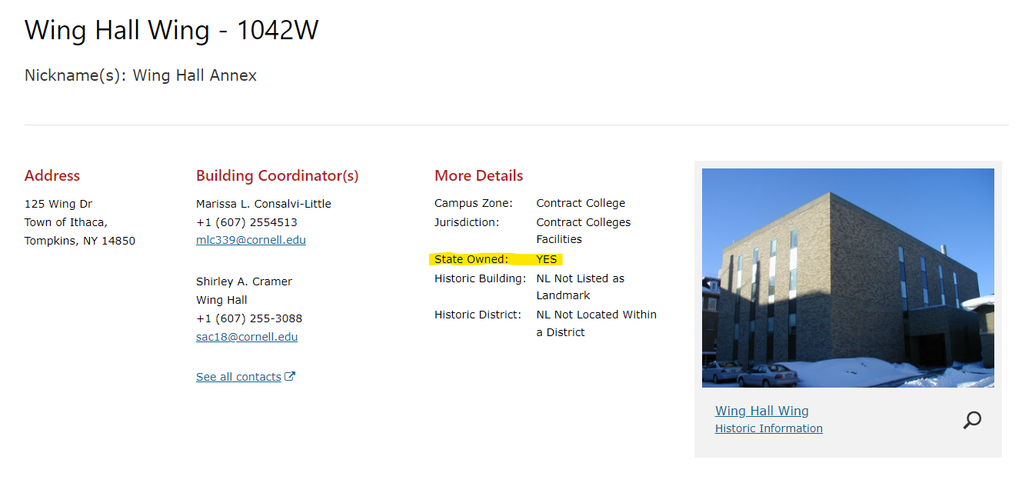

Slide 6
Top 5 Bid Package Tips:
All Drawings and Documents should have the same title using the standard naming convention
(bldg. name_work description).
Be sure to start with the template for the documents from eBuilder Resources for every project (not from your desktop).
Drawings and Technical Specifications should be submitted in PDF format in a combined file.
There shouldn’t be any Tech Specs starting with “01”
If you have special things about your project, please reach out to us a minimum of two weeks before submitting your BP
Ex. IUOE or Grant Funding
Notes:
Try to keep the names as short as possible
There are notes to help in what sections you should be editing and what you shouldn’t
If there’s a note that says not to remove, please don’t remove it
Tech Specs should have the architects name on the documents
They should be incorporated or added to our GR’s
Please consult your Director and reach out to us well before you send us the BP so we can reach out to the IUOE

Slide 7
CRP’s
Please use the “Scope of Work” section to communicate changes
Updating the completion date from the bid docs, put in a comment
Notate if you are accepting/not accepting any Alternates
For Design, make sure your schedule from the RFP is still accurate, if not attach an updated schedule to the process
If the contract has been delayed past the 90 day price hold, request and attach a letter from the Contractor confirming that they are holding the bid price

Slide 8
Contract Amendments
All amendments need to have an attachment showing how the additional work was requested
(Email, meeting minutes, Scope of Work, etc.)
For the “Commitment Change Items”, always click on the “Add All Existing Items” and add the request to the existing committed lines, don’t make new ones.

Slide 9
Change Orders
When you have between 3 - 8 PCO’s you should create a Change Order, no more than 10 please
Do not submit CO’s or CAA’s before the previous one is fully executed as the totals will not match in eBuilder
Allowances may only be used for their intended purpose
Make sure you reconcile your Allowances via a change order before the final Payment Application is submitted

Slide 10
SUCF/Campus Let
NYS legislation that anything over $60k goes to the State for approval
OSC now has up to 75 calendar days to review documents as opposed to 30 calendar days previously
Consultant RFQ/RFP process
Contracts needs to send out a formal Letter of Intent to selected Consultant
The solicitation process is in effect until Contract Award
PM to work with Contracts to negotiate Consultant fees
Make sure you are reviewing the Contract Acknowledgment form and if there are any exceptions listed, please reach out to Contracts to discuss

Slide 11
Reminders
Always check the comments!
Check your queue and email for Request Comments
Please use the templates in eB Resources as they are the most up to date
Emails should be sent to the FC mailbox and copy the person you are working with

Slide 12
Questions?

