Slide 1
Project Status Update Process (PSU) NEW REQUIRED FIELD – Beneficial Occupancy Date
PMPD
August 14, 2024

Slide 2
Beneficial Occupancy Date - Definition
The date a renovation or new construction project is to be turned over to the end users to be occupied for its intended use or the date a maintenance/repair, infrastructure or a non-building project is available for its intended use.

Slide 3
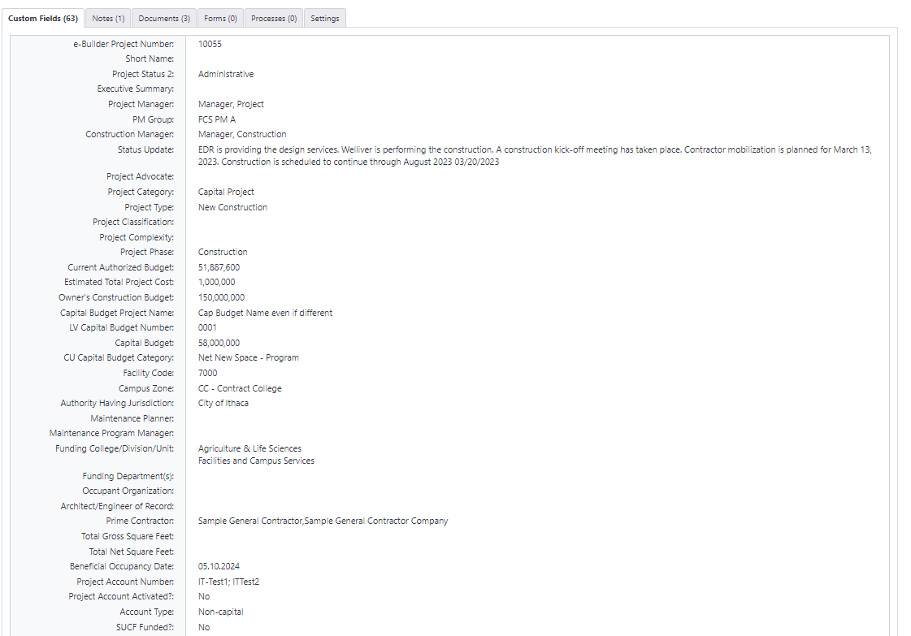
Beneficial Occupancy Date - Project Details Page
“Substantial Completion Date” field has been renamed “Beneficial Occupancy Date”
It can be manually entered by the PM, PC, or PD on the Project Details Page (PDP) at any time.
Updated FY25!

Slide 4
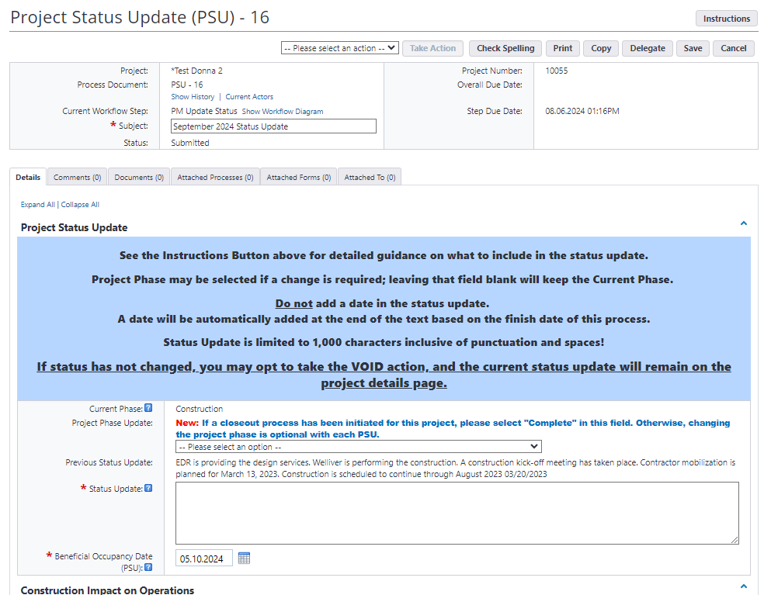
Beneficial Occupancy Date - Project Status Update Process
“Beneficial Occupancy Date” is a new required field on each monthly Project Status Update.
TIP: Review and update the Schedule Module tasks too!😉
New FY25!
Notes:
Beneficial Occupancy Date in the PSU process will auto-populate based on entry on PDP.
Review, update if blank or if there has been a change in BOD.
BOD on PDP will automatically be updated upon completion of the PSU process.
BOD on PDP, most recent PSU and associated Schedule Task End Date should in most cases all be the same.

Slide 5
PSU Resources
PSU help in the *e-Builder Resources project folder titled Documents \ User Resources \ PSU - Project Status Update Process Help
Contact CU e-Builder Group, e-buildergroup@cornell.edu

