Slide 1
Standard Update/Changes Cornell Design and Construction Standards 281316 Electronic Safety and Security Systems
Erich Reichard(ETR33)
Facilities Engineering
June 2024

Slide 2
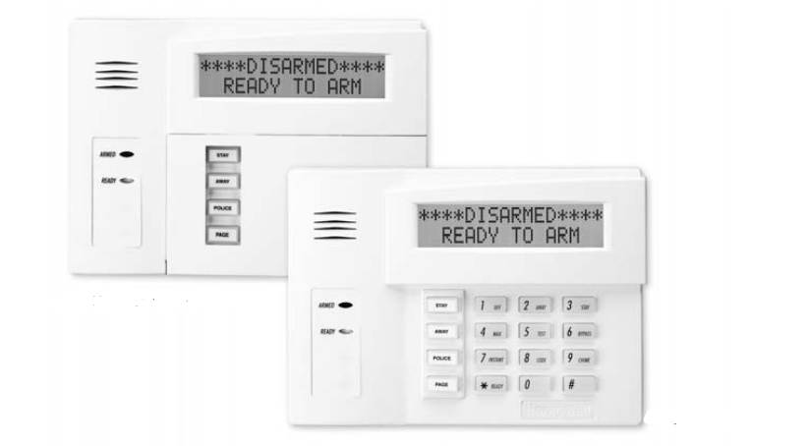
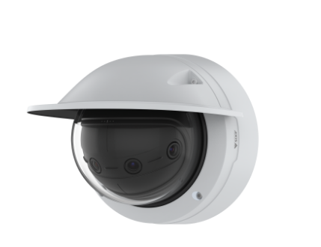
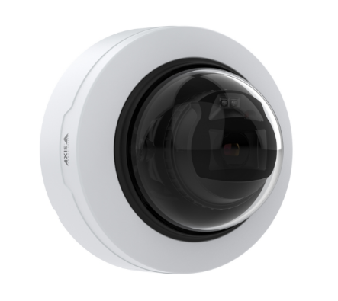
Electronic Safety & Security - Types of Systems
Access Control
Card Reader, Powered Hinge, Locksets
Video Surveillance
Cameras
Intrusion Detection
Alarm Initiating Devices, Remote Dialer, Central Alarm Receiving System

Slide 3
Background
FE maintains this standard in collaboration with Division of Public Safety Access Control
Primary authors/editors of the revised standard:
DPS Access Control – Adam Mahnke
FE Electrical – Erich Reichard, John Bell
FCS Project Management – Brad Newhouse
Author of the related Security Details 5.1.1-5.1.4
FM Central Ops – Chuck Lucas
Authors of the related Door Hardware Standard 087100
FE Architectural – Nadine Hachmann
CU Lockshop Foreman – Brian Parente
DPS Access Control – Adam Mahnke

Slide 4
281316 Electronic Safety and Security Systems Design Standard
Why did we update the standard?
University Stewardship FE reviews all standards every two years, this one every year
All new construction and major renovations will have surveillance and access control
Applying lessons learned on recent projects
Needed PM Guidance Document separate standard information from coordination efforts
Separate standard information from code requirements
Separate Electronic Door Hardware Information - Standard 087100
Terminology
Acronyms
Policy 8.1 Update (Merged with Policy 8.4)
“Security” Labeling of Drawings
Clarification of installers requirements (Certifications/Licensures)

Slide 5
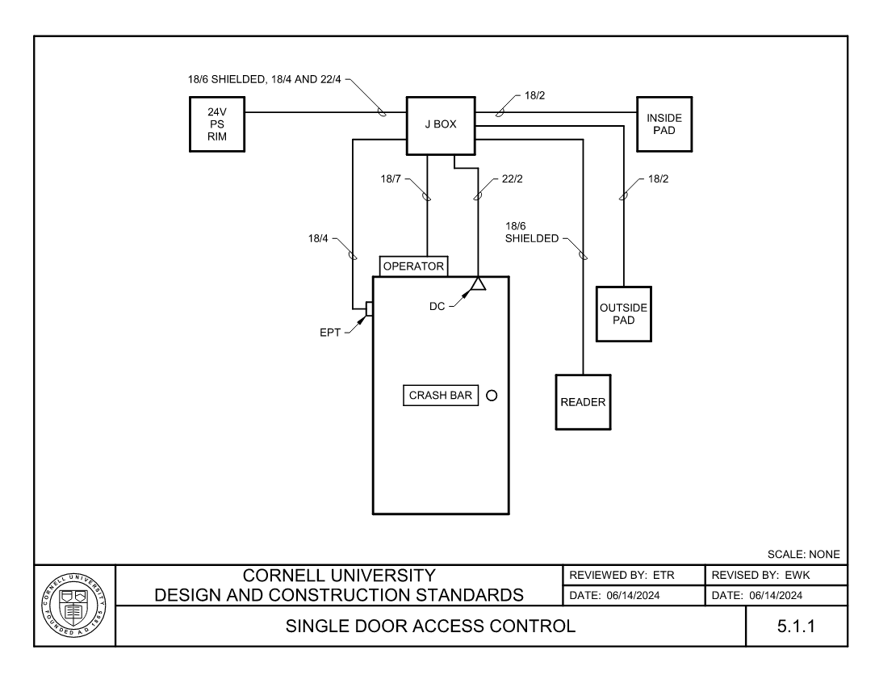

Slide 6
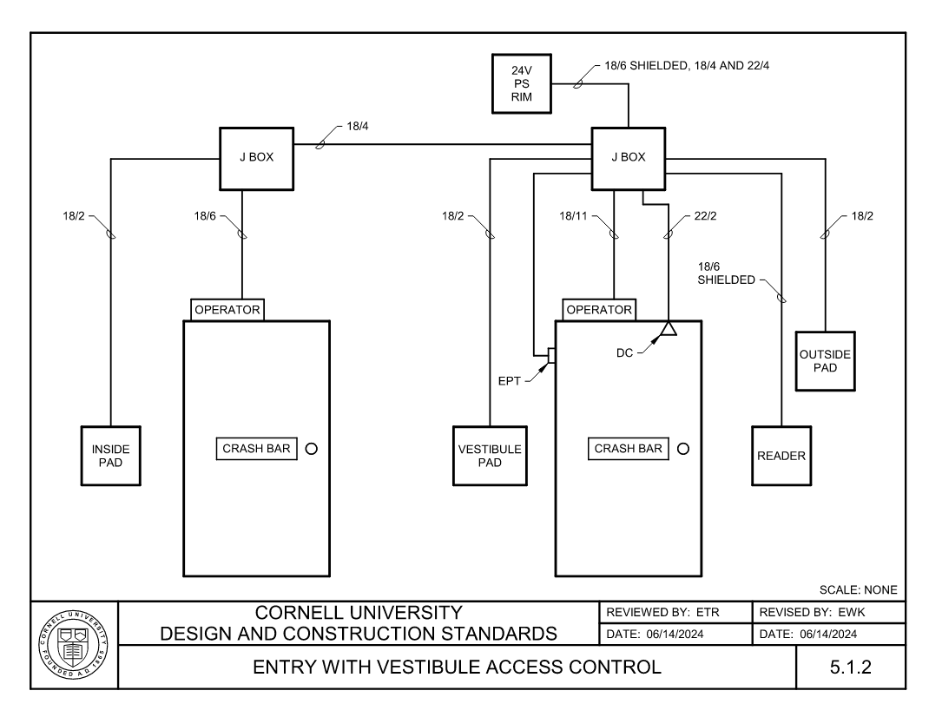

Slide 7
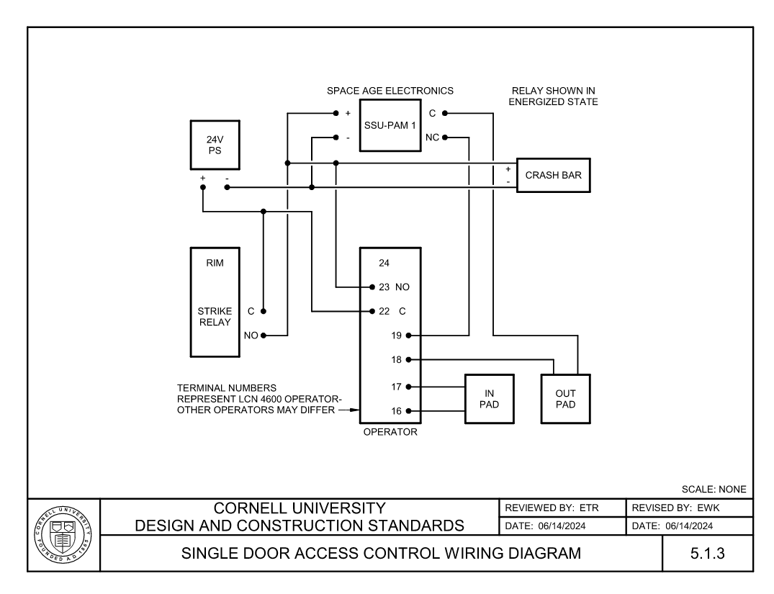

Slide 8
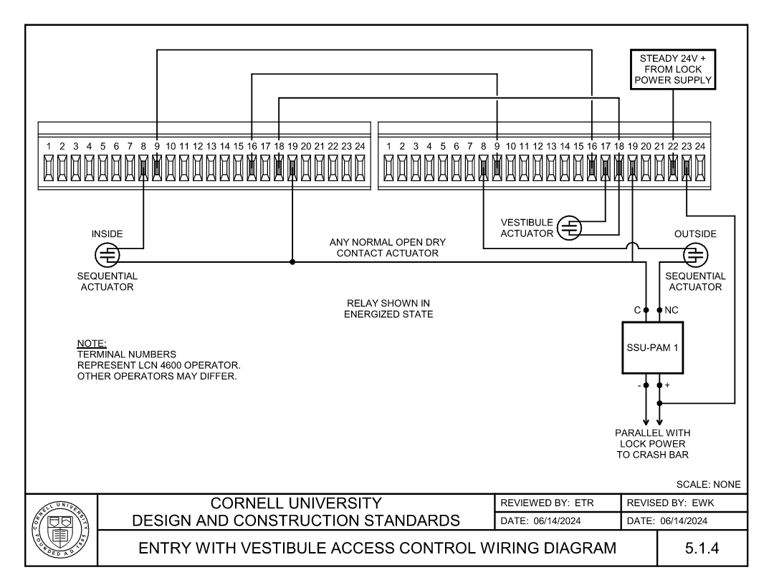

Slide 9
Thank you! Questions?
Please contact me with questions or comments:
Adam Mahnke
arm29@cornell.edu
607-255-8712
Erich Reichard
etr33@cornell.edu
607-255-3934

