Slide 1
Project Management Professional Development Series
June 20, 2024
Facilities and Campus Services Engineering and Project Management
Notes:
August 14

Slide 2
Today’s Agenda
New EPM Employees Introduction
Erik Eshelman
Security Standard Update
Erich Reichard and Adam Mahnke
QA Program Snapshot
Liesl Margolin
Change Order/PCO Requirements
Breanna Brann

Slide 3
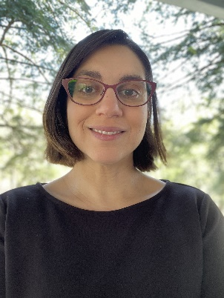
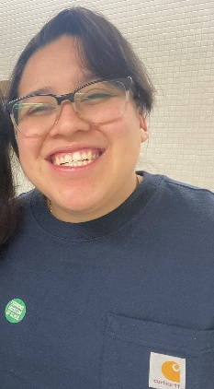
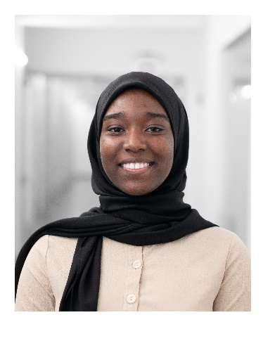
New EPM Hires within the last 3 months
Erin Cuddihy
Environmental Engineer
Previously worked as the Transportation Engineer at the City of Ithaca
She is a licensed Professional Engineer with a Bachelor of Science degree in Civil and Environmental Engineering and a Master of science in Sustainability.
Teresa Crisantos-Pridencio
Civil Summer Intern
Cornell Student, expected graduation with BS in Civil Engineering, May 2025
She will be working on bi-annual assessment of sidewalks and pavement across the campus.
Safiyyah Franklin
Building Code Summer Intern
Cornell Student, graduated with BS in Civil Engineering, May 2024, expected Masters of Engineering in Systems Engineering, December 2024
She will collaborate with the City of Ithaca to create a database of Cornell Building information (including Building Construction types on campus.

Slide 4
Security Standard Update

Slide 5
QA Program Snapshot

Slide 6
Change Order/PCO Requirements

Slide 7
Questions?

Slide 8
Thank you
272133
Notes:
Introduction

