Slide 1
Summer Construction Update
May 15, 2024

Slide 2
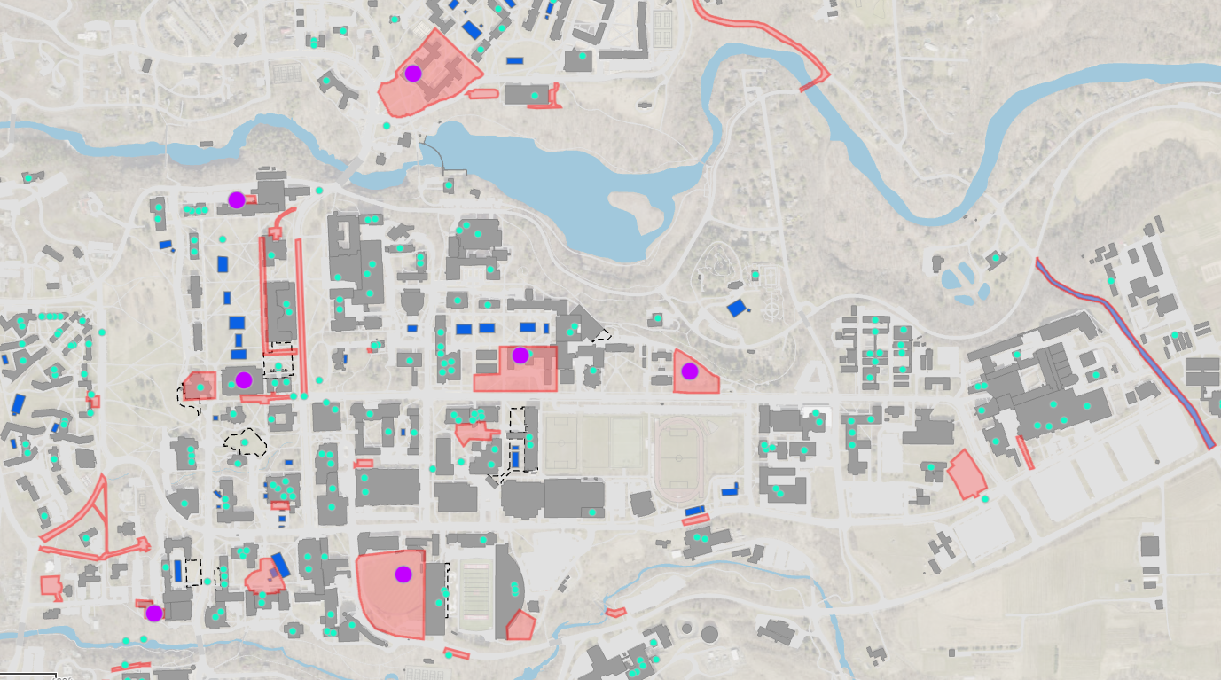
Summer Construction Update
120 projects in construction
$686M in total project cost
https://cornell.maps.arcgis.com/apps/webappviewer/index.html?id=e7eb8bb4a2b0459c8208f3d44612c6fe

Slide 3
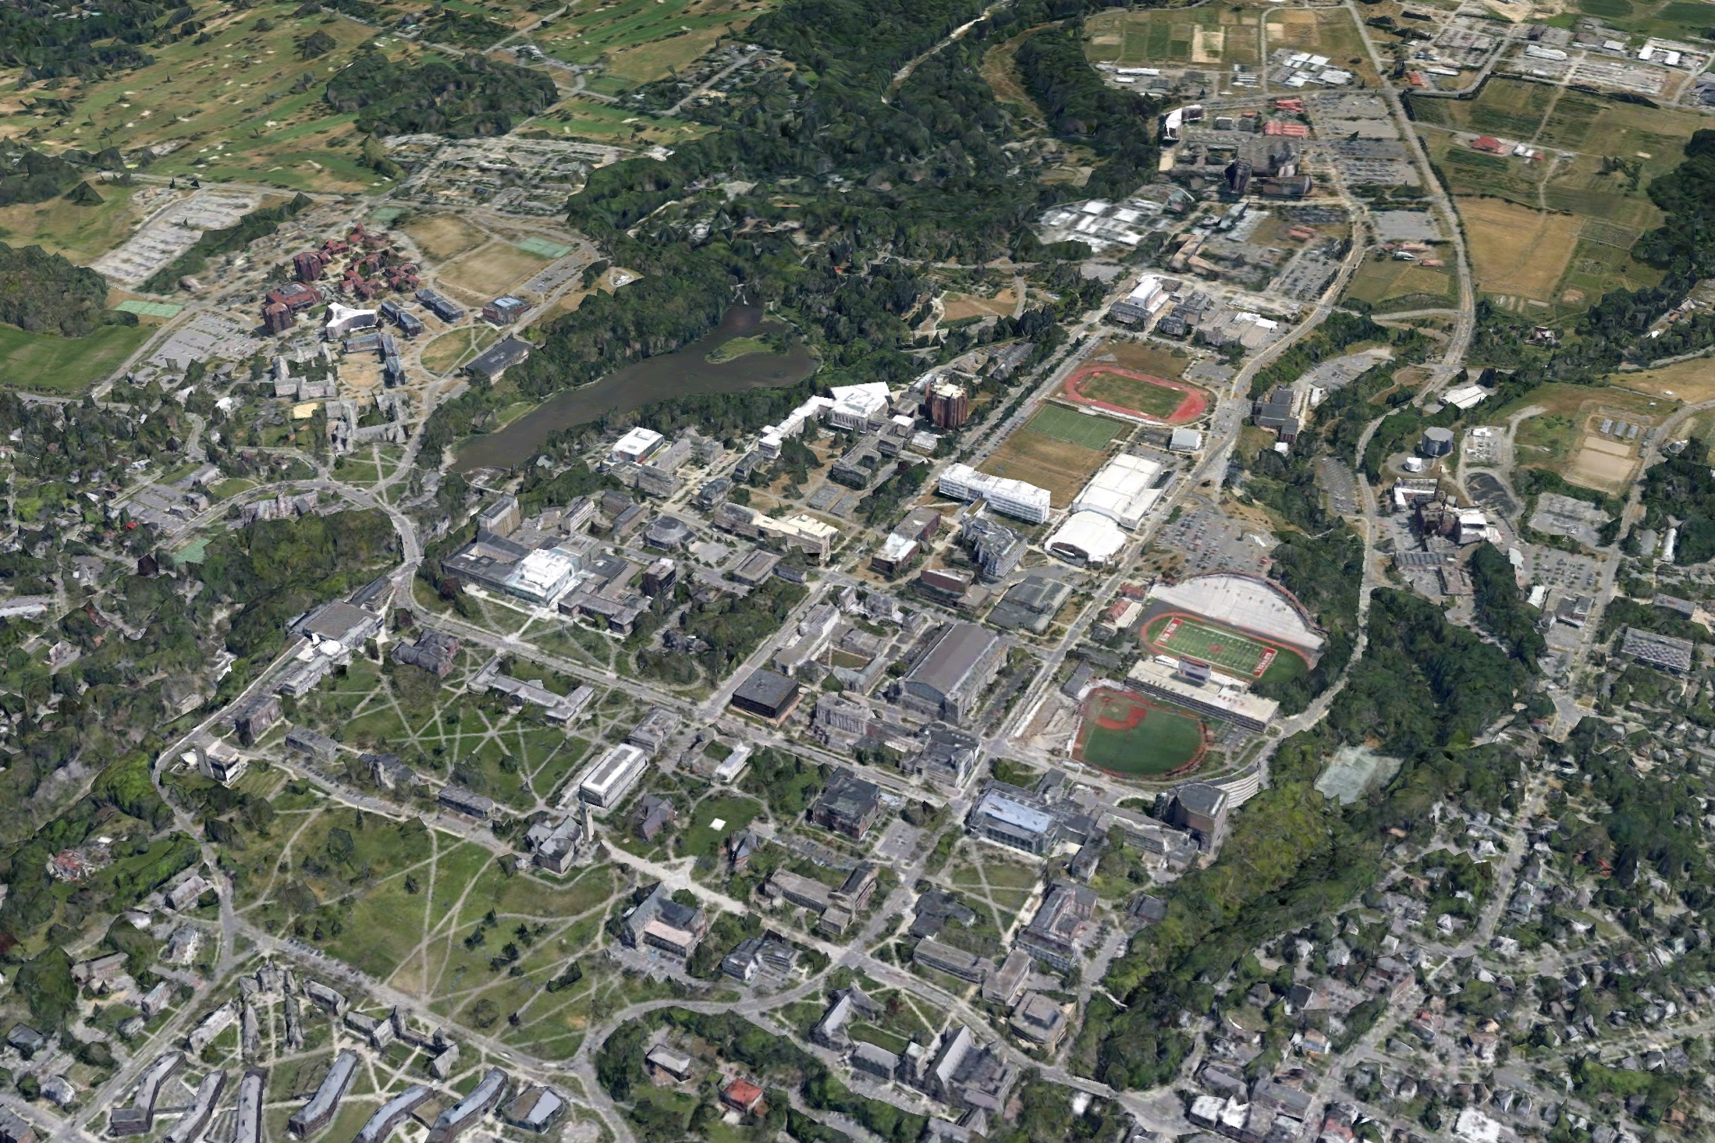
Summer Construction Update
Child Care Center
Mill & Pave
Atkinson Hall
RPCC CCC Swing Space
Plant Science Phase 1
Balch Hall
ST Olin Sprinkler
Corson Mudd Roof
Maplewood Lot Paving
Sibley Dome
Feeney Way Paving
Arts Quad
Site Lighting
Hoy Road Retaining Wall
Olin Library
Stimson Hall
CIS Building
Sage Hall Foundation
McGraw Tower
Thurston Addition
War Memorial Envelope
Campus Road
Hughes Hall Envelope
Cascadilla Hall Window Replacement

Slide 4
Major Roadwork & Paving
Mill & Pave
Helen Newman
Parking Lots
Maplewood Lot Paving
Feeney Way Paving
Hoy Road Retaining Wall
Campus Road Paving

Slide 5
North Campus Area
Child Care Center
RPCC CCC Swing Space
Balch Hall

Slide 6
Arts Quad Area
Sibley Dome
Stimson Hall
Arts Quad
Site Lighting
Olin Library
McGraw Tower

Slide 7
Building Envelope & Roofing
Corson Mudd Roof
Sage Hall Foundation
War Memorial Envelope
Hughes Hall Envelope
Cascadilla Hall Window Replacement

Slide 8
Large Capital Projects
Atkinson Hall
Plant Science Phase 1
CIS Building
Thurston Addition

Slide 9
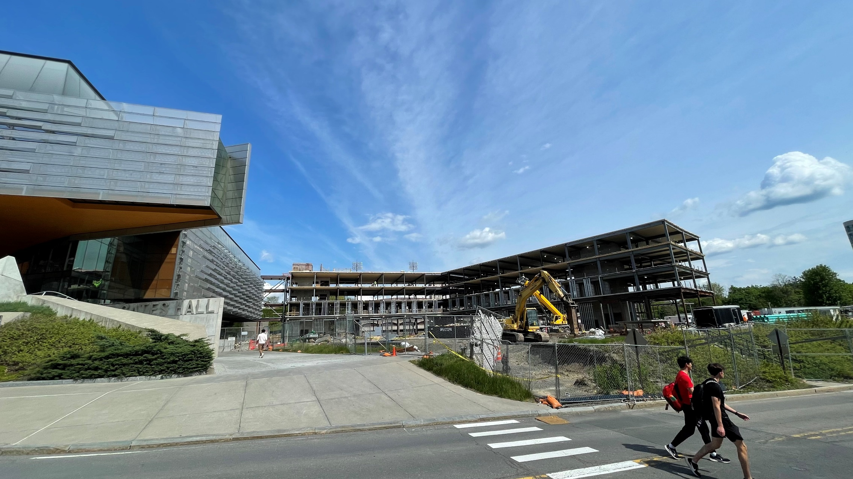
New CIS Building
New 132,000 GSF building to provide the College with additional space to support ongoing growth in student population, faculty hiring, and research activity.

Slide 10
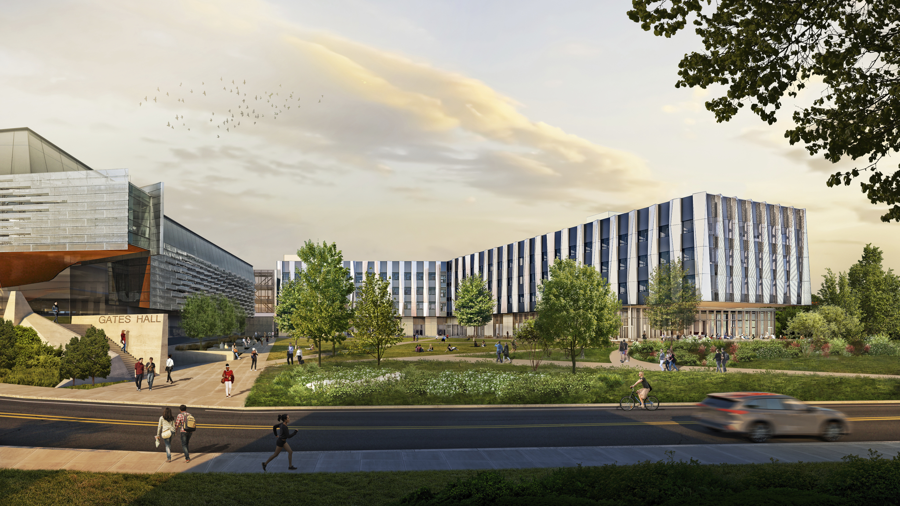
New 132,000 GSF building to provide the College with additional space to support ongoing growth in student population, faculty hiring, and research activity.

Slide 11
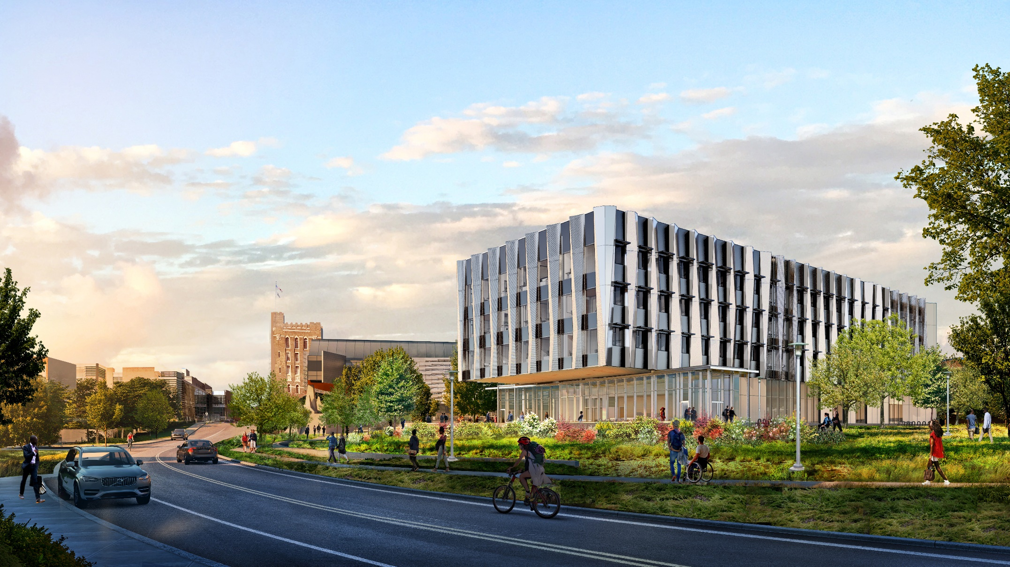
New 132,000 GSF building to provide the College with additional space to support ongoing growth in student population, faculty hiring, and research activity.

Slide 12
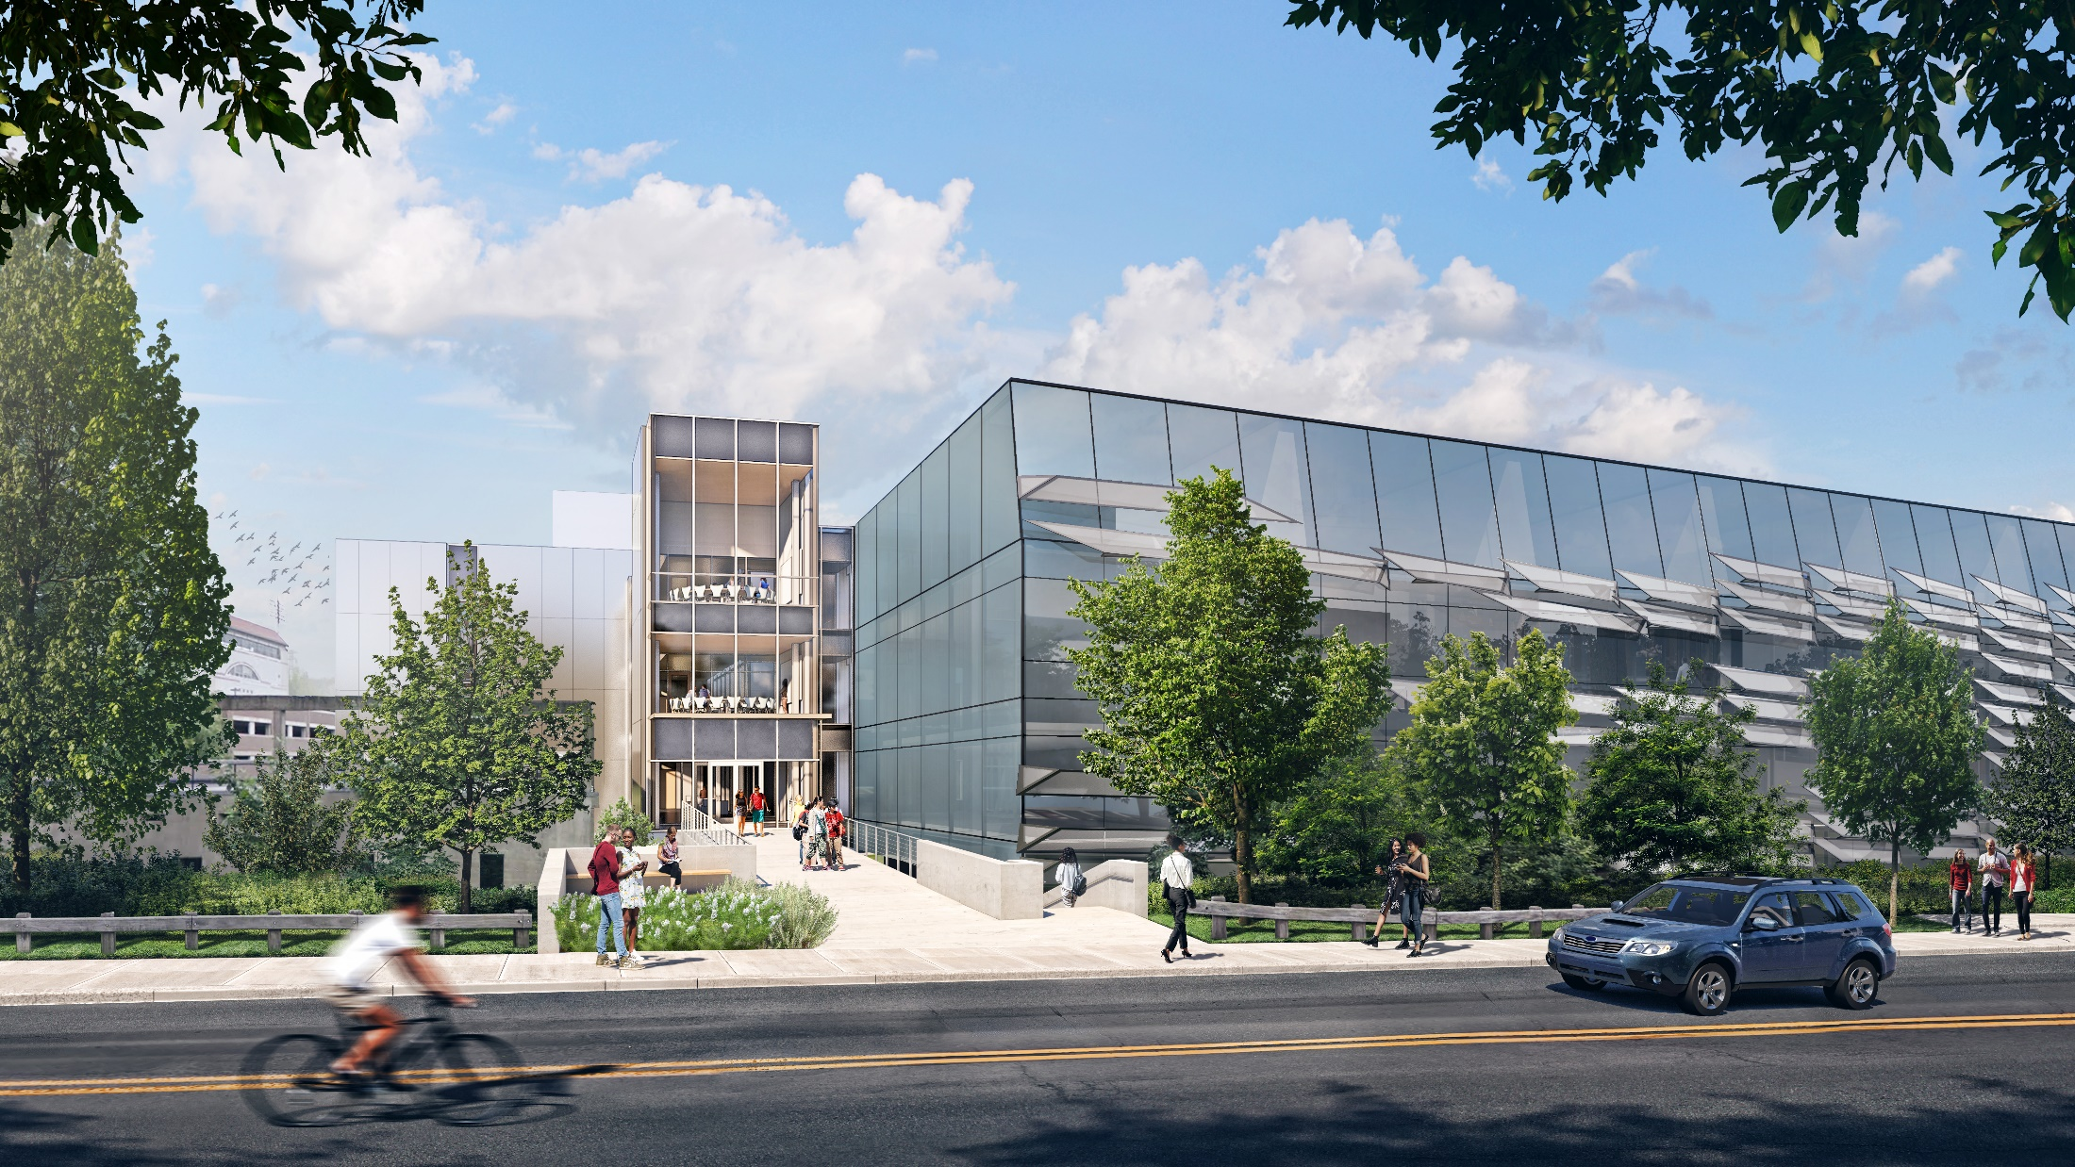
New 132,000 GSF building to provide the College with additional space to support ongoing growth in student population, faculty hiring, and research activity.

Slide 13
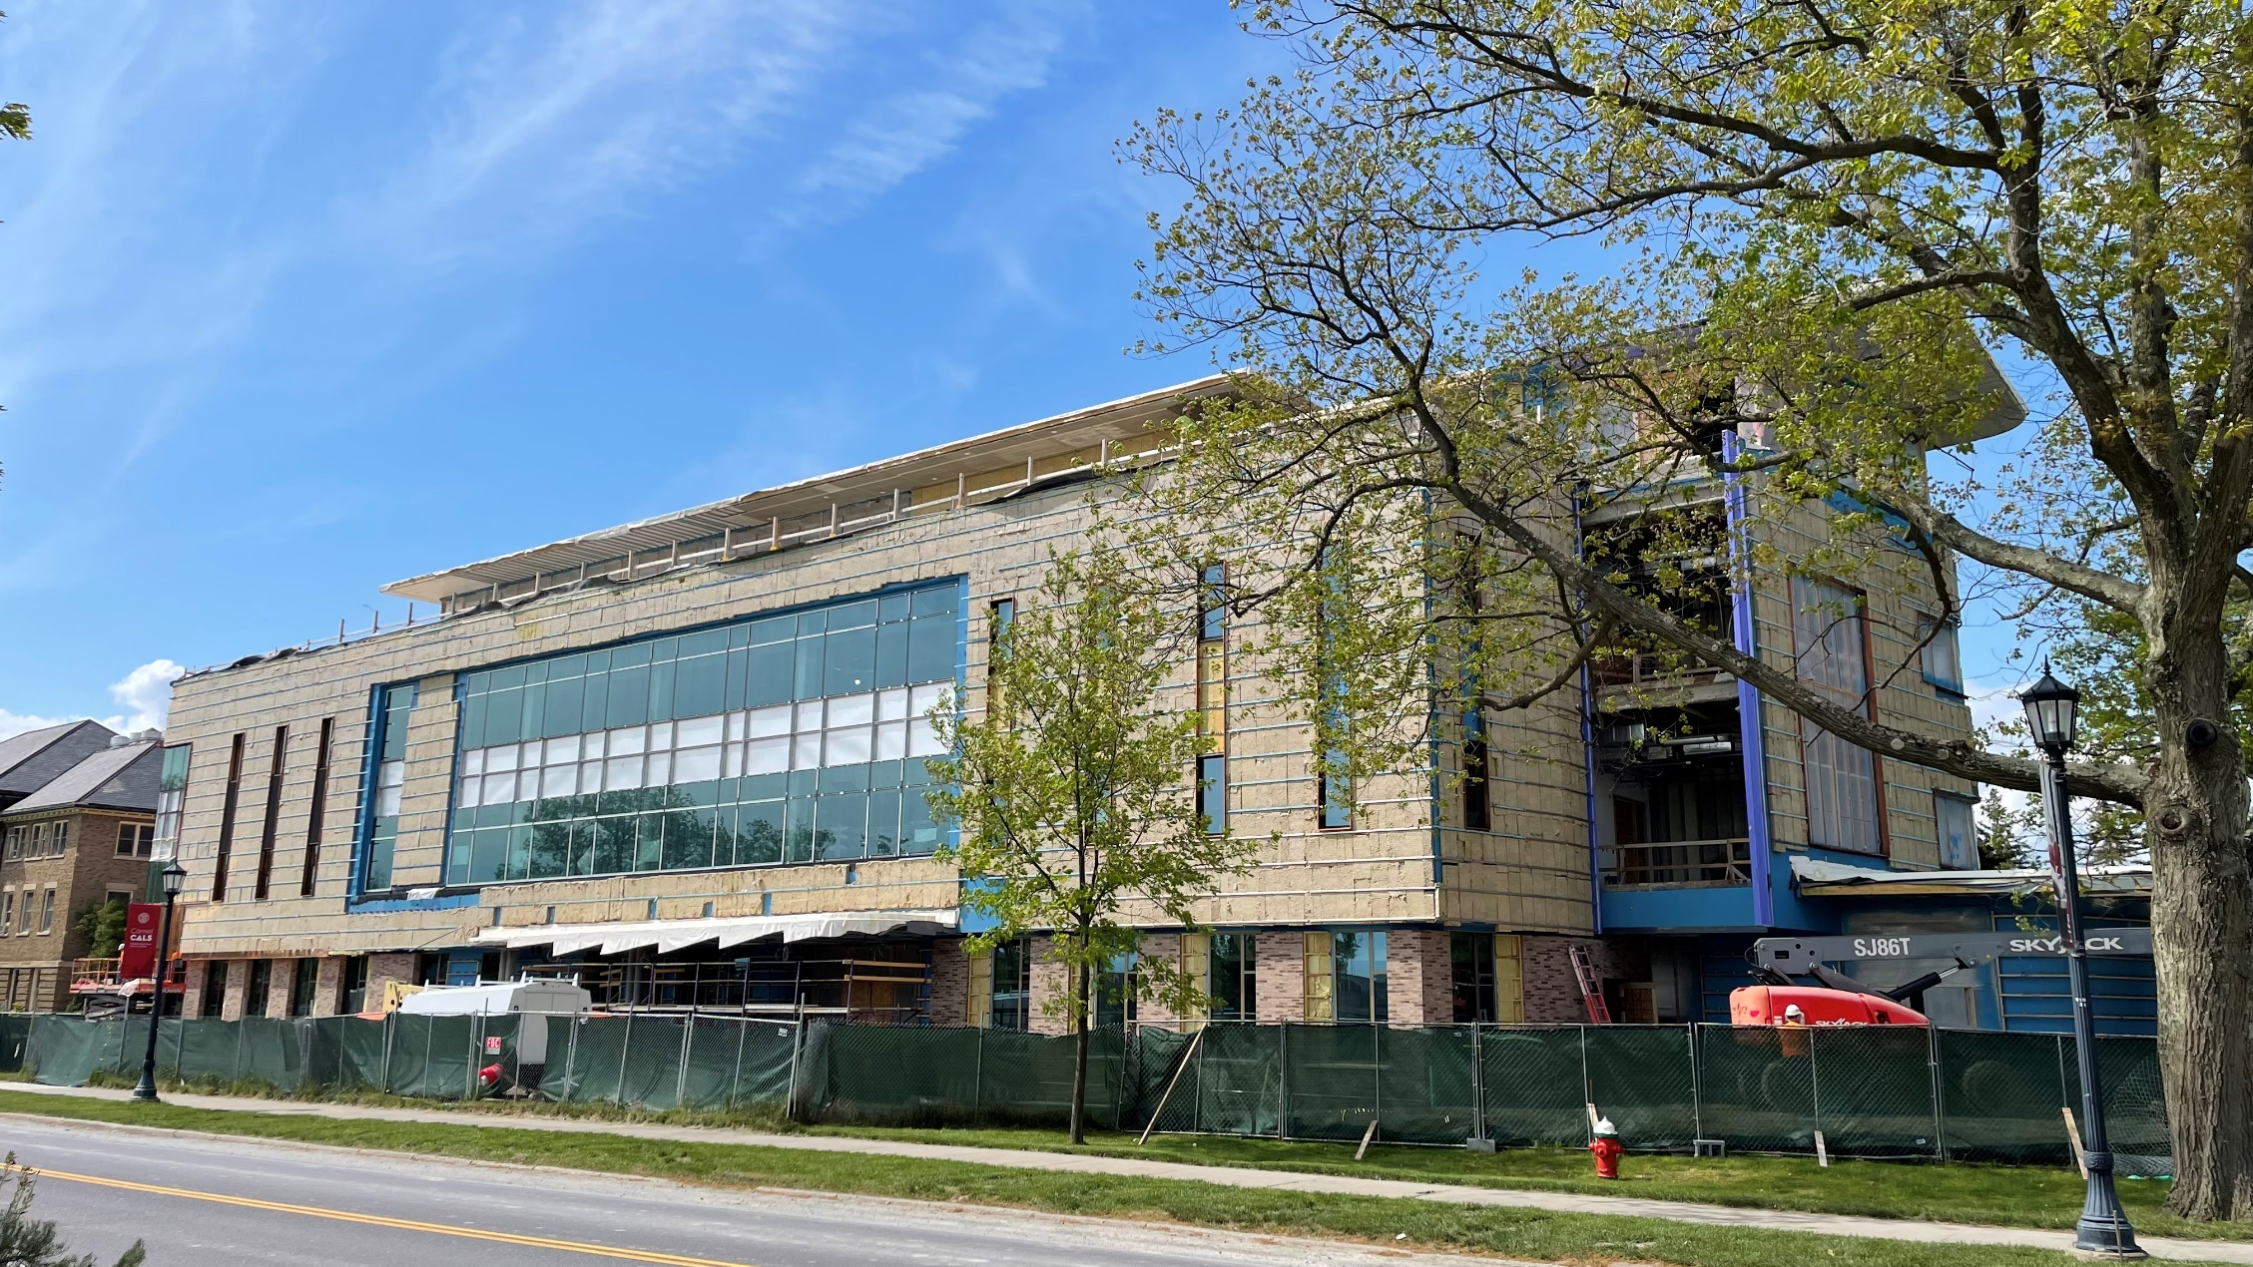
Atkinson Hall
Atkinson Hall

Slide 14
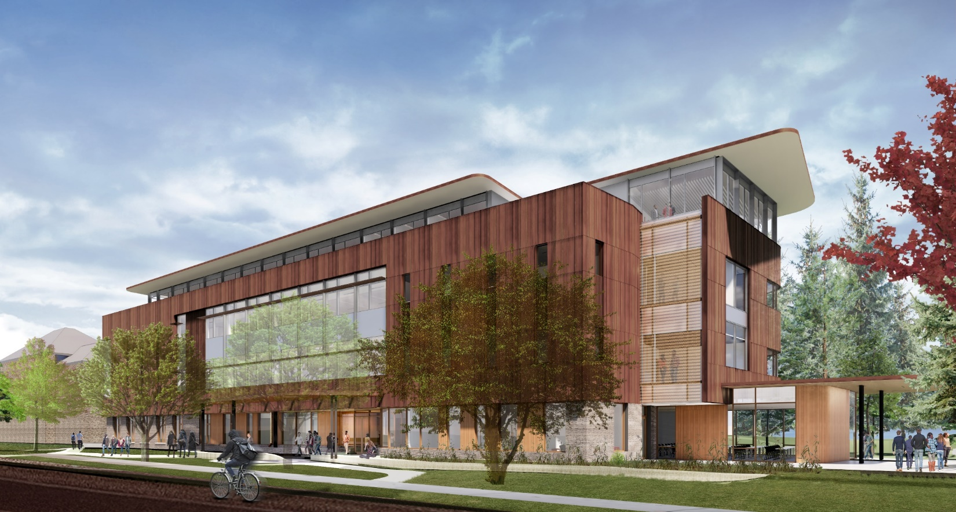
Atkinson Hall

Slide 15
Construction Phase - Communication
“The single biggest problem in communication is the illusion that it has taken place.” - George Bernard Shaw
Please Err on the side of over communicating but…be clear and concise
Think early and often about the local and campus wide impact of your project (update eB project construction impacts statement)
Use a layered approach targeted for each type of audience “Success with CC communications for larger projects”
Don’t forget your third-party consultants (FM Global, Commissioning Agents, Testing agents etc…)
Every project should have a project communication plan/strategy in place…that has been shared and vetted with partners and stakeholders

Slide 16
Questions?

