Slide 1
Project Management Professional Development Series
April 18, 2024
Facilities and Campus Services Engineering and Project Management
Notes:
May 15 at 10am

Slide 2
Today’s Agenda
New EPM Intros
Andrew Magré
Campus REC Policy
Sarah Carson and Matt Kozlowski
Contract Updates for IRA Eligible Projects
Brenda Frank and Jaimee Wilson
Construction Impacts Statements and Staging/Parking
Travis Fisher
Construction Site Safety and Incident Reporting Presentation
Travis Fisher, Nakeschi Watkins, and Johnathon Bootland

Slide 3
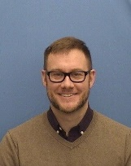
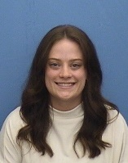
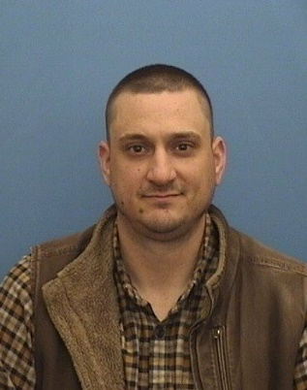
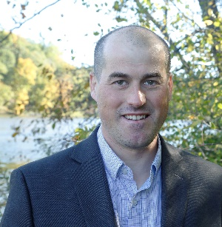
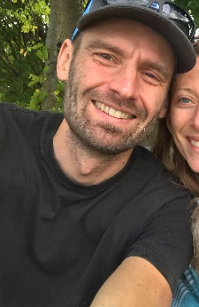
New EPM Hires within the last 3 months
Adam Chaney Project Manager Hired February 12th
Madison Macumber Facilities Engineering Administrative Assistant Hired April 8th
Joe Morabito
Senior Project Coordinator
Hired April 5th
Frank Parish
Project Manager
Hired February 1st
Mike Roberts
Senior Project Coordinator
Hired April 16th
Notes:
Adam Chaney – Project Manager, hired February 12th
Adam Chaney joined the Group B Project Management Team as a project manager in February. He comes to us from Corning Inc. and has managed complex/high value projects in NYS and around the world. Adam holds a BS in Mechanical Engineering from Clarkson University and an AS, in Engineering Sciences from Corning Community College.
Madison Macumber – Facilities Engineering Administrative Assistant, hired April 8th
Madison Macumber comes to us from her previous position as a paralegal at a local legal firm. There she performed a multitude of complex legal tasks, mostly focused on real estate and estate planning law. Madison has an associates degree from TC3 and is excited to learn more about engineering and Cornell.
Joe Morabito – Senior Project Coordinator, hired April 5th
Joe comes to us from EES Energy Services where he was a project manager. Prior to that he was a project manager with ICS which is an internet service provider. He is looking forward to working on the wide variety of projects Cornell has to offer.
Frank Parish - Project Manager, hired February 1st
Frank Parish joined the Group B Project Management Team as a project manager in February. Frank is not a stranger to most, having worked as a Unit Facilities Director at the College of Architecture, Art, and Planning for many years. He started his employment at Cornell back in 2008. Frank holds a BS in Architectural Technology from Keene State College.
Mike Roberts – Senior Project Coordinator, hired April 16th
Mike Roberts – Mike comes to us from the Cornell Botanic Gardens where he was the Natural Areas Project Manager. His background is in Natural Resources and Environmental Conservation. Has been involved with many of the Gorge Management projects, Ash Borer Project and Deer Management program. Similar to Joe he is very keen on getting able to work on the wide variety of pro

Slide 4
Campus REC Policy

Slide 5
Contract Updates for IRA Eligible Projects

Slide 6
Construction Impacts Statements
and
Staging/Parking

Slide 7
Construction Site Safety and Incident Reporting Presentation

Slide 8
Questions?

Slide 9
Thank you
272133
Notes:
Introduction

