Slide 1
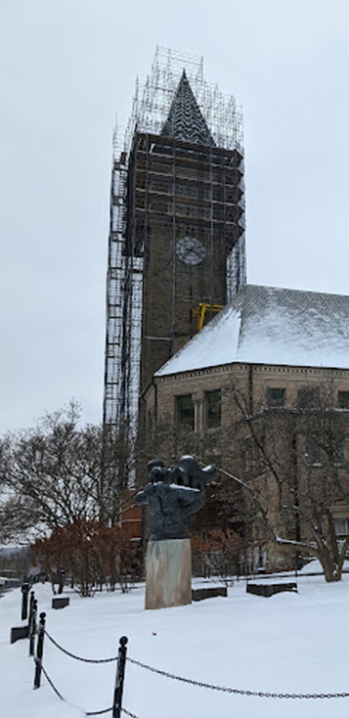
PMPD April Meeting
EHS & Risk Management
Partners With Engineering & Project Management
Construction Site Safety - Incident Reporting
What We May Have Done In The Past May Not Have Been The ‘Best’ Thing To Do Then
It Is Not What We Must Do Today….
AND
It Could Change Tomorrow
Notes:
Introduction

Slide 2
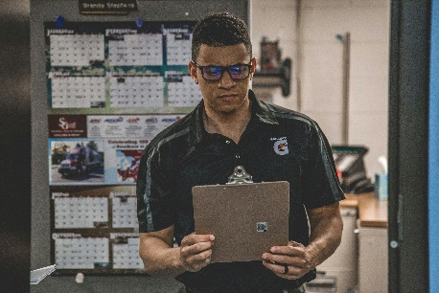
Partnership of Construction Safety Stakeholders
Engineering and Project Management (E&PM):
Project Management Directors, Project Managers, Facilities Engineering
Important players in reporting of incidents.
Risk Management (RMI):
Interested in all incidents. No incident is more important than another. Evaluates incidents globally because any of them could turn into a liability.
It is vital that everyone works together to ensure safety and proper documentation of incidents.
Environment, Health, Safety (EHS):
Focuses on the prevention of site related incidents to the person and environment. The Goal is to be Proactive in nature (pre-incident) and not Reactive (post-incident) and target an incidence rate of zero.
To assure that the interests of Cornell, our Staff, our Student body & our Public Image is preserved.
Providing SME guidance and review to project safety plans and work execution.

Slide 3
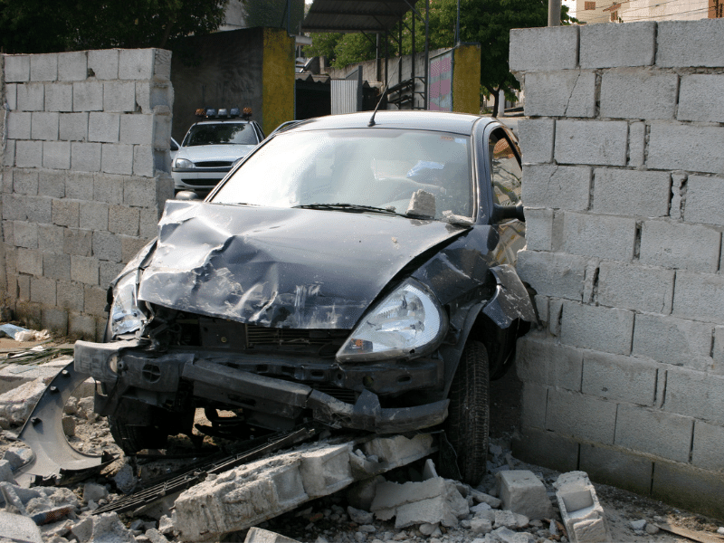
Definitions Common Cornell Safety Language
Accident: THESE DO NOT EXIST
These will never exist at a work-site. By definition these are unplanned, uncontrollable, no-fault events.
Incident:
Includes every situation of deviations from expected outcomes
Injury:
Is a component of people related incidents.
Other components of incidents are property damage, incidental spills, exposure (chemical, biological, radiological), motor vehicle accident, and environmental or injury-free events (a.k.a. near miss or near incident), etc.
This term is used by the general public but not recognized in the workplace.
This is a global term that encompasses behaviors, equipment, people, job-tasks, and the “almost happened”
Can have varying degrees of impact.
Notes:
Identify the difference between incident and accident

Slide 4
When an Incident Occurs
Cornell reserves the right to investigate any and all incidents that occur on its property, associated work-sites etc.
BUT when do we engage EHS, Risk Management, EMS etc.?
INJURIES - Get EMS (a part of EHS) help coming right away !
Call 911 or 607-255-1111 (CU dispatch)
EHS Occupational &/or Environmental Staff:
Depending on the Incident particulars; was it an injury or an almost injury OR was it something that has been released to the Air, Water or Soil.
Need to be notified right away to visit the site and help document the incident.
Call: Joe Emanuel at 607/731-4226 (all H&S/Injury & Property Damage Related)
Call: Jaron Khoury at 607/233-3637 (all environmental incidents)
General Line: 607/255-8200 (EHS Office)
RMI:
Needs to be engaged right away to start evaluating the incident.
RMI hears about this from EHS folks BUT, really needs to hear from Project Managers
Email: Nakeschi Watkins, Nnw6@Cornell.edu
PM’s:
If an incident occurs and the PM has not been notified, Construction Managers must contact the PM ASAP.
The PM needs notification as they are the point of contact for construction projects.
Notes:
Who to report to

Slide 5
Notifying Parties About Incidents?
This can be very subjective
For this group here are “general” guidelines:
Report –
Any injury incident that is more than “first-aid” as defined by OSHA
Including: Any unplanned disturbances of Hazardous Materials
e.g. Asbestos Containing, Lead, and PCB containing materials.
Any Incident that threatens the Environment
releases to the soil, water or air
Any incident that involves a Student or General Public
Any property damage to Cornell owned equipment or services
AND
Anything of significance that we may need to review in the future.
E.g. something that might lead to a liability claim
Notes:
What qualifies as a incident to notify about

Slide 6
Why is it important to report incidents?
We have regulatory requirements
To know of any and all occurrences on/at our facilities
To anticipate regulatory “fall-out” e.g. inspections
To protect the general public
Liability
Immediate
Future
To protect our public image
To avoid Agency Referrals
To control the media narrative
To control our costs
Insurance COSTS $$$$
Legal COSTS $$$$
Future insurance purchases are at stake
Notes:
Why is it important to notify parties about incidents

Slide 7
When do incidents need to be reported?
Timing is extremely important.
This varies depending upon the incident type and severity
In general, EHS timing is always based on a 24 hour period.
Exceptions:
1. Injuries – if not first-aid: IMMEDIATELY Upon Discovery
2. Spills (Environmental Danger) – If a waterway, storm drain, creek etc. is threatened: IMMEDIATELY Upon Discovery
University property damage
should be reported within 24 hours.
Notes:
When do PM’s report

Slide 8
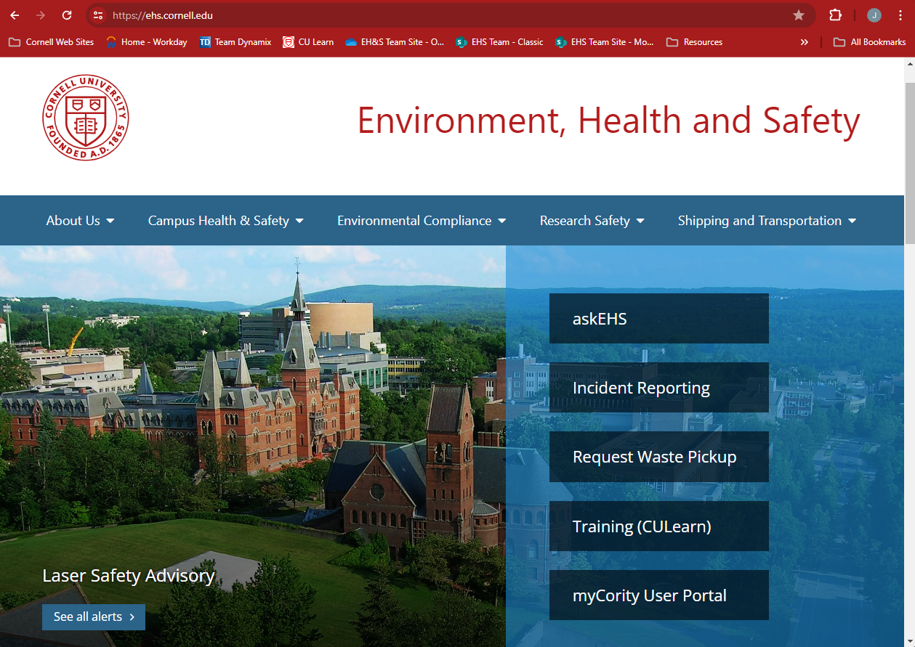
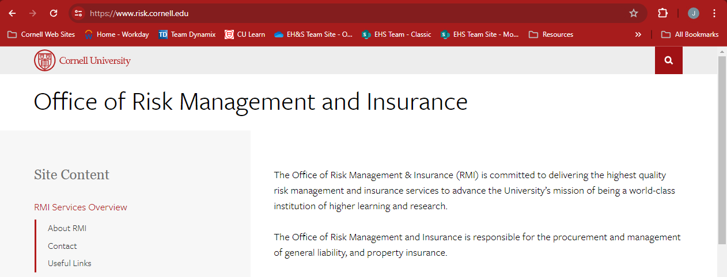
How do you report an incident?
YOU CALL THE PEOPLE LISTED ON SLIDE #4
At Their Direction You May Be Reporting Into Cority
2-Ways to access:
EHS Website Directly -https://ehs.cornell.edu/incident-reporting
RMI Website -
https://www.risk.cornell.edu/incident-reporting/
Notes:
How do PM’s make notifications

Slide 9
CORITY CONTRACTOR DATA ENTRY
WHEN DIRECTED TO 1. FILL IN THE BLANKS
2. DESCRIPTION BOX
Contractor Company Name
Contractor Employee Name
AND
Brief Incident Description
3. NOTES & DOCUMENT TAB
Save the Contractors Incident Investigation Form
What should you put in Ebuilder?
Well, you can duplicate what you put in Cority or…
You can put the Cority Reference Number in the “note section” of your project

Slide 10
The End

