Slide 1
Construction Impacts

Slide 2
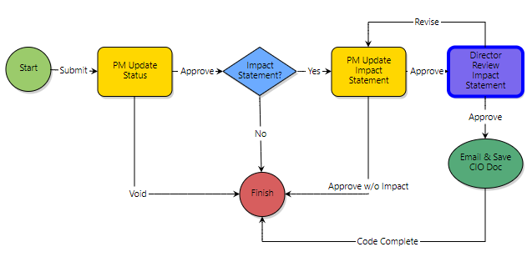
Construction Impacts Steps to notify Campus
Create new Project Status Update (PSU) in eBuilder:
1
Follow guidance provided in eBuilder resources.
Complete project impact statement:
2
Follow guidance provided in eBuilder resources.
Verify your submission:
Review the Construction Projects on and around the Cornell Campus GIS map
Notes:
EHS and RMI work in parallel when handling incidents. They maintain two different positions (Parallel but different eyes). They do not want to slow down or stop work, however addressing the incident safely can impact work. They are always evaluating if the incident can have negative impacts to Campus.

Slide 3
Construction Impacts Documentation
Include the following in your project impact statement:
State how your construction project will affect Campus operations and adjacent facilities.
Identify staging, laydown, and parking needs (both on site and remote)
Attach a visual document which shows contract limit lines and extent of the impacts
Identify duration of impacts

Slide 4
Construction Impacts GIS Mapping
GIS MAP ACCESS
https://cornell.maps.arcgis.com/apps/webappviewer/index.html?id=e7eb8bb4a2b0459c8208f3d44612c6fe
Managed by GIS Data Administrator - Mary Colomaio
Review current map, submit revised impact statements to remove completed projects or changed impacts

Slide 5
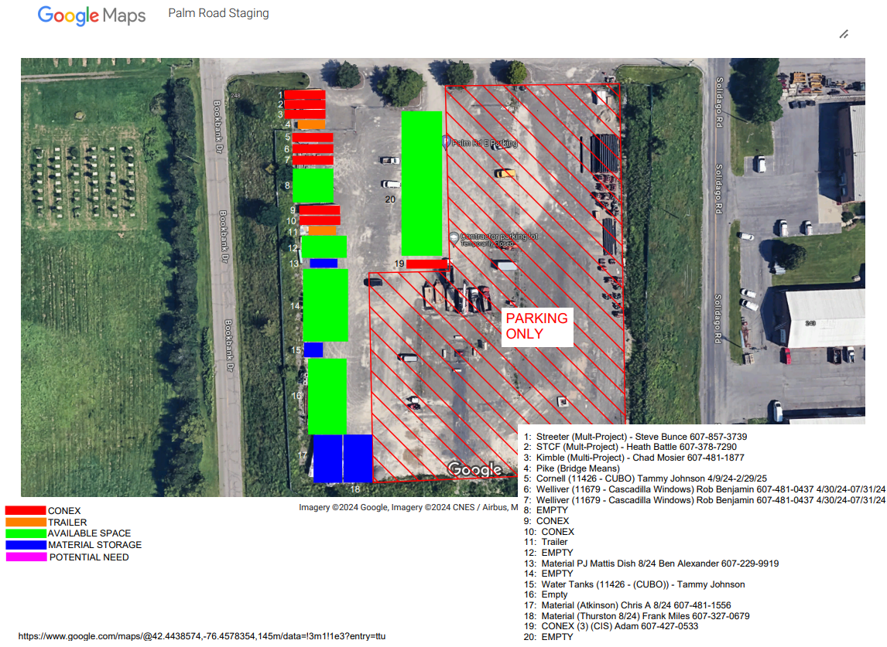
Construction Impacts Remote Staging and Parking
Palm Road Staging and Parking Requests
Tami Norman is no longer the point of contact. Please reach out to Travis Fisher tf222@cornell.edu
Dimension space needed, quantity of CONEX/Trailers, quantity of vehicles, duration of staging.

