Slide 1
Cornell University Fire Marshal’s Office

Slide 2
Objectives
What is Acceptance Testing and why is it required
What is required to be able to conduct Acceptance Testing
The process of Acceptance Testing
Documentation
Shutdown, Impairment, and fire watch

Slide 3
What is Acceptance Testing
Testing of all new fire and life safety equipment (fire alarm, fire sprinkler, other suppression systems, etc.)
Ensures all equipment is working as designed with no malfunctions.
Ensures everything installed is compliant to NYS Codes, Cornell Design Standards and to what is shown on drawings.

Slide 4
What is required for Acceptance Testing
Upon request to have testing done:
Correct permit through AHJ.
All work is completed and pre-tested.
At time of testing:
All associated trades are on site for testing.
All testing equipment provided by contractors.
Knowledge of system and system functions being tested.
At completion of testing:
All associated paperwork from testing.

Slide 5
The Process
Project will reach out to UFMO to request an acceptance test. Testing should be scheduled well in advance to ensure all parties are available.
UFMO will work with AHJ’s and contractors to set up time for testing.
Contractors, UFMO Staff and AHJ will meet on site on day and time of testing. Contractors are preforming testing and UFMO Staff and AHJ will witness.
At completion of testing, contractors will fill out all associated paperwork for testing.

Slide 6
Documentation
At the end of each acceptance test, UFMO Staff will send out:
Testing letter from UFMO staff stating what was tested, if it passed, and anything else is needed to be done by the project.
All testing paperwork completed during testing.
All paperwork will be directed to Cornell Project Manager but will also be sent to associated AHJ’s and other UFMO Staff.

Slide 7
Shutdown, Impairment, Fire Watch Overview
Shutdowns are required anytime fire alarm or fire sprinkler/suppression systems are needed to be shutdown for any reason.
Shutdowns need to be scheduled at least 48 hours in advance of work being done.
Shutdowns may require impairment notifications and fire watch to be done as well.
Impairment notification made to UFMO Staff and workers are then provided with fire watch information and paperwork.

Slide 8
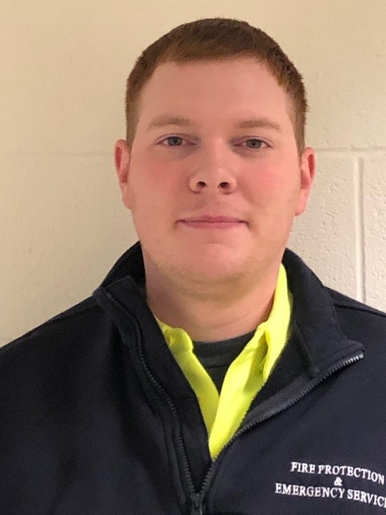
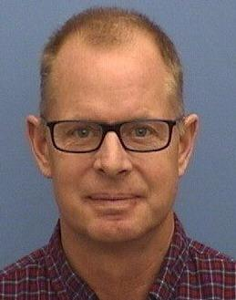
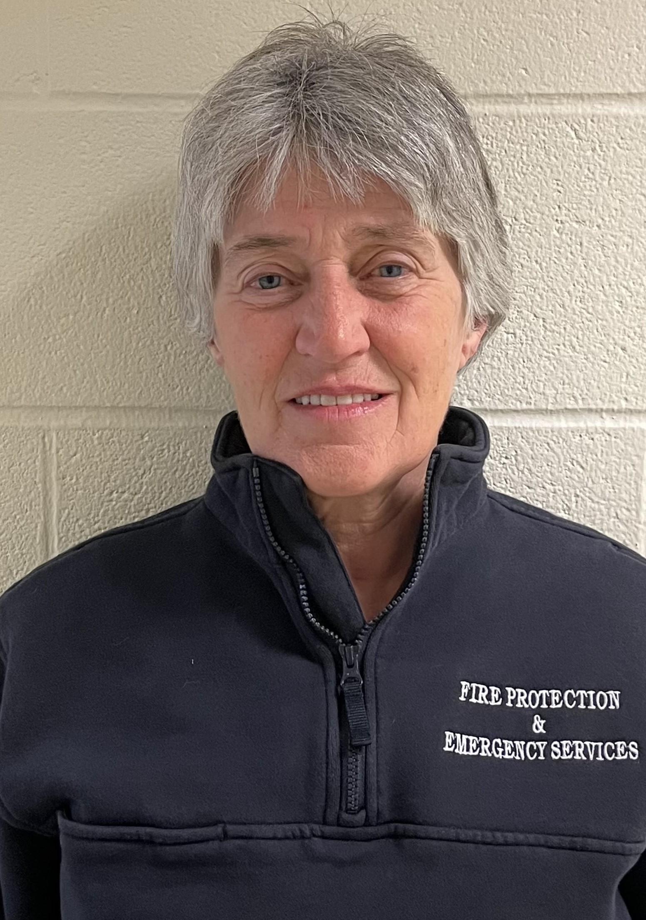
Contacts
Chris McLaughlin-CJM358: Fire Protection Specialist
607-255-0893(o)
607-342-8083(c)
Kathy MacCheyne-KEM9: Fire Protection Specialist
607-254-1611(o)
607-351-4073(c)
Tim Ryan-TR394- University Fire Marshal
607-255-7440(o)
607-592-2155(c)

