Slide 1
Accessibility Update
February 28th, 2024
Andrea Haenlin-Mott
Mike Niechwiadowicz

Slide 2
Topics to Discuss
Structure of ADA Coordination Team
Disability Strategic Plan for FCS
Reminder of Processes
Public Rights of Way Accessibility Guidelines
2024 Building Code Adoption

Slide 3
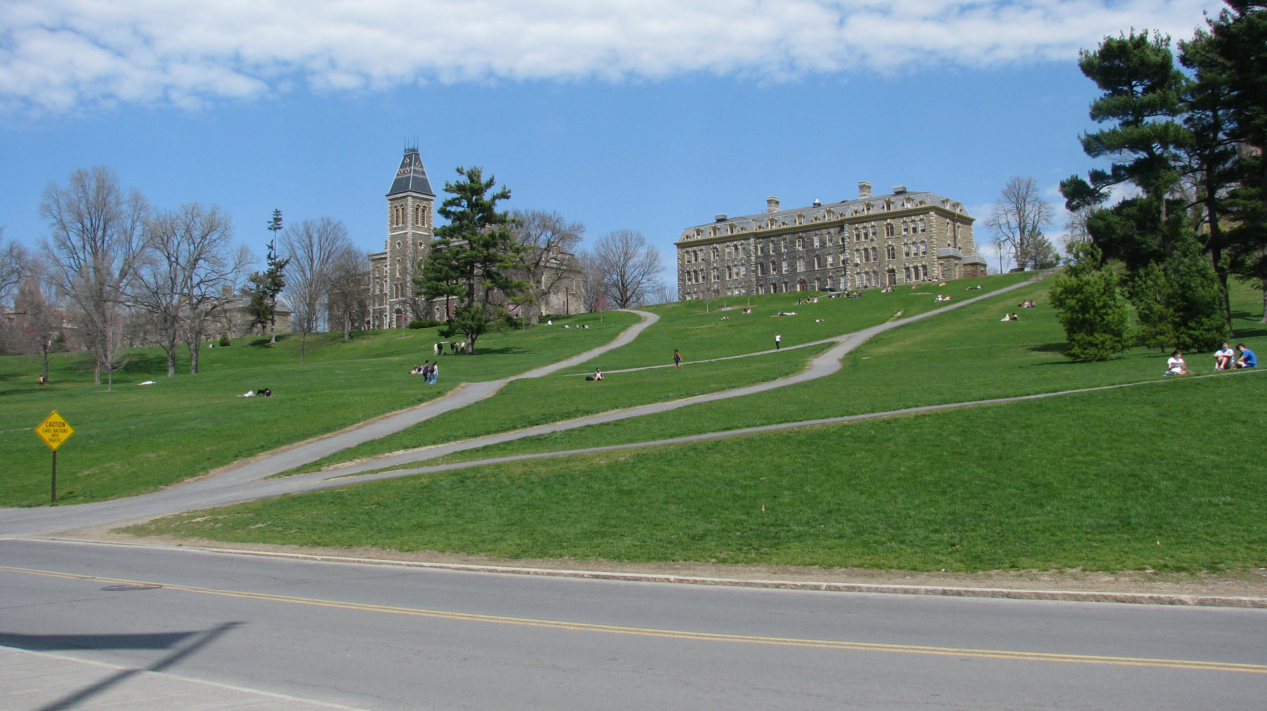

Slide 4
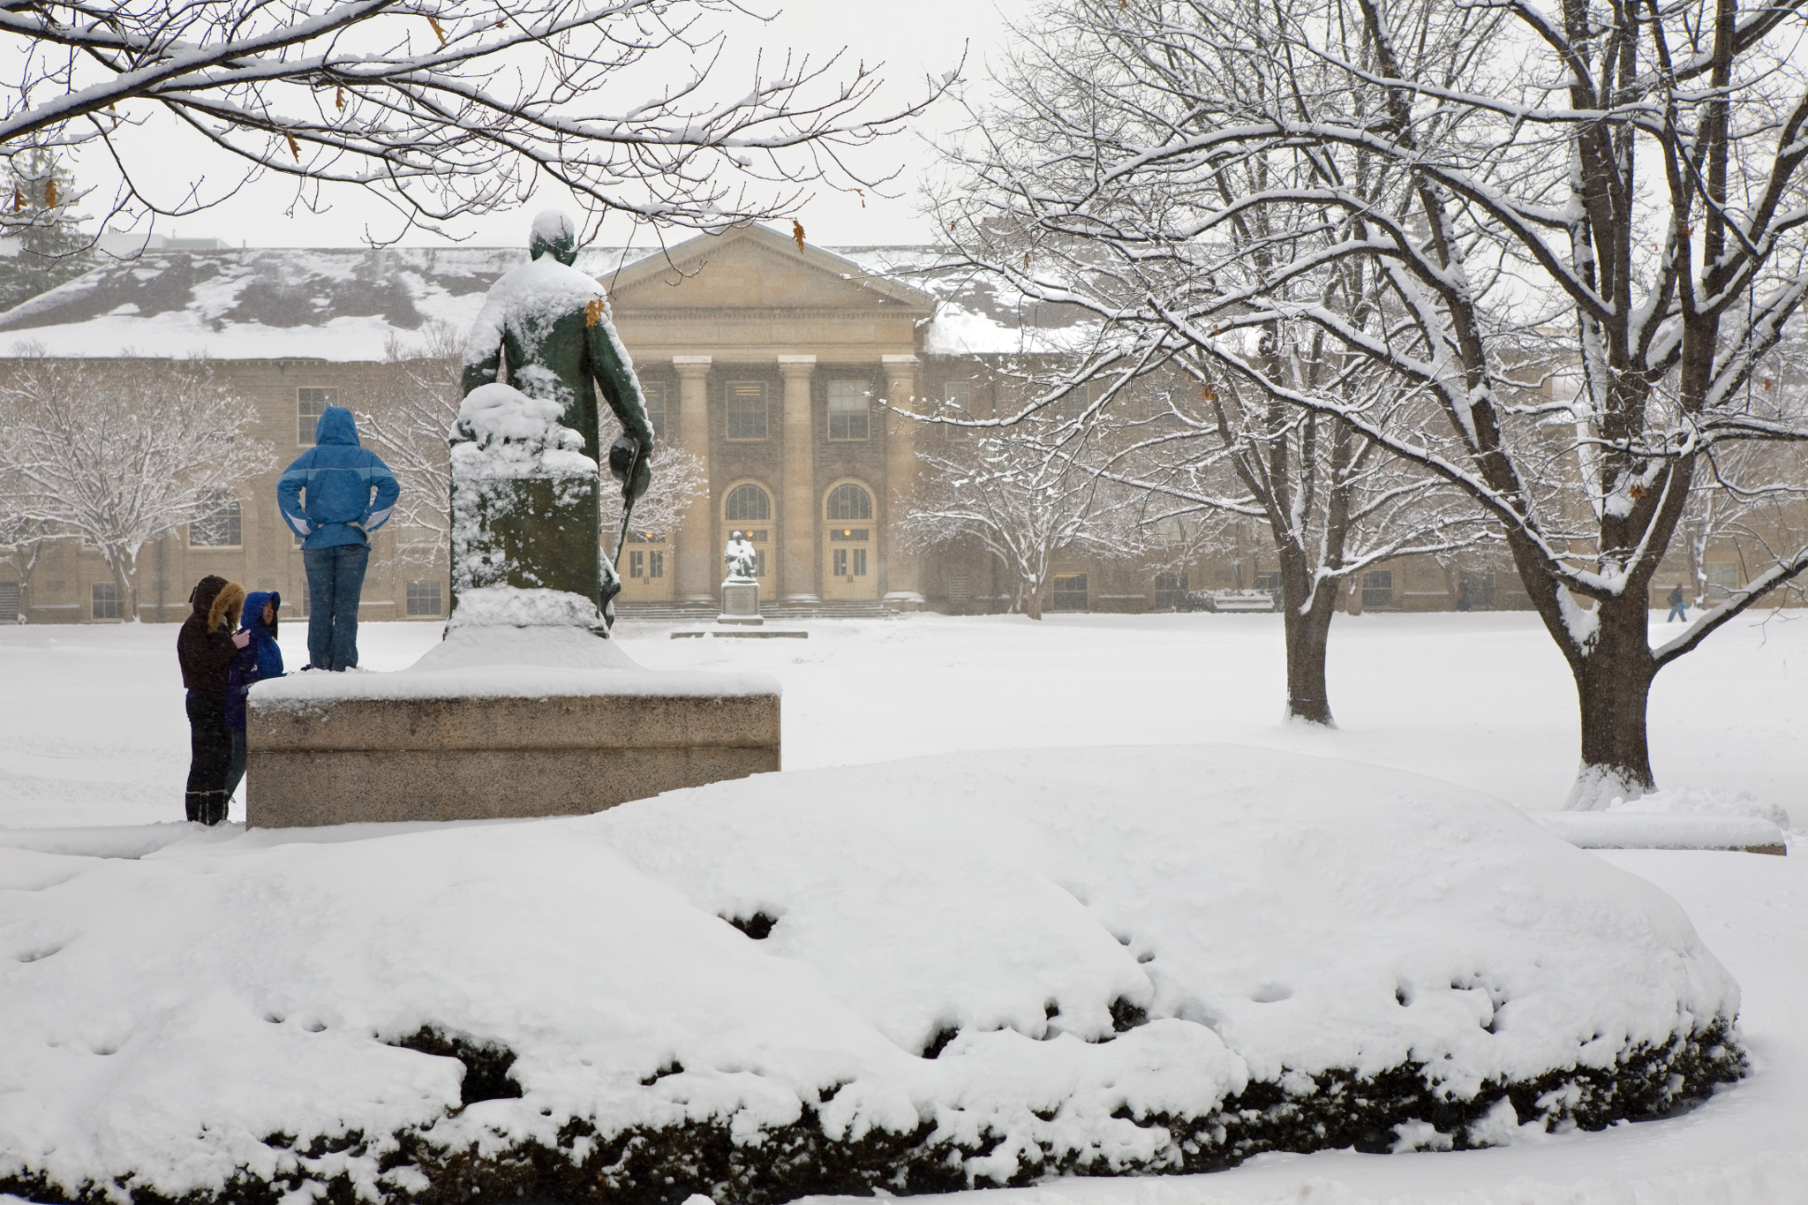

Slide 5
ADA Coordinator Team on Campus
Student Disability Services
Beth Parrott
Title IX Office
Katie King
Facilities and Campus Services
Andrea Haenlin-Mott
CIT
Annie Heckle

Slide 6
Disability Audit 2023 and Strategic Plan
ADA and Disability Responsibilities of Cornell
Readily Achievable Barrier Removal
Accommodations
New Construction and Alterations
UCO Audit 2023
FCS Strategic Plan 2024 and beyond
Collective Responsibililities

Slide 7
Collecting data on access deficiencies
We will continue to review annually access issues across campus
Maintenance of accessible features—snow removal, lift and elevator service, ramps and protruding objects
Assistance with accommodations for students, staff and faculty

Slide 8
Construction impacts
Roofing projects
Exterior path of travel
Whatever may impact use of space, even temporarily

Slide 9
Barrier Removal Priorities
Access from parking/drop off into the door---exterior accessible routes
Access through the building
Restroom accessibility
Any other means---fire alarms, etc.

Slide 10
Priority For Accessibility Projects FACT
Is it Public or Private Space
Public, Classroom Space or Secured Area
Number of People Impacted
Commencement or Reunion, Conference or Move-in Day, Large Visiting Lecture, Normal Class Size, Few People

Slide 11
Priority for Accessibility Projects FACT
Supportive to Academic Mission
Academic Unit Programs & Research, Student and Academic Service Programs, Administrative
Transferability to Like Facility/Location
Space is unique and not portable, space is unique but portable, office or classroom space

Slide 12
Public Rights of Way
https://www.access-board.gov/prowag/
Final Rule
Clarifications – corner truncated dome panels

Slide 13
2024 Building Code Adoption
Likely in early 2025
Will include updates to reference standards
Building Code accessibility reference standard is ICC A117.1
Will be updated from the 2009 version to the 2017 version
Primarily increases the size of turning circles and clear spaces

