Slide 1
Project Management Professional Development Series
February 28, 2024
Facilities and Campus Services Engineering and Project Management

Slide 2
Today’s Agenda
Design Reviews Dashboard
Andrew Magré
QA Program Spotlight
Liesl Margolin and Rob Murray
Acceptance Testing
Chris McLaughlin
ADA/Accessibility Update
Andrea Haelin-Mott and Mike Niechwiadowicz

Slide 3
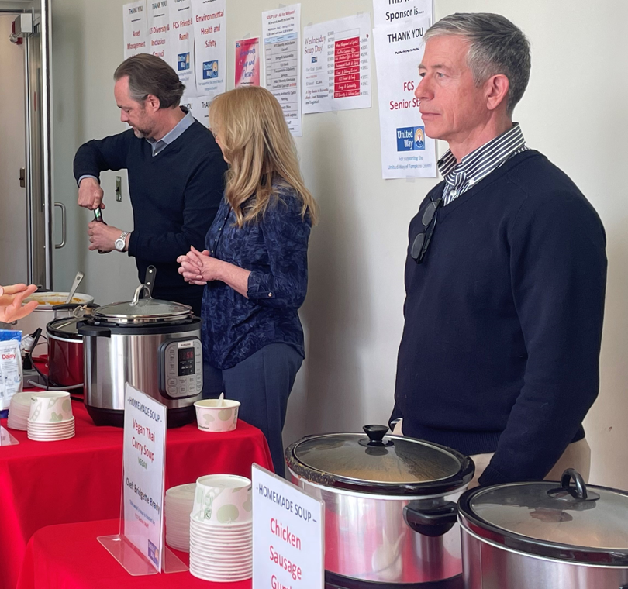
FCS United Way Soup and Dessert Wednesday is Today! TODAY– 11:30 am – 1:00 pm
6 soups/chili including a variety of meat choices, gluten free, vegan, etc. prepared by FCS chefs/bakers
3 dessert bakers- yum!
Only $5.00 for a bowl of soup and bread
Only $1.00 for a dessert
ALL funds raised will be donated to the United Way of Tompkins County.
JOIN US right after this meeting in the HSB Atrium!

Slide 4
Design Reviews Dashboard

Slide 5
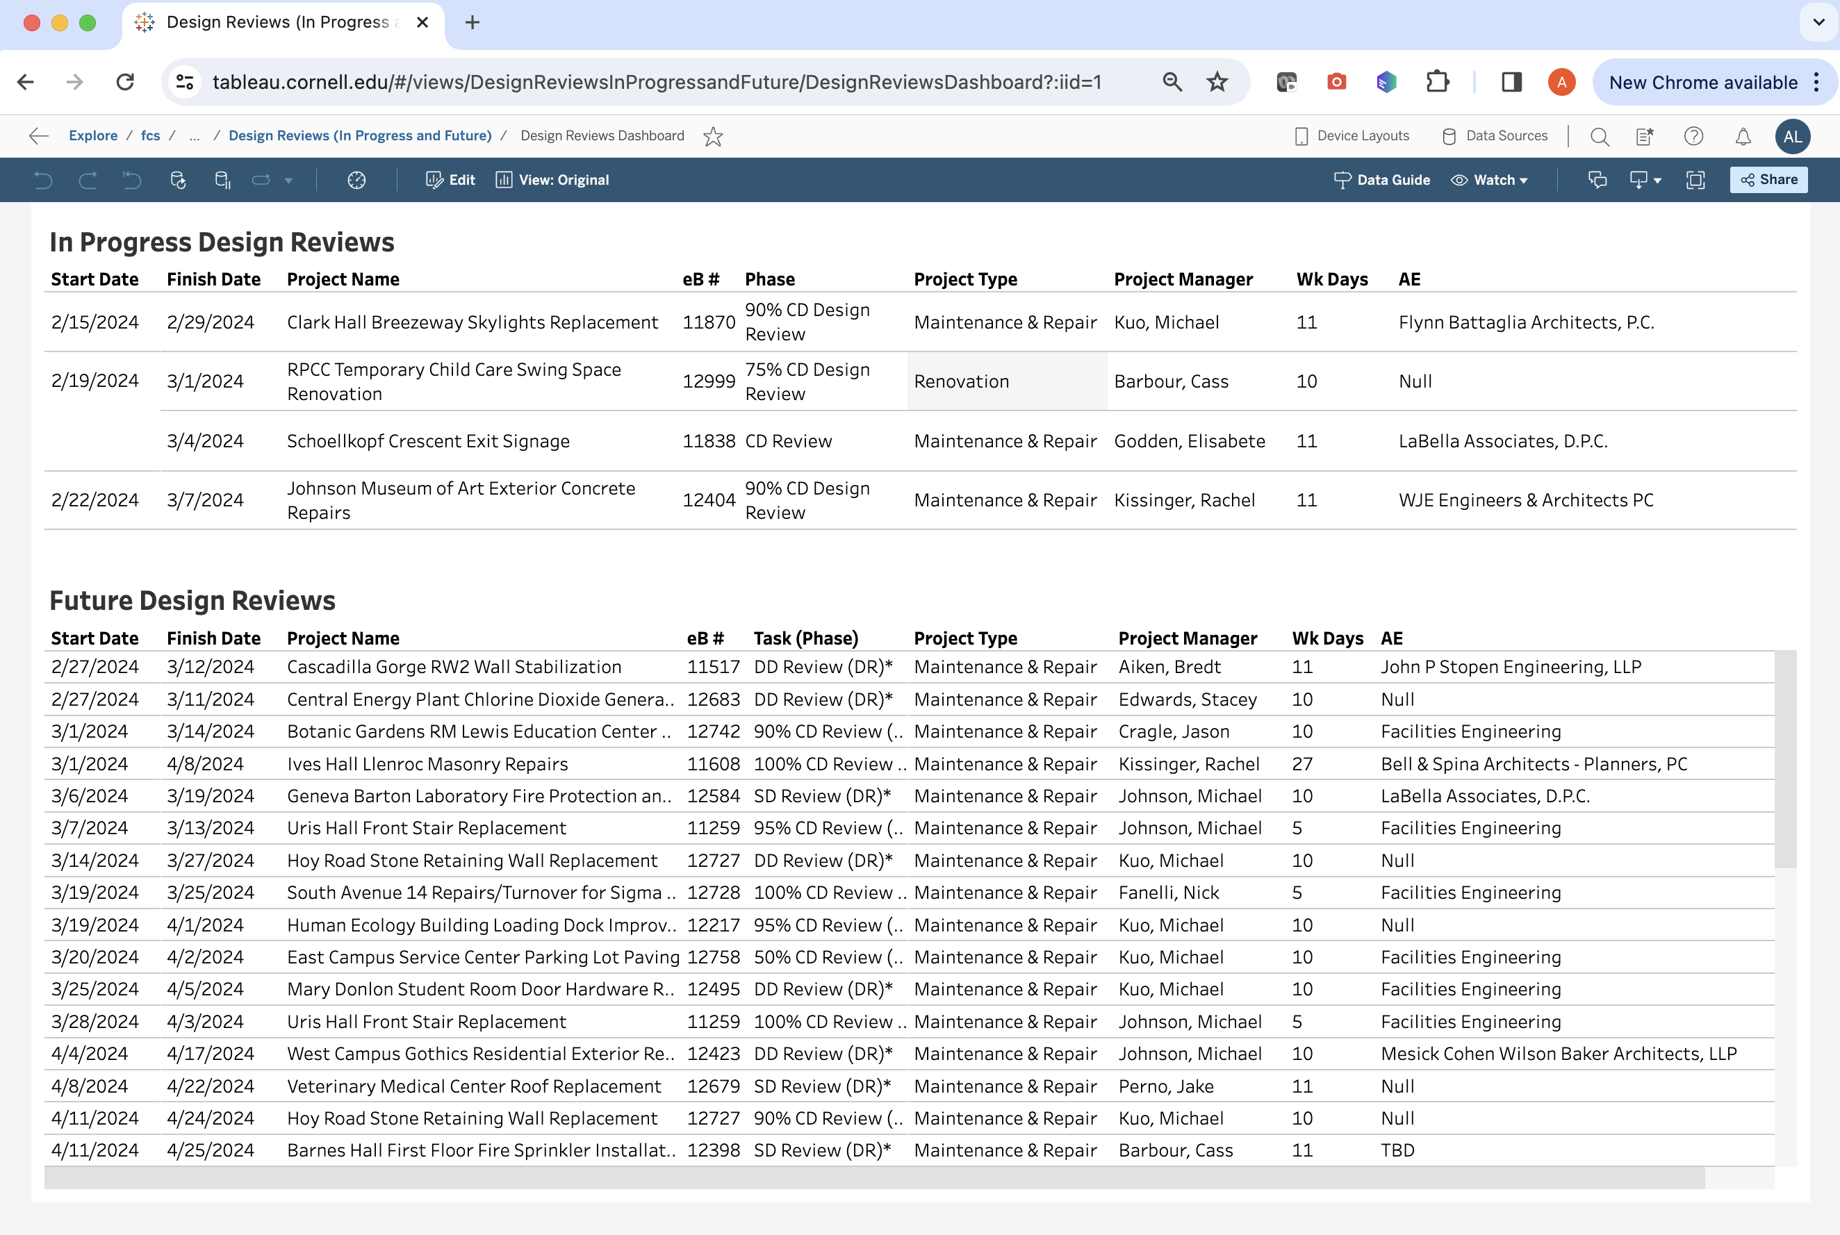
New Design Reviews Dashboard!!
You can find the link here or on our FCS EPM Tableau Dashboards Gdoc

Slide 6
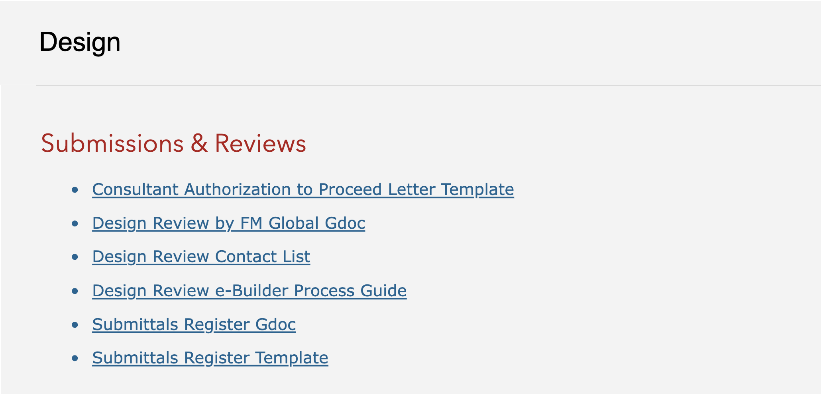
Reminder: Design Review Resources

Slide 7
Reminder: Design Review Checklists

Slide 8
New Design Reviews Dashboard!!
You can find the link here or on our FCS EPM Tableau Dashboards Gdoc

Slide 9
QA Program Spotlight

Slide 10
Acceptance Testing

Slide 11
Accessibility Update

Slide 12
Questions?

Slide 13
Thank you
272133
Notes:
Introduction

