Slide 1
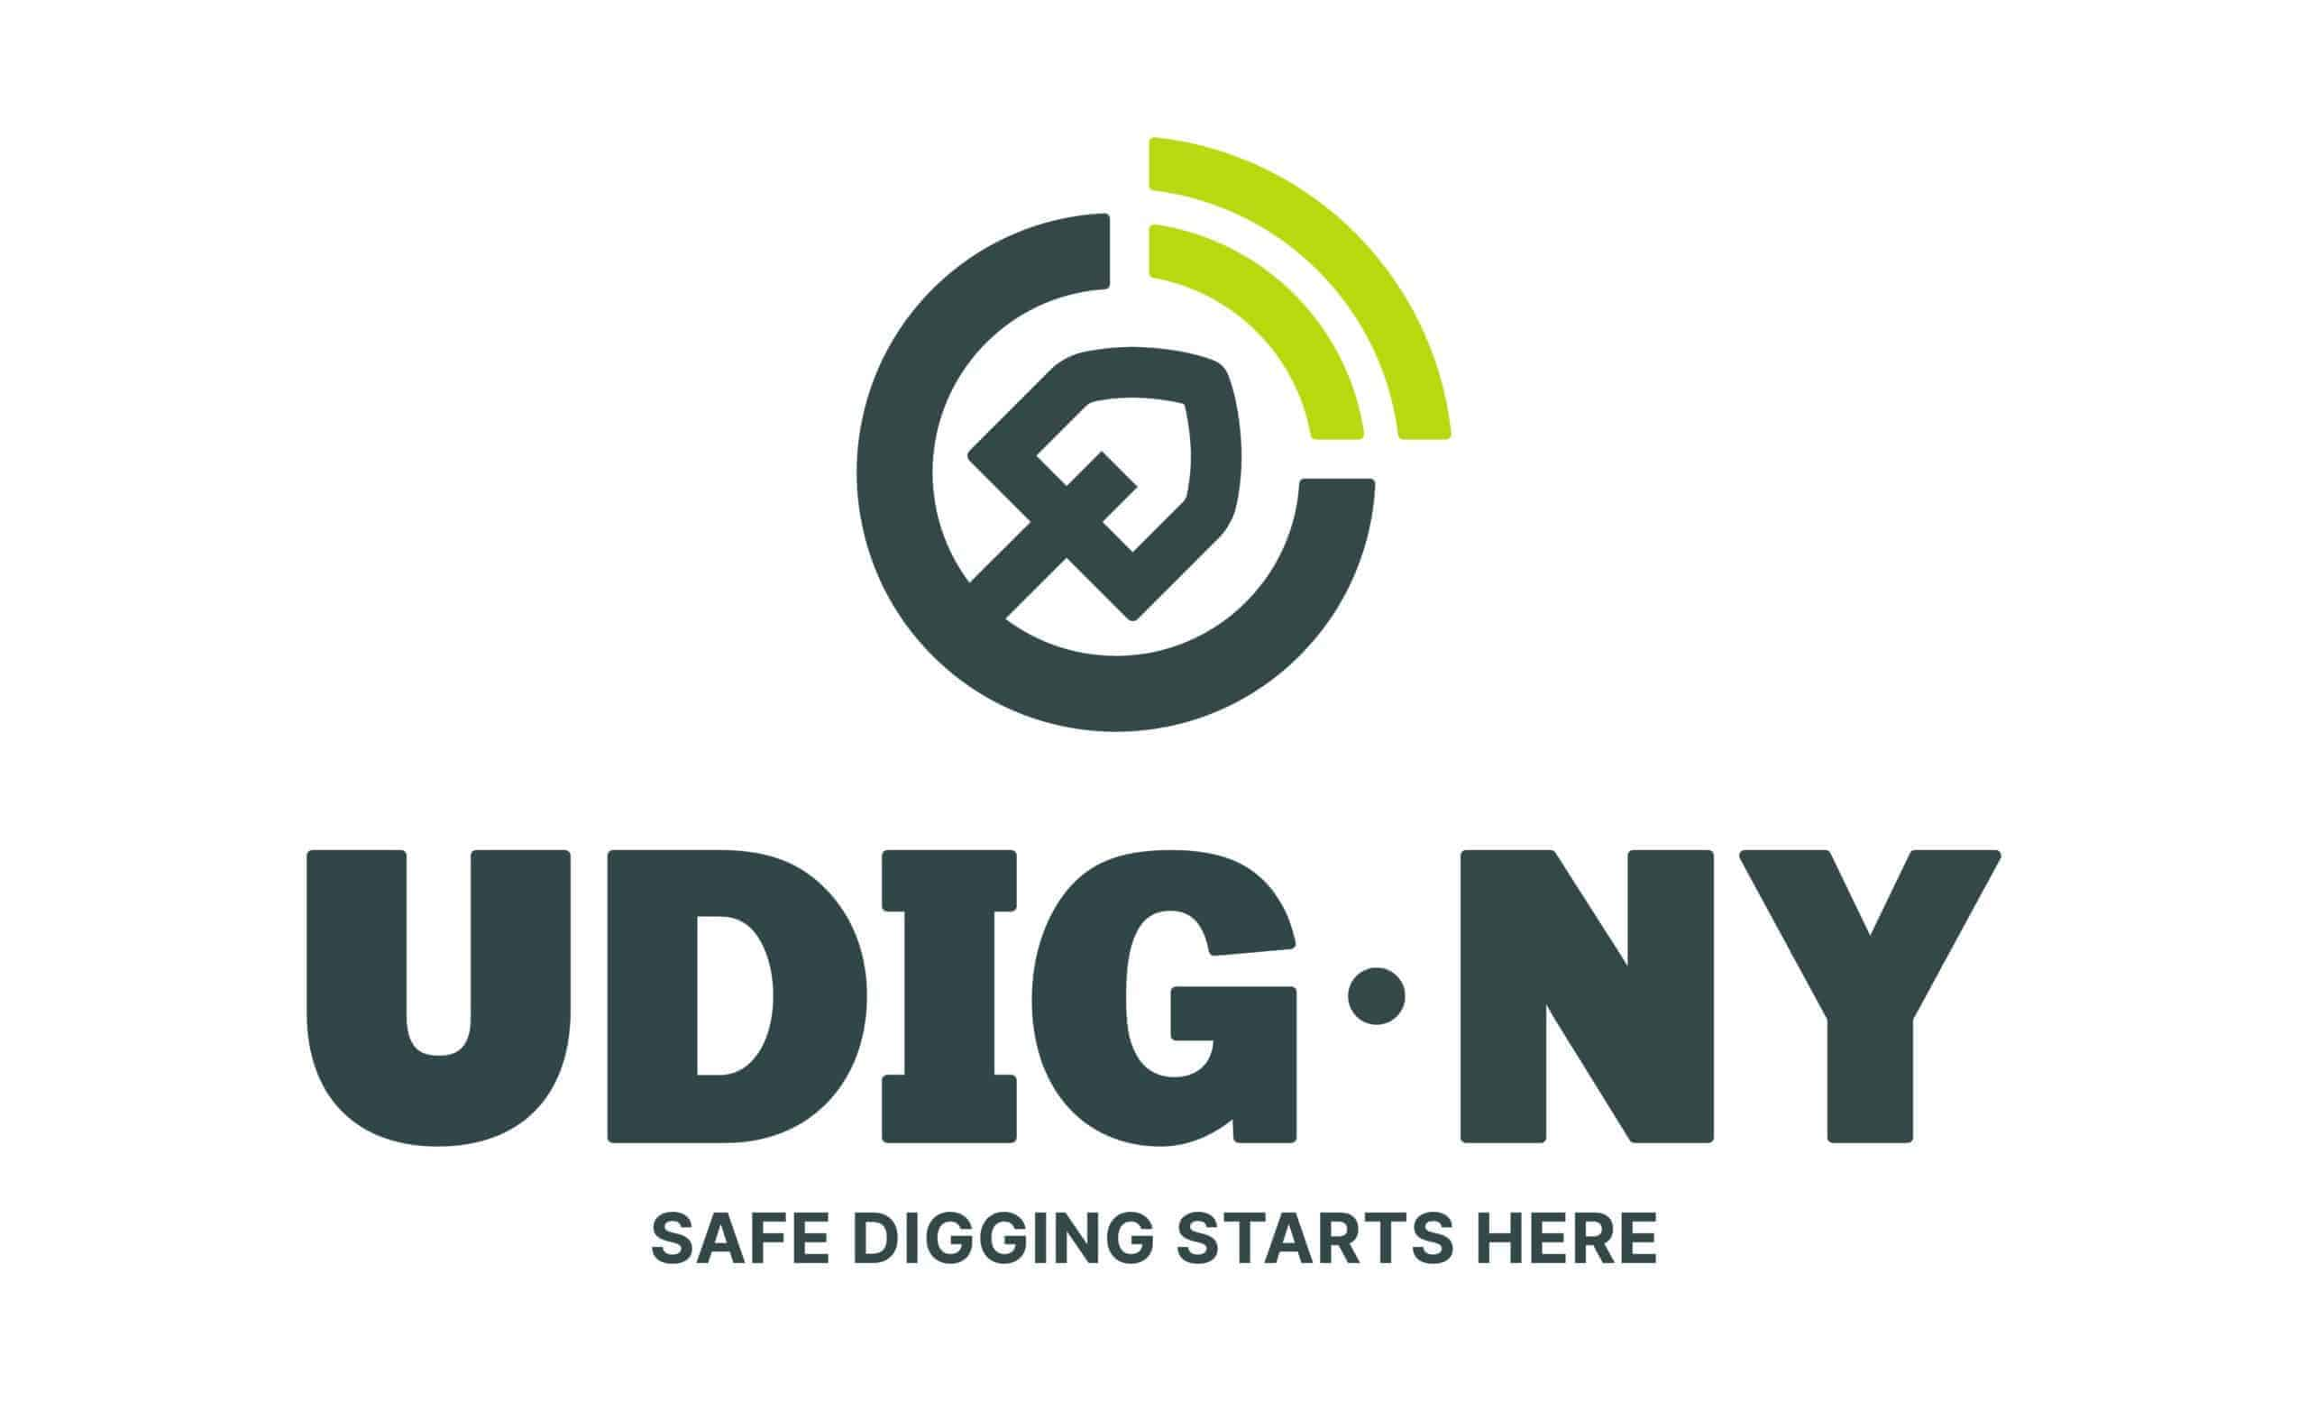
https://udigny.org/
UDIGNY Overview
Emily Mix/Letty McFall

Slide 2

NYS Code Rule 753 - It’s the law
https://udigny.org/resources/nys-code-rule-753/
The excavator or company is required to call UDIGNY (811) or enter a ticket on the website 2 to 10 days in advance of start date notifying UDIGNY of the area to be impacted. UDIGNY will create a Dig Request ticket.
https://udigny.org/
UDIGNY notifies all utility owners in the area of the upcoming excavation with a “DIG REQUEST” ticket.
Cornell receives the Request ticket through our email as well as the UDIGNY website.
Cornell and all utility owners have 3 days to respond to the dig request. That response includes locating all utilities in the site or verifying that there are no utilities in that area then responding with a completed action for the dig ticket.

Slide 3
Responsibilities
It is important to make sure whenever digging, drilling or pounding in stakes to request a UDIG ticket. Safety to the workers as well as the utilities is one of the most important responsibilities of a company.
Many utilities are shallower than people realize and are a risk to the workers as well as the utilities.
Failure of a request to UDIGNY may result in legal fines, penalties and damage cost that may occur to any utilities in the area.

Slide 4
The excavator is responsible for tracking the dig request and not starting to dig until the ticket for the site has been completed by all utility owners.
It is the excavator's responsibility to preserve all utility marks and flags once the work has been started.
It is the excavator's responsibility to understand the location marks and tolerance zone.
If the identity of the discovered underground facility is not known or obvious, the excavator shall report the discovery to the one-call notification system and each operator notified by the one-call notification system shall respond immediately

Slide 5
EMERGENCY AND DESIGN TICKETS
Emergency tickets can be requested in the event of a threat to life, property or a vital utility. These tickets require utility companies to respond within a few hours of receiving it.
Excavators are not allowed to dig until they receive a response from all utility companies.
Design tickets can be request through the 811 call center or online. Design tickets are a great way to see what utilities may be interfered with when planning for a project. Design tickets do not allow excavators to dig on site but help to inform them of what utilities exist in the area and an approximate location of the utilities.

Slide 7
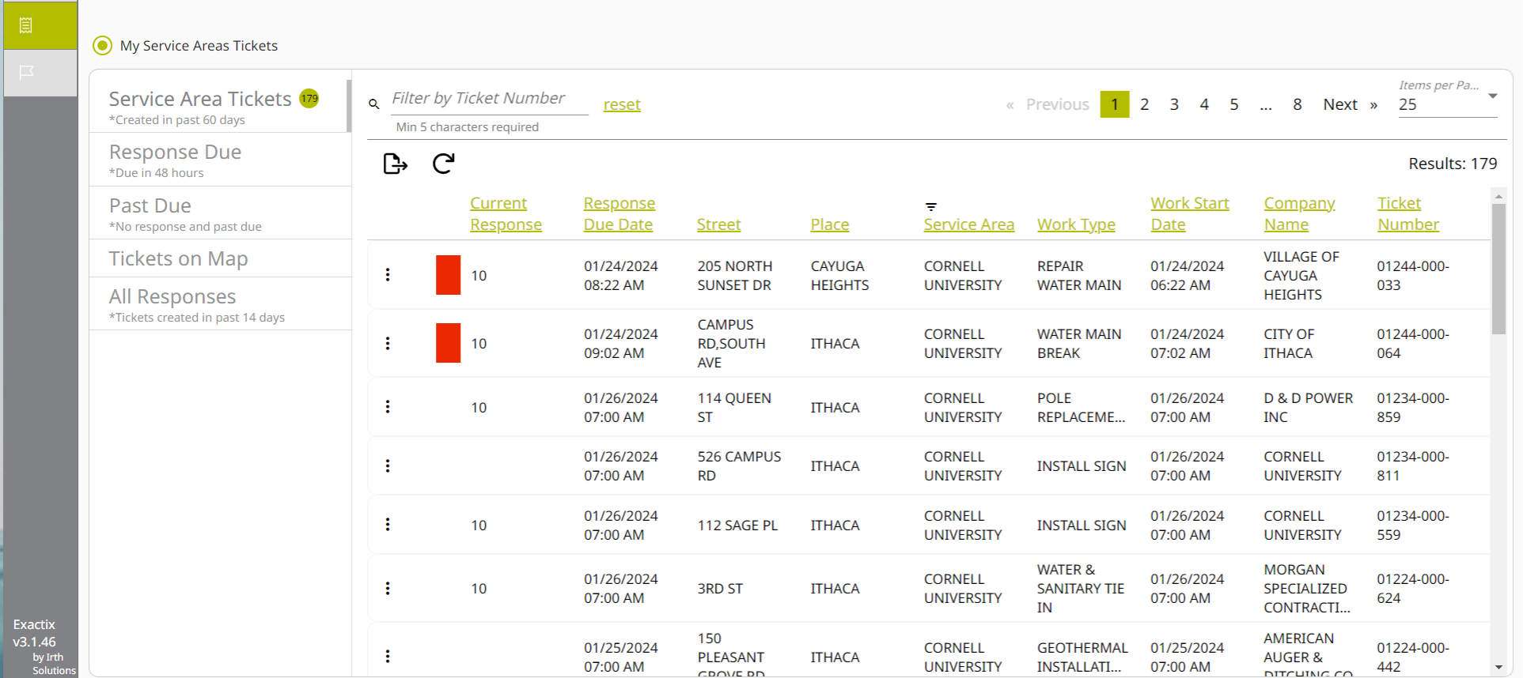

Slide 8
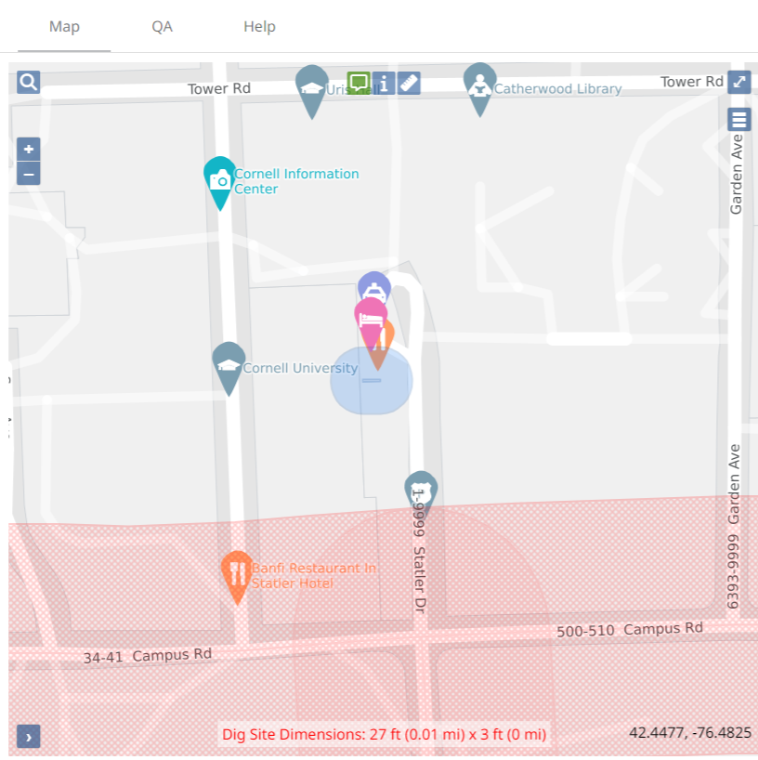

Slide 9
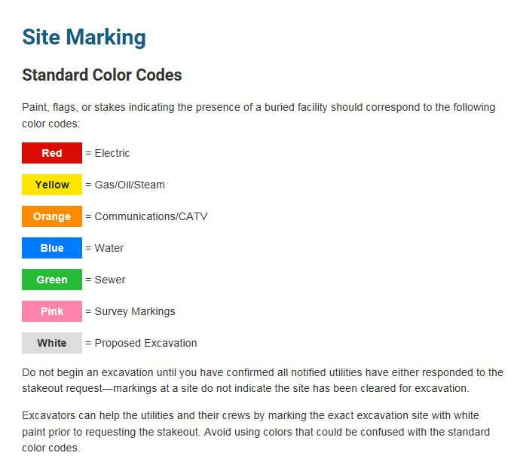
SITE MARKINGS

Slide 10
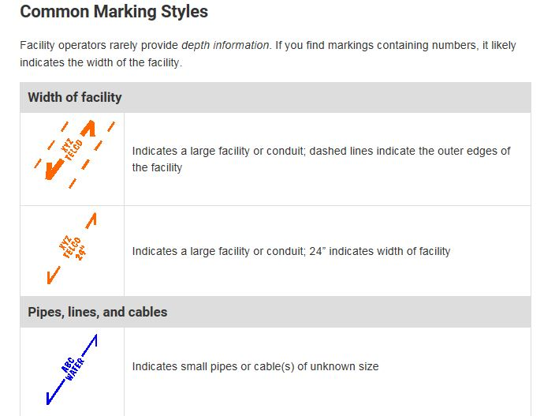

Slide 11
Verify locations/Tolerance Zone (See 753-1.2 (k) & (i), 753-3.6 and 753-3.7 Before using powered equipment within the tolerance zone, the locations of gas and liquid petroleum lines MUST be verified by means of hand-dug test holes.

Slide 12
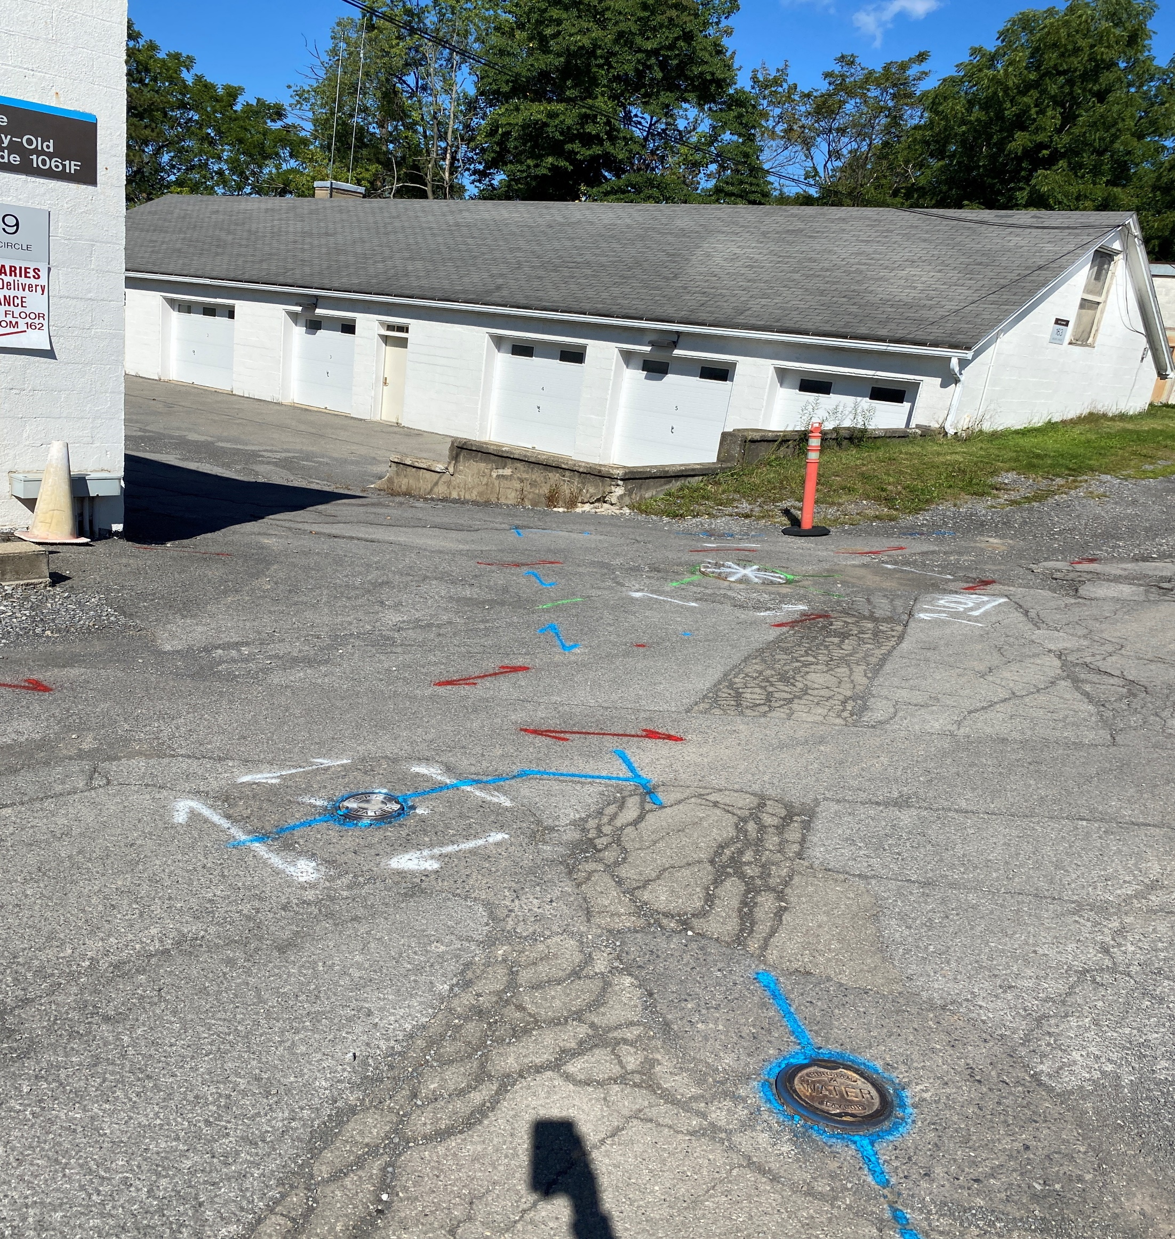

Slide 13
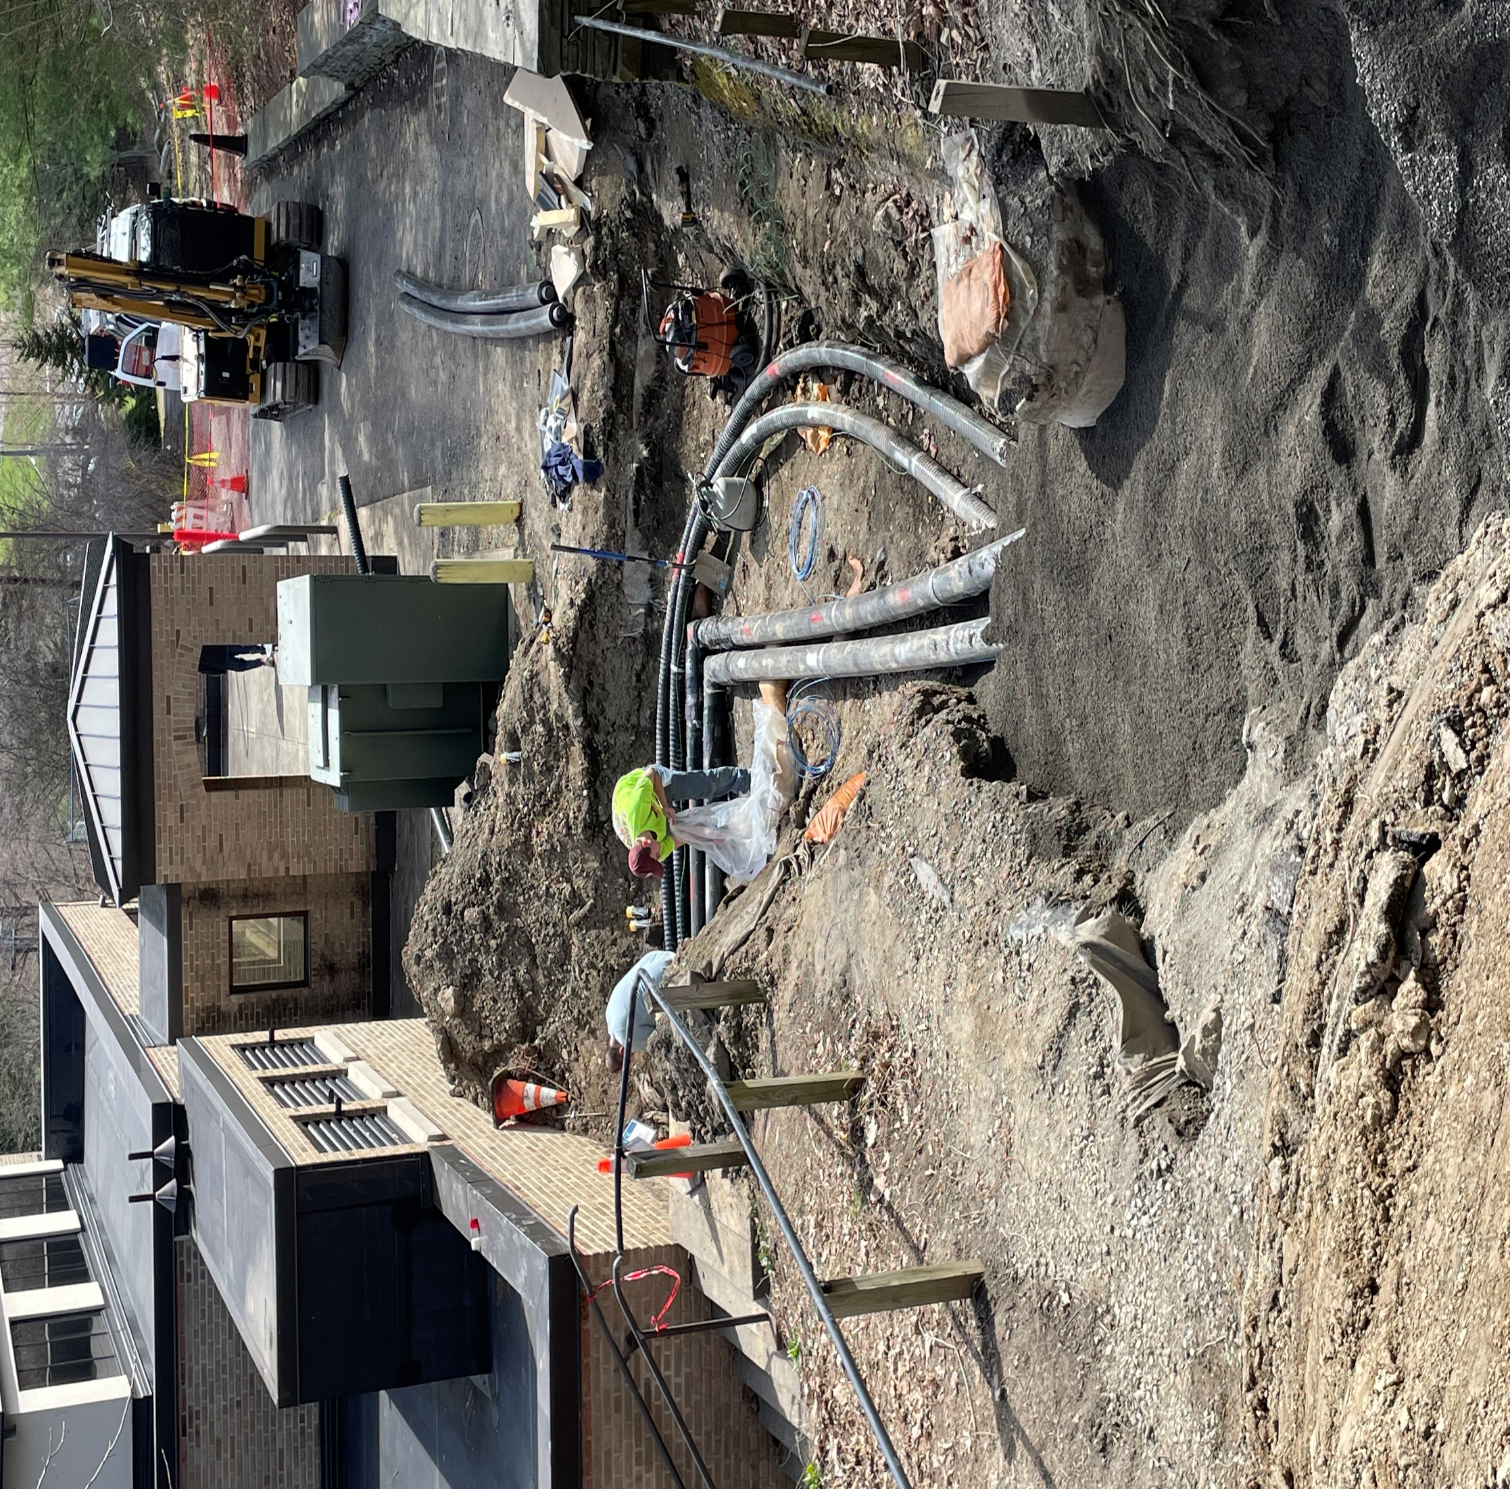

Slide 15
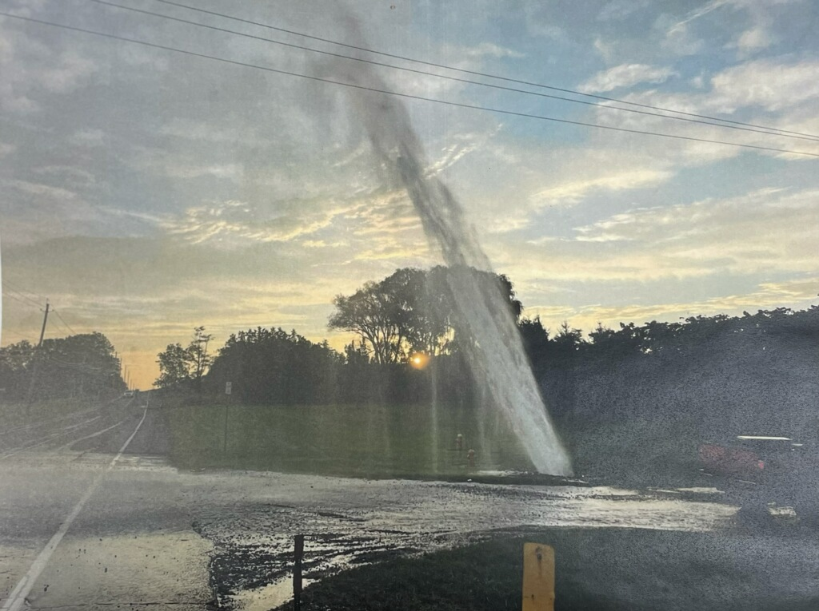

Slide 16
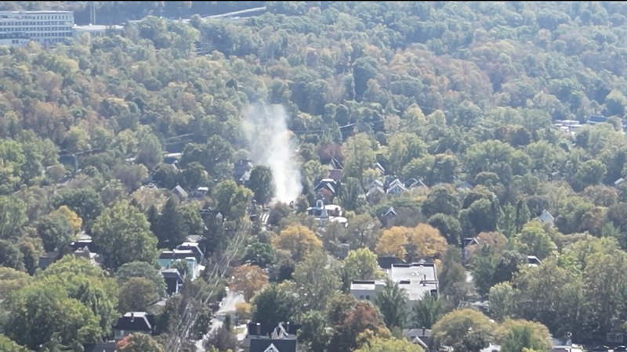

Slide 17
Utility Maps
Locating is not an exact science!
Utility maps are vital for us to know what utilities are in the area as well as where the utilities are located. Without these maps locating would be almost impossible.
Keeping up to date records is important for future projects and safe digging.

Slide 18
Utility Maps
Although the Utility maps we supply are cad files, they were original created by copying the old ink on mylar hand drawn utility quad mapping.
Cornell has maps of all active as well as abandoned utilities. Our maps allow us to see locations, size, material and years of install.
This information must be sent to the utility mapping group for the updating of the master utility files.

Slide 19
GPS/Photos and As-Built
Photos and GPS points allow us to accurately locate and map all utilities that get installed or exposed during an excavation
Asbuilts and CAD files are the best way to update our utilities as well as our base map of buildings, pavements sidewalks and any other structures.
Having the exact location/elevation of a utility not only helps the locators, it helps the excavators and the planning department on any future or ongoing projects that may occur in that area.

Slide 20
Summary
It is the responsibility of the excavator to call 811.
We only mark Cornell owned utilities.
Once work has started it is the responsibility of the excavator to maintain the marks.
When utilities can’t be located or unknown utilities are discovered the excavators are required to notify Udig responders. Often resulting in visits back to the job site.
It's required to provide all as-builts to the utility mapping group once work is complete.
Photos and GPS points are invaluable to keeping accurate records and maps

